Slide 1



Design and Manufacturing of Road Garbage Cleaning Machine
Under Esteemed guidance of :
Prof. S. V. Gawali
Asso. Professor
Dept. of Mechanical Engineering
Prof. S. S. Rampurkar
Asst. Professor
Dept. of Mechanical Engineering
Submitted by:
Shambhuraj Mane B.E. (Mechanical) | Anup Deshmukh B.E. (Mechanical) | Vedant Kau B.E. (Mechanical)

Slide 2
Contents
Introduction
Problem Statement
Objective
Conceptual Design
Plan of action
Cost Estimation
Apps of 3DEXPERIENCE
Future Scope
References

Slide 3
Introduction
The current scenario in India of garbage cleaning is not automated. From garbage collection to separation, everything is done manually.
There are some automated systems of garbage cleaning vehicles in India are available only in metropolitan cities. But those are very costly and not affordable in every region in India. So there is a need of automated garbage cleaning system which also reduces human efforts.
To tackle this problem, a semi-automated battery operated (SABO) garbage cleaning vehicle can be introduced which cleans the garbage effectively .

Slide 4
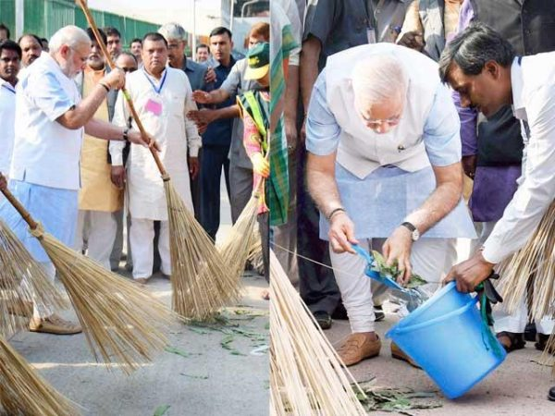
STEP TOWARDS CLEAN INDIA !!!

Slide 5
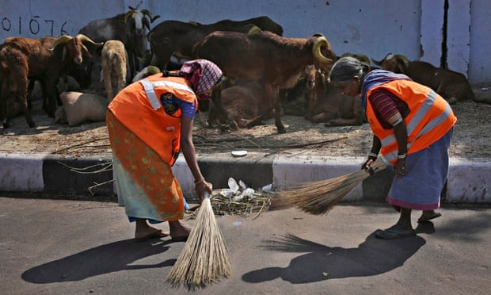
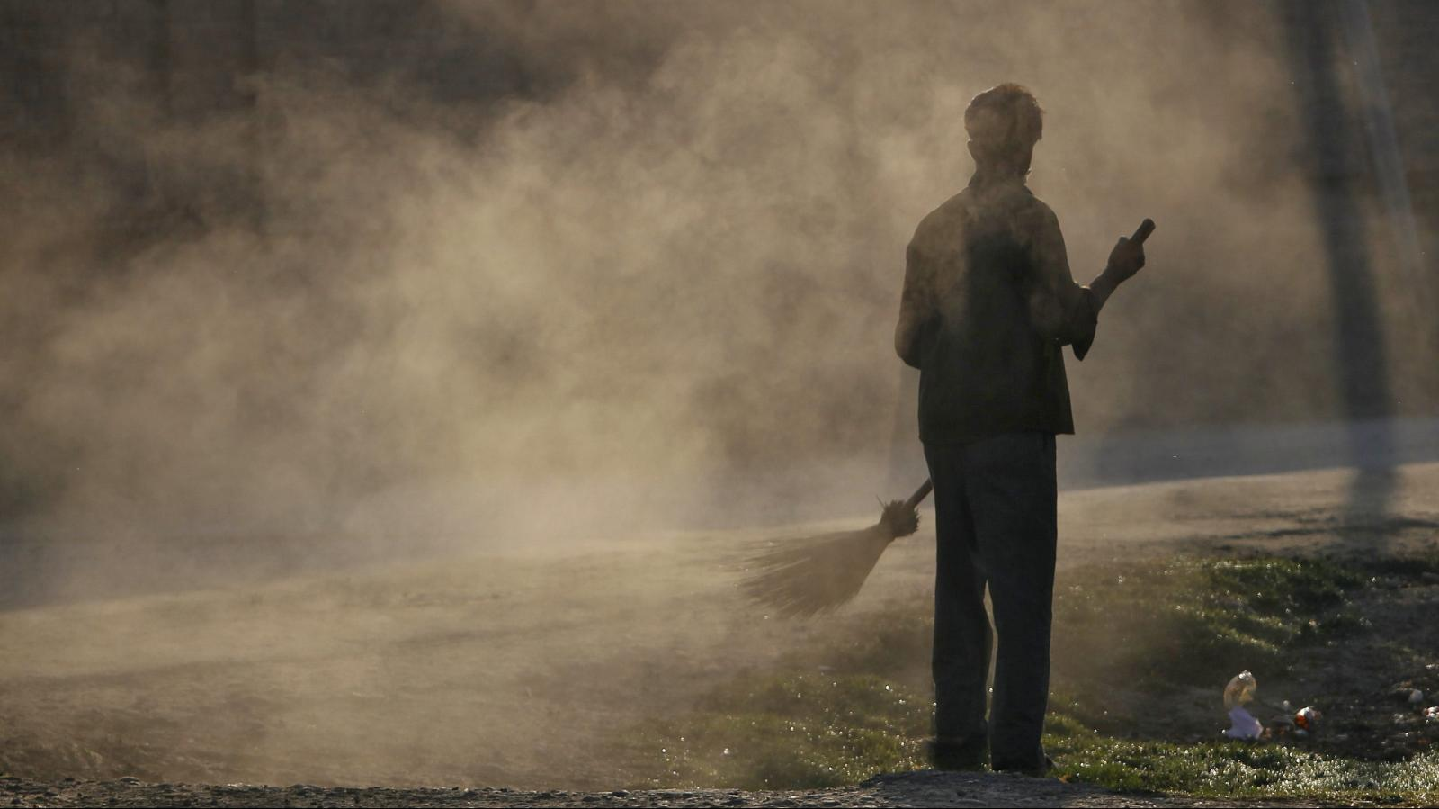
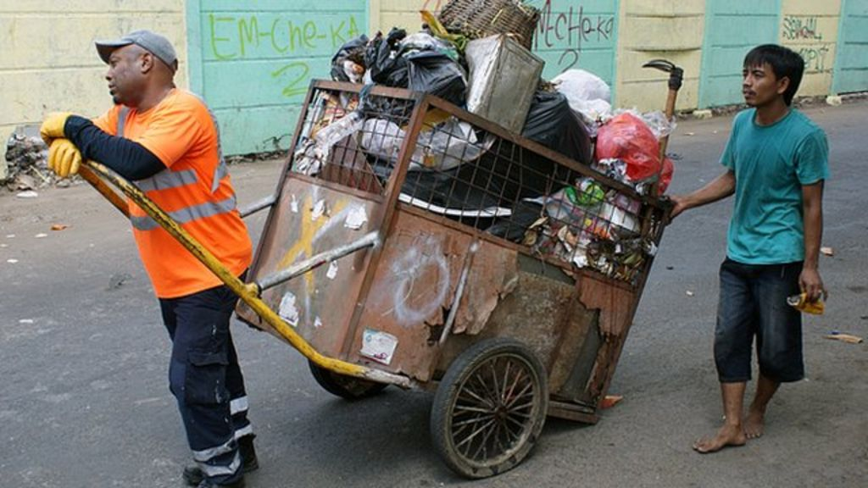
Problem Statement
Conventional brooming method is not efficient.
3) Transport of garbage with trolley require more efforts .
2) Health of workers and passers-by is also in danger .

Slide 6

OBJECTIVE
Reduce fatigue of the workers doing garbage collection in India by using semi automatic system with electric battery and control the investment of our country instead of using the traditional “Reciprocating manual broom method”.
Keep the system cheap , efficient
and affordable .

Slide 7
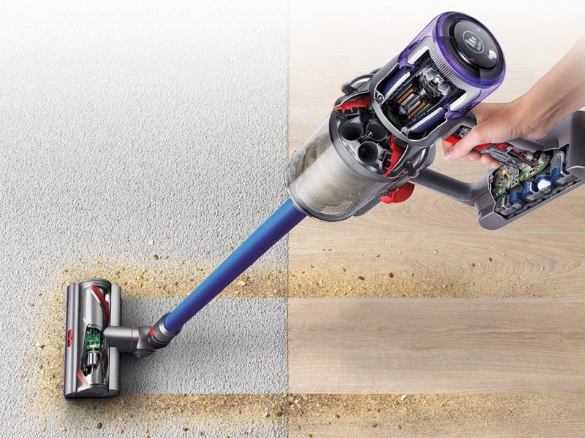
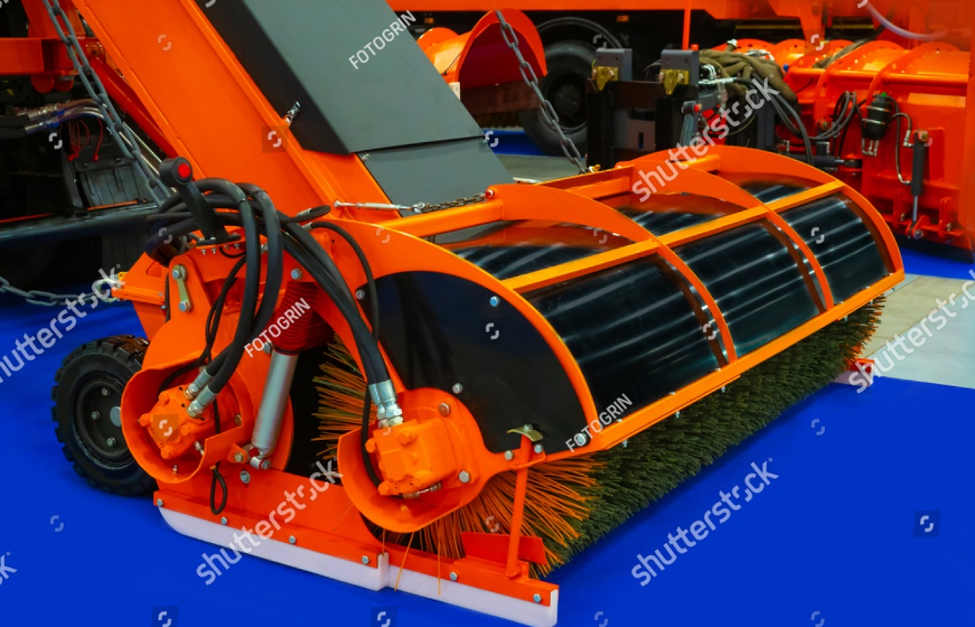
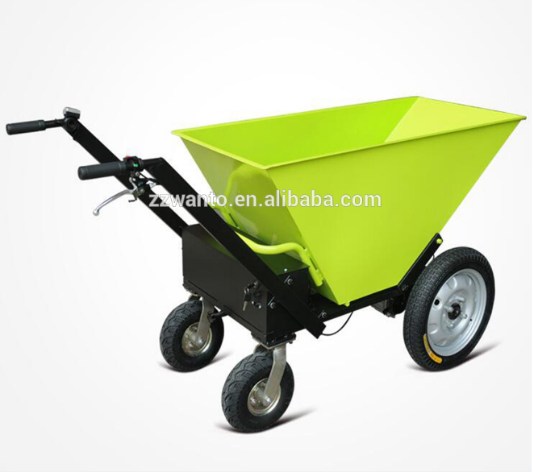
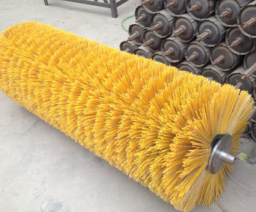
OBJECTIVE
Replacing conventional brooming method with brush and motor system , which is more efficient in cleaning .
Keeping the system close packed to avoid air contamination.
Electric drive control of trolley to minimize required transportation efforts of workers.
Maximum capacity of garbage collection.

Slide 8
Plan of Action
1
2
3
4
Manufacturing of parts using FDM 3Dprinter
5
6
Study of required drives and its interfacing
CAD modelling of various parts & also performing Simulations using 3D Experience platform
Assembly of cleaning mechanism prototype
Study of existing garbage cleaning model
Optimization and improvisation
Conceptual designing of SABO Garbage Vehicle

Slide 9
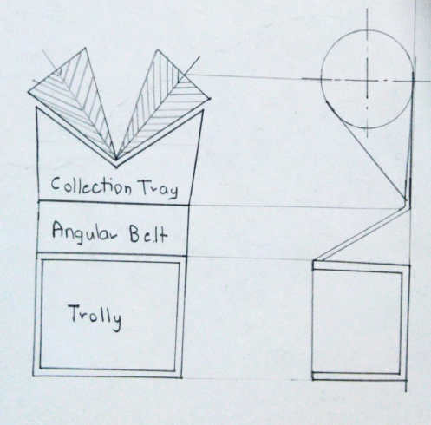
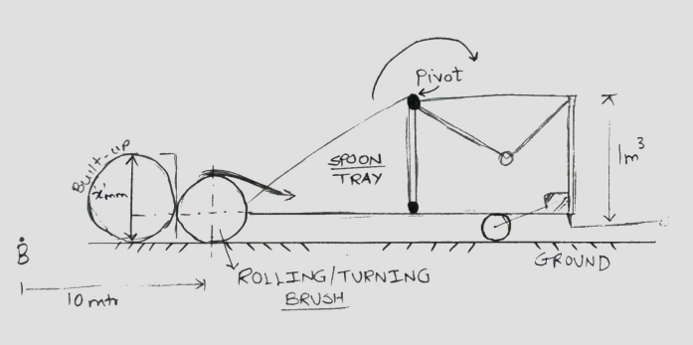
Conceptual Design
Concept Model 1
Concept Model 2

Slide 10
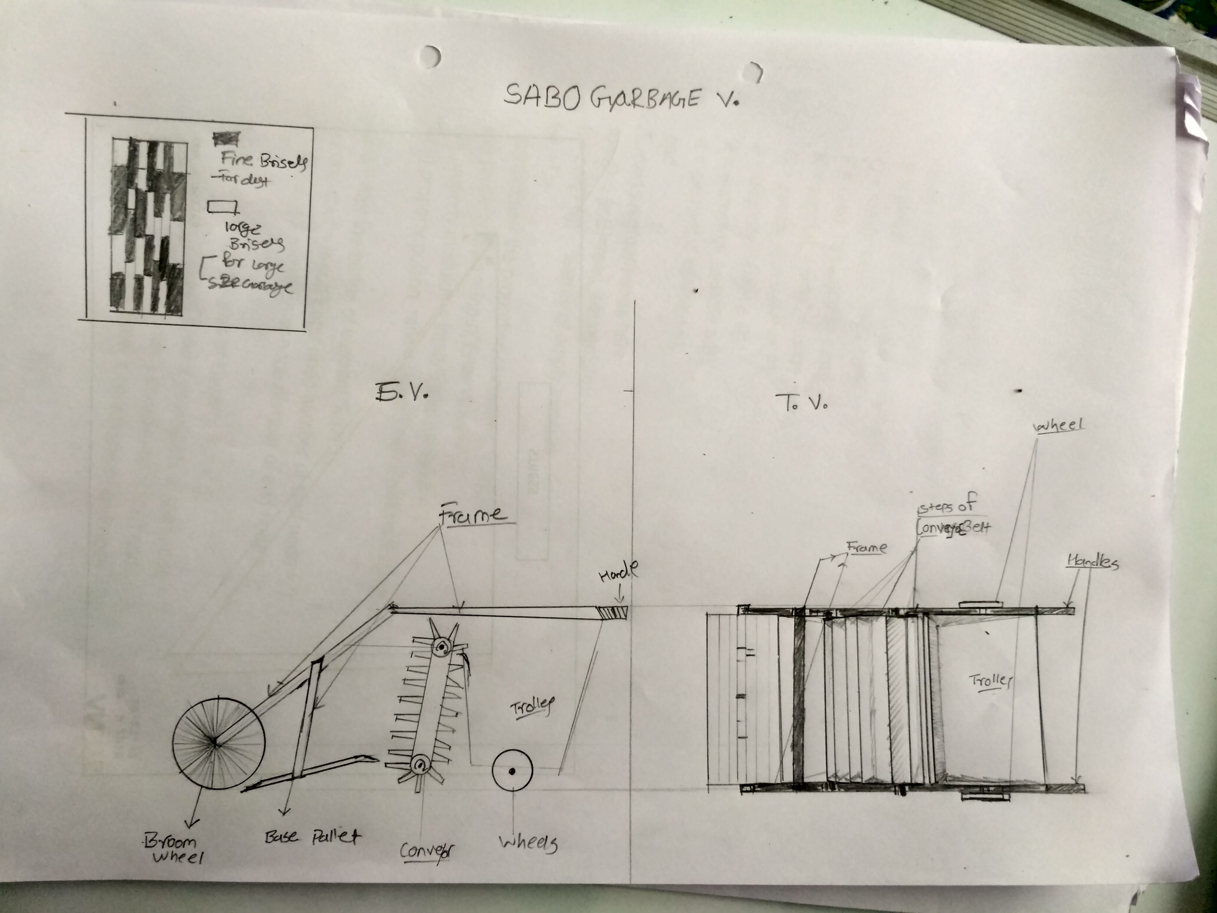

Slide 11
Cost Estimation
Sr. No. | COMPONENTS | QUANTITY | PRICE | TOTAL
ELECTRONIC COMPONENTS
1 | Battery | 1 | 1,200 | 1,200
ACTUATORS
2 | Motor - End | 1 | 3,000 | 3,000
3 | Motor - Front | 1 | 4,000 | 4,000
3D PRINTING MATERIAL
4 | PLA Filaments | 2 | 1,100 | 2,200
MECHANICAL COMPONENTS
5 | Trolley | 1 | 20,000 | 20,000
6 | Frame | 1 | 2,000 | 2,000
7 | Brush | 2 | 2,000 | 4,000
8 | Miscellaneous |  | 3,000 | 3,000
TOTAL COST |  |  |  | 39,400

Slide 12





Apps of 3DEXPERIENCE

Slide 13
Future Scope
Making the SABO garbage cleaning system compatible with current vehicle handled by janitor.
Making SABO cleaning vehicle totally green and clean using Solar technologies.

Slide 14
References
Clean City Initiative by PMC.
Adar Poonawalla Clean City Initiative vehicles.
iRobot Roomba Vacuum cleaning robots.
Ecovacs Deebot Ozomo 930.

Slide 15
Thank You !!

