Slide 1
Graduate Rotational Internship Program The Sparks Foundation Computer Vision & Internet of Things.
Prepared by:
SHAMBHU NATH MANDAL
Objective: Character detector which extracts printed or handwritten text from an image or video.

Slide 2
Character detector which extracts printed or handwritten text from an image or video.
Model and library used: ResNet, Keras and TensorFlow
ResNet and the Residual Module was First introduced by He et al. The ResNet architecture can be used to train extremely deep networks using standard SGD. In order to train networks at depths greater than 50-100 (and in some cases, 1,000) layers, ResNet relies on a micro-architecture called the residual module.

Slide 3
Resnet structure was constructed to read MNIST 0-9 and Kaggle A-Z hand written dataset as input.
The output labels are digits 0-9 and capital alphabets A-Z.
The codes are divided into 3files:
To build the architecture.
To train the model using the architecture and to save it as .h5 file.
To predict the model on a hand written document.

Slide 4
The model was run for 50 Epochs with mini batch size of 128. The model performed very well with final results of 97% accuracy.
Epoch 50/50
2765/2765 [====================] - 303s 110ms/step - loss: 0.5803 - accuracy: 0.9667 - val_loss: 0.3933 - val_accuracy: 0.9693
accuracy 0.97 88491
macro avg 0.96 0.97 0.96 88491
weighted avg 0.97 0.97 0.97 88491

Slide 5
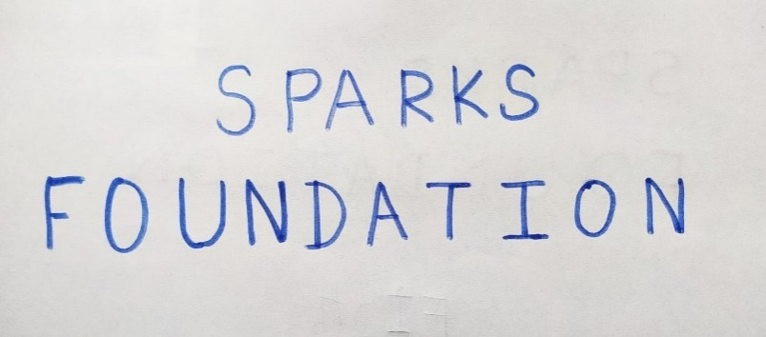
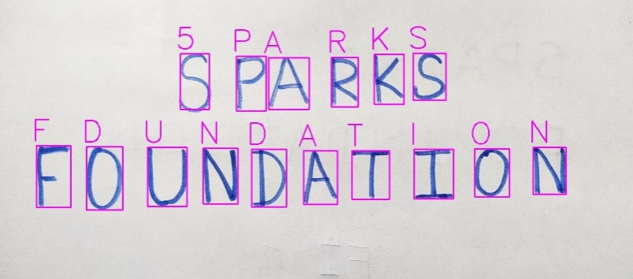
The below figures shows the individual character has been detected using bounding box and has been classified as per labels.
‘S’ and ‘O’ has been miss-classified as ‘5’ and ‘D’ respectively by the model, as obvious
Original image Predicted image

