Slide 1







IBM Data Analyst Capstone Project
Final Presentation
Shay Delaney
17-Oct-2022

Slide 2



OUTLINE
Executive Summary
Introduction
Methodology
Results
Visualization – Charts
Dashboard
Discussion
Findings & Implications
Conclusion
Appendix

Slide 3

EXECUTIVE SUMMARY
In order to keep pace with changing technologies, it is important to keep track of current and future trends
This document attempts to outline trends in the following areas of IT and Consulting;
Programming languages
Databases
Platforms
Web frameworks
This analysis should enable more informed data driven decisions for hiring in these areas.

Slide 4

INTRODUCTION
This document is a presentation on the results of analysis conducted in order to identify trends for this year's report on emerging IT skills.
Data has been collected from various sources including
Job postings
Training portals
Surveys
This data has been analysed the insights and trends have been identified. We aim to answer the following questions:
What are the top programming languages in demand?
What are the top database skills in demand?

Slide 5

METHODOLOGY
Data Collection
Scraped internet web sites
Accessed APIs to collect data in various formats like .csv files, excel sheets, and databases.
Stack Overflow Developer 2019 survey
GitHub job postings
Data Wrangling
Once collection was complete, we made the data ready for analysis using data wrangling techniques.
Data Exploration
Application of statistical techniques to analyse the data.
Data Visualisation
Python Matplotlib
IBM Cognos Analytics for dashboards.

Slide 6
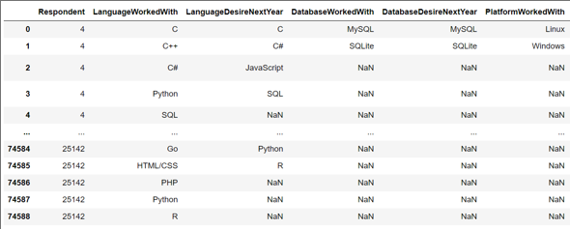
RESULTS

Slide 7
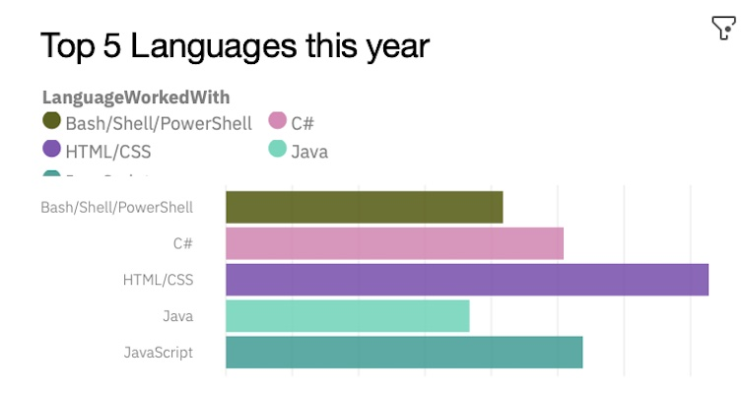
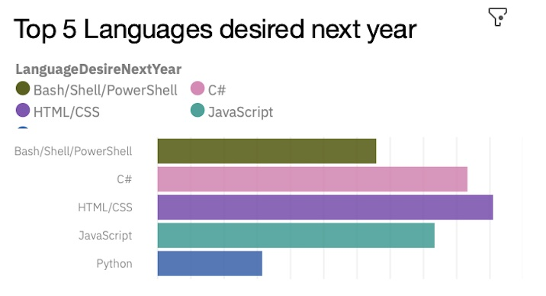
PROGRAMMING LANGUAGE TRENDS
Current Year
Next Year

Slide 8
PROGRAMMING LANGUAGE TRENDS - FINDINGS & IMPLICATIONS
Findings
HTML/CSS is the most popular language for both years.
Bash and JavaScript remain strong but C# has increased in popularity
Python is has replaced Java in the top 5 from current to next year.
Implications
Web Developer are still in high demand
AI and Data Analysis could be part of the reason Python has become more popular.

Slide 9
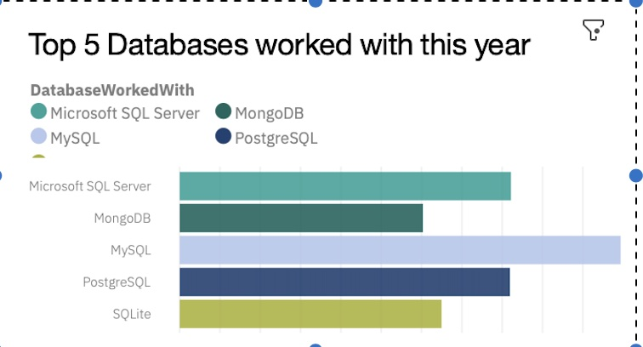
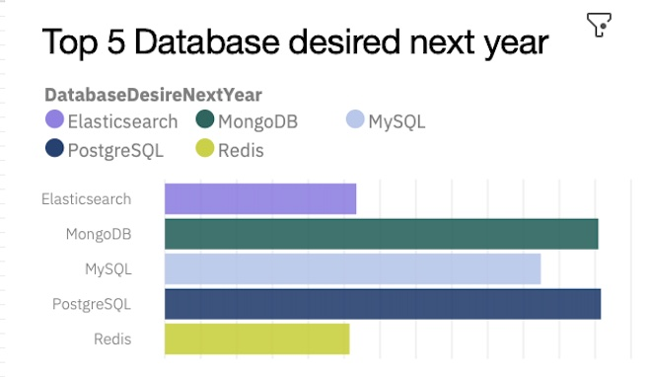
DATABASE TRENDS
Current Year
Next Year

Slide 10
DATABASE TRENDS - FINDINGS & IMPLICATIONS
Findings
MySQL is the most popular database
Microsoft SQL Server is still very popular and widely used.
MongoDB and Redis are the most popular NoSQL databases
Implications
Opensource databases are preferable
SQL databases account for the most this year and next.
NoSQL databases have a good foothold

Slide 11

DASHBOARD
Please find the permanent link of the read-only view of the Cognos dashboard below.
https://eu-gb.dataplatform.cloud.ibm.com/dashboards/99447518-a523-4a25-bc1b-961128a39842/view/5534a13607b91ee116f3c8e4079b285728362309e0bb805686d17b4909652097f33f4295c87a4d0bdb130330a2ea465dca

Slide 12
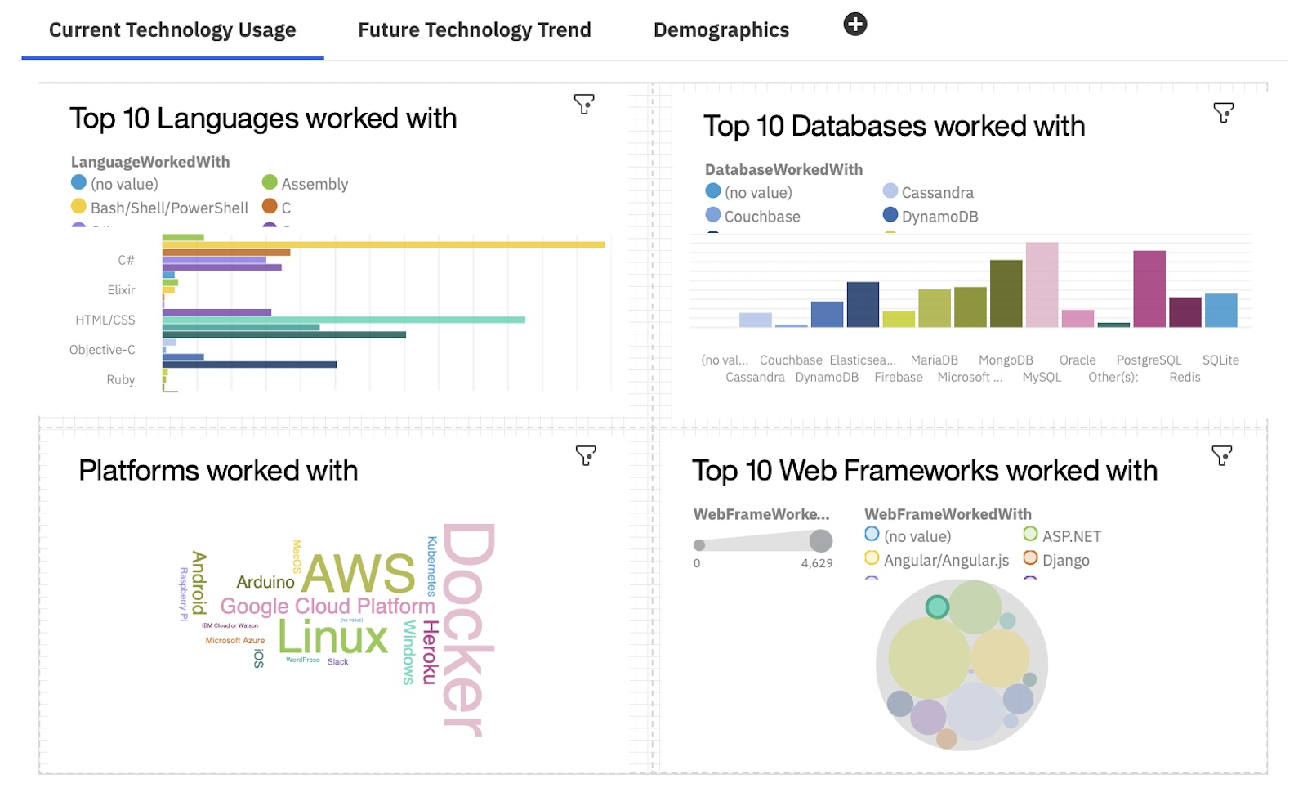
CURRENT TECHNOLOGY USAGE

Slide 13
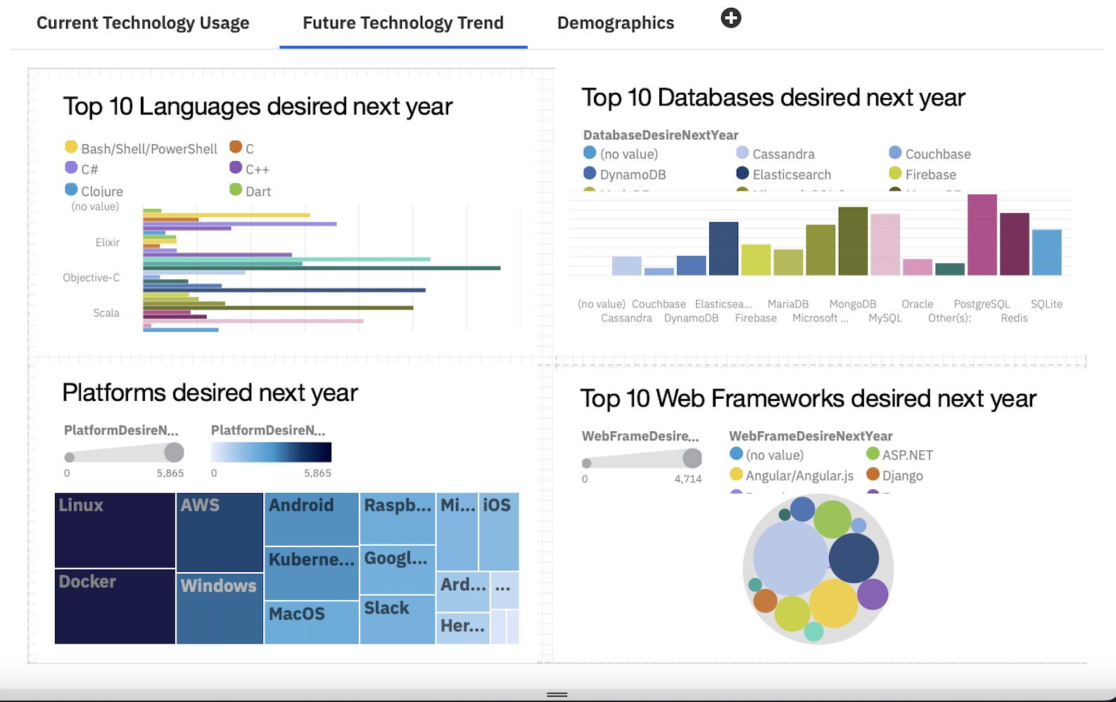
FUTURE TECHNOLOGY USAGE

Slide 14
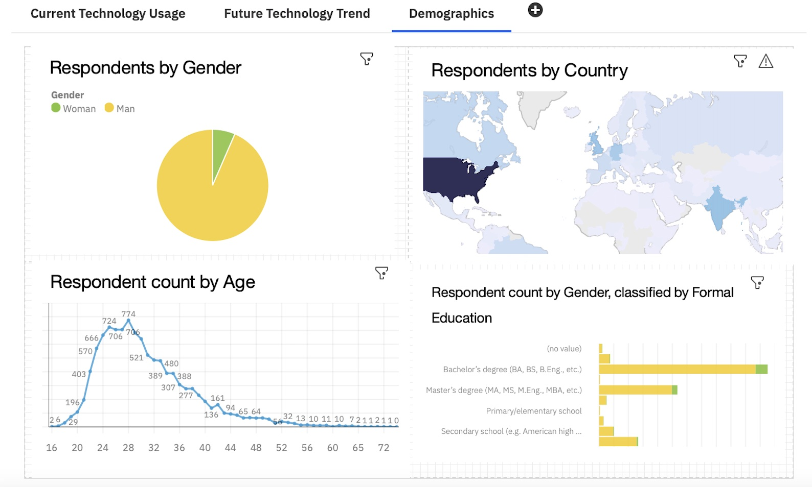
DEMOGRAPHICS

Slide 15
DISCUSSION
What makes a technology popular?
Why are some technologies left behind?

Slide 16
OVERALL FINDINGS & IMPLICATIONS
Findings
In demand technologies can fluctuate from year to year
React.js is predicted to be the most popular web framework replacing jQuery
Linux, Docker and AWS are the most popular platforms.
Gender imbalance as 93% more respondents were male
Implications
Technologists should upskill where the demand is to keep themselves relevant in the market.
Hire more people with frameworks experience like React.js and Vue.js
Continue to staff Linux but employ people with Cloud experience – AWS, Docker, Kubernates etc

Slide 17

CONCLUSION
Hire more people with skills in future trend technologies
Upskill those already employed
Gender and Education

Slide 18

APPENDIX
Include any relevant additional charts, or tables that you may have created during the analysis phase.

Slide 19
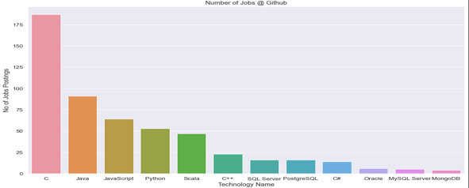
JOB POSTINGS

Slide 20
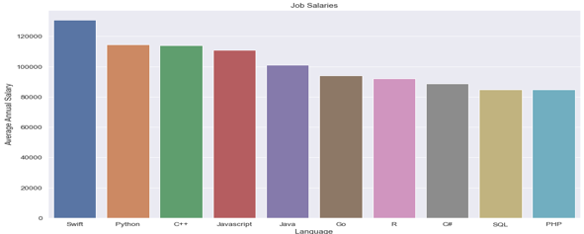
POPULAR LANGUAGES

