Slide 1
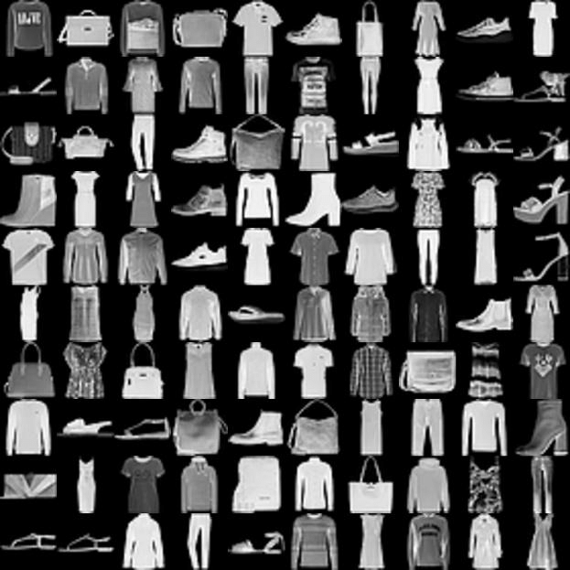
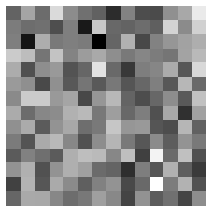
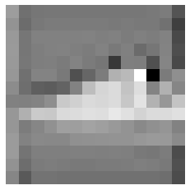
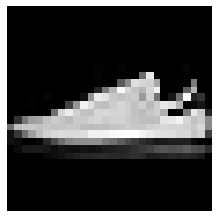
Text-Conditioned Latent Diffusion Model on Fashion-MNIST
1. AutoEncoder (Trained with MSE+Perceptual Loss)
3. Diffusion Model (Corresponds to Prior in the DALL-E 2)
Conditioned
Diffusion
Model
Encoder
Decoder
Noise
(1*14*14)
Target
(Image Latents)
(1*14*14)
FashionMNIST
(1*28*28)
Image Latents
(1*14*14)
2. Text Encoder (Pre-Trained on Large Dataset )
Decoder
Prompts:
“A photo of [label]”
{'T-shirt', 'Trouser',
'Pullover', 'Dress',
'Coat', 'Sandal',
'Shirt', 'Sneaker',
'Bag', 'Boot'}
CLIP
Text Latents
(1*512)

Slide 2
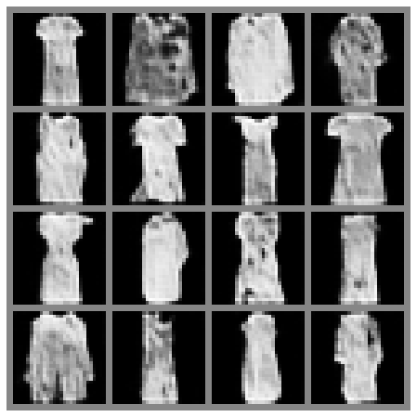
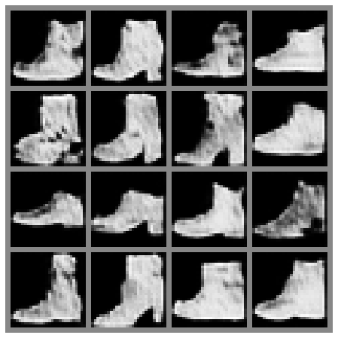
Example Generations
Prompts form training
“a photo of a Dress”
“a photo of a Boot”

Slide 3
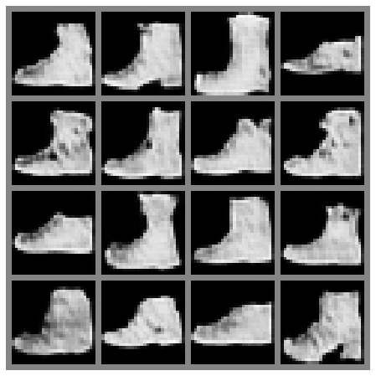
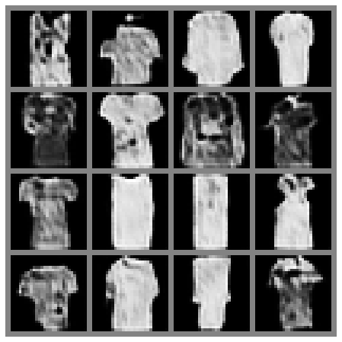
Example Generations
Prompts resembles training
“Boot”
“Something to wear on summer”

Slide 4
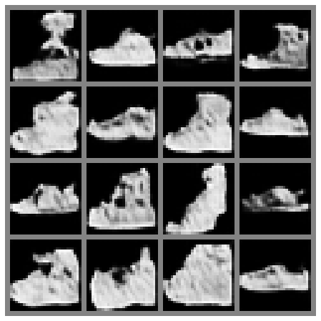
Example Generations
Prompts resembles training
“Boot” (only)
“Something to wear on summer”
“Something you wear on the foot”

Slide 5
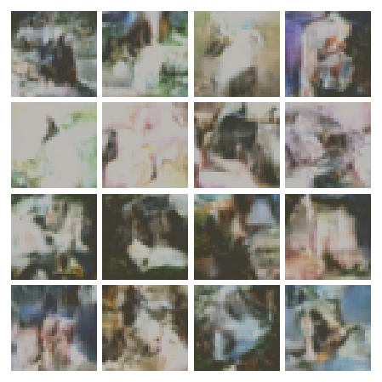
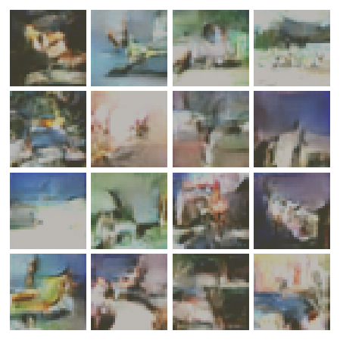
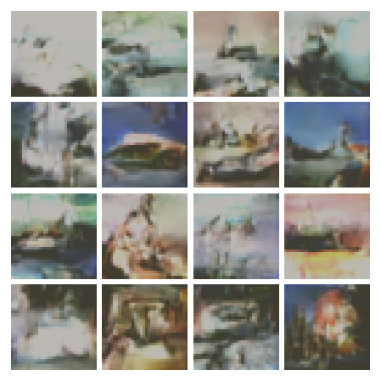
Example Generations on CIFAR10: (Not successful)
AutoEncoder is trained successfully. Latent diffusion failed.
Original paper trained CIFAR10 diffusion model with 8 V100 GPUs with 10.6 Hours. Model had 35.7 Million parameters.
Mine is trained with a generous GPU with 1 hour. Model has 9.3 million parameters. (works on 16*16)
“a photo of a cat”
“a photo of a airplane”
“a photo of a ship”

Slide 6
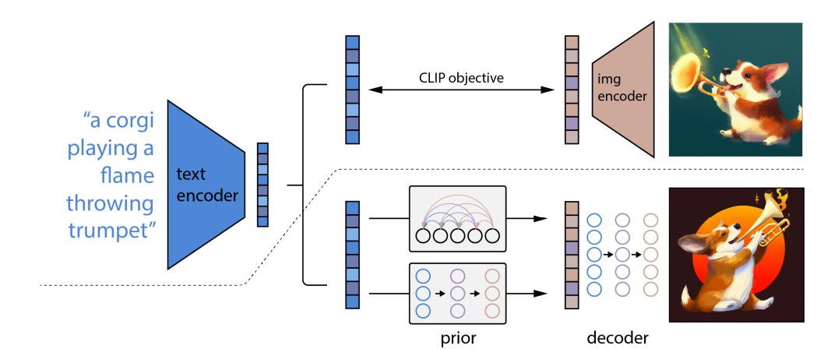
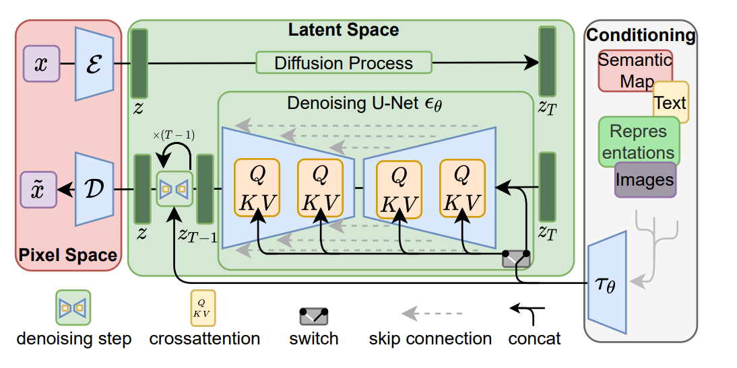
Architectural Choices:
Two main architectures (and one method) are needed:
Latent Space Generation / Embedding of images and the conditions (text, another image, mask)
CLIP (text-image embeddings), Transformers (text embeddings), AutoEncoders (image embeddings)
Reconstruction of new images
Diffusion models, GAN, VAE, AE (Autoencoder)
Conditioning Method on reconstruction with conditioning latents/embeddings
Concatenation, Adaptive (Layer/Instance) Normalization, Cross Attention
These are the two prominent text to diffusion models.
Latent Diffusion (LDM) / Stable Diffusion
DALL-E 2
text embedding
image embedding

Slide 7
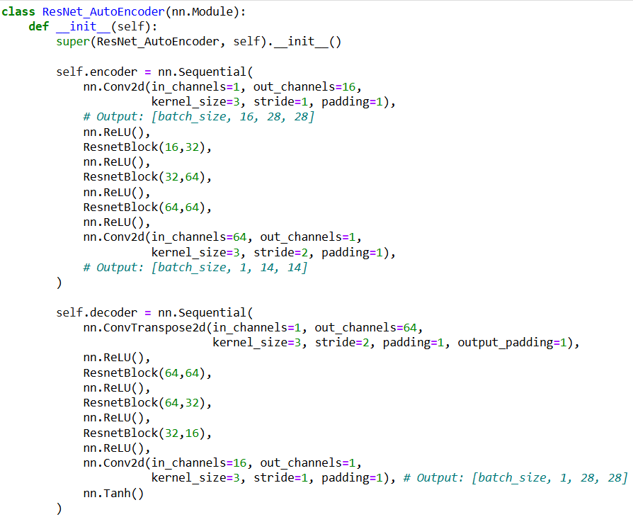
Design Choices of Simple T2I LDM on FashionMNIST | AutoEncoder
Layer Types:
Convolutional: Upsampling/Downsampling
ResNet: Feature Learning
Important Notes:
VAE / KL loss is not used.
Probably latent space will be more structured because of the KL regularization. Distribution learning done by the diffusion during text to image latent transformation.
Spatial information preserved in the latent space
Otherwise diffusion model fails. (I flattened the learned feature of [256/128*2*2])
Spatial information is valuable for diffusion model.
Perceptual Loss used for better reconstruction.

Slide 8
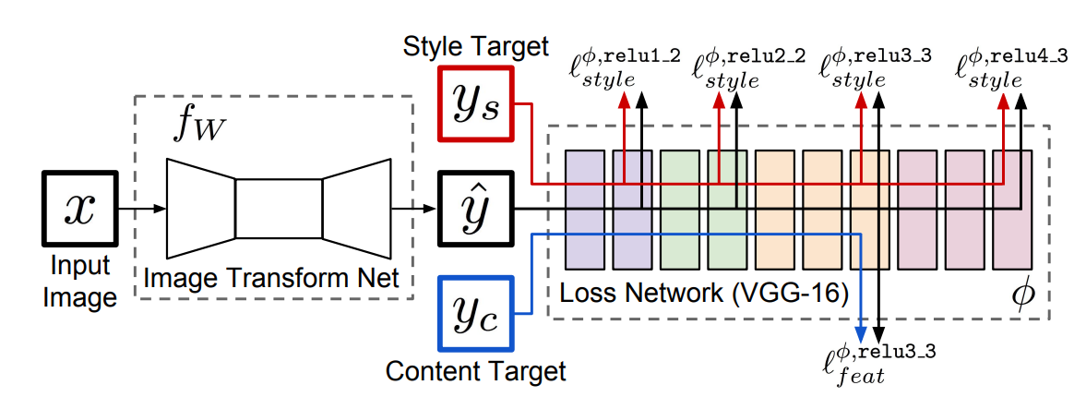
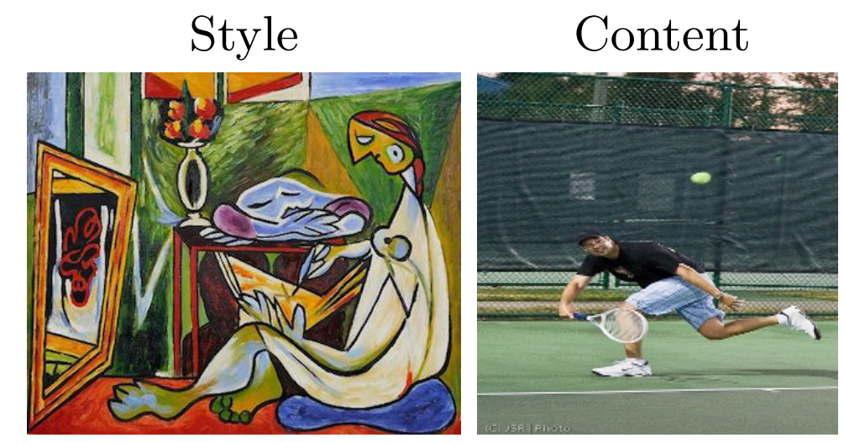
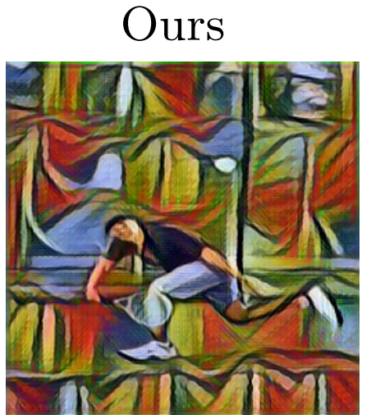
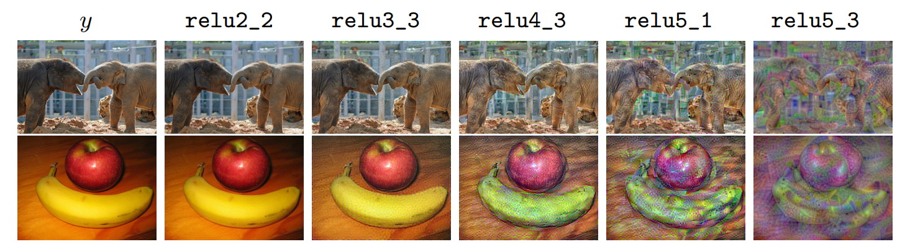
Perceptual Loss
(Johnson, Justin, Alexandre Alahi, and Li Fei-Fei. "Perceptual losses for real-time style transfer and super-resolution.", 2016)
(Zhang, Richard, et al. "The unreasonable effectiveness of deep features as a perceptual metric.",2018)
Main Idea: Using features of a neural network as a (perceptual) metric.
First paper uses VGG as the feature generator.
VGG consists of a feature submodule with conv layer and a classifier submodule with linear layers.
For style transfer they use 4 different feature set from the network.
For image super-resolution they only uses the feature a middle layer.
Below there are images that minimizes the perceptual losses taken solely from the indicated layer. The last layers do not possess the general structure of the original image.
VGG becomes a defacto for perceptual loss.

Slide 9
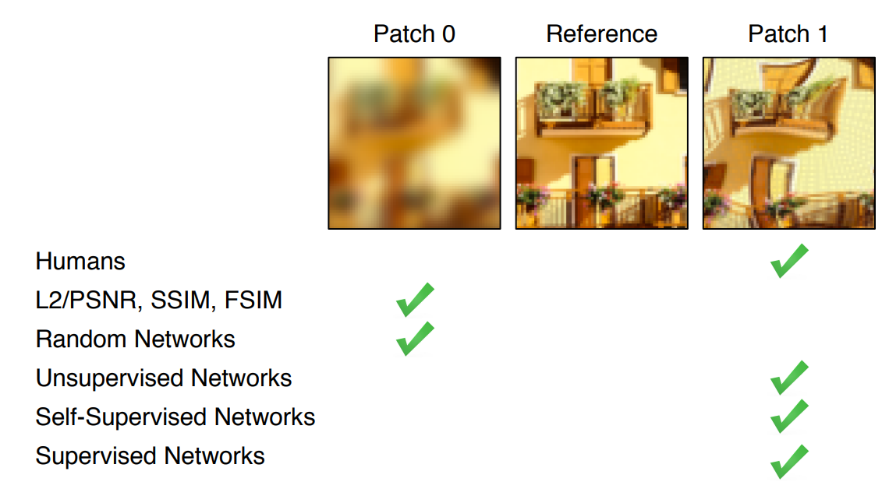
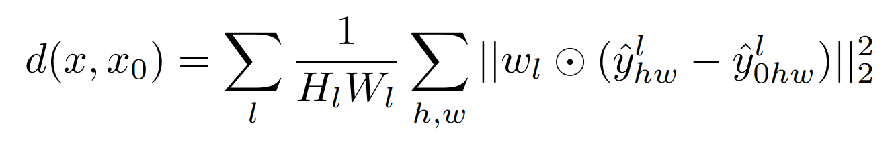
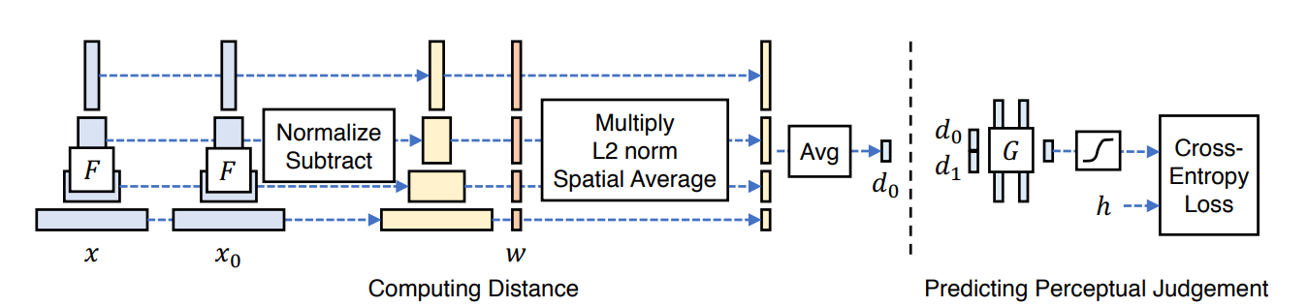
Perceptual Loss
(Johnson, Justin, Alexandre Alahi, and Li Fei-Fei. "Perceptual losses for real-time style transfer and super-resolution.", 2016)
(Zhang, Richard, et al. "The unreasonable effectiveness of deep features as a perceptual metric.",2018)
Second paper generalizes the idea of perceptual loss.
They show that not only VGG, even not only supervised networks, but also un/self-supervised networks do better than traditional metrics.
They also train a small network that predicts the perceptual loss.

Slide 10
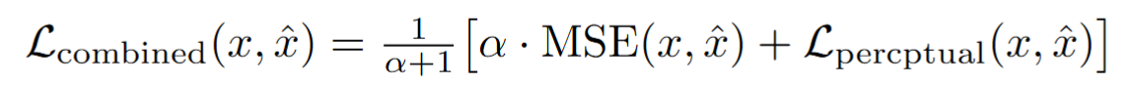
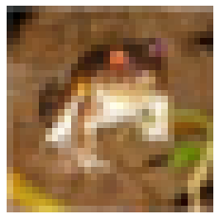
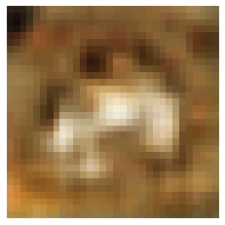
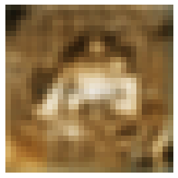
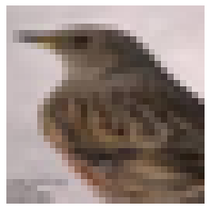
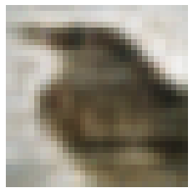
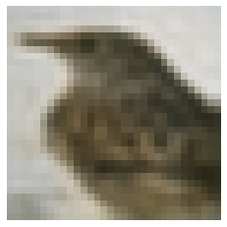
Perceptual Loss
(Johnson, Justin, Alexandre Alahi, and Li Fei-Fei. "Perceptual losses for real-time style transfer and super-resolution.", 2016)
(Zhang, Richard, et al. "The unreasonable effectiveness of deep features as a perceptual metric.",2018)
I implemented a combined loss function with both MSE
and perceptual loss. Only perceptual loss need calibration.
L_combined
(2 epochs)
Original Image
Only MSE Loss
These two examples are from the same network, but trained with different parameters.
I did not trained the second network further and have no saved examples with same net, different loss.
I first used VGG for feature generation, then trained my own classifier and used it features.

Slide 11
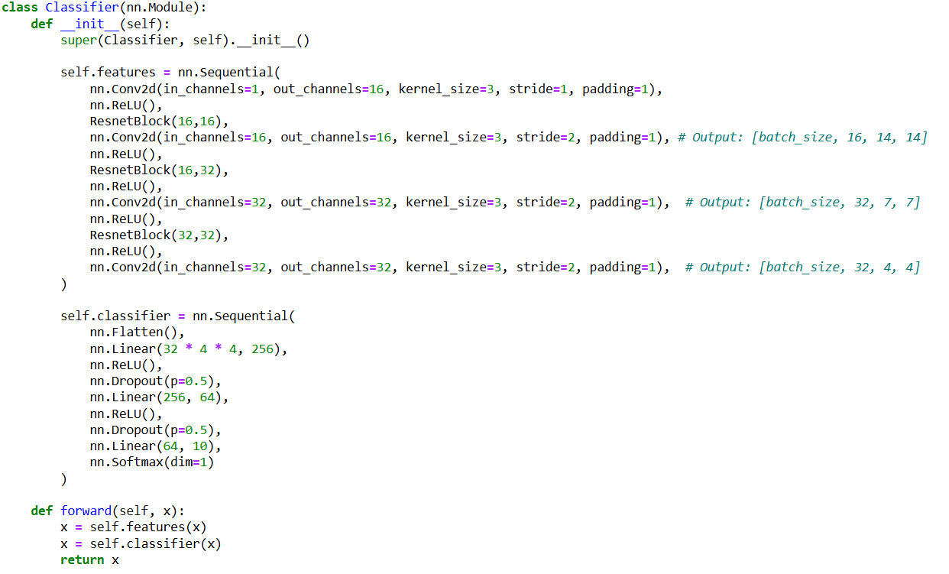
Code for classifier: I used the output of the feature module for perceptual loss (FashionMNIST)

Slide 12
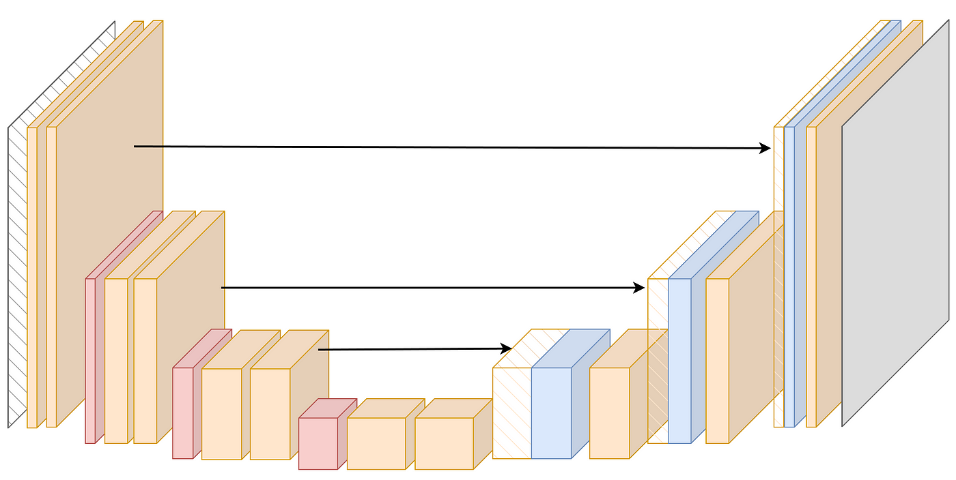
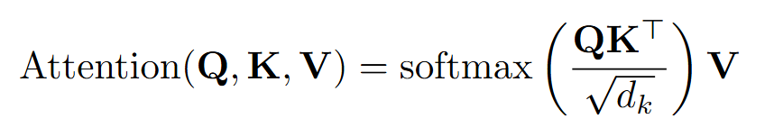
Diffusion Model
Diffusion Model takes the place of prior in the DALL-E 2 model.
Diffusion here generates image latents for the decoder from (=conditioned on) text latens.
It is also learns the latent space distribution, which is why using a VAE is not essential for autoencoder.
Mid-Blocks (1 for my model) is named: “UNetMidBlock2DCrossAttn”
which is essentially 2 ResNet Block with an cross-attention block in between.
Cross-attention:
Query from feature maps of UNet
Key and Values from embeddings
Down Blocks
Mid Blocks
Up Bloks
*I tried training a VAE takes text embedding directly, outputs image embedding. Variance exploded (KL loss)

