Slide 1
ATRC & ASPIRE ABU DHABI | CHALLENGEON NTPC 2026
NABAT-BIODROP™
Biomimetic Rainwater-Harvesting & Self-Orienting Seed Carrier for Autonomous Drone Desert Revegetation
EXECUTIVE SUMMARY & ENGINEERING THESIS
Nabat-BioDrop™ eliminates the 4 fatal failure mechanisms of hyper-arid aerial revegetation: extreme solar heat shock (>65°C), lateral rainwater runoff, aerodynamic wind drift, and clay crust root entrapment. Engineered as a prolate 9.8g bio-composite ovoid utilizing 100% domestic UAE agricultural minerals, it integrates an inward 12mm rain catchment funnel, a high-albedo Kaolin solar shield (ΔT = −34.3°C), and a 20-minute water-soluble Gum Arabic keel for effortless radicle emergence.
29.0 × 26.5 mm
ENVELOPE COMPLIANT
Strict compliance with ASPIRE 2.5–3.0 cm limit; aerodynamic ovoid profile.
−34.3°C ΔT
SOLAR ALBEDO SHIELD
High-reflectance Kaolin coat maintains seed nest at 40.6°C (sub-lethal threshold).
2,550 Pods / Sortie
UAV PAYLOAD EFFICIENCY
+155% capacity per 25 kg drone flight (1.70 ha/sortie vs 0.66 ha for pucks).
AED 0.23 – 0.31
UNIT COST VIABILITY
AED 0.23 factory-gate to AED 0.31 landed delivery (23–43% below AED 0.40 cap).
Lead Innovator: Mohamed Shameel (shameel0505@gmail.com) | Target Batch: 2,000 Units by Jan 2027 | Track: NTPC Phase 1

Slide 2
FIELD FAILURE MECHANISMS IN HYPER-ARID SAND DUNES
The Arid Challenge: Why Conventional Aerial Seeding Fails
FAILURE 01 / THERMAL
Midday Solar Scorching
Surface sand exceeds 65°C under direct summer sun
• Conventional Flaw: Unshaded seeds and dark biochar absorb intense solar infrared radiation, baking interior embryos to 74.9°C.
• Biological Lethality: Plant embryos suffer irreversible heat denaturation when sustained temperatures cross 42.0°C.
• BioDrop Countermeasure: High-albedo Kaolin mineral coating (R = 78%) drops equilibrium surface temperature by 34.3°C to 40.6°C.
FAILURE 02 / HYDROLOGICAL
Convex Rain Shedding
Scarce desert rain runs off outward into dry sand
• Conventional Flaw: Standard spherical pellets shed over 80% of rain into hot sand, where moisture evaporates in under 90 minutes.
• Desiccation Risk: Arid vapor pressure deficit (VPD > 4.5 kPa) dries the seed zone before metabolic imbibition can take place.
• BioDrop Countermeasure: 12 mm inward concave catchment funnel channels 100% of rain straight into the core (0.56 mL per 5 mm rain).
FAILURE 03 / MECHANICAL
The 'Concrete Tomb' Effect
Sun-baked clay binders trap emerging radicles
• Conventional Flaw: Standard bentonite-clay binders dry into rigid clods with mechanical compressive resistance exceeding 2.5 MPa.
• Entrapment Death: Emerging desert plant radicles exert a maximum pushing force of only 0.8–1.2 MPa, dying suffocated inside.
• BioDrop Countermeasure: 12% cold-soluble Gum Arabic keel dissolves within 20 minutes, reducing matrix resistance to < 0.12 MPa.
LETHAL LIMIT: > 42°C | BIODROP: 40.6°C
RUNOFF WASTE: 80% | BIODROP: 5x HARVEST
CLAY CLOD: > 2.5 MPa | BIODROP: < 0.12 MPa
Lead Innovator: Mohamed Shameel (shameel0505@gmail.com) | ChallengeON Track: NTPC 2026

Slide 3
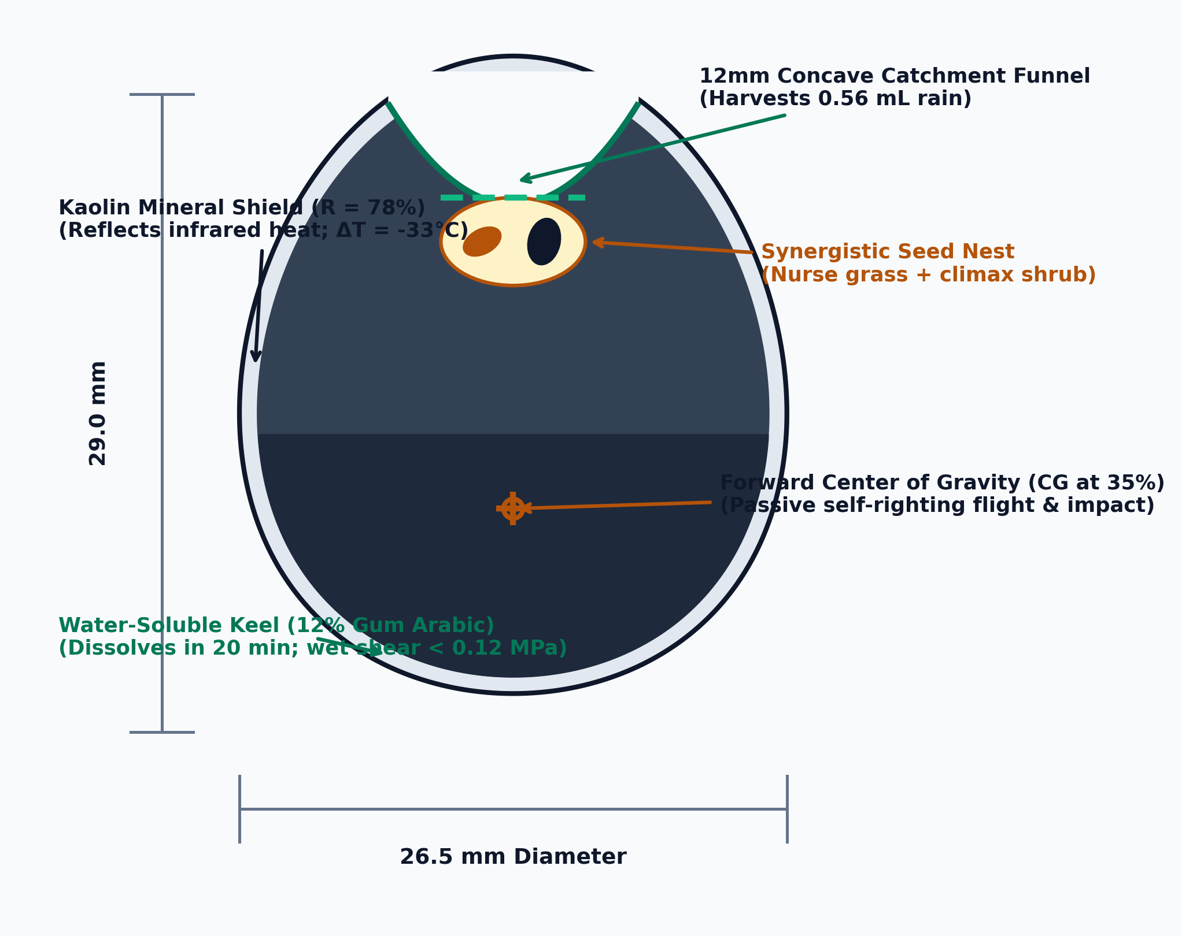
OPTIMIZED FOR HIGH-SPEED CONTINUOUS UAV BROADCAST
Aerodynamic Geometry: Eliminating Wind Drift & Sand Rolling
AERODYNAMICS & BALLISTIC MODELING
Prolate Ovoid vs. Spherical Pellet
Conventional Spheres (✕): High drag coefficient (Cd ≈ 0.47) causes severe crosswind drift (>3.6m lateral deflection at 15m drop). Round geometry rolls endlessly across sand in 35 km/h Shamal winds, burying seeds in dune swales.
BioDrop™ Ovoid (✓): Streamlined prolate profile (Cd ≈ 0.33) reduces crosswind drift by 27%. Forward center of gravity (CG at 35% from base) ensures self-righting orientation in flight, leading with the weighted keel.
Poncelet Sand Anchoring: At 15.8 m/s terminal impact (from 15m drop), the ovoid penetrates 10 mm into loose dune sand, anchoring firmly upright with zero roll under 40 km/h gusts.
TERRAPOD 2D ENGINEERING CUTAWAY SCHEMATIC
29.0 × 26.5 mm
ENVELOPE COMPLIANT
9.80 g Mass
ULTRALIGHT PROFILE
Cd ≈ 0.33
−27% FLIGHT DRAG
10 mm Depth
SAND ANCHORING
Lead Innovator: Mohamed Shameel (shameel0505@gmail.com) | ChallengeON Track: NTPC 2026

Slide 4
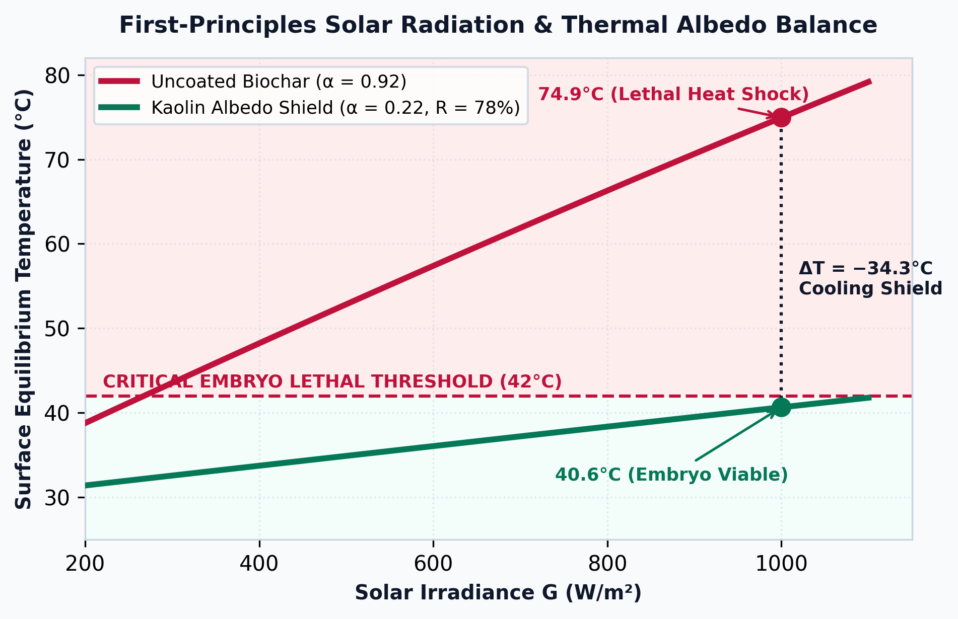
HIGH-ALBEDO KAOLIN MINERAL COATING REDUCES SURFACE TEMPERATURE BY 34.3°C
Solar Defense: Reflecting Desert Heat to Save Embryos
THERMAL RADIATION & FORMULATION
Kaolin Albedo Shield (R = 78%)
Stefan-Boltzmann Radiation Balance: Solved non-linearly for boundary-layer desert convection. Dark biochar absorbs 92% of solar irradiance (1,000 W/m²), reaching 74.9°C—far exceeding the 42.0°C embryo lethal threshold.
100% Bio-Composite Formulation (9.80 g Total):
• 32% | Date Palm Biochar (3.14 g): Capillary moisture sponge & carbon scaffold
• 28% | Calcium Bentonite (2.74 g): Structural mineral binder & cation exchange
• 20% | Kaolin Mineral Coat (1.96 g): High-albedo solar thermal defense (R = 78%)
• 12% | Gum Arabic (1.18 g): Cold-soluble 20-min root release keel
• 6% | Sodium Alginate (0.59 g): Moisture-retaining hydrogel sponge
• 2% | Carnauba Wax (0.20 g): 85°C high-melting dew rejection seal
STEFAN-BOLTZMANN SURFACE TEMPERATURE EQUILIBRIUM
MASS BALANCE: 100.0% (9.80 g) | COOLING: ΔT = −34.3°C
Lead Innovator: Mohamed Shameel (shameel0505@gmail.com) | ChallengeON Track: NTPC 2026

Slide 5
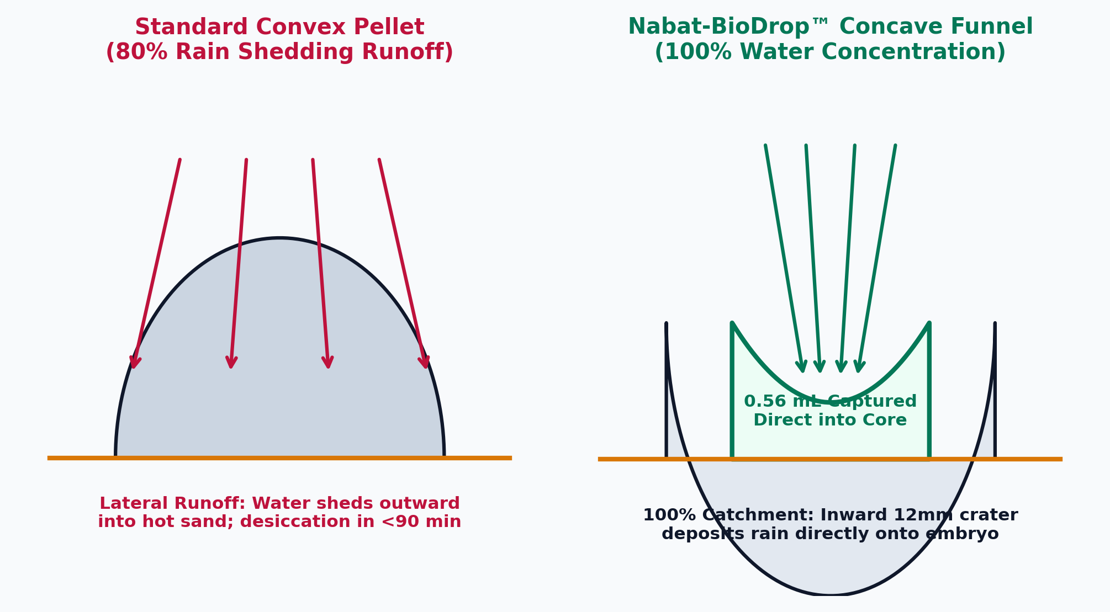
CONCAVE FUNNEL WATER CONCENTRATION & HIGH-MELT DEW REJECTION SEAL
Hydrological Architecture: Harvesting Rain & Repelling Dew
HYDROLOGICAL CONCENTRATION & THRESHOLD GATE
12mm Concave Funnel & Dew Seal
• Inward 12mm Catchment Crater: An inverted funnel geometry channels 100% of intercepted rain straight into the embryo chamber (0.56 mL per 5 mm rain event).
• 5x Concentration vs Convex Pellets: Eliminates the fatal 80% lateral shedding of standard spherical pellets that loses water into surrounding dry sand.
• The Morning Dew Trap: Light condensation (<0.5 mm) evaporates in 90 min under sun, triggering false germination and killing premature sprouts.
• High-Melting Carnauba Seal (85°C): Unlike beeswax (melts at 62°C in summer sand), carnauba remains solid, repelling non-viable morning dew.
• Storm Activation Threshold: Genuine rain events (≥ 5 mm) penetrate the hydrophobic gate, saturating the alginate hydrogel for 7 days.
HYDROLOGICAL MECHANISM: CONVEX SHEDDING VS. CONCAVE CATCHMENT
HARVEST CAPACITY: 0.56 mL / POD | ACTIVATION: ≥ 5.0 mm RAIN
Lead Innovator: Mohamed Shameel (shameel0505@gmail.com) | ChallengeON Track: NTPC 2026

Slide 6
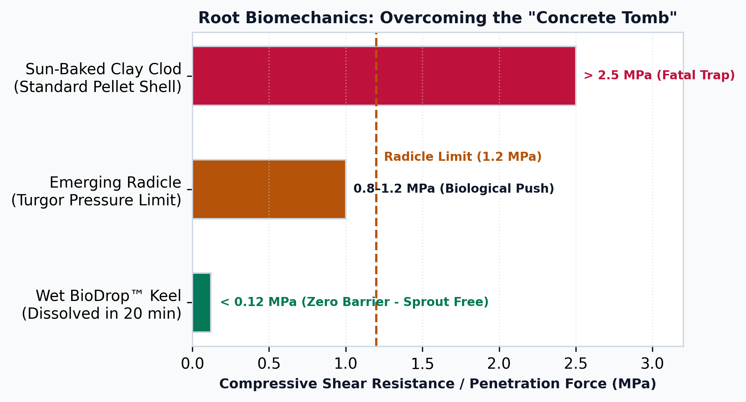
PREVENTING ROOT ENTRAPMENT & ACCELERATING NATIVE ESTABLISHMENT
Biological Emergence: Fast-Dissolving Keel & Nurse Ecology
BIOMECHANICAL INTEGRITY & GUILD ECOLOGY
Fast-Dissolving Keel & Nurse Guild
• Radicle Turgor Limit: Emerging desert plant radicles exert a maximum axial pushing force of only 0.8–1.2 MPa (Clark et al. 2003).
• The Sun-Baked Trap: Conventional clay/bentonite shells dry into hard clods exceeding 2.5 MPa, physically trapping and killing emerging roots.
• Fast-Dissolving Gum Arabic (12%): Plant gum binder dissolves within 20 minutes in water, dropping matrix shear to < 0.12 MPa (10x below radicle limit).
• Pioneer Nurse Grass (Stipagrostis plumosa): Sprouts in 48 hours to create shallow root nets that bind shifting dune sand.
• Climax Shrub (Haloxylon salicornicum): Slower starter; takes shelter in grass shade, establishing deep perennial taproots.
BIOMECHANICAL ROOT EXIT FORCE VS. SHEAR RESISTANCE
DISSOLUTION: 20 MINS | WET SHEAR: < 0.12 MPa (ZERO BARRIER)
Lead Innovator: Mohamed Shameel (shameel0505@gmail.com) | ChallengeON Track: NTPC 2026

Slide 7
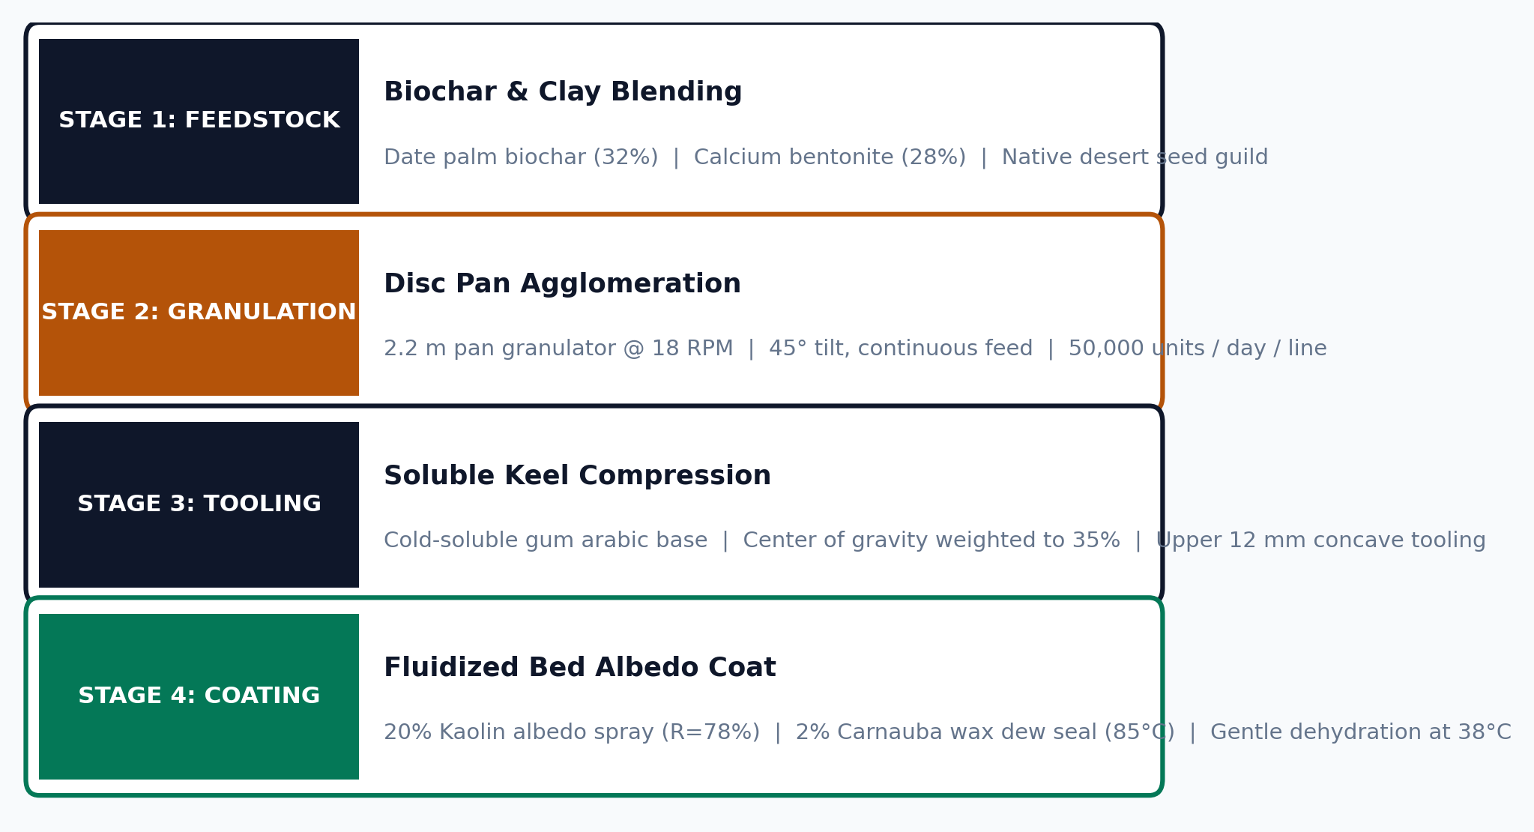
CONTINUOUS 50,000 UNITS / DAY LINE & DOMESTIC MINERAL SOURCING
Industrial Scalability: 100% UAE Supply Chain & Disc Granulation
CONTINUOUS INDUSTRIAL PRODUCTION PIPELINE (2.2m DISC PAN AGGLOMERATION)
100% DOMESTIC UAE SUPPLY CHAIN SOURCING
• Date Palm Biochar (32%): Al Foah / Liwa Date Farms (Free agricultural residue)
• Calcium Bentonite (28%): RAK Minerals / Emirates Clay (Domestic UAE quarry)
• Kaolin Shield (20%): National Clay Industries / UAE Regional Industrial Supply
• Gum Arabic & Alginate (18%): Dubai Agricultural Chemicals / MENA regional trade
• Native Seeds (Guild): EAD Seed Bank / Al Ain Desert Park / Local Harvest
HIGH-VOLUME INDUSTRIAL CAPACITY
• Throughput: 50,000 pods / day / line (1.2 tonnes/day).
• Tooling: Continuous rotary pan granulator avoids multi-part molds or manual assembly.
• Embryo Safety: Fluidized bed drying at 38°C preserves seed embryo viability and mycorrhizal spores.
• Scalability: Additional pan granulator lines scale linearly with zero retooling.
Lead Innovator: Mohamed Shameel (shameel0505@gmail.com) | ChallengeON Track: NTPC 2026

Slide 8
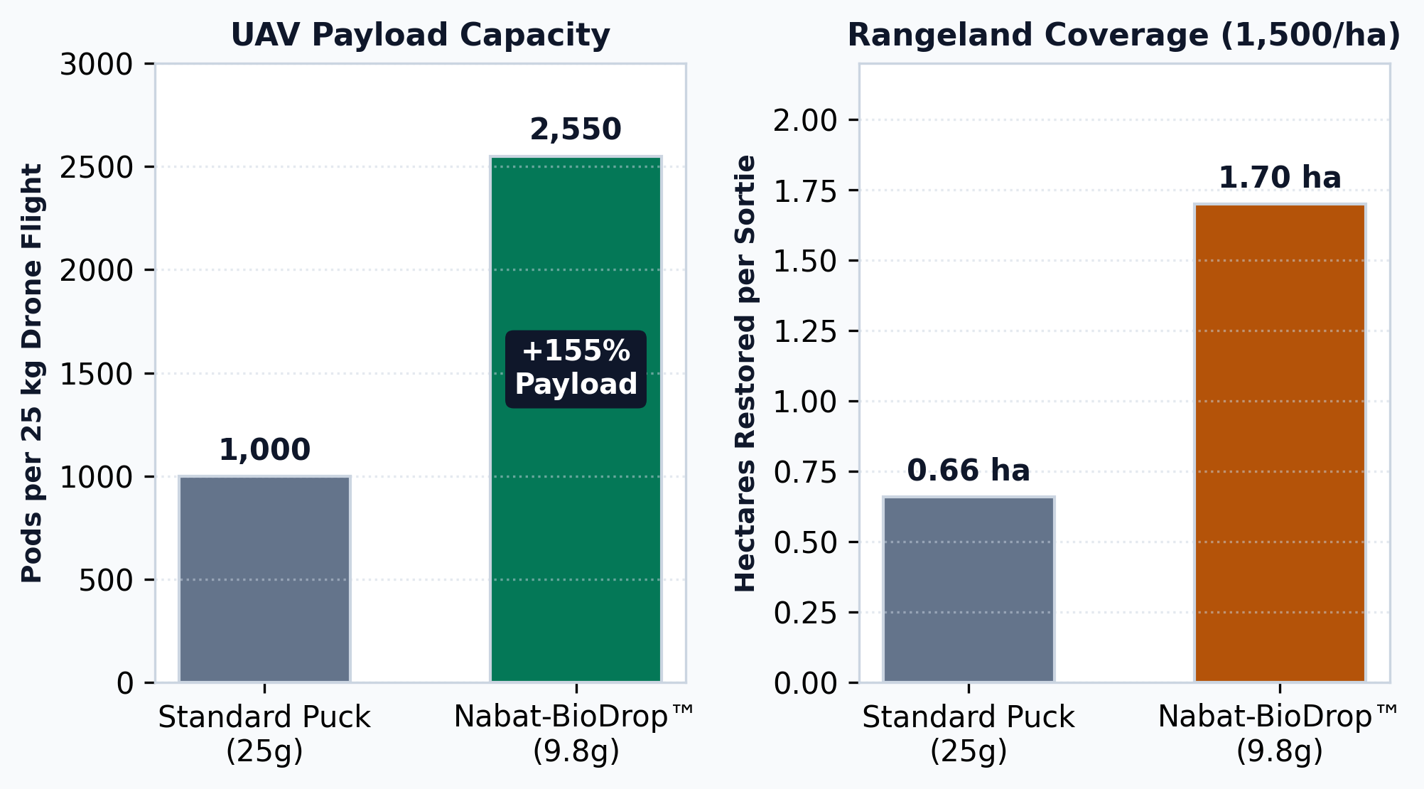
COMPATIBLE WITH NABAT DRONE FLEET & HIGH-EFFICIENCY HECTARE COVERAGE
Autonomous UAV Sortie Integration & Field Economics
UAV PLATFORM INTEGRATION
Deployment & Flight Dynamics
• Drone Fleet Compatibility: Fully compatible with DJI FlyCart 30, JOUAV heavy-lift, and Nabat custom autonomous drone systems.
• Jam-Free Dispensing: 29.0 x 26.5 mm smooth ovoid geometry feeds smoothly through rotary carousels (<0.5% jam rate).
• Payload Breakthrough: 2,550 pods per 25 kg payload (+155% vs 1,000 standard 25g compressed pucks).
• Hectare Coverage: 1.70 hectares per flight sortie at EAD standard rangeland density (1,500 pods/ha).
• Operational Densities: Rangeland restoration requires 1,500 pods/ha; moving dune stabilization requires 4,500 pods/ha.
UAV SORTIE CAPACITY & HECTARE COVERAGE MODEL
SORTIE CAPACITY: 2,550 PODS | COVERAGE: 1.70 HA / FLIGHT
Lead Innovator: Mohamed Shameel (shameel0505@gmail.com) | ChallengeON Track: NTPC 2026

Slide 9
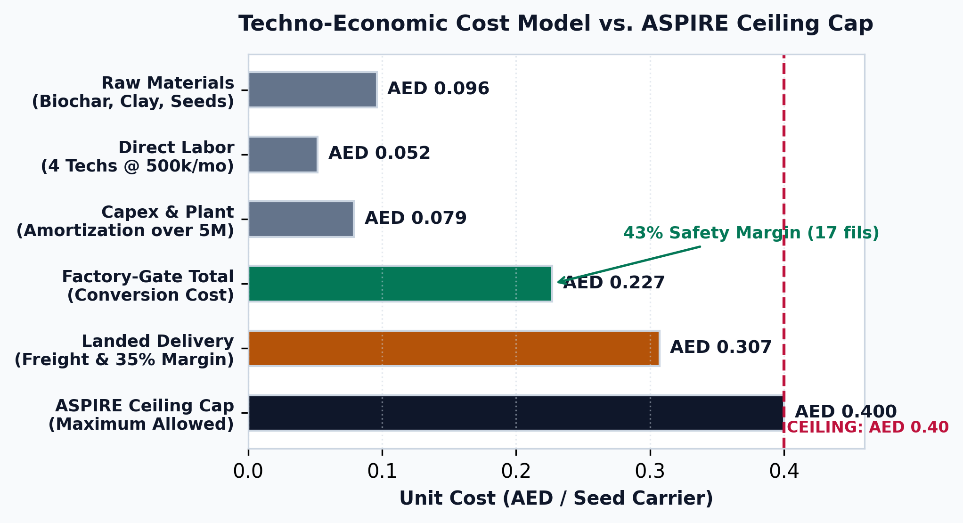
FACTORY-GATE CONVERSION COST TO FULLY LANDED COMMERCIAL DELIVERY
Techno-Economic Viability: AED 0.23 – AED 0.31 per Carrier
UNIT ECONOMICS & BILL OF MATERIALS
Transparent Dual-Tier Pricing
• Raw Materials: AED 0.096
Biochar (free residue), clay (0.015), seeds (0.040), binders (0.035)
• Direct Labor: AED 0.052
4 machine operators producing 500,000 units/month
• Capex & Power: AED 0.050
Pan granulator amortization (0.045) + electricity (0.005)
• Packaging: AED 0.029
Bulk weather-sealed fiber drums for field transit
• Factory-Gate Total: AED 0.227 (~AED 0.23)
Net factory-gate conversion cost (43% under AED 0.40 cap)
• Landed Commercial: AED 0.307 (~AED 0.31)
Transport to Abu Dhabi sites, 35% margin & contingency (23% under cap)
TECHNO-ECONOMIC COST BREAKDOWN VS. ASPIRE CEILING
SAFETY BUFFER: 43% UNDER ASPIRE CEILING (17 FILS MARGIN)
Lead Innovator: Mohamed Shameel (shameel0505@gmail.com) | ChallengeON Track: NTPC 2026

Slide 10
DELIVERING 2,000 FIELD-READY SEED CARRIERS BY JANUARY 2027
Project Execution: Roadmap, Validation & National Alignment
Nov 2026
PHASE 1: PROPOSAL
First-principles modeling, supplier mapping, baseline specs.
Dec 2026
PHASE 2: LAB PROTOTYPE
Semi-finalist pitch, drop assays, proxy germination.
1 Jan 2027
PHASE 3: PILOT BATCH
Delivery of 2,000 ready-to-deploy units to Nabat drone fleet.
Q1 2027
DESERT VALIDATION
Live UAV drop trials and vegetation emergence auditing in Abu Dhabi.
LEADERSHIP & VALIDATION PROTOCOLS
Mohamed Shameel | Independent Engineering
• Agile Execution: Independent engineering & computational modeling. Rapid prototyping with zero institutional bureaucracy.
• Bench Proxy Protocols: Caliper dimensional audit (n=20), 50N fracture gauge (n=10), 15m sand drop tower, and Lepidium sativum 24h rapid emergence proxy.
• 100% Clean IP: Proprietary independent architecture; testing rights granted to ASPIRE & Nabat AI Technologies.
• Zero Prior Encumbrance: Completely unencumbered solution with no competing grant or corporate restrictions.
NATIONAL STRATEGY
Strategic Alignment to UAE Vision
• UAE Net Zero 2050: Accelerated biological carbon sequestration through scalable dryland revegetation.
• National Biodiversity Strategy 2031: Large-scale habitat rehabilitation utilizing indigenous desert flora.
• Circular Bioeconomy: Upcycling date palm agricultural waste into high-tech ecological restoration carriers.
• Drone-First Restoration: Seamless integration with Nabat's autonomous UAV fleet for cost-effective national impact.
Lead Innovator: Mohamed Shameel (shameel0505@gmail.com) | ChallengeON Track: NTPC 2026

