Slide 1

Mazenet Technologies
Data Engineering Training
PROJECT: BANKING DATA PLATFORM DEVELOPMENT
Submitted by: Shameena
Batch: DE-2025 Batch 1
Trainer: Aaryan Kumar
Date: 10-12-2025

Slide 2
INDEX - DAY 1 TO DAY 5
Day-wise Overview:
• Day 1 – Data Ingestion & Storage Setup
• Day 2 – Automated Processing & Queue Handling
• Day 3 – Database Integration (Azure SQL / Cosmos DB)
• Day 4 – Fraud Detection & Real-Time Alerts
• Day 5 – Analytics & Silver Layer Dataset

Slide 3
Project Overview
Azure Banking Project – Day 1 to Day 5
Includes objectives, services, implementation, challenges & improvements.

Slide 4
Day 1 – Objective
Goal: Set up ingestion foundation for banking raw data.
Services Used:
Azure Storage Account
• Blob Containers
• Event Grid
• Azure Function App (HTTP)

Slide 5
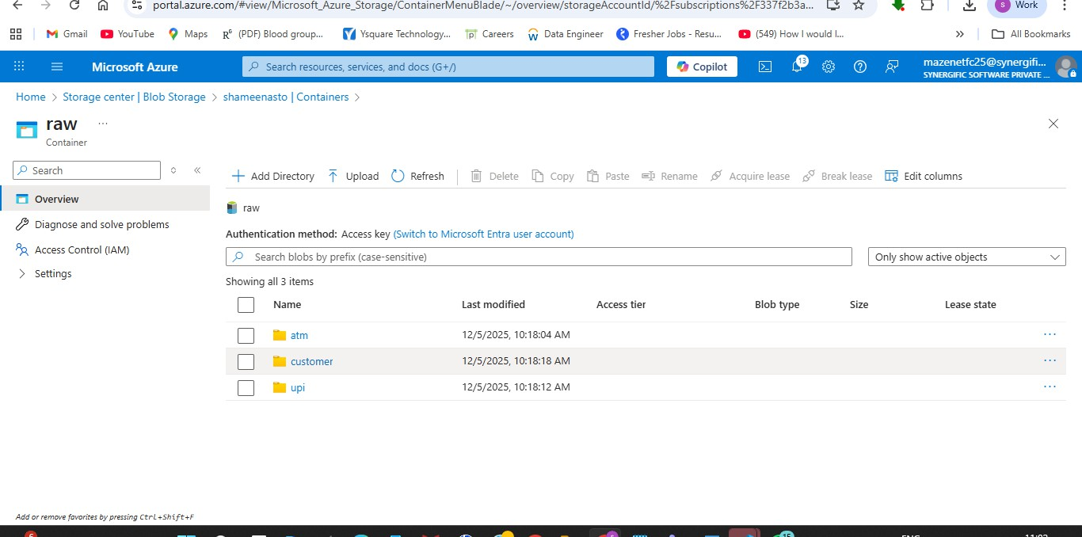
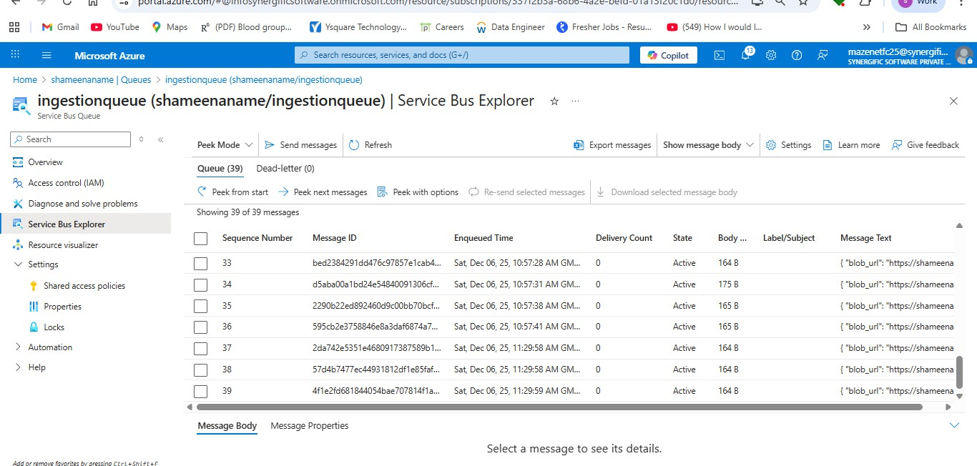
Day 1 – Implementation
Implementation Steps:
1. Created Storage Account & Containers
2. Created a service queue
3. Configured Event Grid trigger

Slide 6
Day 1 – Challenges & Improvements
Challenges:
• Trigger mismatch
• Incorrect webhook format
Improvements:
• Corrected headers & schema

Slide 7
Day 2 – Objective
Goal: Automate queue-based processing.
Services Used
• Azure Storage Queue
• Queue Trigger Function
• Blob Service Client

Slide 8
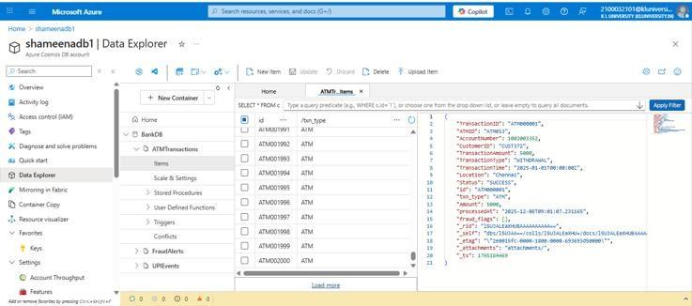
Day 2 – Implementation
Implementation Steps:
1. Created queue
2. Implemented queue-trigger function
3. Created a Cosmo DB and I did data transformation finally loaded in Cosmo DB.

Slide 9
Day 2 – Challenges & Improvements
Challenges:
• Queue message format issues
Improvements:
• Standardized message body & logging

Slide 10
Day 3 – Objective
Goal: Store cleaned data in Azure SQL / Cosmos DB.
Services Used
• Azure SQL DB
• Cosmos DB
• MERGE Operations

Slide 11
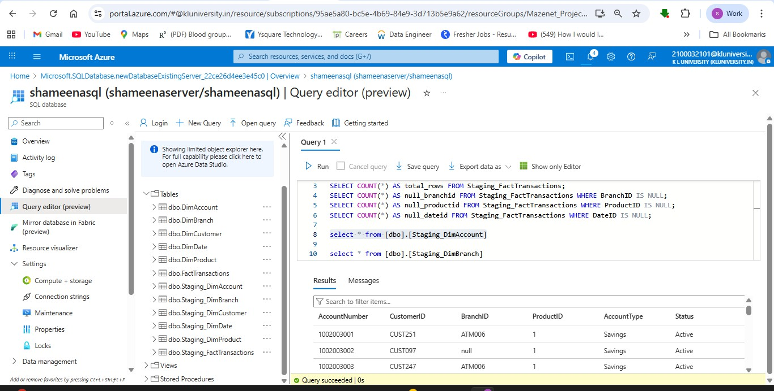
Day 3 – Implementation
Created Fact and Dimension tables (DimCustomer, DimAccount, FactTransactions).
Used PySpark to transform Silver layer data and load into SQL DW.
Handled MERGE/UPSERT operations to maintain history (SCD Type 2 for DimCustomer).

Slide 12
Day 4 – Objective
Goal: Implement fraud detection with Event Grid notifications.
Services Used
Event Grid
Azure Function (Event Grid trigger)
Service Bus
Cosmos DB.

Slide 13
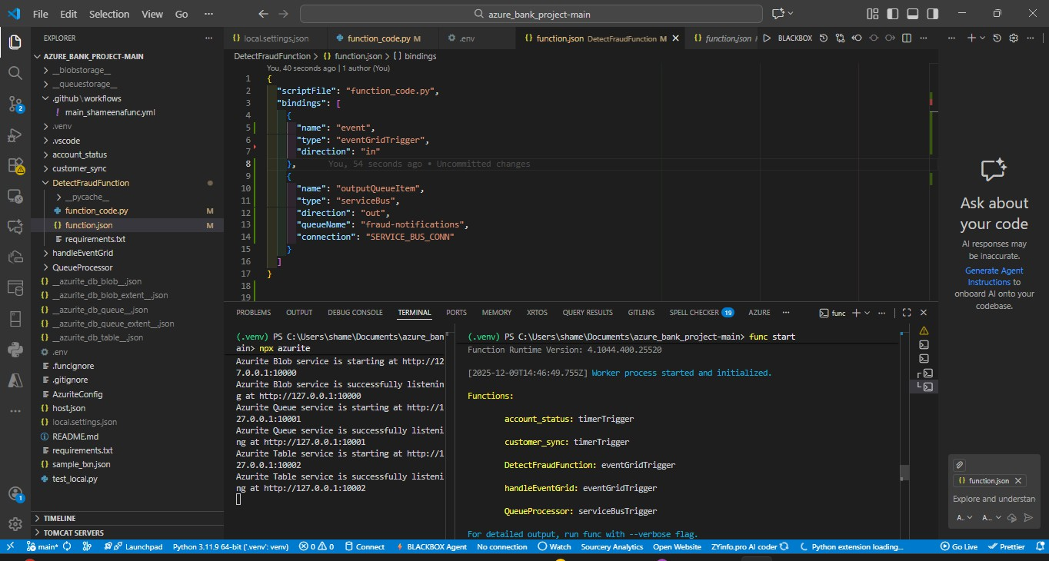
Day 4 – Implementation
Event Grid triggers function on high-value transactions (>₹50,000).
Function checks for anomalies: unusual location/device, rapid transactions,
odd login times.
Inserts alert into FraudAlert Container
Sends notifications via Service Bus

Slide 14
Day 5 – Silver Layer Overview
Goal: Transform and consolidate clean data for analytics and reporting.
Services Used:
Azure Databricks
Azure SQL
Silver layer in ADLS
Power BI.

Slide 15
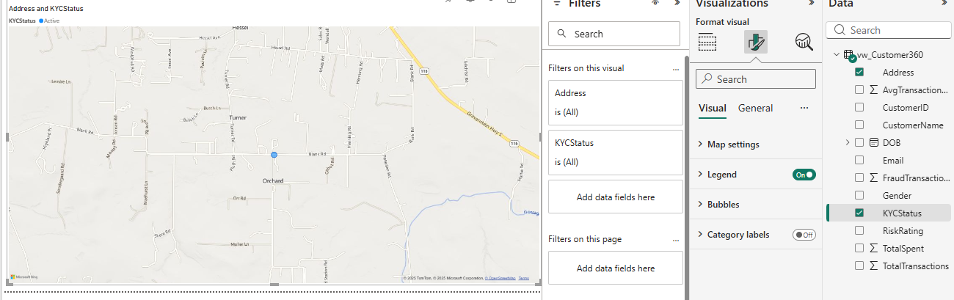
Day 5 – Implementation
Combined ATM, UPI, Account data, removed duplicates, enriched records.
Verified data integrity, standardized timestamps, and amounts.
Built dashboards for Customer 360

Slide 16
THANK YOU

