Slide 1
Retail Client Market Data Analysis
Prepared by : Shameen Aslam

Slide 2
Executive Summary
Retail clients market data shows sales in mouth and dental products declined by 16% in march year on year
Total sales from retail clients Loyalty card customers increased by 1% . In the case of non carded customers sales has declined by 33 % in value and around 40% in total number of purchase when compared to previous year.
A few key metrics
Retail clients over all sales in mouth and dental products decreased due to poor performance in non carded customer category which declined by 33%
Most of revenue for retail client in mouth and dental category from sub category mouthwash products whose sales has declined by 1.9million , where as dental floss and mouth spray has increased in sales.
Sale of Listerine brand under mouth wash sub category decreased by 1.57 million, also average price of mouth wash products under this brand increased by 23.60 ie by 20.5% from last year for non carded customers.

Slide 3
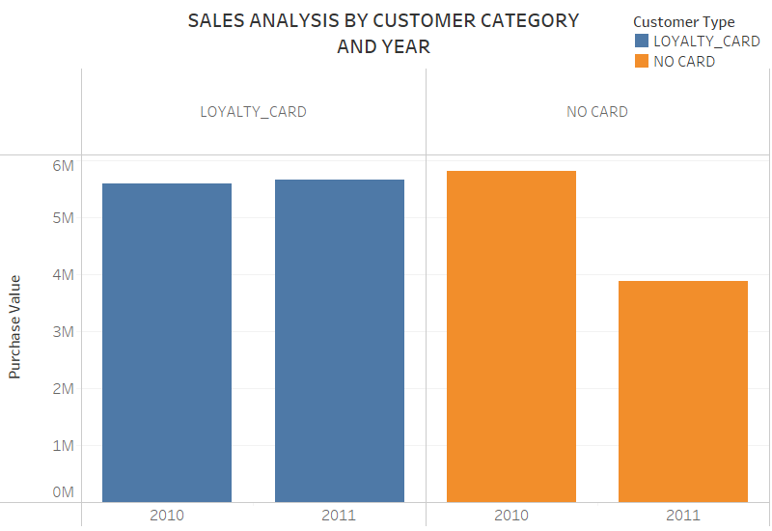
Overall, sales from retail clients Loyalty card customers increased by 1% and that from non carded customers declined by 33 %

Slide 4
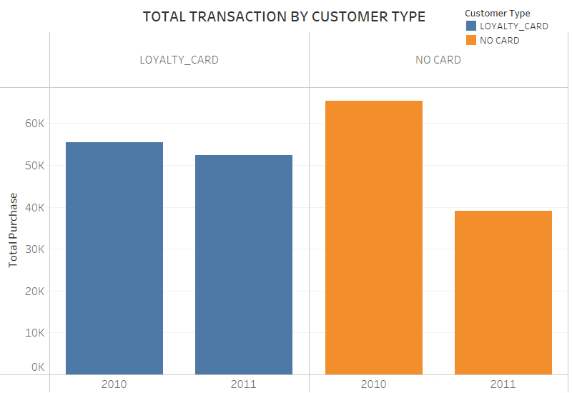
Total purchase by Loyalty card customers were similar , but a 40% decline in total number of purchase when compared to previous year in non carded customers

Slide 5
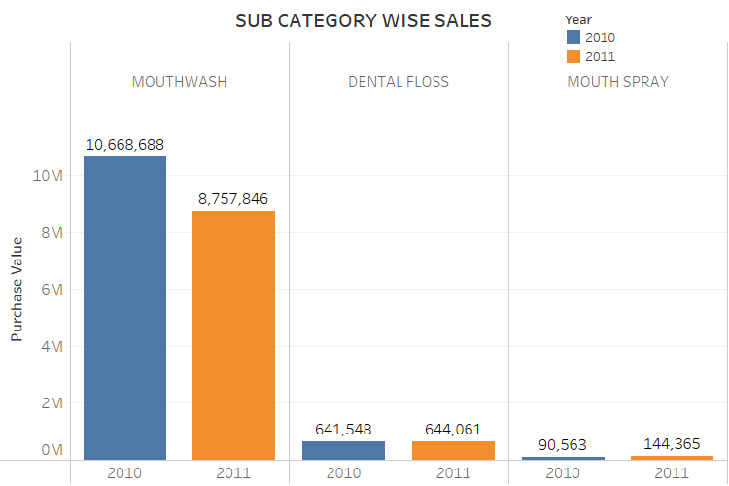
Sales analysis shows that mouth wash products declined in sales by 1.9 million, dental floss product shows similar sales and a slight increase in products under dental floss category.

Slide 6
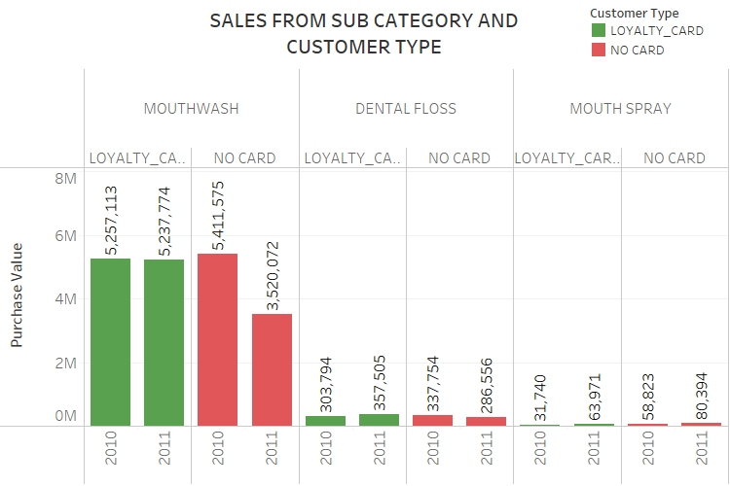
On further analysis based on customer category it is clear that bad performance in mouth wash subcategory is due to non carded customers which declined by 1.89 million in sales , Loyalty card customers shows similar sales in all sub categories

Slide 7
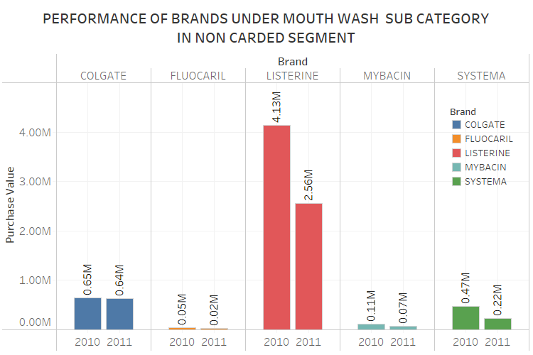
Retail clients non carded customers are not happy with increase in average price of products by 20.5% under LISTERINE brand, over all sales from this brand declined by 1.57 million which decreased overall performance of sales under mouth and dental category .

Slide 8
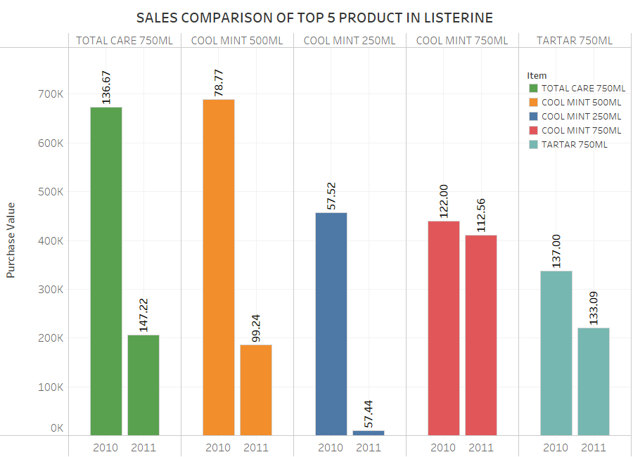
Further analysis on items under LISTERINE brand shows poor performance of top 5 selling products from previous year. Items mainly belongs to COOL MINT and TOTAL CARE , also average price of two top selling products have increased

Slide 9
Recommendations
Retail client Loyalty card customers got more discount on sales compared to non carded customers. Even though overall discount reduced by 2% on gross value, Loyalty card customers were consistent in sales. Increasing Loyalty card customers is key to retail clients success
Tailor new marketing techniques to increase Loyalty card customers
More than 92% sales in “mouth and dental products” category came from “Mouth Wash” sub category, both year combined. Retail client need to control increase in average price of product in this category especially products belonging to top selling brand, Listerine
Incentivize customers to buy products under Listerine brand by giving promotional offers
Do market study to understand why sales of some products under Listerine brand decreased even though average price remained same year on year. Identify new product release by brands under same category and price
Retail client should focus on promotion of mouth wash products in Hypermarkets, since more than 98% of total mouth wash sales come from this Retail Group

