Slide 1
ShelfSight
AI-Based Shelf Intelligence System
CSC-233 Artificial Intelligence Lab · BNU Spring 2026
Shameer Nadeem · Ibrahim Zahid · Saad Riaz · Samia Rehan · Ayesha Gohar

Slide 2
The Problem
📋
💰
⏱
Manual Audits
High Cost
Delayed Insights
Field reps physically visit stores to count products, check shelf positions and note gaps. Slow and error prone.
Companies like Coca Cola spend millions annually on manual shelf auditing across hundreds of retail stores.
By the time data is collected and analysed, shelf conditions have already changed decisions are always reactive.

Slide 3
Our Solution
ShelfSight uses a trained YOLOv8 model to automatically analyse retail shelf photos and calculate key retail metrics instantly.
SOS %
% Match
Auto
Share of Shelf
Planogram Compliance
Recommendations
Coca-Cola vs competitor facing count
Actual shelf vs reference layout
Actionable steps to improve compliance

Slide 4
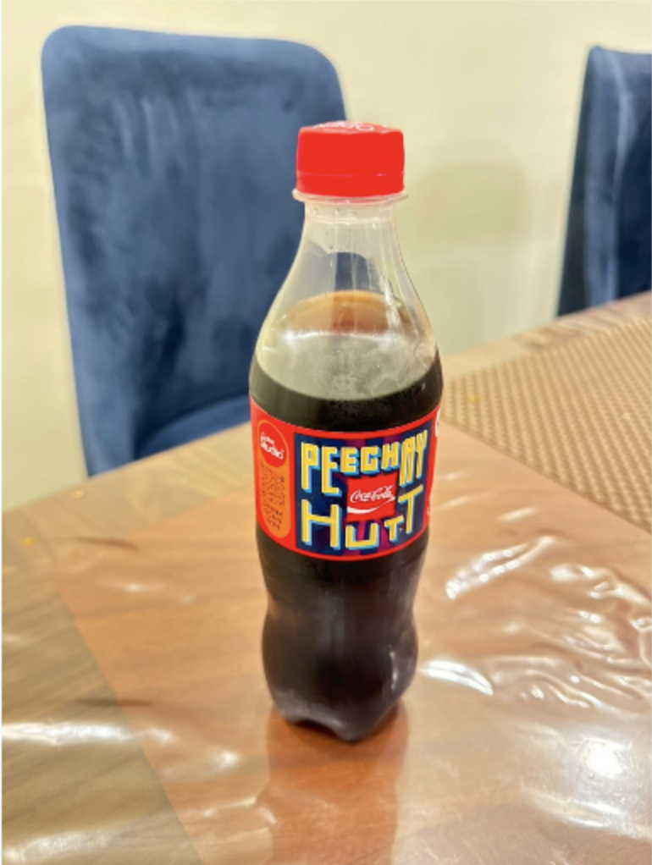
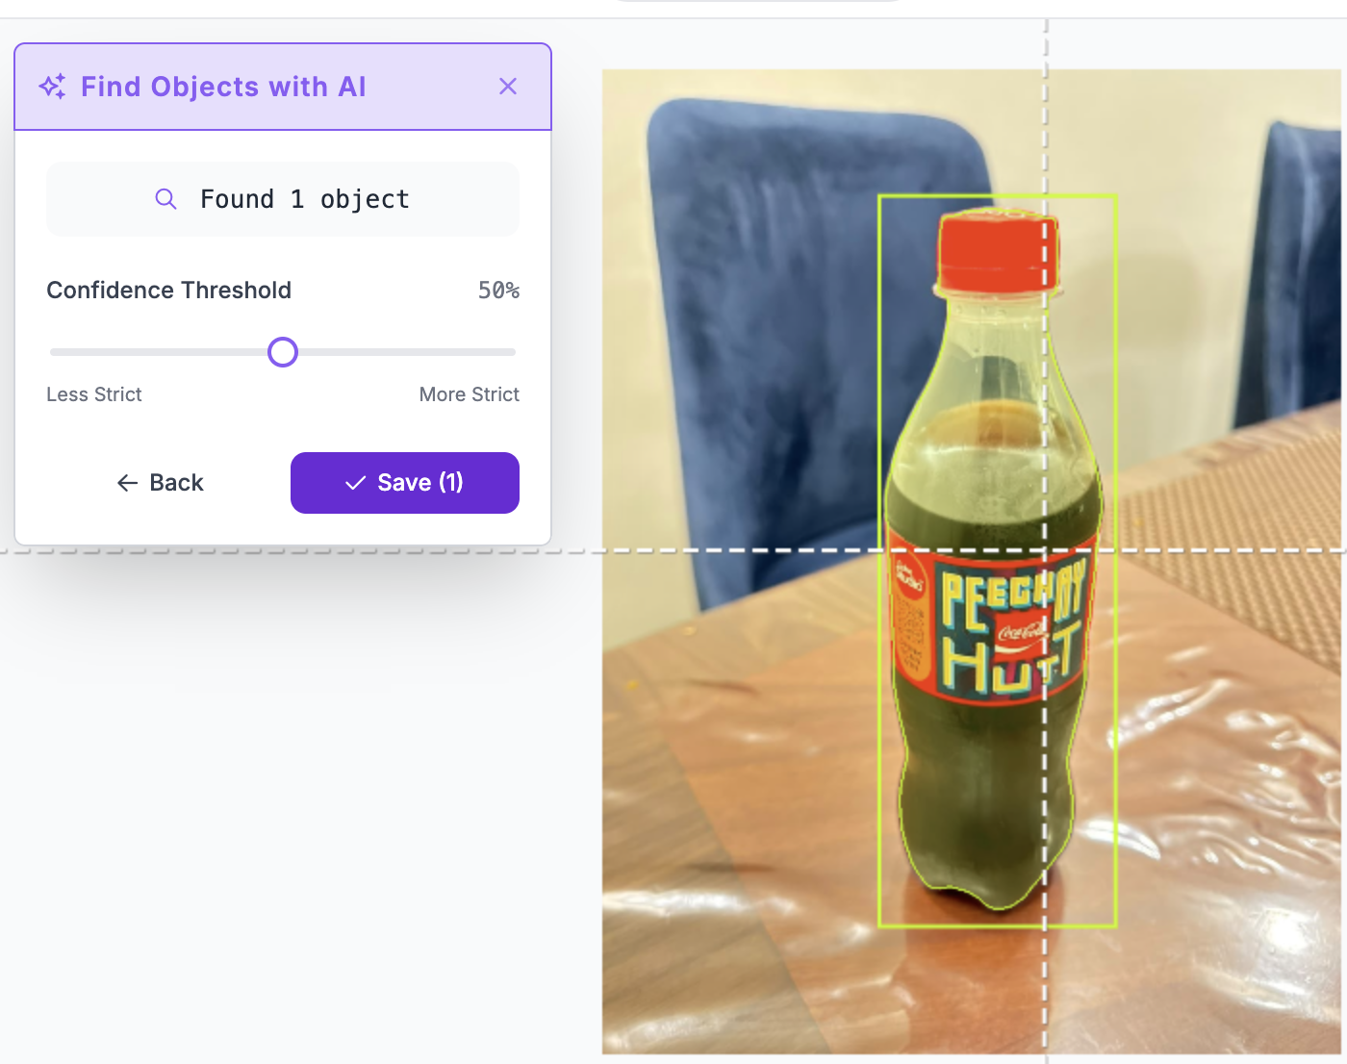
Dataset
Source
Roboflow Universe
Total Images
451 labeled images
Classes
coca-cola-500ml · coca-cola-zero · coca-cola-can · fanta · sprite
Format
YOLOv8 (YOLOv8n + Augumentation)
Split
70% Train / 20% Validate / 10% Test
Augmentation
Flip · Rotate · Brightness · Mosaic

Slide 5
Model Architecture — YOLOv8
Input Image
640×640px
Backbone
CSPDarknet
Neck
PANet+FPN
Detection Head
Multi-scale
Output
BBoxes + Labels
⚡ Trained on COCO
🎯 Single stage Detector
80 object classes. Fine tuned on our shelf dataset in ~40 min on free Colab T4 GPU.
Detects and classifies products in one forward pass — faster than two-stage detectors like Faster R-CNN.
📦 Anchor Free Design
🔁 Transfer Learning
YOLOv8 predicts object centers directly, improving detection of densely packed shelf products.
Pre trained weights give strong visual features. Only the final layers re-trained on our 5 class dataset.

Slide 6
5 Models Trained & Compared
Model
Member
mAP50
Notes
YOLOv8n
Shameer
94.61%
Baseline — fastest nano model
YOLOv8s
Ibrahim
94.61%
Small model — more parameters than nano
YOLOv8n + Augmentation
Saad
95.06%
WINNER — best data strategy
★ WINNER
MobileNet + SSD
Samia
47.80%
Lightweight, TensorFlow framework
ResNet50
Ayesha
51.20%
Classification backbone adapted for detection

Slide 7
Training Process
01
Dataset Preparation
Images were manually taken for each SKU and was labelled and prepared on Roboflow
02
Google Colab Setup
T4 GPU enabled. YOLOv8 installed via Ultralytics. Dataset downloaded via Roboflow API
03
Model Training
50 epochs, batch size 16, image size 640×640. Early stopping with patience=10
04
Evaluation
Tested on unseen test split. mAP50, precision, recall, and confusion matrix generated
05
Model Export
best.pt saved to Google Drive. Used for comparison notebook and Streamlit UI deployment

Slide 8
Shelf Metrics Calculated
Share of Shelf (SOS)
Planogram Compliance
Formula: Brand facings ÷ Total facings × 100
Shelf divided into a grid. Each cell compared against the reference planogram. Compliance % = matching cells ÷ total cells × 100
Reference Planogram Grid (2 rows × 5 cols)
🟥 Coca-Cola 🟧 Fanta 🟩 Sprite

Slide 9
Results — YOLOv8n + Augmentation (Winner)
95.06%
94.09%
92.91%
28.6m
mAP50
Precision
Recall
Training Time

Slide 10
Full Stack Application
Frontend
Dark themed UI — drag & drop shelf photo, animated SOS bars, planogram grid comparison, recommendations
HTML / CSS / JavaScript
Backend
REST API with /analyse endpoint. Receives image, runs YOLO inference, returns JSON with all metrics
FastAPI (Python)
AI Model
Saad's trained best.pt — auto-loaded from model/ folder. Swap model by replacing .pt file — no code changes
YOLOv8n + Augmentation
Deployment
Live at shameer-nadeem-shelfsight2-0.hf.space — free hosting, 16GB RAM, permanent URL
Hugging Face Spaces

Slide 11
Our Team
Shameer Nadeem
YOLOv8n · Streamlit UI · GitHub
Ibrahim Zahid
Image Collection · YOLOv8s · UI Design
Saad Riaz
Dataset Search · YOLOv8n+Aug (Winner)
Samia Rehan
Dataset Search · MobileNet+SSD
Ayesha Gohar
ResNet50 · Poster & Standee

Slide 12
Conclusion
1
Trained 5 different YOLO and CNN models on a custom shelf dataset
2
YOLOv8n + Augmentation achieved the highest mAP50 of 95.06%
3
System calculates Share of Shelf (SOS) and Planogram Compliance automatically
4
Full stack app deployed live on Hugging Face Spaces with auto model-swap support
5
GitHub repository includes frontend, backend, model, and all training notebooks
https://github.com/shameer-nadeem/ShelfSight

