Slide 1
Eye Blink Detection from EEG Signals
Efficient algorithm for detecting the occurrence of eye blinks is developed and its performance is investigated. Using this algorithm, the required eye blinks can be detected successfully with high accuracy.

Slide 2
Two types of eye activity are analysed; eye blinks and eye movements. It is found that EEG signal obtained from voluntary eye blink condition produces clearer signals with larger amplitude than that obtained from eye movements.
The eye blinking activity is detected from EEG(electroencephalogram) signal via a brain computer Interface(BCI)

Slide 3
We analyzed EEG signals obtained from various conditions to identify a suitable eye activity that can be further used to for various purposes
Once the eye activity is found, an algorithm is developed to examine its performance in detecting the occurrence of this activity.

Slide 4
Eye blinks can be classified into three types: reflexive, voluntary and spontaneous .
In comparision to others, voluntary eye blinking involves multiple areas of the cerebral cortex as well as basal ganglion, brain stem and cerebella structures.

Slide 5
The EEG signals obtained from the eye activities are compared with that obtained when the subject was in relax condition. This is done to identify the best eye activity that can produce clear signal with high amplitude. The effect of various eye blinks and duration of blink on the EEG signals are also studied.
The EEG signal is sampled using a sampling frequency of 50Hz. The signal is then filtered using a low pass filter with a cut off frequency of 5 Hz to remove high frequency signal.

Slide 6
Among all the conditions mentioned above, the voluntary eye blink produced high amplitude EEG signals
A threshold value of ±4J.1V was used to preserve the peak amplitude and remove the lower amplitude of EEG signals.

Slide 8
Figure shows the process of filtering, removing low amplitude signal and detecting the eye blinks from EEG signals.
The eye blinking information is extracted using an algorithm written in MATLAB. This algorithm detects three adjacent local maxima and minima within a specific amplitude and range that can differentiate between spontaneous eye blink.

Slide 9
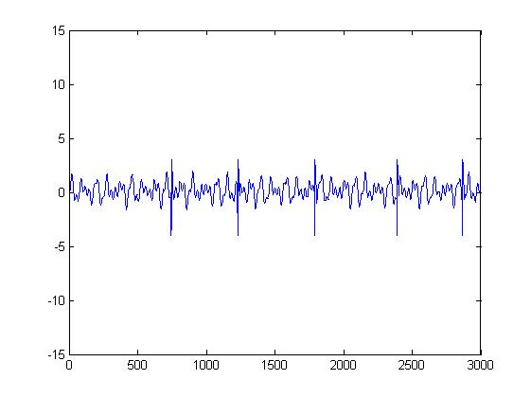
The Normal EEG Signal Of A Relaxed Patient

Slide 10
The signal consists of beta waves which lie in the frequency range of 13 to 22 Hz and spontaneous eye blinks which is below 5 Hz. The negative amplitude shows the eyelids closure and positive value shows the opening of eyelids.
The amplitude of spontaneous eye blink is in the range of -4 V to 3 V and its duration is less than 400 ms.

Slide 11
Figure shows the eye blinks for the voluntary eye blinking condition.
This EEG signal comprises eye blinking waveforms (below 5 Hz) that have larger amplitude and longer duration (400-500 ms) compared to that obtained from spontaneous eye blink.
It is also found that three continuous eye blinks (with a duration of 1.5 to 2.5 seconds between eye closure and opening) are suitable enough to detect eye blink.

Slide 12
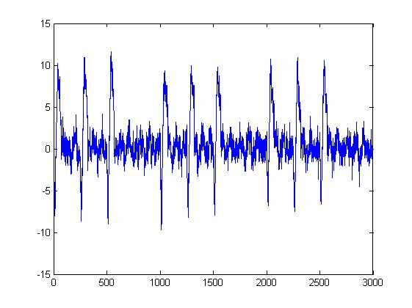
Figure: EEG signal for voluntary eye blinking condition.

Slide 13
Figure shows the EEG signal after filtering.
It is obvious that the signals above 5 Hz have been removed leaving only very clear eye blinking signals. Other artifacts such as 50 Hz power line interference and noise have also been eliminated using analogue filtering provided by the EEG instrument.

Slide 14
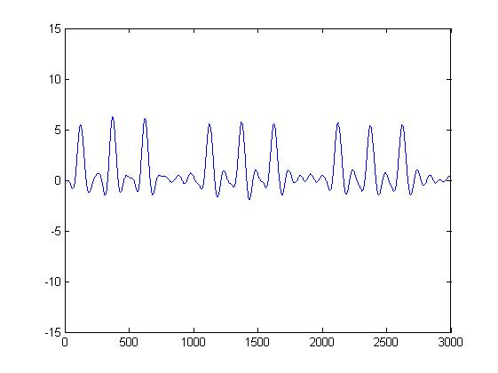
Figure: Noise-filtered EEG signal

Slide 15
Figures below show the EEG signals after applying threshold and the pulses obtained from eye blink detection respectively.
The pulse is generated when three continuous eye blinking (with the condition mentioned above) occur in the EEG signal which represent the activation of the switch whereas the zero state indicates the switch is turned OFF.

Slide 16
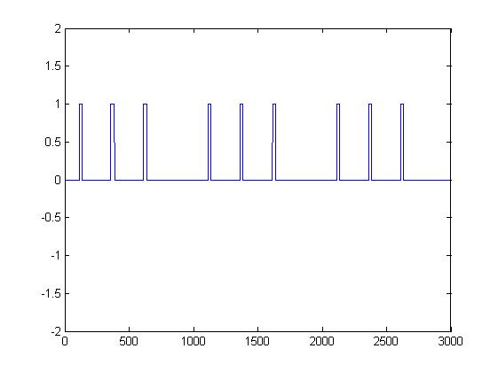
Figure : EEG signal after applying threshold

Slide 17
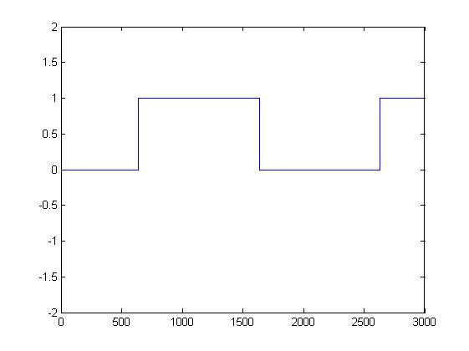
Figure: Pulses obtained from eye blinking detection indicating the switching states.

Slide 18
Applications
With proper filtering and accurate detection, the eye blinks could be used for multiple purposes like controlling various systems eg: activating home lighting system.
Can be used by disabled people to control switches.

Slide 19
Conclusion
The EEG signals obtained from voluntary eye blink produced clear signals which could be easily detected.
The simulation results showed that eye blinks can be detected successfully from the EEG signals using the proposed algorithm with the success percentage of approximately 85%.
Good detection results could not be obtained from some of the records. This is due to noises generated from improper electrode placements and low amplitude of EEG signals when the subject's eyes were not fully blinked.

