Slide 1
♪
ENGINEERING SIMULATION · MATHWORKS INNOVATION CHALLENGE
Simulink Hearing Aid
A modular, real-time digital hearing-aid DSP pipeline —
designed, simulated, and validated in Simulink.
Built with MATLAB R2025b & Simulink | MathWorks Excellence in Innovation — Project 241

Slide 2
♪
INTRODUCTION
Project Overview
1
Engineering Simulation
2
Innovation Challenge Entry
A modern digital hearing-aid signal-processing system modeled end to end.
Developed in MATLAB R2025b and Simulink for the MathWorks Innovation Challenge.
3
Frequency-Selective DSP
4
Real-Time Pipeline
Multi-band processing replaces simple uniform amplification.
Frame-based audio processing with live speaker playback.
5
Modular Architecture
6
Validated on Real Speech
Each processing stage is independently testable and traceable.
Tested against recordings from the TIMIT speech corpus.
7
Educational Scope
An engineering & educational simulation — not a clinical device.
SIMULINK HEARING AID · PROJECT 241
02

Slide 3
⌘
GOALS
Objectives
✓
Study the DSP architecture of modern digital hearing aids
✓
Reduce unwanted background noise components
✓
Develop a complete hearing-aid pipeline in Simulink
✓
Implement adaptive acoustic feedback cancellation
✓
Implement frequency-dependent amplification via multi-band filtering
✓
Analyse individual processing stages via MATLAB
✓
Apply DSP techniques to improve speech audibility
✓
Validate using real TIMIT speech recordings
✓
Investigate Dynamic Range Compression (DRC)
✓
Demonstrate model-based design for a practical DSP application
SIMULINK HEARING AID · PROJECT 241
03

Slide 4
⇄
SIGNAL PATH
System Architecture
Audio
Input
Pre-
Processing
Multi-Band
FIR Filter
Gain
Comp.
DRC
Noise
Reduction
Feedback
Cancel.
Output
Protect.
Audio
Output
Each subsystem is independently verifiable — enabling clear signal tracing and parameter transparency.
MULTI-BAND FREQUENCY PROCESSING DETAIL
1
Low FIR
2
Mid FIR
3
High FIR
0 dB gain (×1.0)
+8 dB gain (×2.51)
+15 to +20 dB (×5.62–10.0)
→ parallel band, summed downstream
→ parallel band, summed downstream
→ parallel band, summed downstream
All three bands are recombined by summation to form the Compensated Audio signal, which passes to the DRC and downstream stages — representing a generic sensorineural hearing-loss profile where high frequencies need more boost.
SIMULINK HEARING AID · PROJECT 241
04

Slide 5
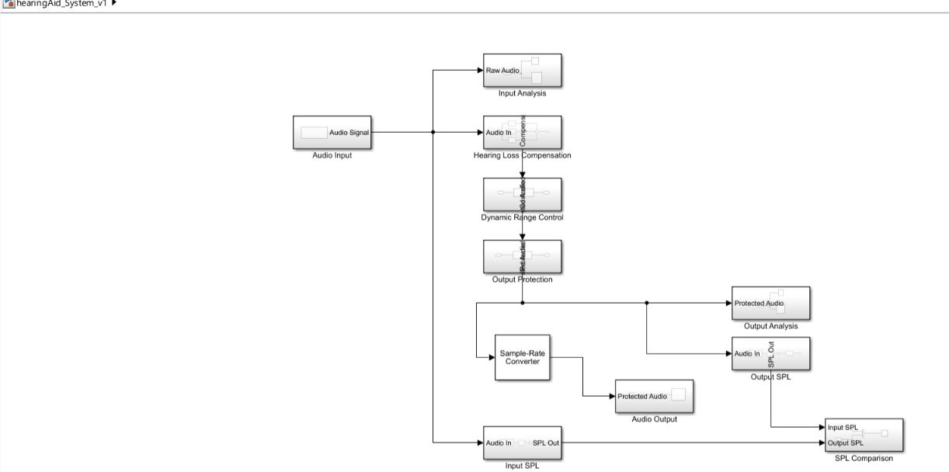
▦
MODEL ARCHITECTURE
The Top-Level Simulink Model
hearingAid_System_v1 — the actual block diagram implementing the pipeline above, captured directly from the Simulink canvas.
Compensation Chain
Analysis Taps
Loudness Monitoring
Output Stage
Hearing Loss Compensation → Dynamic Range Control → Output Protection: the core real-time DSP path.
Input Analysis & Output Analysis scope the raw and protected audio for inspection.
Input SPL & Output SPL feed SPL Comparison to quantify the gain achieved.
Sample-Rate Converter conditions Protected Audio for the Audio Output block.
SIMULINK HEARING AID · PROJECT 241
05

Slide 6
≈
FILTERING
Multi-Band FIR Filtering
FILTER PARAMETERS
GAIN CONFIGURATION
Filter Type
Finite Impulse Response (FIR)
Three parallel bands are processed simultaneously:
Filter Order
376 (377 taps)
LOW BAND
0 dB gain (×1.0)
Sampling Frequency
16 kHz
MID BAND
+8 dB gain (×2.51)
Group Delay
188 samples ≈ 11.75 ms
Formula
τg = N / 2 (linear-phase FIR)
HIGH BAND
+15 to +20 dB (×5.62–10.0)
WHY FIR?
Represents a generic sensorineural hearing-loss profile where high frequencies need more boost. All three bands are recombined by summation before passing to the DRC and downstream stages.
Guaranteed stability
Linear-phase response
Predictable frequency roll-off
Suitable for multi-band parallel paths
SIMULINK HEARING AID · PROJECT 241
06

Slide 7
◈
LOUDNESS & CLARITY
Dynamic Range Compression & Noise Reduction
DRC MODULE
NOISE & FEEDBACK
Dynamic Range Compression (DRC)
Noise Reduction
Controls the amplitude-to-gain relationship
Boosts weak speech without over-amplifying loud signals
Evaluated via Moving RMS analysis
Reduces unwanted background components
Goal: improve SNR, not complete elimination
Avoids excessive speech distortion
Evaluated by: time-domain waveform comparison, frequency-domain spectrum analysis, RMS signal-level measurements, and subjective listening tests.
MOVING RMS CONFIGURATION
Method
Sliding window
Window length
1024 samples
Adaptive Feedback Cancellation
Overlap
0 samples
Estimates and suppresses the acoustic feedback path
Foundation for LMS / NLMS algorithms
Observable difference in RMS before vs. after DRC confirms correct compression operation.
SIMULINK HEARING AID · PROJECT 241
07

Slide 8
⚙
TOOLCHAIN
Tools, Software & Dataset
1
Software Stack
2
Hardware & Entry Point
MATLAB R2025b
Simulink R2025b
Audio Toolbox
DSP System Toolbox
Signal Processing Toolbox
Standard computer audio I/O, verified with live mic & speaker playback
run_hearingaid.m — single-command launch
Auto-loads FIR coefficients from .mat file; opens & runs the model automatically
3
TIMIT Speech Dataset
4
MATLAB & Simulink Roles
Standard speech corpus used for evaluation
Located under Data/datasets/TIMIT/
TRAIN/DR1/FCJF0/SA1.WAV used as the primary input
MATLAB: filter design, spectrum/waveform analysis, parameter sweeps, result visualisation
Simulink: block-diagram modelling, frame-based real-time DSP, audio streaming & end-to-end integration
SIMULINK HEARING AID · PROJECT 241
08

Slide 9
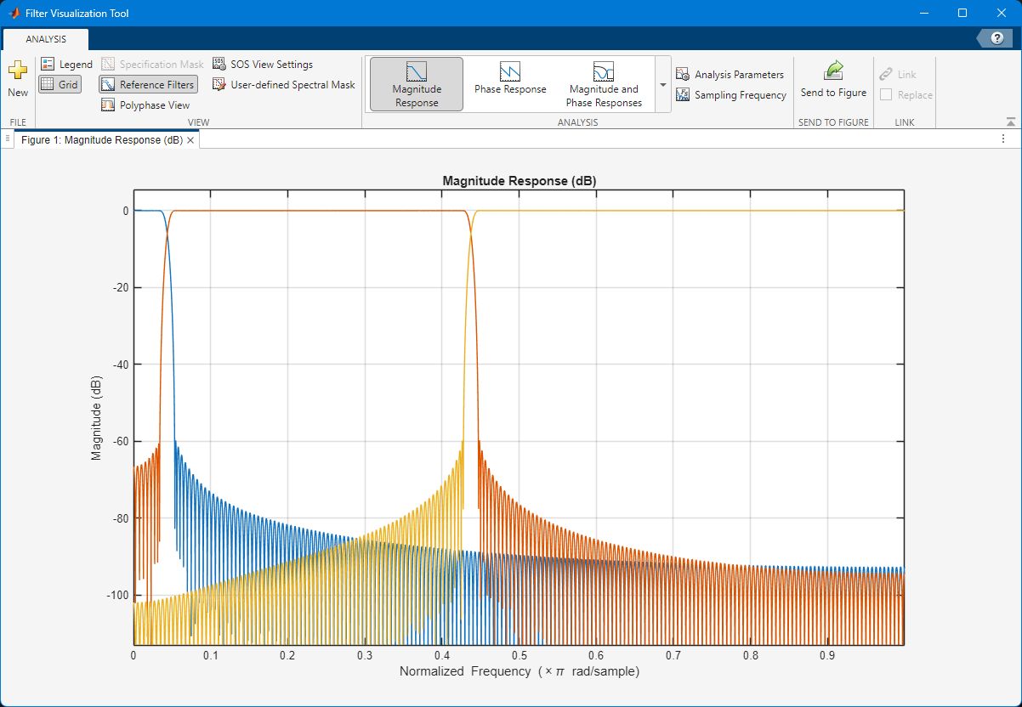
∫
RESULTS
FIR Filter Frequency Response
Three overlaid FIR band responses (Low / Mid / High)
Order 376 (377 taps) — linear-phase, stable
16 kHz sampling rate | Group delay: 188 samples (≈ 11.75 ms)
SIMULINK HEARING AID · PROJECT 241
09

Slide 10
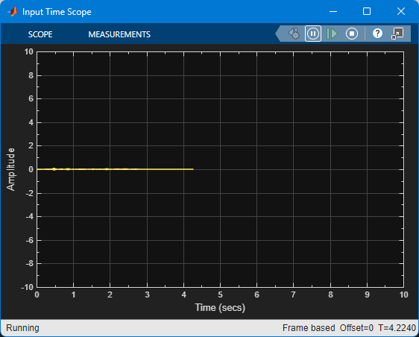
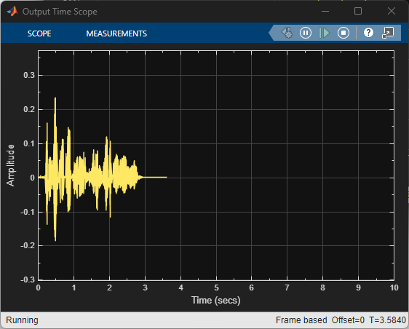
∿
RESULTS
Input vs Output Waveforms
INPUT — raw speech (SA1.WAV)
OUTPUT — after full DSP pipeline
Observable amplitude difference confirms frequency-dependent gain applied
Output envelope shows DRC action — louder regions compressed, quieter regions boosted
No clipping artefacts — output protection stage operating correctly
Waveform shape preserved — speech intelligibility maintained
SIMULINK HEARING AID · PROJECT 241
10

Slide 11
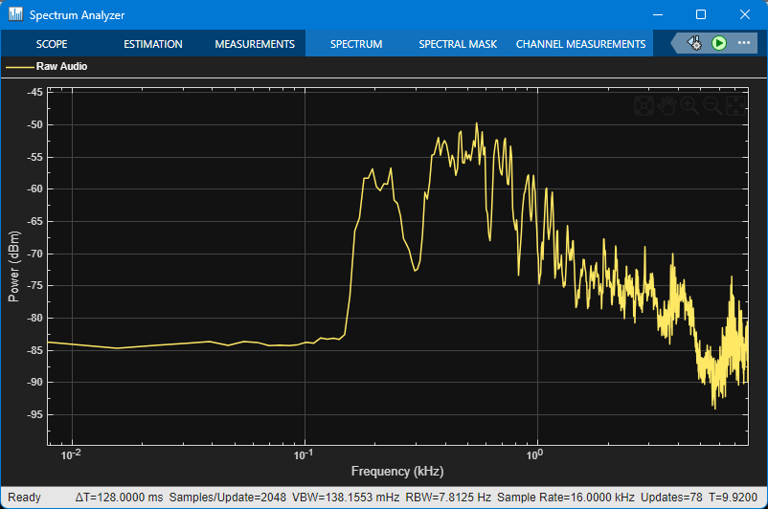
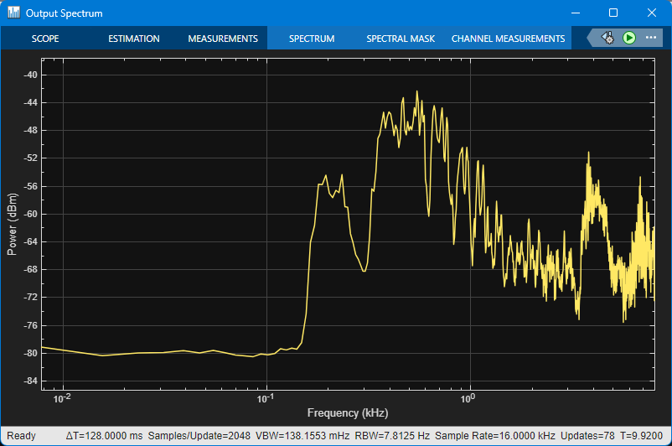
≋
RESULTS
Input vs Output Frequency Spectrum
INPUT spectrum — before processing
OUTPUT spectrum — after hearing-aid DSP
High-frequency components (+15 to +20 dB) clearly elevated in the output spectrum
Mid-frequency region boosted by +8 dB as configured
Low-frequency content unchanged (0 dB gain) — consistent with the hearing-loss profile
Noise floor relatively contained — noise reduction stage effective
SIMULINK HEARING AID · PROJECT 241
11

Slide 12
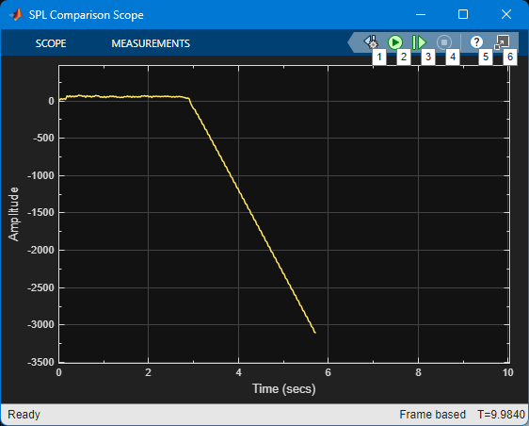
△
RESULTS
SPL Comparison — Input vs Output
SPL (Sound Pressure Level) measured in dB
Output SPL consistently higher across speech segments
Confirms frequency-dependent gain applied as designed
Silent frames produce log(0) warnings — expected and harmless
Corroborates successful DRC and gain compensation
SIMULINK HEARING AID · PROJECT 241
12

Slide 13
≣
REFERENCE
Key System Parameters
Parameter | Value | Notes
DSP Sampling Frequency | 16 kHz | Standard speech-band rate
FIR Filter Order | 376 | 377 taps total
FIR Group Delay | 188 samples | ≈ 11.75 ms
Low Band Gain | 0 dB (×1.0) | No boost required
Mid Band Gain | +8 dB (×2.51) | Moderate boost
High Band Gain | +15 to +20 dB | ×5.62 – ×10.0
Moving RMS Window | 1024 samples | DRC analysis window
RMS Overlap | 0 samples | Non-overlapping
Audio Dataset | TIMIT SA1.WAV | TRAIN/DR1/FCJF0
Simulation Exit Code | 0 (SUCCESS) | No errors detected
SIMULINK HEARING AID · PROJECT 241
13

Slide 14
✓
VALIDATION
Experimental Results Summary
✓
Successful end-to-end Simulink simulation — exit code 0, zero errors
✓
Output protection preventing clipping at the final audio stage
✓
Real-time audio playback verified through laptop speaker interface
✓
SPL consistently higher at output, confirming hearing-aid amplification
✓
Multi-band FIR filter paths operating correctly (Low / Mid / High independent)
✓
Input/output waveform and spectrum differences clearly visible
✓
Frequency-dependent gain applied per the configured hearing-loss profile
✓
Stable audio reproduction with no oscillation or instability
✓
Dynamic Range Compression operating — RMS-level difference observable
✓
TIMIT SA1.WAV speech dataset processed successfully
✓
Noise reduction stage reducing unwanted background components
SIMULINK HEARING AID · PROJECT 241
14

Slide 15
→
ROADMAP
Limitations & Future Development
CURRENT LIMITATIONS
FUTURE DEVELOPMENT DIRECTIONS
Generic hearing-loss profile (not audiogram-based)
Not a clinically validated hearing-aid device
Gain values are simulation parameters only
Feedback path doesn't fully replicate the physical ear
No objective speech-intelligibility metrics
Real-time performance depends on host hardware
No dedicated audio codec or embedded hardware
Audiogram-based personalised gain fitting
More detailed multi-band DRC
Advanced adaptive feedback cancellation (LMS/NLMS)
Machine-learning speech enhancement
Directional microphone & beamforming
Acoustic environment classification
Embedded implementation (ARM / DSP chip)
Formal latency & computational-load benchmarking
Hardware prototype development
SIMULINK HEARING AID · PROJECT 241
15

Slide 16
✓
CONCLUSION
A Successful DSP Hearing-Aid
Simulation in MATLAB & Simulink
A complete, modular, real-time hearing-aid DSP pipeline was successfully implemented and validated
Multi-band FIR filtering, DRC, noise reduction, feedback cancellation and output protection all verified
TIMIT speech data processed end-to-end with audible playback confirmed
All experimental results (waveforms, spectra, SPL) confirm system behaviour matches design targets
The modular Simulink architecture provides a reproducible and extensible platform for future research
SIMULINK HEARING AID · PROJECT 241
16

