Slide 1
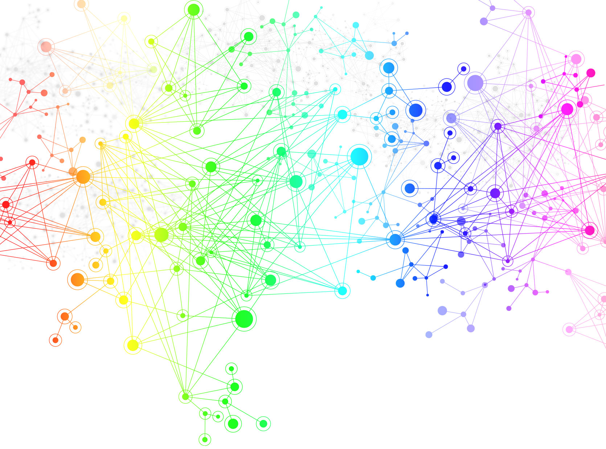
Plant Genes Lab
Kids’ Tech University
January 24, 2015

Slide 2
Lab 1: Connect the dots
Kids’ Tech University
January 24, 2015

Slide 3
Graph Theory
Mathematicians developed GRAPH THEORY to study all kinds of networks.

Slide 4
Graph Theory
Mathematicians developed GRAPH THEORY to study all kinds of networks.
A network, or GRAPH, is a set of dots connected by lines.

Slide 5
Vertex-Edge Graph
The dot in a graph is usually called a NODE or VERTEX (V).
1
2

Slide 6
Vertex-Edge Graph
The dot in a graph is usually called a NODE or VERTEX (V).
The line connecting two dots in a graph is called an EDGE (E).
1
2

Slide 7
Example
In this GRAPH there is one EDGE that connects two VERTICES.
We write the vertices as a list V={1,2} and the edges as a list of pairs of vertices E={{1,2}}.
1
2

Slide 8
Example
In this GRAPH there are three EDGES and four VERTICES.
We write the vertices as a list V={1,2,3,4} and the edges as a list of pairs of vertices
E={{1,2}, {1,3}, {3,4}}.
3
2
1
4

Slide 9
Undirected Edge
Look at the list of pairs E={{1,2}, {1,3}, {3,4}}.
An UNDIRECTED EDGE from vertex 1 to vertex 2 {1,2} is the same thing as an undirected edge from vertex 2 to vertex 1 {2,1}.
3
2
1
4

Slide 10
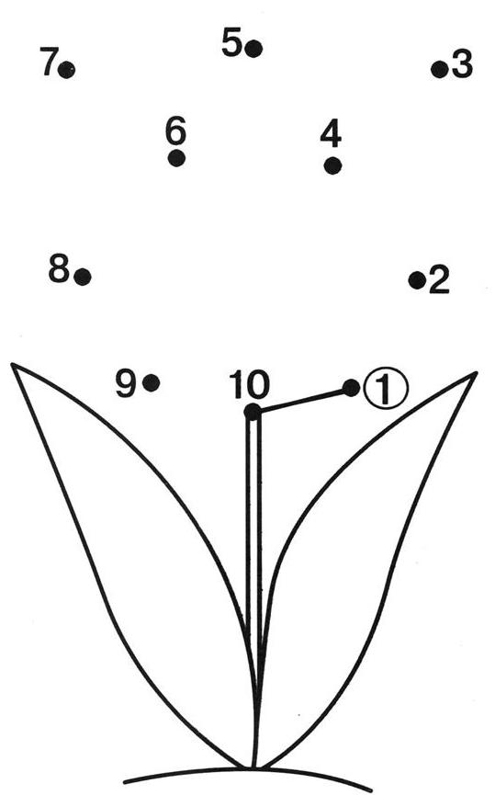
Undirected Graph
List the vertices.
List the edge.
Draw the following edges.
  E={{1,2}, {2,3}, {3,4}, {4,10}, {5,10}, {5,6}, {6,10}, {7,10}, {7,8}, {8,9}, {9,10}}

Slide 11
Undirected Graph
List the vertices.
V={1,2,3,4,5,6,7,8,9,10}
List the edge.
E={{10,1}} or E={{1,10}}
Draw the following edges.
  E={{1,2}, {2,3}, {3,4}, {4,10}, {5,10}, {5,6}, {6,10}, {7,10}, {7,8}, {8,9}, {9,10}}

Slide 12
Loop
An edge with identical vertices is a LOOP.
V={1,2,3,4} and E={{1,2}, {2,2}, {1,3}, {3,4}}.
3
2
1
4

Slide 13
Example
Add the following loops.
E={{3,3}, {4,4}, {8,8}}

Slide 14
Example
Add the following loops.
E={{3,3}, {4,4}, {8,8}}

Slide 15
Practice
Complete the following graph.
E={{1,2}, {2,3}, {3,4}, {4,10}, {10,5}, {5,5}, {10,6}, {6,7}, {7,8}, {8,9}, {9,10}}

Slide 16
Practice
Complete the following graph.
E={{1,2}, {2,3}, {3,4}, {4,10}, {10,5}, {5,5}, {10,6}, {6,7}, {7,8}, {8,9}, {9,10}}

Slide 17
Your Graph
Draw your own graph.
List the edges.
Write your list of edges on an index card and give it to your neighbor.

Slide 18
Neighbor’s Graph
Draw your neighbor’s graph.
Compare your graph and your neighbor’s graph.
Did you draw the same graph as your neighbor?

Slide 19
Subgraph
Part of a graph is called a SUBGRAPH.
V={1,3,4} and E={{1,3}, {3,4}}.
3
2
1
4

Slide 20
Example
Highlight the subgraph.
E={{10,7}, {7,8}, {8,9}, {9,10}}

Slide 21
Example
Highlight the subgraph.
E={{10,7}, {7,8}, {8,9}, {9,10}}

Slide 22
Adjacent Vertices
Two vertices are called ADJACENT if they share a common edge.
Vertices 1 and 2 are adjacent.
Vertices 1 and 4 are not adjacent.
3
2
1
4

Slide 23
Example
What vertices are adjacent to vertex 7?
What vertex is not adjacent to vertex 7?

Slide 24
Example
What vertices are adjacent to vertex 7?
Vertex 8 and vertex 10
What vertex is not adjacent to vertex 7?
Vertex 9

Slide 25
Adjacency Matrix
An ADJACENCY MATRIX is a way of showing which vertices of a graph are adjacent.
We write a 1 if vertices are adjacent.
We write a 0 if vertices are not adjacent.
V | 1 | 2 | 3 | 4
1 | 0 | 1 | 1 | 0
2 | 1 | 0 | 0 | 1
3 | 1 | 0 | 0 | 1
4 | 0 | 0 | 1 | 0
3
2
1
4

Slide 26
Example
Fill in the adjacency matrix.
V | 7 | 8 | 9 | 10
7
8
9
10

Slide 27
Example
Fill in the adjacency matrix.
V | 7 | 8 | 9 | 10
7 | 0 | 1 | 0 | 1
8 | 1 | 0 | 1 | 0
9 | 0 | 1 | 0 | 1
10 | 1 | 0 | 1 | 0

Slide 28
Good work!
You completed Lab 1: Connect the dots.
Next, you will learn how vertex-edge graphs can be used to model the interactions between plant genes.
Click here and follow the directions in your workbook.

