Slide 1
Fault-Tolerant University Records Service
Baseline versus improved: eight fault-injection experiments, measured
Final Project, Fault Tolerance and Dependable Computing, Astana IT University
Shamil Yakupov, ID 255193 | Instructor: Azamat Serek | Individual work | 6 November 2026
Notes:
Option A: the university information system from the midterm and endterm. All data synthetic, local lab, no production system.

Slide 2
A wrong record is worse than an outage
Sign in
Choose record space
Read ledgers
Post a record
Row + balance move in one transaction
System
Data
If it fails
hoWallet Go API as a stand-in for a university records service. Gateway, API, PostgreSQL, Prometheus, Grafana, migration job.
All synthetic: household = a student's record space, account = a ledger, transaction = a fee payment.
Unavailable: deadline risk. Duplicate or lost record: a fee charged twice. Disclosure: one student sees another's records.
Notes:
The critical workflow is multi-step: insert a row and move a balance. Comparison: same image and database, different infrastructure.

Slide 3
Objectives were set as numbers before the runs
≥ 99 %
≤ 500 ms
≤ 10.5 s
success during one instance loss (SLO-2)
p95 at 30 req/s (SLO-3)
worst GET answer under a dependency fault (SLO-4)
≤ 10 / 30 s
0 lost, 0 dup
≤ 30 s
recovery: instance / database (SLO-5)
acknowledged writes, balance = −Σ (SLO-6)
fault to alert firing, none in quiet windows (SLO-7)
Plan: evidence/test-plan.md, written before the runs, with two dated amendments.

Slide 4
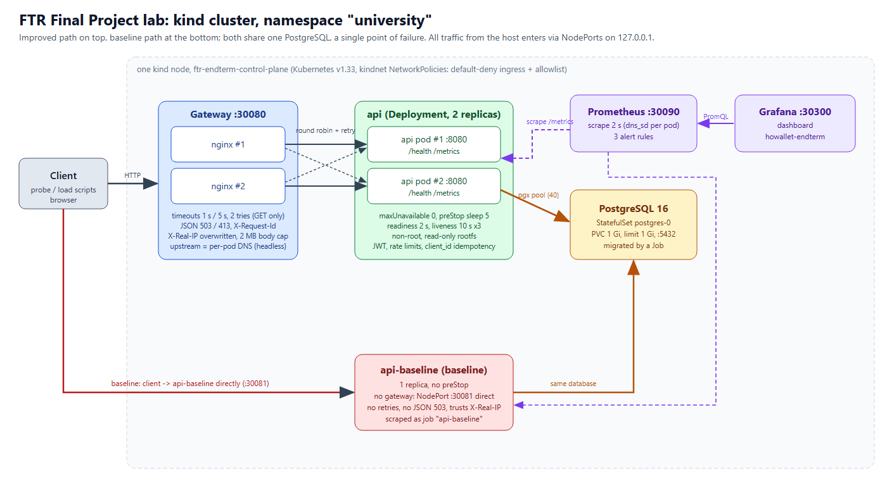
Two paths, one database: redundancy stops at PostgreSQL
AI-generated figure (Claude Code, HTML/SVG rendered to PNG), checked by the author against k8s/; prompt in report Appendix 14.6.
Notes:
One kind node. Replicas on one node do not protect against node failure. PostgreSQL is a single point of failure in both configurations.

Slide 5
Mechanisms and their evidence
Infrastructure
 | Mechanism | Proved by
M1 | Timeouts, bounded retries | experiments only
M2 | Idempotent create | 16 unit tests
M3 | Transaction rollback | Exp 4; integration tests cited
M4 | Health and readiness | experiments only
M5 | JSON 503 degradation | 2 unit tests
M6 | Rate limit, Retry-After | 1 unit test
API × 2, gateway × 2
Replacement and liveness restart
Rolling update and rollback
preStop drain
Postgres restart in place
Prometheus 3 alerts, Grafana, request id in gateway and API logs
Notes:
20 unit tests passed. M1 and M4 have no Go test. For M3 the unit test only proves error propagation; Exp 4 is the evidence.

Slide 6
Eight experiments, 2–4 repetitions, baseline and improved
# | Scenario | Fault | Runs | Improved | Baseline
1 | Instance failure | pod delete, graceful and forced | 3 + 3 | PASS | no target
2 | Database unavailable | stop or freeze Postgres, 20 s | 4 + 4 | PASS | PASS
3 | Network delay | netem 2000 ms, one replica | 3 + 3 | PASS | no target
4 | Interrupted transaction | SIGKILL between insert and balance | 3 + 3 | PASS | PASS
5 | High load | 5 → 30 → 5 req/s | 2 + 2 | PASS | FAIL
6 | Monitoring | hang, database stop, locks, quiet | 9 | PASS | no rules
7 | Unauthorized, invalid | 22 access, 38 input cases | 4 | access FAIL, input PASS | –
8 | Rollback | broken release, rollout undo | 2 + 2 | PASS | PASS
Notes:
Exp 7 has two sets: access control is a recorded FAIL because of one wrong expected value; input and limits passed. INVALID runs are kept and excluded.

Slide 7
Success during the fault: Exp 2 is the exception
Exp 2 is not an availability gain for either.
Baseline requests wait up to 12 s, so some finish after the restore. The gain is bounded response time.
Exp 5* excludes 429.
Baseline also got 1080 × 429 from the per-process limiter.
Notes:
Fault-window ratios from the consolidated table. Exp 1 and Exp 4 are after the injection, Exp 2 and Exp 3 during the fault, Exp 5 in the step phase.

Slide 8
What the mechanisms bought, in time
25.0–25.6 s → 0
34.0 s → 5.08 s
12.0 s → 10.0 s
Exp 1 outage after a graceful delete, baseline → improved (forced delete: 2.0 s → 0)
Exp 3 worst response under delay; improved keeps 247/247 OK
Exp 2 worst response with the database down, with a JSON 503
3.6 s → 1.2–1.7 s
11.2–16.2 s
0 lost, 0 dup
Exp 4 retry after a first crash; later baseline retries are longer, likely kubelet back-off
Exp 6 fault to alert firing; zero alerts in quiet windows
Every write run in both configs (Exp 2: 143 and 146 acked). In the application, so it does not separate them

Slide 9
What failed, or did not help
Exp 7: recorded FAIL
Exp 3: hypothesis wrong
Exp 3: false positive
Exp 5: limiter artefact
One case expected 404, got 405: that route has no GET. Nothing disclosed. Stays as written.
Predicted 8–10 s; p50 10–18 s, 30 % failed, with 1001 client retries confounding.
ApiHighErrorRate fired in all improved runs while clients saw no failure.
Two replicas double the limit. Cause of 41 connection errors not established.
Exp 6: no failover
Exp 8: no gain
Postgres OOM at 256 Mi
Endterm figure corrected
34 of 1076 got 503 after 5 s on a hung replica. DNS explanation is a hypothesis.
A default rolling update also survived. No alert noticed the stuck rollout.
Run at 3.61 % kept INVALID, limit raised to 1 Gi by dated change. Supports memory pressure, does not prove it.
23 s was understated; now 25.0–25.6 s. Why graceful is slower than forced: not established.

Slide 10
Measured and theoretical are not the same claim
Measured, short fault windows
ILLUSTRATIVE, not measured
Exp | Config | MTTR (s) | A | R_req
1 | baseline | 17.6 | 55.95 % | 68.51 %
1 | improved | undefined | 100.00 % | 100.00 %
2 | baseline | 25.7 | 50.42 % | 75.28 %
2 | improved | 28.6 | 44.95 % | 50.56 %
3 | baseline | 33.8 | 62.13 % | 86.27 %
3 | improved | undefined | 100.00 % | 100.00 %
Assume each instance A = 0.999. Improved path ≈ 0.998998, baseline path ≈ 0.998001. What remains is the database.
One node, laptop, load generator on it
Small repetition counts: behaviour, not statistics
Replicas do not protect against node failure
PostgreSQL is a single point of failure
MTTF and λ mostly reflect injection timing, so they are not field reliability.
Notes:
Theory assumes independent failures and instant failover. Exp 2 shows both replicas failing together when the shared database is lost.

Slide 11
Live demonstration: four scenarios
1
Instance failure
Delete a pod under 8 req/s. Expect no failed request; replacement in about 1.3–1.7 s.
2
Database outage
Stop Postgres. Expect JSON 503 and 500 with a bound, alerts at 15–21 s, recovery without intervention.
3
Interrupted transaction
SIGKILL between insert and balance, retry with the same key. Expect one row, balance = −Σ, retry in 1.2–1.7 s.
4
Unauthorized access
No token 401, other tenant 404, oversized body 413, denial visible under one request id.
Notes:
Commands, screens and restore steps are in report/demo-runbook.md. Controlled local lab only.

Slide 12
Conclusions
Helps when one instance fails or slows down: Exp 1, Exp 3, retry time in Exp 4
A database outage is not more available; it is bounded and signalled
Write integrity comes from the application and holds in both configurations
Next: database replica and timed restore drill, shared limiter, rollout alert, real multi-node runs
Raw data, scripts and report: repository, evidence/results and analysis

