Slide 1
Dependency Injection
Session 1: Fundamentals of Dependency Injection

Slide 2

What Is Dependency Injection
Giving a class (client) the objects (services) it needs from outside.

Slide 3
Why Use DI
Reduce coupling
Improve testability
Better reusability

Slide 4
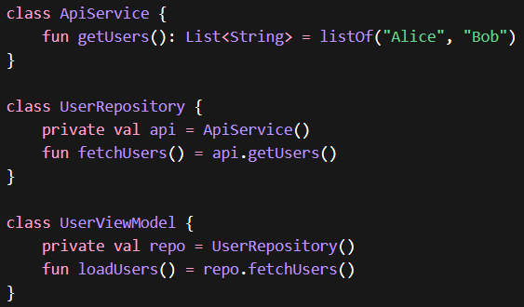
Reduce Coupling (No DI)

Slide 5
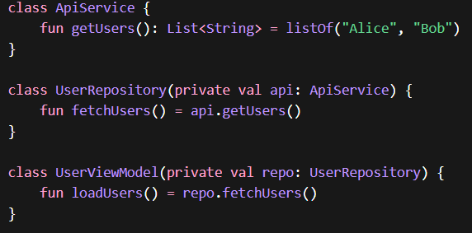
Reduce Coupling (DI)

Slide 6
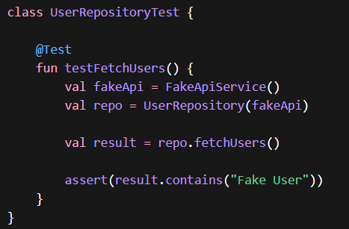
Improve Testability

Slide 7

Better Reusability

Slide 8
Problem With Manual DI
Lot’s of boilerplate
Harder to maintain as codebase grows

Slide 9
Hilt As Dependency Framework
Reduced boilerplate.
Intuitive once understood.
Advance mechanism and capabilities.

Slide 10
Ways of Injection
Constructor Injection
Field Injection
Method Injection

Slide 11
Constructor Injection
Use when you control the class and can inject dependencies via constructor (Most preferred)

Slide 12
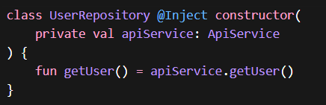
Constructor Injection

Slide 13
Field Injection
Used when Android creates the class (Activity, Fragment, etc.)

Slide 14
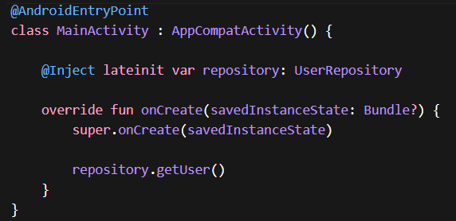
Field Injection

Slide 15
Method Injection
Used when dependency is needed only at a specific time or setup step.
When field injection is not possible until certain point of time.

Slide 16
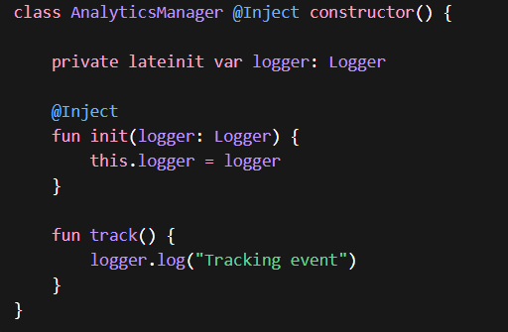
Method Injection

Slide 17
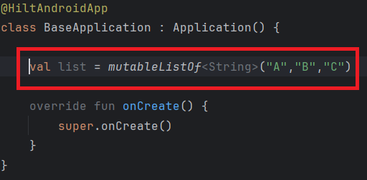
Quick Question
Does below code snippet violets DI pattern or not?

Slide 18
Hilt Components
Each dependency is bound to a certain component.
Components define lifecycle and scope of dependencies.
Hilt comes with built in components where we can install our dependencies as per our needs.
We can define our own component if needed.
Important Components: SingletonComponent, ViewModelComponent, ActivityComponent.

Slide 19
SingletonComponent
Lives as long as the application lives.
Dependencies of this component are accessible across application.

Slide 20
ViewModel Component
Lifecycle tied per viewModel.
Dependencies of this component are accessible across viewModels.

Slide 21
Activity Component
Lives per Activity lifecycle.
Used for activity specific dependencies.

Slide 22
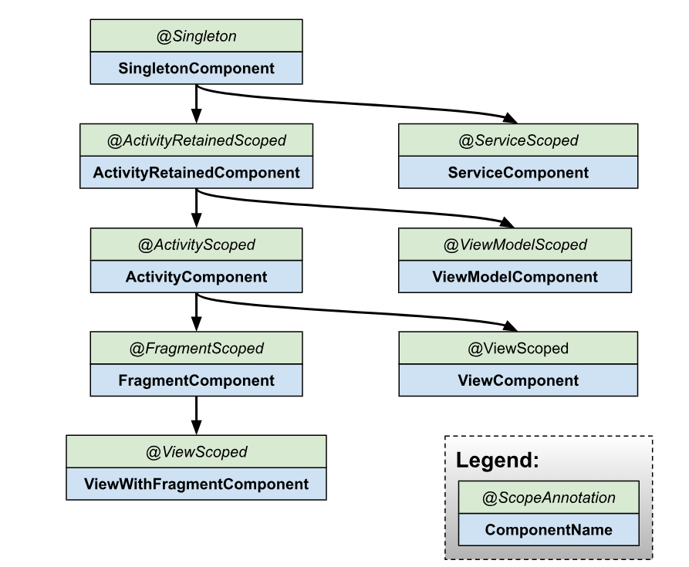
Component Hierarchy

Slide 23
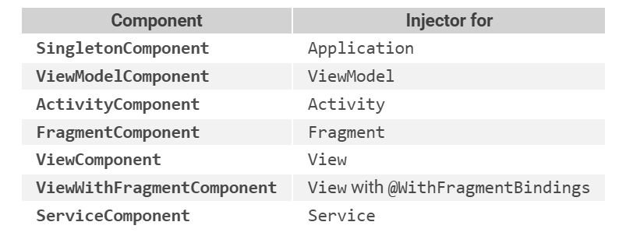
Component Default Binding

Slide 24
Modules
We use it to create dependencies.
Also sets in which component these dependencies would be installed/available.

Slide 25
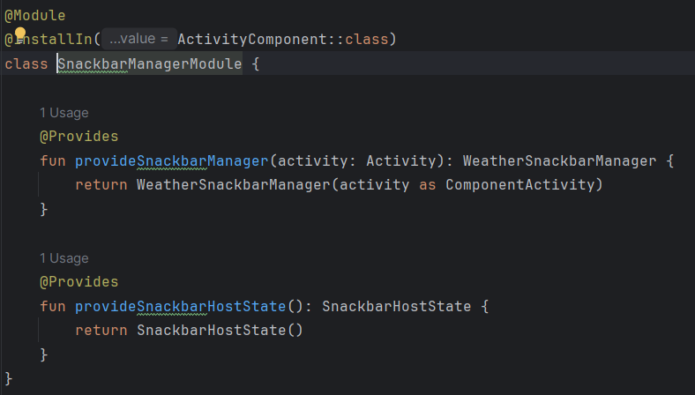
Modules

Slide 26
Modules
All modules installed in the same component share their dependencies.

Slide 27
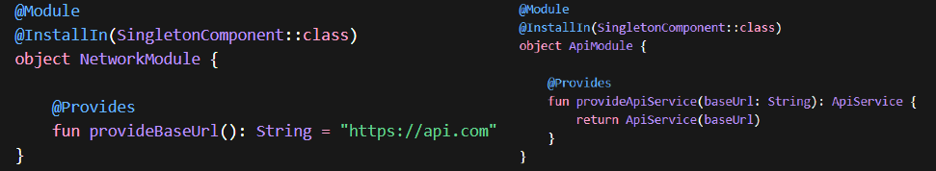
Modules

