Slide 1
Sales Forecasting Using Data Mining & Machine Learning Techniques
Course: CSE-M398
Presented By:
Md. Nazrul Islam
ID: 14701085
Session: 2018-2019
Department of Computer Science and Engineering
University of Chittagong
Chittagong, Bangladesh
Supervised By:
Rokan Uddin Faruqui
Associate Professor
Department of Computer Science and
Engineering
University Of Chittagong
Chittagong, Bangladesh

Slide 2
Introduction
An estimate of sales in physical units (or monetary value) for a specified future period under proposed marketing plan or program and under the assumed set of economic and other forces outside the organization for which the forecast is made.

Slide 3
Problem Statement
Point of Sales(POS)
Customer Retention
Characteristics of Product
Statistical Learning
Predictive Models

Slide 4
Motivation
To spot potential issues while there's still time to avoid or mitigate them.
Can create a forecast every day
They don't need to be perfect to be valuable.
Manage and forecast sales
Automate customer, product, supplier management on the system
Manage system access and roles on the system

Slide 5
Releated Work
Subjective (Delphi Method,Sales force composite method)
Objective (Regression Analysis)

Slide 6
Methodology
The proposed methodology aims to make a predictive model for Future Sales Prediction system
Making some hypothesis about what factors could potentially affect the outcome of the problem statement
Collecting Data
Data Exploration
Data Cleaning
Feature Engineering
Building a predictive Model
Predicting
Evaluation Of Predicted Outcomes
Hypothesis Generation
Market Test Method
Time Series Analysis
Regression Analysis
ExponentialSmoothing

Slide 7
Models
Linear Regression
Lasso Regression
Ada Boost Regression
Ride Regression
Decision Tree Regression
Random Forest Regression

Slide 8
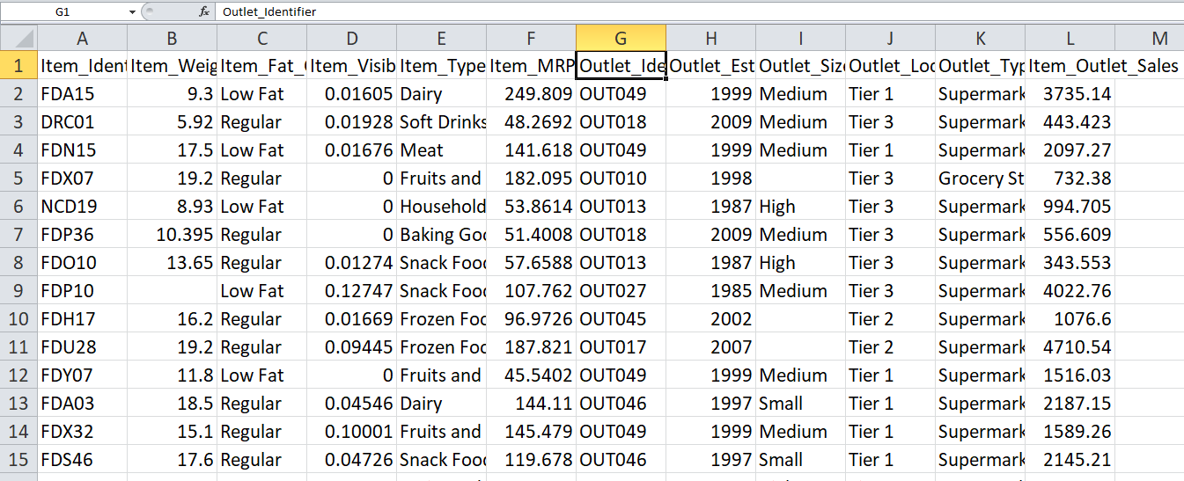
Sample of Data Set
Training Data Set

Slide 9
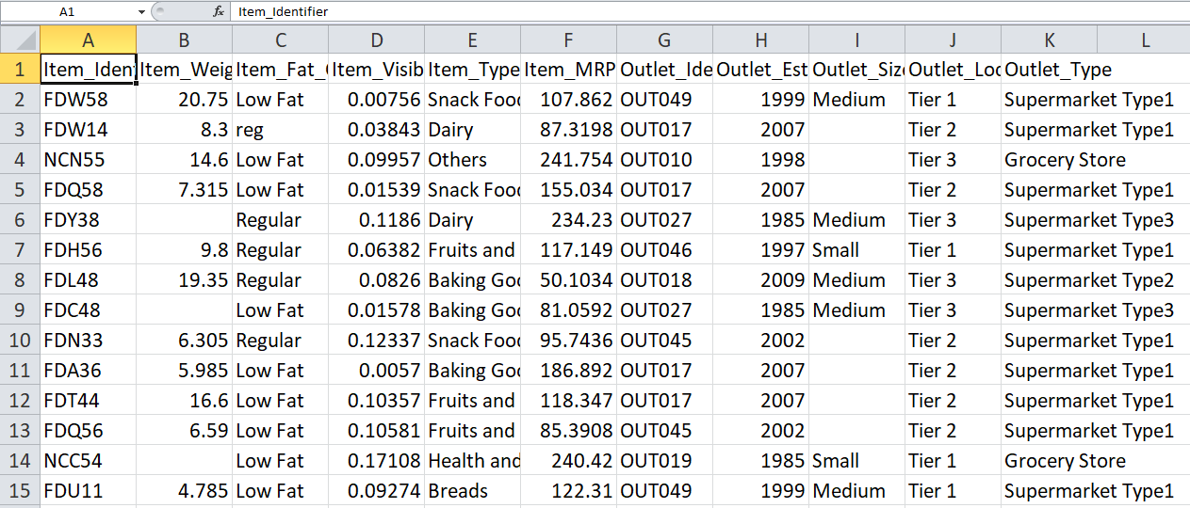
Test Data Set

Slide 10
Result Evaluation
Model | RMSE Value | R squared Value
Linear Regression | 48.70715949972778 | 0.41800537250203177
Lasso Regression | 48.656871372516605 | 0.418656047462923
Ada Boost Regression | 48.70028211358386 | 0.418138928648388
Ride Regression | 48.69851612158346 | 0.41815699488384483
Decision Tree Regression | 48.865410192892206 | 0.4161629680485319
Random Forest Regression | 48.44411027965156 | 0.4211966000171756

Slide 11
Conclusion
In this project the focus was on data exploration. we performed data cleaning and feature engineering, where we imputed missing values and solved other irregularities, made new features and also made the data model-friendly by one-hot-coding. Finally we made regression, decision tree, and random forest model and got a glimpse of how to tune them for better results.
Future Works
There is also another popular Machine Learning model for sales forecasting called Time Series Analysis. In future I try to implement Time Series Analysis for better outcomes.

Slide 12
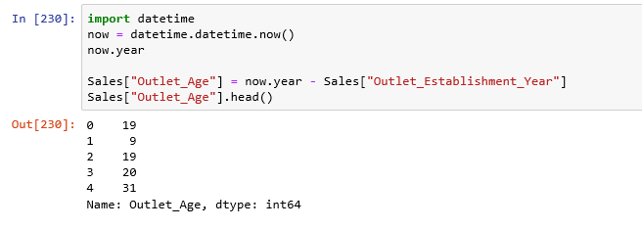
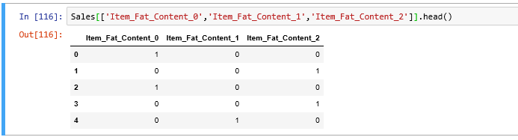
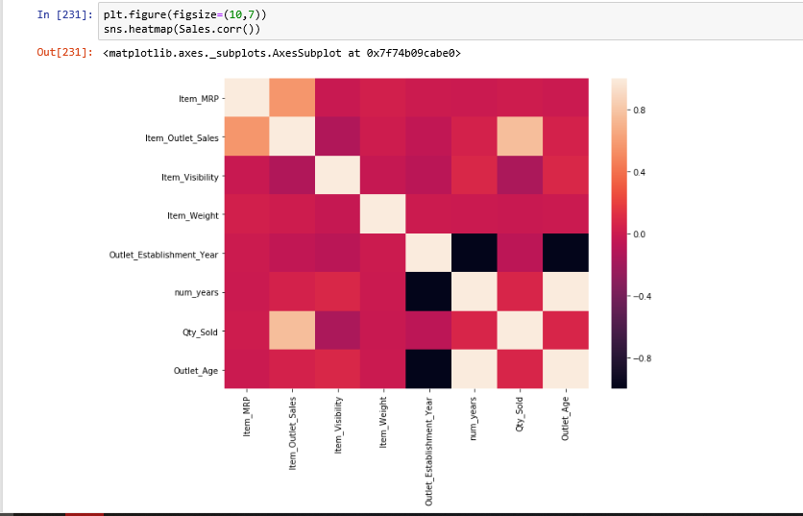
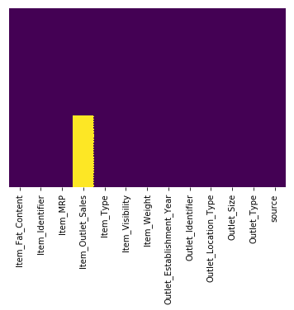
Appendix

