Slide 1
CRM & ESS

Slide 2
Msemaji | G.8792 SGT SHAMIL
Kitengo | Afisa Tehama
Kituo cha Kazi | RPC DODOMA
Elimu | Shahada ya Kwanza
Fani | Sayansi ya Mifumo ya Taarifa
Ubobezi | Ubunifu na Utengenezaji wa Mifumo

Slide 3
ESTIMATION OF PARAMETERS cont…

Slide 4
ESTIMATION OF PARAMETERS cont…
INTRODUCTION
One of the major applications of statistics is estimating population parameters from sample statistics. For example…?
Definitions of Key Terms:
Estimation: Is the procedure of using sample statistic to estimate a population parameter.
Under estimation we have no prior idea about the unknown population parameter.
So, we want to make a guess (to infer) about the population parameter based on the drawn sample.

Slide 5
ESTIMATION OF PARAMETERS cont…
Estimator: A statistic used to estimate a population parameter.
To emphasize, estimator = statistic (formula).
Estimate: The value taken by the estimator i.e. the exact value or number obtained by an estimator.
To emphasize, estimate = number (calculated value from the formula).

Slide 6
ESTIMATION OF PARAMETERS cont…
PROPERTIES OF ESTIMATORS
NOTE THAT:
Not any STATISTIC can be used as an ESTIMATOR for some population parameter.
THUS, THE QUESTION IS:
How do we judge a GOOD ESTIMATOR?

Slide 7
ESTIMATION OF PARAMETERS cont…
THE ANSWER IS,
There are CRITERIA that are used to judge GOOD ESTIMATORS, namely:
Unbiasedness
Consistency
Efficiency
Sufficiency

Slide 8
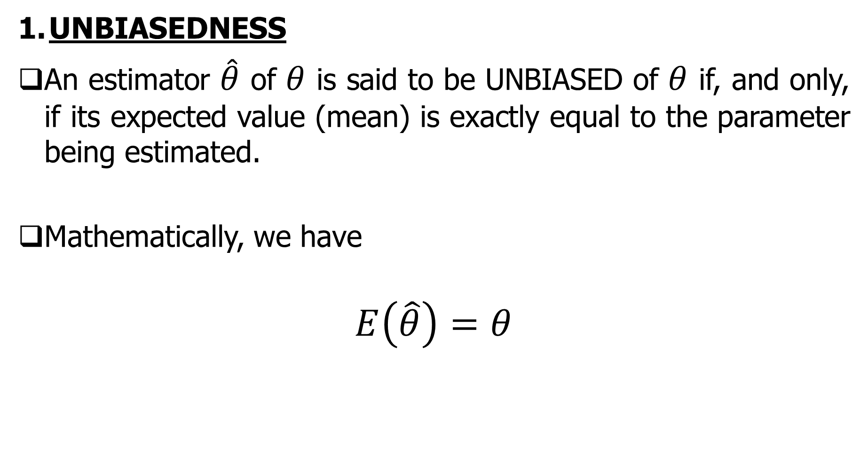
ESTIMATION OF PARAMETERS cont…
UNBIASEDNESS
An estimator $\hat{θ}$ of $θ$ is said to be UNBIASED of $θ$ if, and only, if its expected value (mean) is exactly equal to the parameter being estimated.
Mathematically, we have
$$E\left(\hat{θ}\right)=θ$$

Slide 9
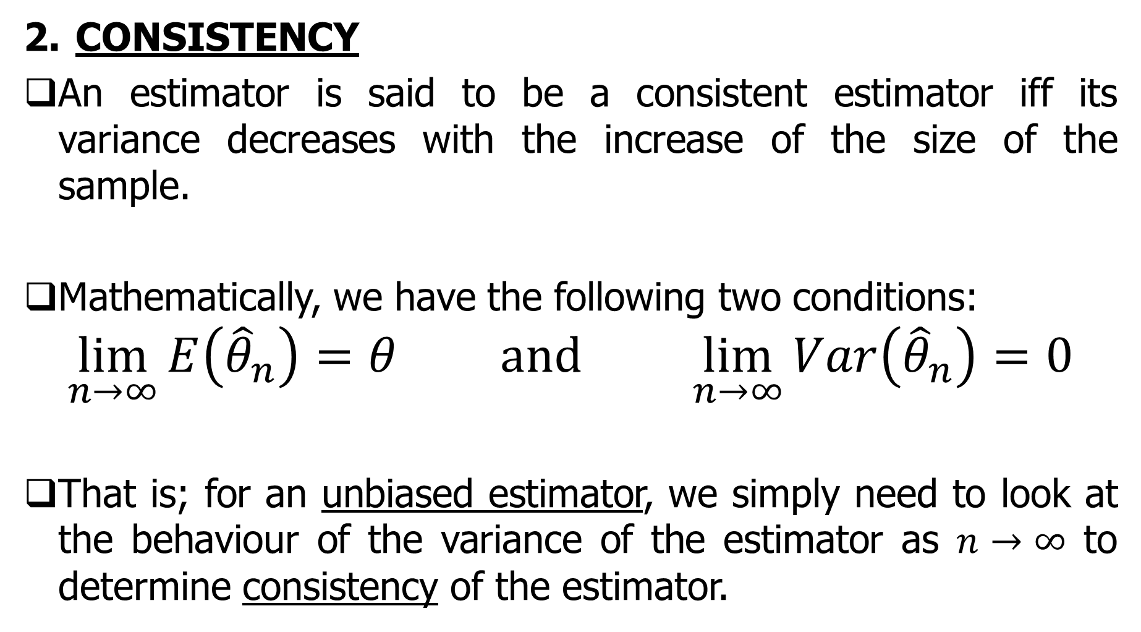
ESTIMATION OF PARAMETERS cont…
CONSISTENCY
An estimator is said to be a consistent estimator iff its variance decreases with the increase of the size of the sample.
Mathematically, we have the following two conditions:
$$\lim_{n→∞}{E\left({\hat{θ}}_{n}\right)}=θ and \lim_{n→∞}{Var\left({\hat{θ}}_{n}\right)}=0$$
That is; for an unbiased estimator, we simply need to look at the behaviour of the variance of the estimator as $n→∞$ to determine consistency of the estimator.

Slide 10
ESTIMATION OF PARAMETERS cont…
EFFICIENCY
An estimator with relatively smaller variance or standard deviation is called an efficient estimator.
Note:
If an estimator is UNBIASED and it has the MINIMUM VARIANCE then an estimator is called the MINIMUM VARIANCE UNBIASED ESTIMATOR (MVUE).

Slide 11
ESTIMATION OF PARAMETERS cont…
4. SUFFICIENCY
An estimator is said to be sufficient if it utilizes all the information in the sample to arrive to the estimate.
For example:…?

Slide 12
ESTIMATION OF PARAMETERS cont…
POINT ESTIMATION AND INTERVAL ESTIMATION
Estimation of population parameters is divided into two classes, namely
Point Estimation Approach, and
Interval Estimation Approach

Slide 13
ESTIMATION OF PARAMETERS cont…
POINT ESTIMATION
Here, we compute a single value from sample information.
We put forward our inferential procedure with that value as likely the value of unknown population parameter.
Here, the criterion we use to base our argument is that of unbiasedness property.
However,
Point estimate cannot tell how close it is to the true value.

Slide 14
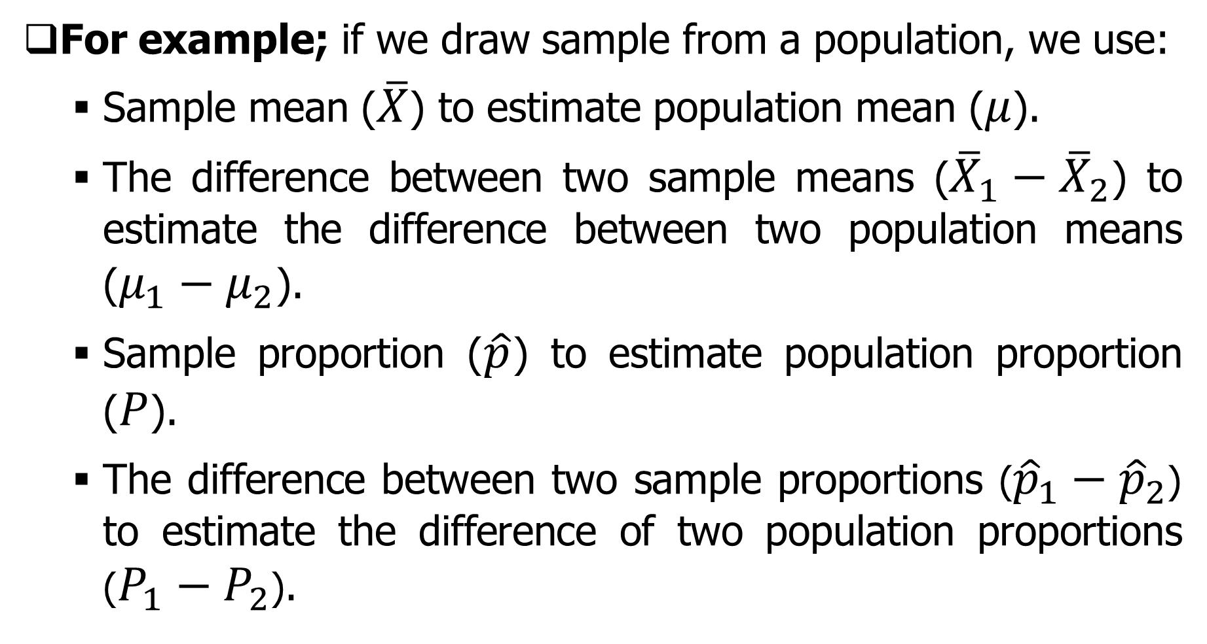
ESTIMATION OF PARAMETERS cont…
For example; if we draw sample from a population, we use:
Sample mean ($\overline{X}$) to estimate population mean ($μ$).
The difference between two sample means (${\overline{X}}_{1}−{\overline{X}}_{2}$) to estimate the difference between two population means ($μ_{1}−μ_{2}$).
Sample proportion ($\hat{p}$) to estimate population proportion ($P$).
The difference between two sample proportions (${\hat{p}}_{1}−{\hat{p}}_{2}$) to estimate the difference of two population proportions ($P_{1}−P_{2}$).

Slide 15
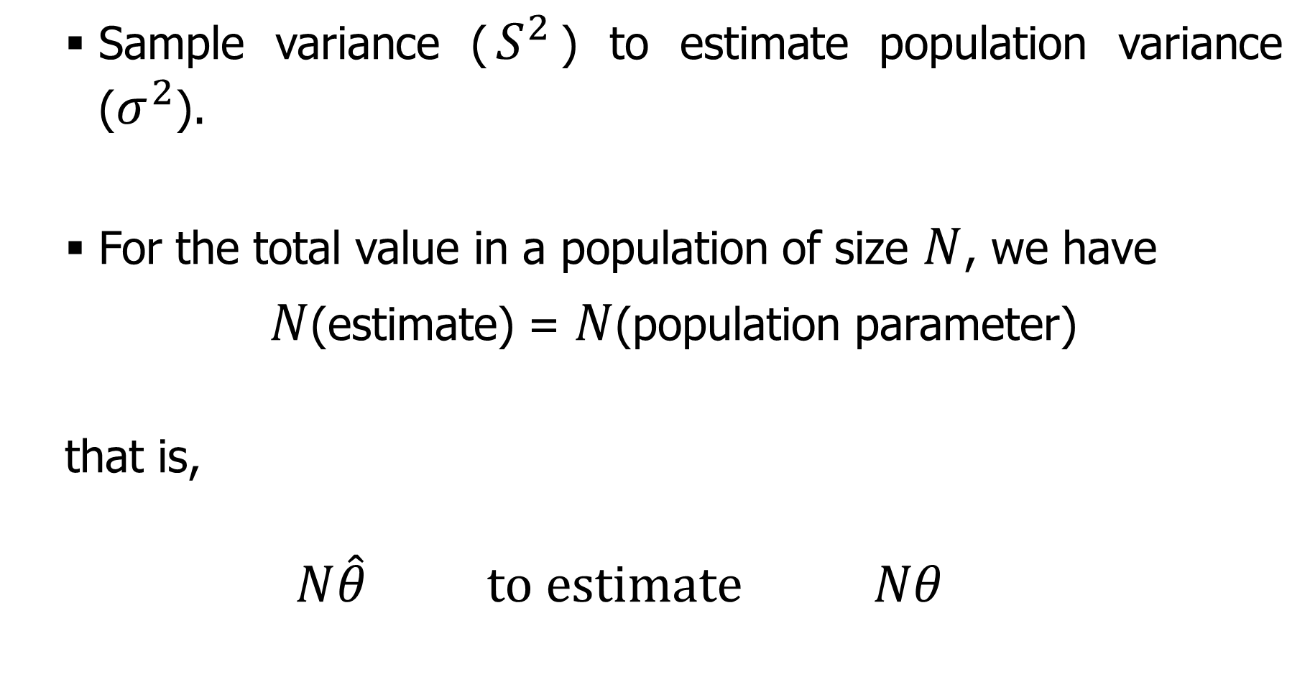
ESTIMATION OF PARAMETERS cont…
Sample variance ($S^{2}$) to estimate population variance ($σ^{2}$).
For the total value in a population of size $N$, we have
$N$(estimate) = $N$(population parameter)
that is,
$$N\hat{θ} to estimate Nθ$$

Slide 16
ESTIMATION OF PARAMETERS cont…
EXAMPLE MS211_05_01_01
A marketing research analysts collects data for a random sample 100 customers of the 500 who purchased a particular item under promotion. The 100 in the sample spent an average (mean) of TZS27,000 in the store with a standard deviation of TZS8,000, and 70% of the customers in the sample made at least one other purchase in addition to the item under promotion.
Required:
Based on these results, estimate the value of the following parameters:

Slide 17
ESTIMATION OF PARAMETERS cont…
Mean purchase amount by all 500 customers who purchased the item that is under promotion.
The standard deviation of the distribution of purchase amounts by the 500 customers.
Total amount of purchases made by the 500 customers.
The number of customers out of 500 who made at least one other purchase in addition to the product under promotion.

Slide 18
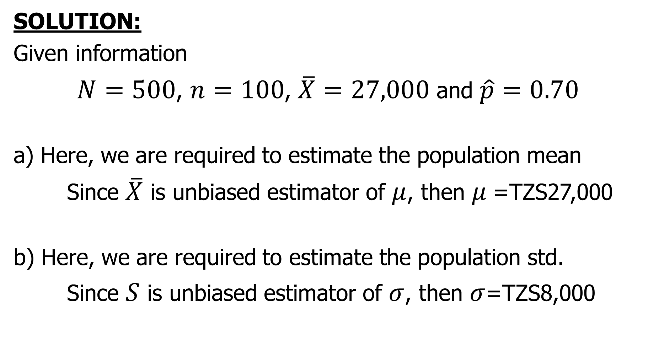
ESTIMATION OF PARAMETERS cont…
SOLUTION:
Given information
$N=500$, $n=100$, $\overline{X}=27,000$ and $\hat{p}=0.70$
a) Here, we are required to estimate the population mean
Since $\overline{X}$ is unbiased estimator of $μ$, then $μ$=TZS27,000
b) Here, we are required to estimate the population std.
Since $S$ is unbiased estimator of $σ$, then $σ$=TZS8,000

Slide 19
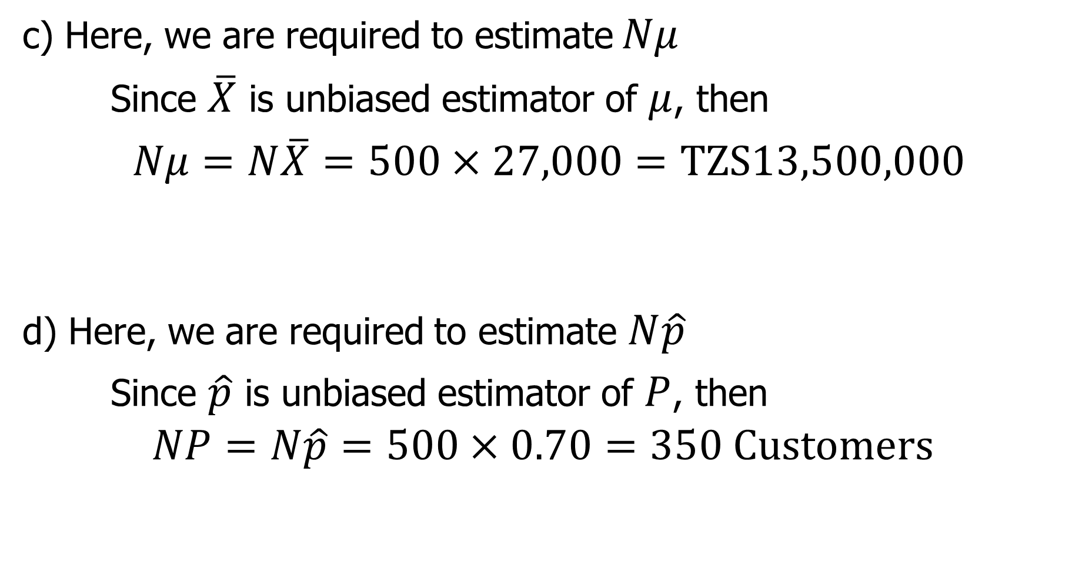
ESTIMATION OF PARAMETERS cont…
c) Here, we are required to estimate $Nμ$
Since $\overline{X}$ is unbiased estimator of $μ$, then
$Nμ=N\overline{X}=500×27,000=TZS13,500,000$
d) Here, we are required to estimate $N\hat{p}$
Since $\hat{p}$ is unbiased estimator of $P$, then
$$NP=N\hat{p}=500×0.70=350 Customers$$

Slide 20
ESTIMATION OF PARAMETERS cont…
INTERVAL ESTIMATION
Here, we compute a range of values.
It gives the precision of the estimate.
THAT IS:
By having a range of values also we have a certain confidence that the unknown parameter will fall into the constructed interval.

Slide 21
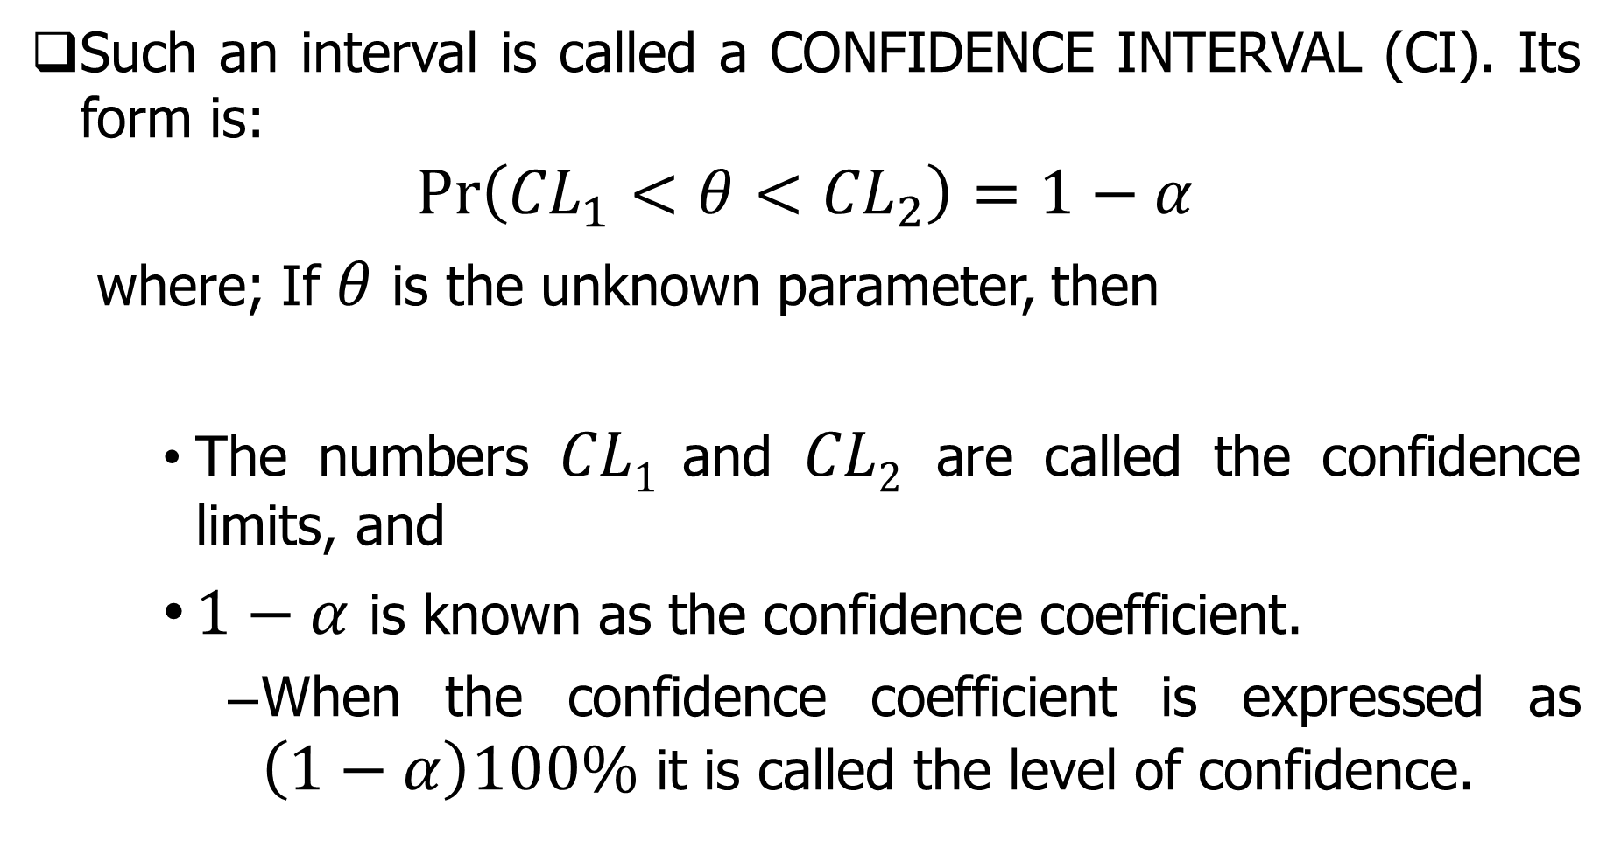
ESTIMATION OF PARAMETERS cont…
Such an interval is called a CONFIDENCE INTERVAL (CI). Its form is:
$$Pr\left({CL}_{1}<θ<{CL}_{2}\right)=1−α$$
where; If $θ$ is the unknown parameter, then
The numbers $CL1$ and $CL2$ are called the confidence limits, and
$1−α$ is known as the confidence coefficient.
When the confidence coefficient is expressed as $\left(1−α\right)100\%$ it is called the level of confidence.

Slide 22
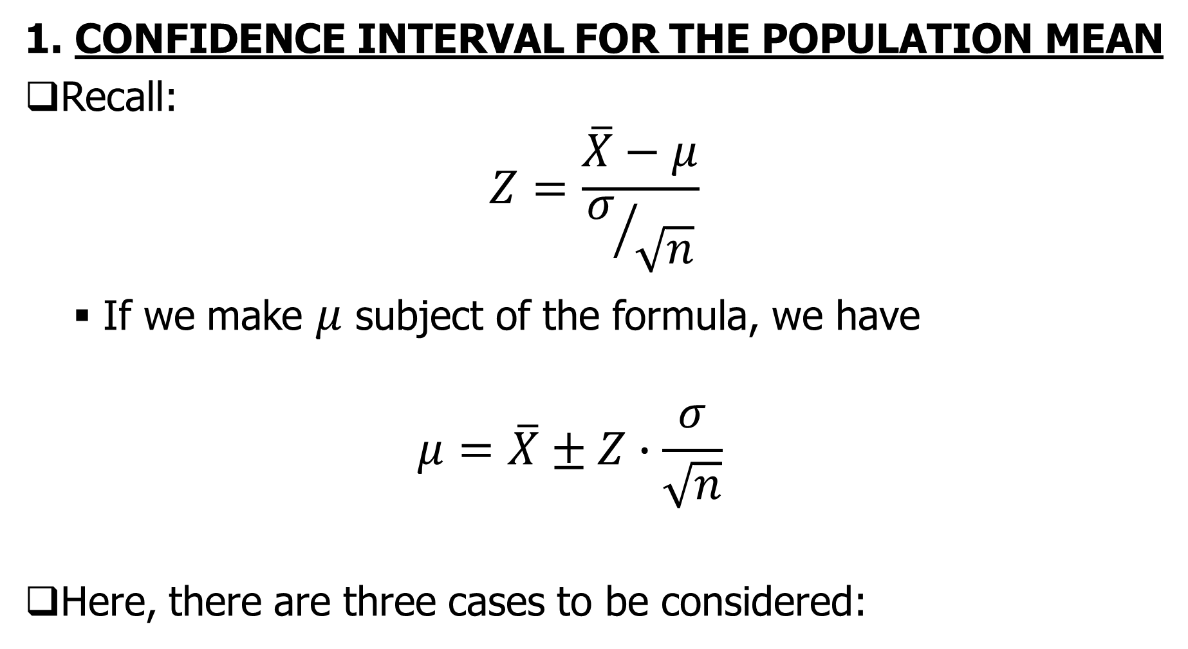
ESTIMATION OF PARAMETERS cont…
1. CONFIDENCE INTERVAL FOR THE POPULATION MEAN
Recall:
$$Z=\frac{\overline{X}−μ}{σ/{\sqrt{n}}}$$
If we make $μ$ subject of the formula, we have
$$μ=\overline{X}±Z∙\frac{σ}{\sqrt{n}}$$
Here, there are three cases to be considered:

Slide 23
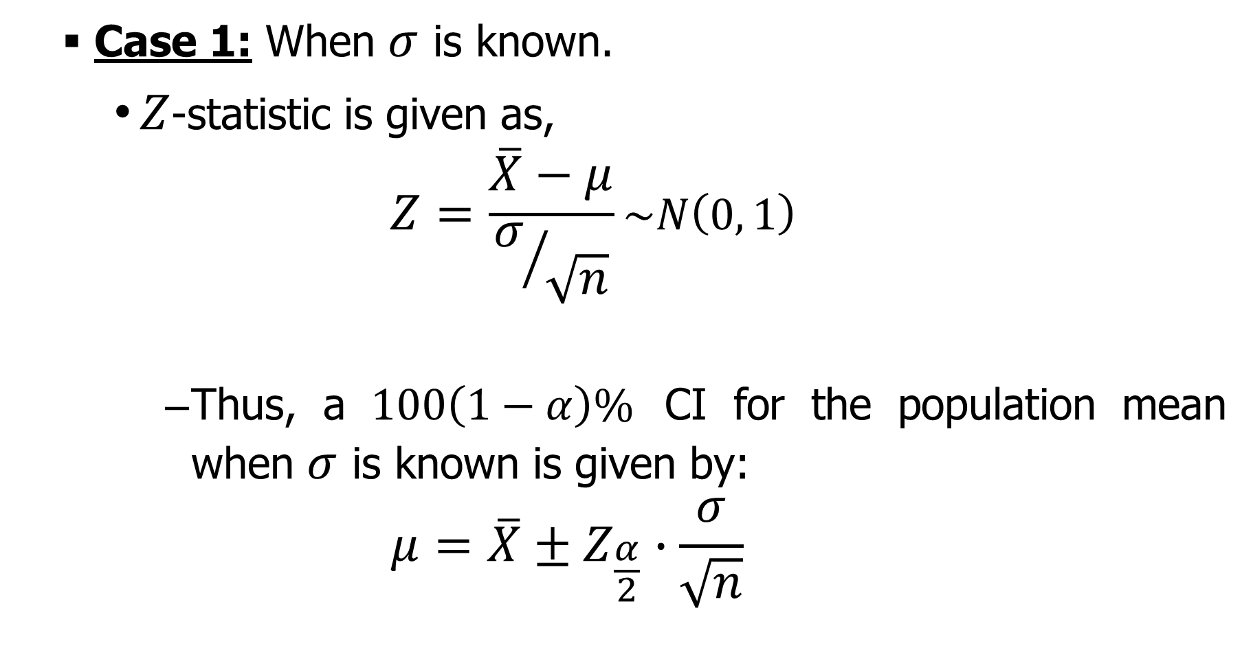
ESTIMATION OF PARAMETERS cont…
Case 1: When $σ$ is known.
$Z$-statistic is given as,
$$Z=\frac{\overline{X}−μ}{σ/{\sqrt{n}}}\sim N\left(0, 1\right)$$
Thus, a $100\left(1−α\right)\%$ CI for the population mean when $σ$ is known is given by:
$$μ=\overline{X}±Z_{\frac{α}{2}}∙\frac{σ}{\sqrt{n}}$$

Slide 24
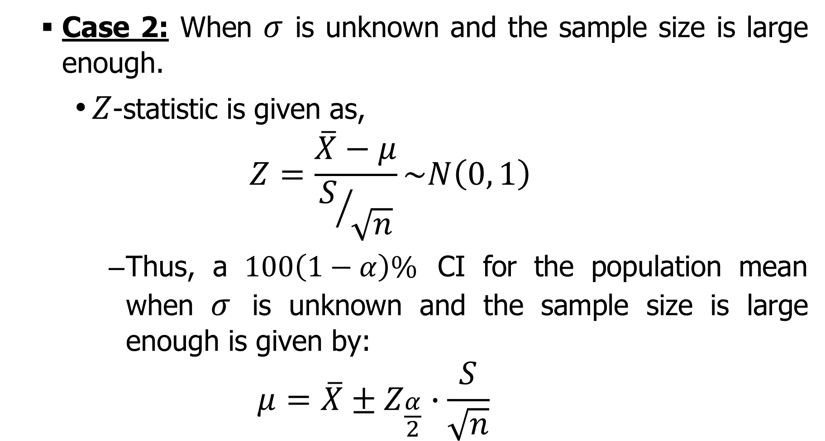
ESTIMATION OF PARAMETERS cont…
Case 2: When $σ$ is unknown and the sample size is large enough.
$Z$-statistic is given as,
$$Z=\frac{\overline{X}−μ}{S/{\sqrt{n}}}\sim N\left(0, 1\right)$$
Thus, a $100\left(1−α\right)\%$ CI for the population mean when $σ$ is unknown and the sample size is large enough is given by:
$$μ=\overline{X}±Z_{\frac{α}{2}}∙\frac{S}{\sqrt{n}}$$

Slide 25
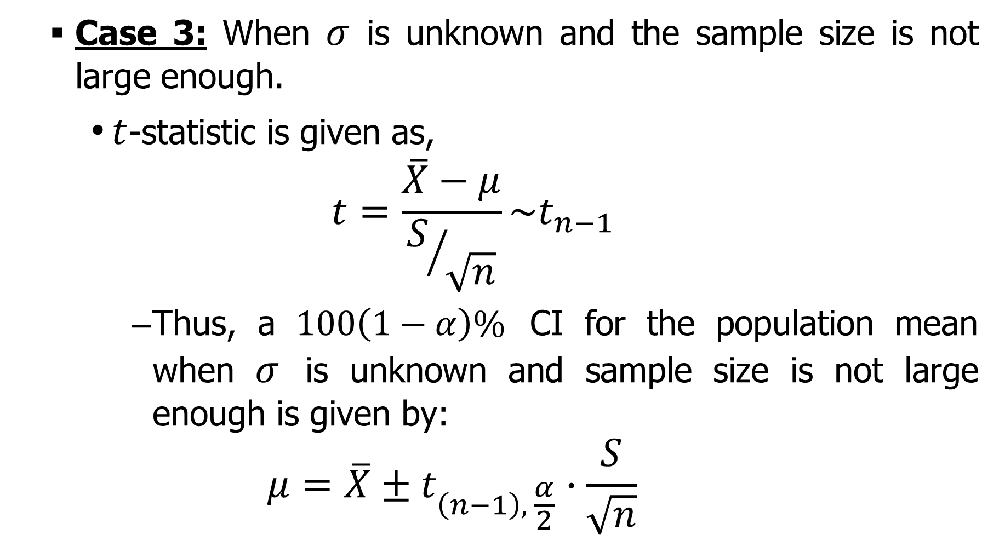
ESTIMATION OF PARAMETERS cont…
Case 3: When $σ$ is unknown and the sample size is not large enough.
$t$-statistic is given as,
$$t=\frac{\overline{X}−μ}{S/{\sqrt{n}}}\sim t_{n−1}$$
Thus, a $100\left(1−α\right)\%$ CI for the population mean when $σ$ is unknown and sample size is not large enough is given by:
$$μ=\overline{X}±t_{\left(n−1\right), \frac{α}{2}}∙\frac{S}{\sqrt{n}}$$

Slide 26
ESTIMATION OF PARAMETERS cont…
EXAMPLE MS211_05_01_02
A random sample of 25 with a mean of 80 is taken from a population that is normally distributed with a standard deviation of 30.
Required:
Find the 90% confidence interval for the unknown population mean.

Slide 27
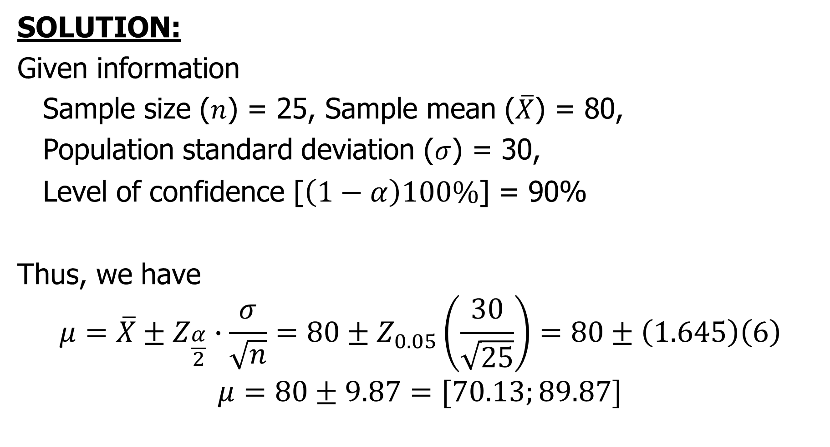
ESTIMATION OF PARAMETERS cont…
SOLUTION:
Given information
Sample size ($n$) = 25, Sample mean ($\overline{X}$) = 80,
Population standard deviation ($σ$) = 30,
Level of confidence [$\left(1−α\right)100\%$] = 90%
Thus, we have
$$μ=\overline{X}±Z_{\frac{α}{2}}∙\frac{σ}{\sqrt{n}}=80±Z_{0.05}\left(\frac{30}{\sqrt{25}}\right)=80±\left(1.645\right)\left(6\right)$$
$$μ=80±9.87=[70.13;89.87]$$

Slide 28
ESTIMATION OF PARAMETERS cont…
EXAMPLE MS_05_01_03
A research firm conducted a survey to determine the mean amount steady smokers spend on cigarettes during a week.
A sample of 49 steady smokers revealed that the mean is TZS 20,000 and the standard deviation is TZS 5,000.
Required:
Using the 95 percent level of confidence, determine the confidence interval for population mean.

Slide 29
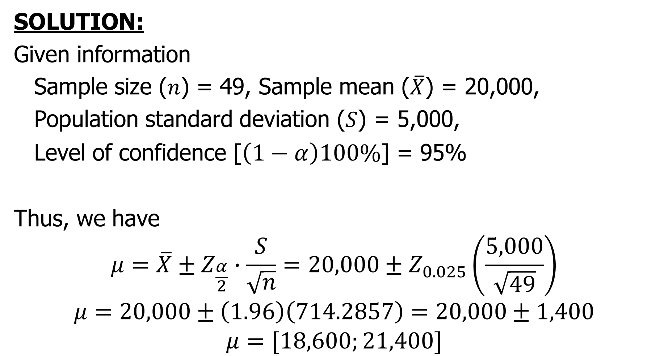
ESTIMATION OF PARAMETERS cont…
SOLUTION:
Given information
Sample size ($n$) = 49, Sample mean ($\overline{X}$) = 20,000,
Population standard deviation ($S$) = 5,000,
Level of confidence [$\left(1−α\right)100\%$] = 95%
Thus, we have
$$μ=\overline{X}±Z_{\frac{α}{2}}∙\frac{S}{\sqrt{n}}=20,000±Z_{0.025}\left(\frac{5,000}{\sqrt{49}}\right)$$
$$μ=20,000±\left(1.96\right)\left(714.2857\right)=20,000±1,400$$
$$μ=[18,600;21,400]$$

Slide 30
ESTIMATION OF PARAMETERS cont…
EXAMPLE MS211_05_01_04
A management consulting firm needs to estimate the average number of years of experience of sales representatives in a given company. A random sample of 25 sales reps gives a mean of 6.7 years and standard deviation of 2.4 years.
Required:
Find the 90% confidence interval for the average number of years of experience for all sales reps in this company.

Slide 31
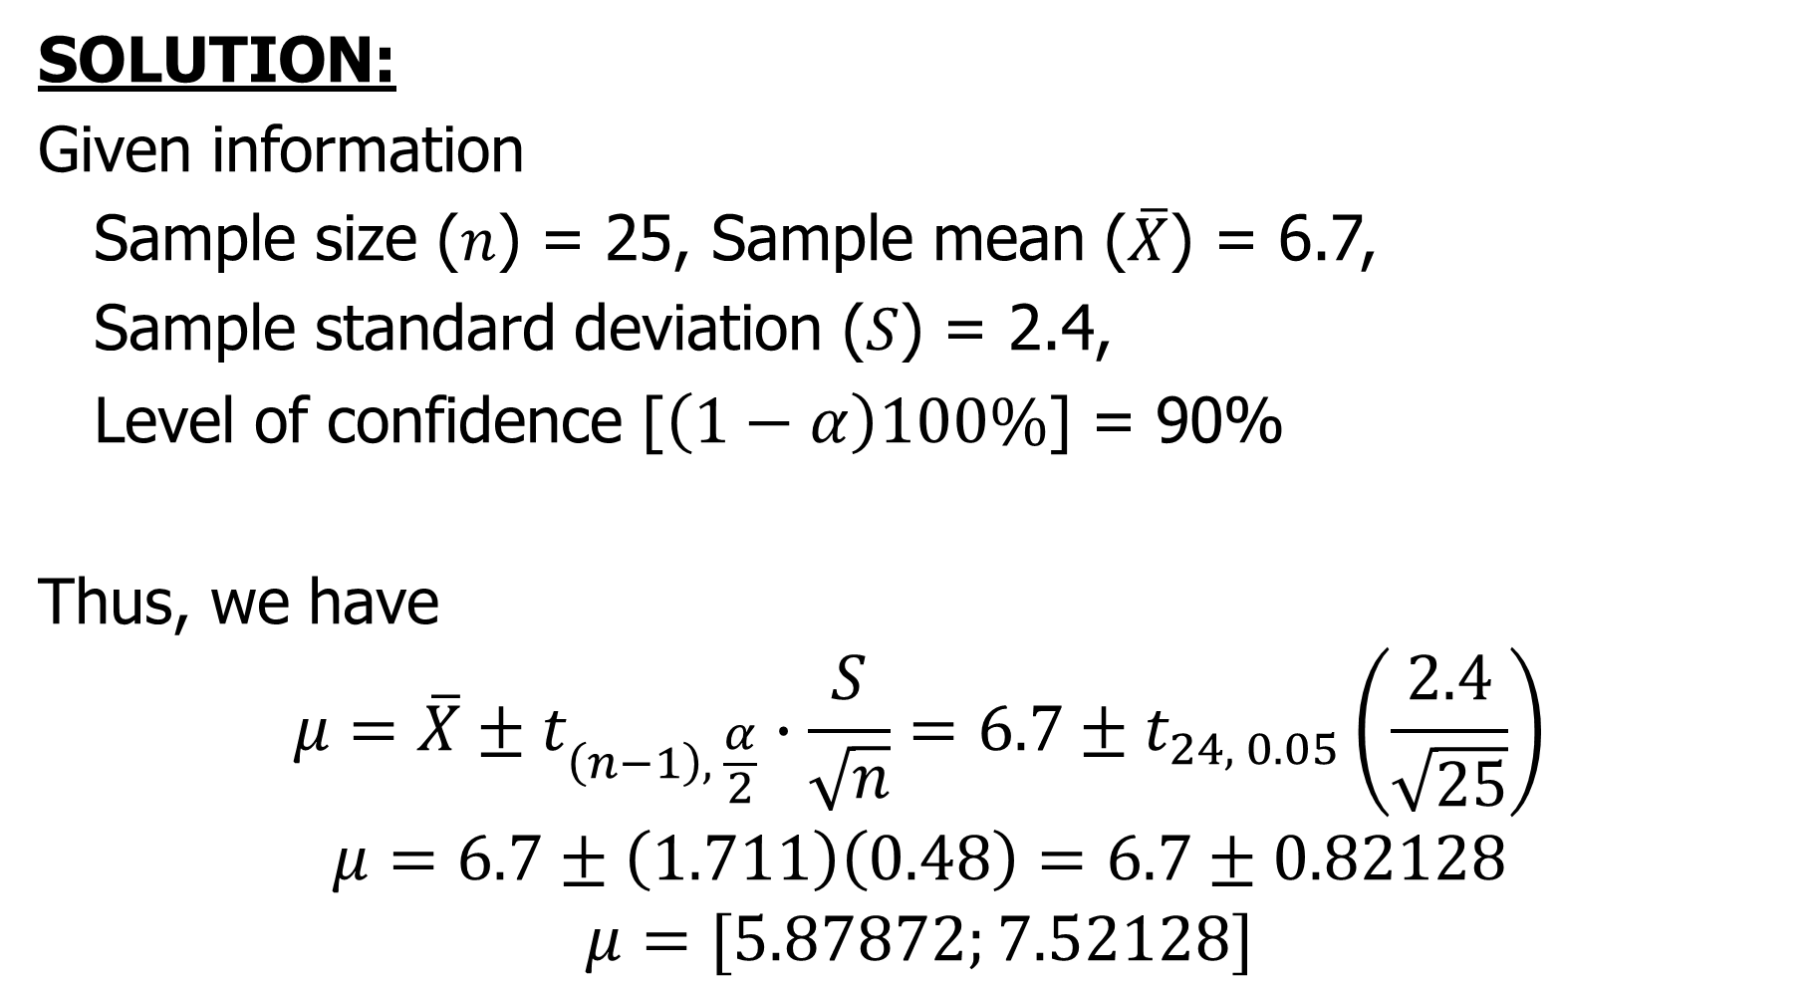
ESTIMATION OF PARAMETERS cont…
SOLUTION:
Given information
Sample size ($n$) = 25, Sample mean ($\overline{X}$) = 6.7,
Sample standard deviation ($S$) = 2.4,
Level of confidence [$\left(1−α\right)100\%$] = 90%
Thus, we have
$$μ=\overline{X}±t_{\left(n−1\right), \frac{α}{2}}∙\frac{S}{\sqrt{n}}=6.7±t_{24, 0.05}\left(\frac{2.4}{\sqrt{25}}\right)$$
$$μ=6.7±\left(1.711\right)\left(0.48\right)=6.7±0.82128$$
$$μ=[5.87872;7.52128]$$

