Slide 1

n.b.k.r. institute of science & technology (autonomous) Vidyanagar – 524 143 – Tirupati DISTRICT A.P.
DEPARMENT OF COMPUTER SCIENCE and ENGINEERING
PROJECT NAME :- ONLINE FOOD ORDERING SYSTEM
PRSENTED BY :-
I-BTECH-CSE-B (batch-8)

Slide 2

TEAM INTRODUCTION :-
A.YOGYA SAI SRI - 24KB1A0504
A.MANEESHA - 24KB1A0513
B.SHAMITHA - 24KB1A0542
B.ROOPA - 24KB1A0572

Slide 3
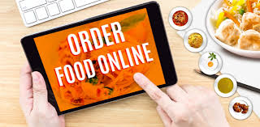
Introduction :-
What is online food ordering system ?
Importance in today’s digital age.
Examples :- Swiggy ,Uber Eats ,Zomato…

Slide 4
About the project :-
This project demonstrate a simple online food ordering system in c
Each menu is stored in arrays
Each menu maintains a linked list of food orderings
Each menu has a name and a prices of their cost

Slide 5
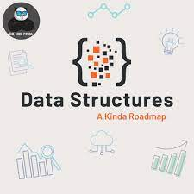
Data structures used :-
Array : to store the list of menu litems
Linked list : for customers orders
Each node contains :
Menu items list
With prices

Slide 6
Objectives :-
Simplify the process of ordering food
Enhance customer experience
Reduce errors and improve order accuracy
Increase restaurant reach and efficiency

Slide 7
System overview :-
Customer places order via app/website
Order goes to restaurant
Restaurant confirms and prepares food
Delivery agent picks up and delivers
Customer receives order and can provide feedback

Slide 8
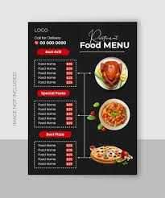
Key features :-
User can choose the items
Restaurant listing and menu
Cart and checkout process
Online payment integration

Slide 9
Advantages :-
Convenience for customers
Increased sales for restaurants
Efficient order management
Real-time analytics and reporting

Slide 10

Future enhancements :-
AI-based recommendations
Voice ordering integration
Drone or robot delivery
Loyalty programs and subscriptions

Slide 11

challenges :-
Internet connectivity issues
Ensuring food quality during delivery
Managing delivery logistics
Handling peak-time orders

Slide 12
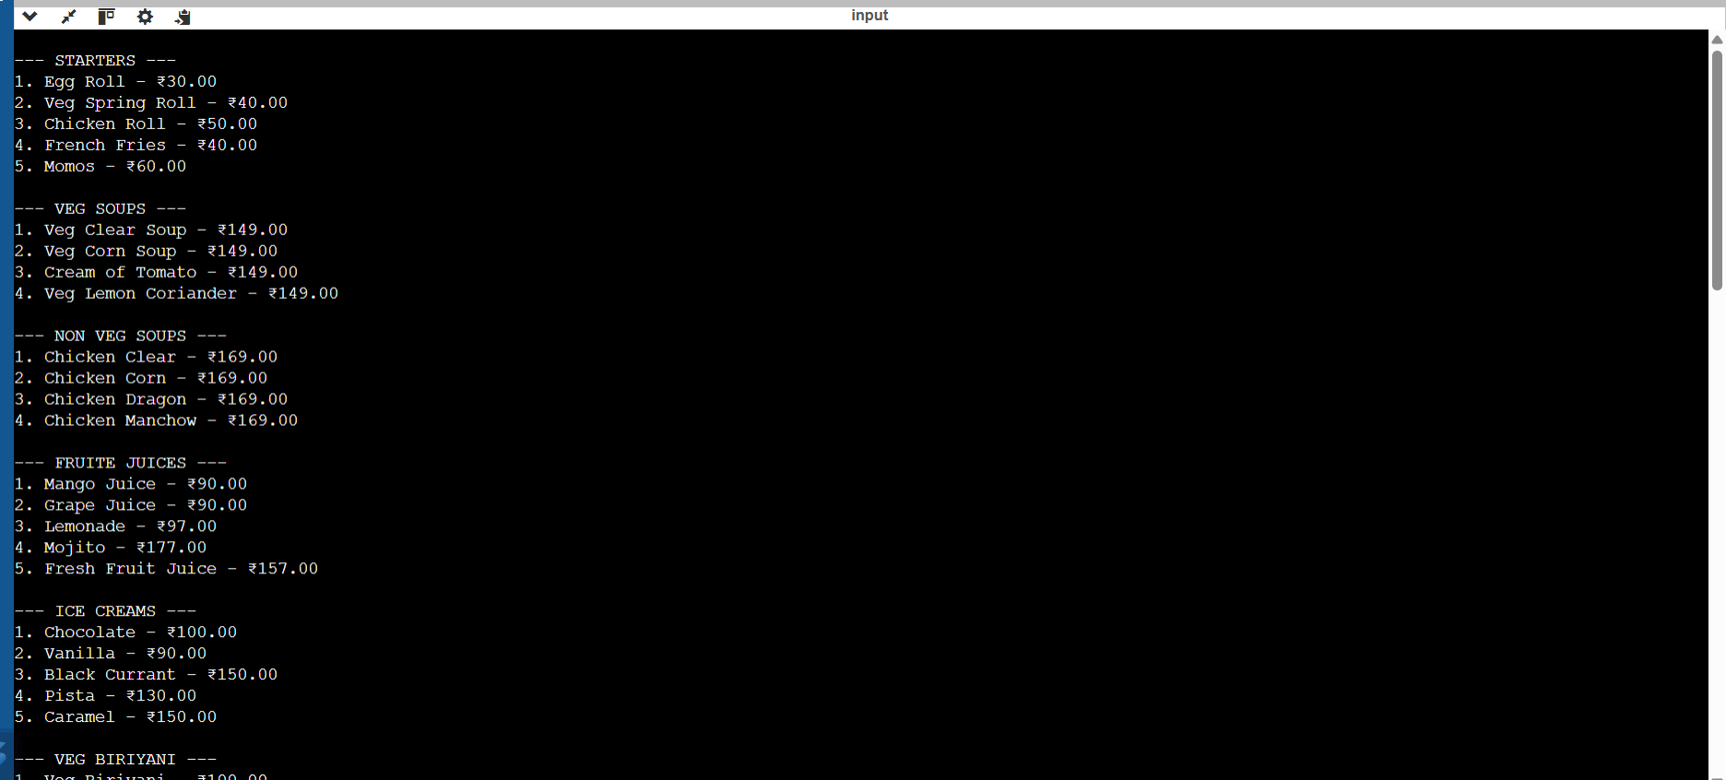
Out put:-

Slide 13
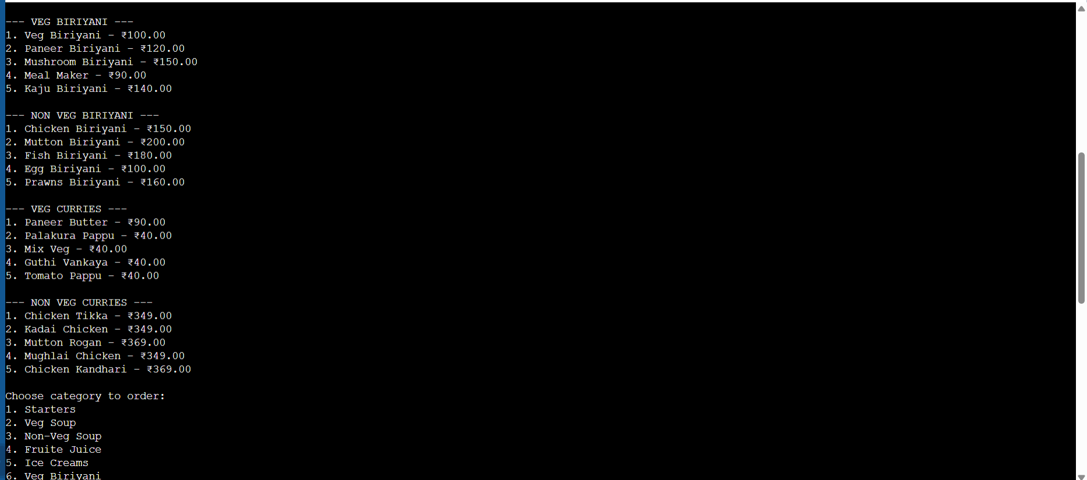

Slide 14
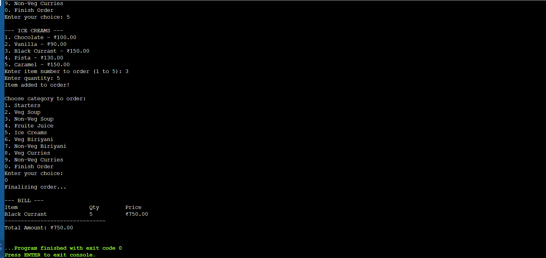

Slide 15
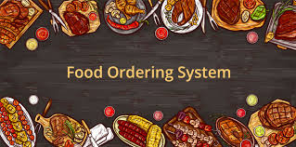
Conclusion :-
Recap of purpose and benefits
Growing relevance in the food industry
Continuous scope for improvement

Slide 16


