Slide 1


Travel & Tourism Management Project
This project involves developing a travel and tourism management system designed to streamline operations for travel agencies and tourism organizations. The system will incorporate modern technologies to improve the overall experience for both businesses and customers.

Slide 2
TEAM MEMBERS
221003078-SHAMITHA
221003085-JAHNAVI
2210030423-KUSUMITHA
2210030416-ANUSHKA
2210030341-HEMA

Slide 3

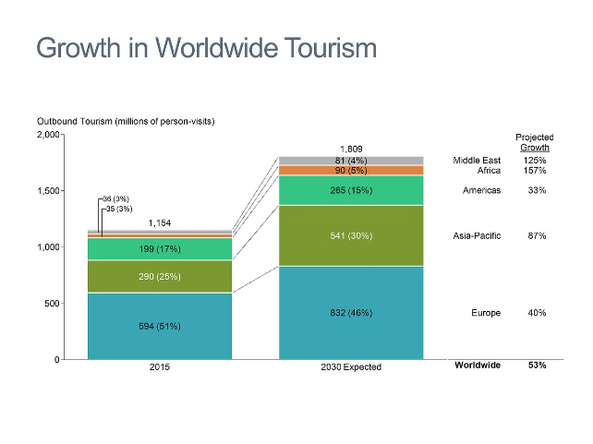
Problem Statement
The current travel and tourism industry often faces challenges with data management, booking processes, and customer service.
Inefficient Processes
Limited Customer Interaction
Manual processes can be time-consuming and prone to errors.
Lack of personalized experiences and limited communication channels can impact customer satisfaction.
Data Silos
Information is fragmented across different departments, leading to poor decision-making.

Slide 4
Existing Projects
Several existing systems and platforms cater to the travel and tourism industry, but they often lack advanced features and integration capabilities.
Legacy Systems
Specialized Platforms
Open Source Solutions
Outdated systems are often difficult to maintain and lack modern functionalities.
These platforms may focus on specific aspects of travel management but lack a holistic approach.
Open source options can be customizable but may require significant technical expertise.

Slide 5

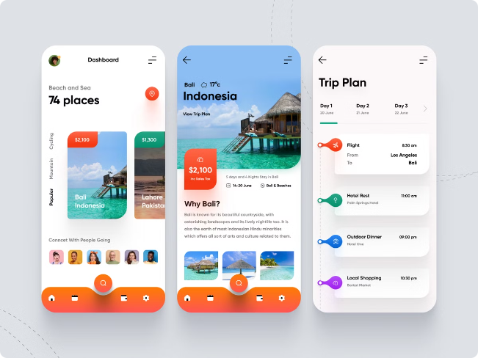
Key Features
The project aims to address existing challenges by incorporating a range of key features, which will enhance the efficiency and effectiveness of travel management.
1
Centralized Data Management
2
Automated Booking Processes
Consolidating data from various sources into a single platform provides a comprehensive overview of operations.
Streamlining bookings and reducing human error through automated workflows.
3
Personalized Customer Experiences
4
Real-Time Communication
Facilitating seamless communication between travel agencies, customers, and service providers.
Tailoring travel recommendations and services based on individual preferences and past behaviors.

Slide 6
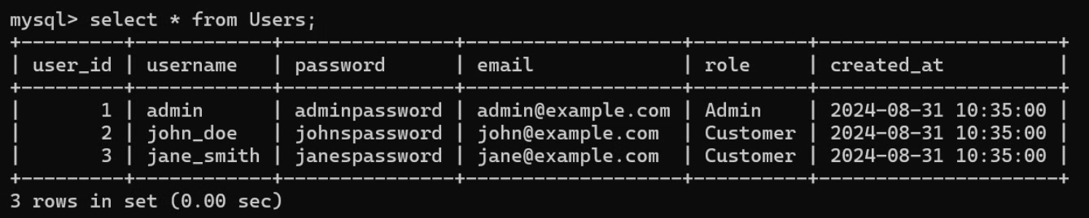
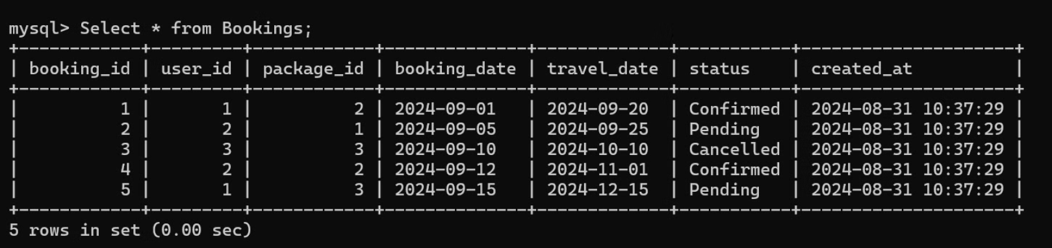
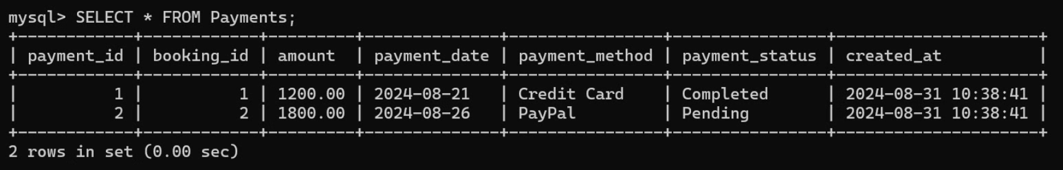
SQL TABLES

Slide 7
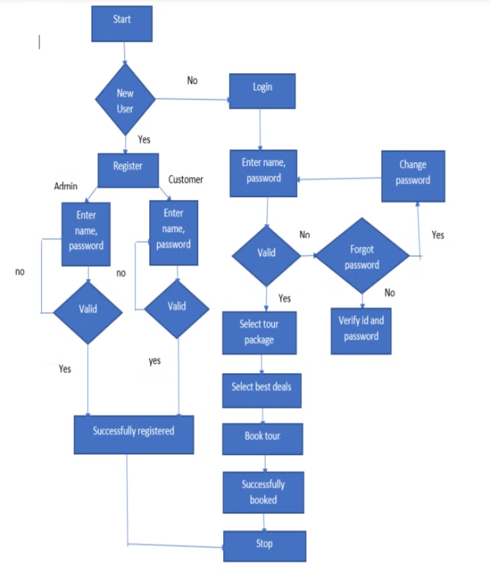
Workflow Diagram

