Slide 1
CSE7302 - INTERNSHIP Review - 5 Presentation CLIENT SUCCESS INTERN
Student Details
Name | SHAMITHA VIJAYAKUMAR
Roll No | 20221CSE0280
Section | 8CSE08
Under the Supervision of,
Dr. Taranath N L
Associate Professor
Presidency School of CSE
Presidency University
Name of the Program: B.Tech CSE
Name of the HoD: Dr. Asif Mohammed
Name of the Program Internship Coordinator: Dr. Balakrishnan
Name of the School Internship Coordinator: Dr. Md Ziaur Rahman

Slide 2
Content
About Company or Organization
Working domain or the technology
About your team and reporting Manager
Challenges Faced in Internship
Objectives of the work
Literature Review
Proposed System
Problem Statement
System Requirements
Advantages of Proposed System/Work
System Design
System Implementation
System Testing
Conclusion
References
Github Link

Slide 3
About Company or Organization
Talent Recruit is an advanced Recruitment and Onboarding platform designed to simplify,
automate, and enhance the entire hiring lifecycle. It leverages cutting-edge technologies
such as Machine Learning and Artificial Intelligence to help organizations attract, screen, evaluate, and hire the right talent efficiently and accurately.
One of its key highlights is ERIKA – the 24×7 Robotic Recruiter, which automates
candidate engagement, interview scheduling, follow-ups, and communication, ensuring a
seamless and responsive recruitment experience for both recruiters and candidates.
ERIKA reduces manual effort, improves turnaround time, and enhances candidate satisfaction through continuous availability and intelligent interaction.
Talent Recruit enables recruiters to manage job postings, track applications, shortlist
candidates, conduct assessments, schedule interviews, and complete onboarding
processes within a single integrated platform. Its AI-driven analytics and smart
recommendations help recruiters make data-driven hiring decisions, minimize bias, and improve overall hiring quality.
3

Slide 4
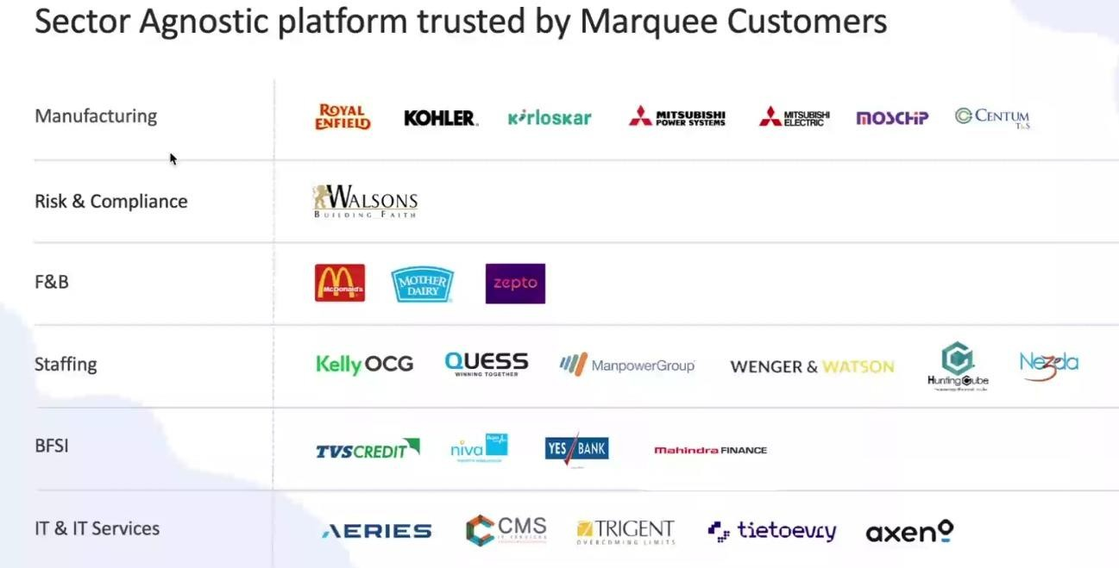
Our Clients
27-02-2026
4

Slide 5
Working domain or the technology
Artificial Intelligence (AI) for intelligent recruitment automation
Machine Learning (ML) for resume screening and candidate ranking
Natural Language Processing (NLP) for chatbot and candidate interaction
Applicant Tracking System (ATS) architecture
SaaS (Software as a Service) cloud-based platform model
Database Management Systems for candidate and job data storage
REST APIs for integration with job portals and communication tools
Chatbot Technology (ERIKA – Robotic Recruiter)
Recruitment Analytics and Reporting Dashboards
Workflow Automation Systems

Slide 6
About your team and reporting Manager
Team Structure, Project, Reporting & Technology Understanding
Our team consists of 9 members, guided by our Reporting Manager, Mr. Ashish Meridatta.
Currently, we are in the training phase on the company’s ATS (Applicant Tracking System) product.
We are learning how each technology supports the recruitment process:
Technology Understanding:
AI & ML: Helps in resume screening and candidate ranking.
NLP: Enables chatbot communication and candidate interaction.
ATS Workflow: Helps track candidates across hiring stages.
Databases: Store and manage candidate and job data.
APIs: Integrate job portals and communication tools.
Dashboards & Analytics: Provide recruitment performance insights.
This training helps us understand how technology solves real recruitment challenges.
We are now being assigned to live projects for practical client exposure.

Slide 7
Challenges Faced in Internship
During the initial days of my internship at TalentRecruit Software Private Limited, adapting to a new work environment and getting comfortable with new teammates was slightly challenging. Understanding the various concepts, workflows, and features of the TalentRecruit product also took some time, as it is a comprehensive recruitment platform.
Another initial challenge was managing daily travel through heavy traffic, which was tiring in the beginning. However, with time, support from the team, and regular exposure, I have adjusted well to both the work culture and the product.
Overall, TalentRecruit is a good organization with a strong and growing product. I am now comfortable with the environment and looking forward to learning more and gaining valuable experience in the coming days.

Slide 8
Objectives of the work
To understand ATS system architecture and recruitment workflows.
To support AI-based resume parsing and candidate shortlisting processes.
To assist in database validation and candidate data management.
To ensure accurate workflow automation across hiring stages.
To support API-based integrations with job portals and communication tools.
To analyze recruitment dashboards and system reports.
To help in identifying and resolving basic system-level issues.
To improve overall system efficiency and data consistency.

Slide 9
Literature Review
Study of Applicant Tracking Systems (ATS) in modern recruitment
Use of AI & ML for resume screening and candidate ranking
NLP-based chatbots for automated candidate interaction
SaaS-based recruitment platforms for scalability
Workflow automation in hiring lifecycle
REST API integrations with external job portals
Recruitment analytics for data-driven hiring decisions
Limitations of traditional hiring systems (manual & time-consuming)

Slide 10
Proposed System / Work
Development and use of an AI-powered Applicant Tracking System (ATS)
Centralized platform for managing end-to-end recruitment lifecycle
Automated resume screening and candidate shortlisting using AI/ML
Chatbot-based candidate engagement (ERIKA) for continuous communication
Workflow automation for job creation, interviews, and onboarding
Integration with job portals and external tools via APIs
Real-time dashboards and analytics for data-driven hiring decisions

Slide 11
Problem Statement
Recruitment processes are often manual, fragmented, and time-consuming.
Candidate data is scattered, leading to poor tracking and data inconsistency.
Handling large volumes of applications results in slow and inefficient screening.
Lack of automation causes delays in communication and interview scheduling.
Limited integration with external platforms reduces overall system efficiency.
Organizations lack real-time insights and analytics for effective decision-making.
Therefore, there is a need for a centralized and automated recruitment system to improve efficiency, accuracy, and candidate experience.

Slide 12
System Requirements
Web-based ATS platform
Cloud infrastructure
Database for candidate and job data
API integrations with job portals and communication tools
Power BI and Tableau API connectivity\
Support for Advanced Analytics via REST APIs enabling real time data synchronization.
Security aspects:
Role based data Access (RBAC)
Securing data Sharing across different clients.

Slide 13
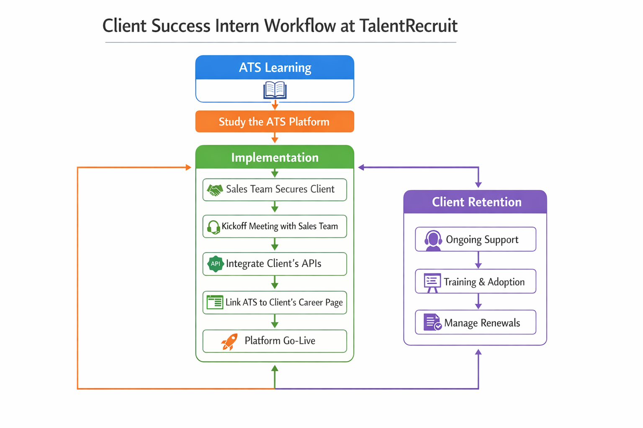

Slide 14
Advantages of Proposed System/Work
Reduces manual effort through automation of recruitment workflows
Improves candidate screening accuracy using AI/ML techniques
Enables faster hiring process by streamlining all recruitment stages
Provides centralized data management for better tracking and consistency
Enhances candidate experience through continuous engagement (chatbot)
Supports real-time analytics and reporting for data-driven decisions
Ensures seamless integration with job portals and external tools
Improves overall efficiency, scalability, and system reliability

Slide 15
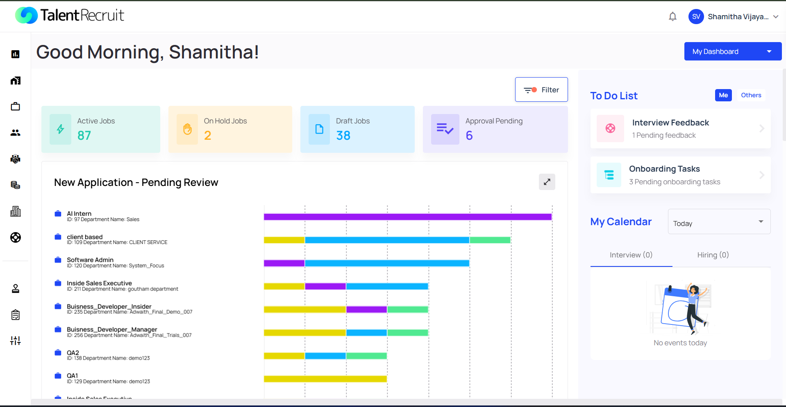
System Design

Slide 16
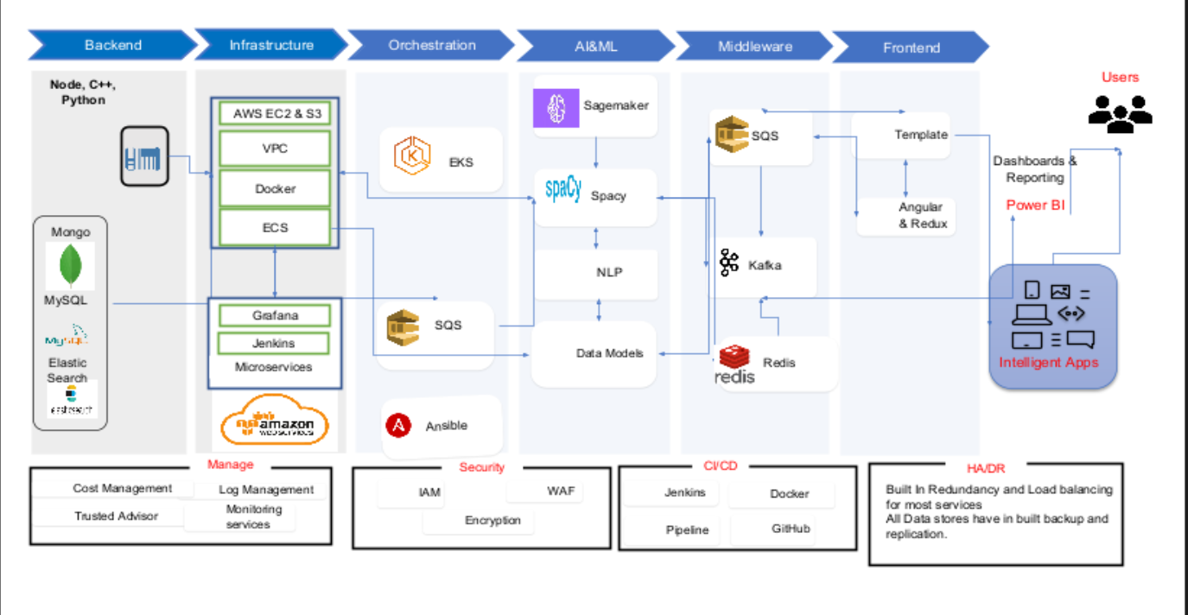

Slide 17
System Implementation
Implementation of a centralized Applicant Tracking System (ATS) to manage the recruitment lifecycle
Job Creation & Configuration: Defining job roles, skills, and hiring criteria
Candidate Sourcing: Integration with job portals, referrals, and internal databases
Resume Screening: AI-based filtering and shortlisting of candidates
Interview Management: Scheduling interviews and collecting feedback
Candidate Tracking: Monitoring candidate status across all hiring stages
Offer Management: Generating and managing offer letters with approval workflows
Onboarding Process: Managing document submission and joining formalities
Dashboard & Analytics: Real-time tracking of recruitment performance

Slide 18
System Testing
Performed functional testing of recruitment workflow modules
Tested job creation and candidate application process
Verified candidate status transitions across hiring stages
Validated data accuracy and consistency in candidate records
Tested API integrations with job portals and external tools
Ensured proper role-based access control (RBAC)
Identified and reported system-level issues and bugs
Supported User Acceptance Testing (UAT) with real-time scenarios

Slide 19
Conclusion
Successfully gained hands-on experience in Applicant Tracking System (ATS)
Understood real-time implementation of AI-driven recruitment workflows
Learned end-to-end hiring process from job creation to onboarding
Improved knowledge of workflow automation, APIs, and data management
Developed problem-solving, communication, and teamwork skills
Gained exposure to client requirements and industry practices
Internship helped bridge the gap between academic learning and real-world application

Slide 20
References
TalentRecruit Official Website – https://www.talentrecruit.com/
Documentation on Applicant Tracking Systems (ATS)
Research articles on Artificial Intelligence & Machine Learning in Recruitment
Study materials on Natural Language Processing (NLP) and chatbot systems
REST API documentation and integration guides
SaaS (Software as a Service) architecture resources
Articles on Recruitment Analytics and Dashboard Reporting
Internal training materials and knowledge shared during internship

Slide 21
Github Link
https://github.com/shamithavij/Talentrecruit_Intership_2026

Slide 22
Q&A

Slide 23
Thank you !!

