Slide 1
CSE7302 - INTERNSHIP
Review-III Presentation CLIENT SUCCESS INTERN
Student Details
Name | SHAMITHA VIJAYAKUMAR
Roll No | 20221CSE0280
Section | 8CSE08
Under the Supervision of,
Dr. Taranath N L
Associate Professor,
Presidency School of CSE Presidency University
Name of the Program: B.Tech CSE
Name of the HoD: Dr. Asif Mohammed
Name of the Program Internship Coordinator: Dr. Balakrishnan
Name of the School Internship Coordinator: Dr. Md Ziaur Rahman

Slide 2
Content
About Company or Organization
Working domain or the technology
About your team and reporting Manager
Challenges Faced in Internship
Objectives of the work
Proposed System
Problem Statement
System Requirements
Advantages of proposed System
System Design
System Implementation
Internship Roadmap
Github Link

Slide 3
About Company or Organization
Talent Recruit is an advanced Recruitment and Onboarding platform designed to simplify,
automate, and enhance the entire hiring lifecycle. It leverages cutting-edge technologies
such as Machine Learning and Artificial Intelligence to help organizations attract, screen, evaluate, and hire the right talent efficiently and accurately.
One of its key highlights is ERIKA – the 24×7 Robotic Recruiter, which automates
candidate engagement, interview scheduling, follow-ups, and communication, ensuring a
seamless and responsive recruitment experience for both recruiters and candidates.
ERIKA reduces manual effort, improves turnaround time, and enhances candidate satisfaction through continuous availability and intelligent interaction.
Talent Recruit enables recruiters to manage job postings, track applications, shortlist
candidates, conduct assessments, schedule interviews, and complete onboarding
processes within a single integrated platform. Its AI-driven analytics and smart
recommendations help recruiters make data-driven hiring decisions, minimize bias, and improve overall hiring quality.
3

Slide 4
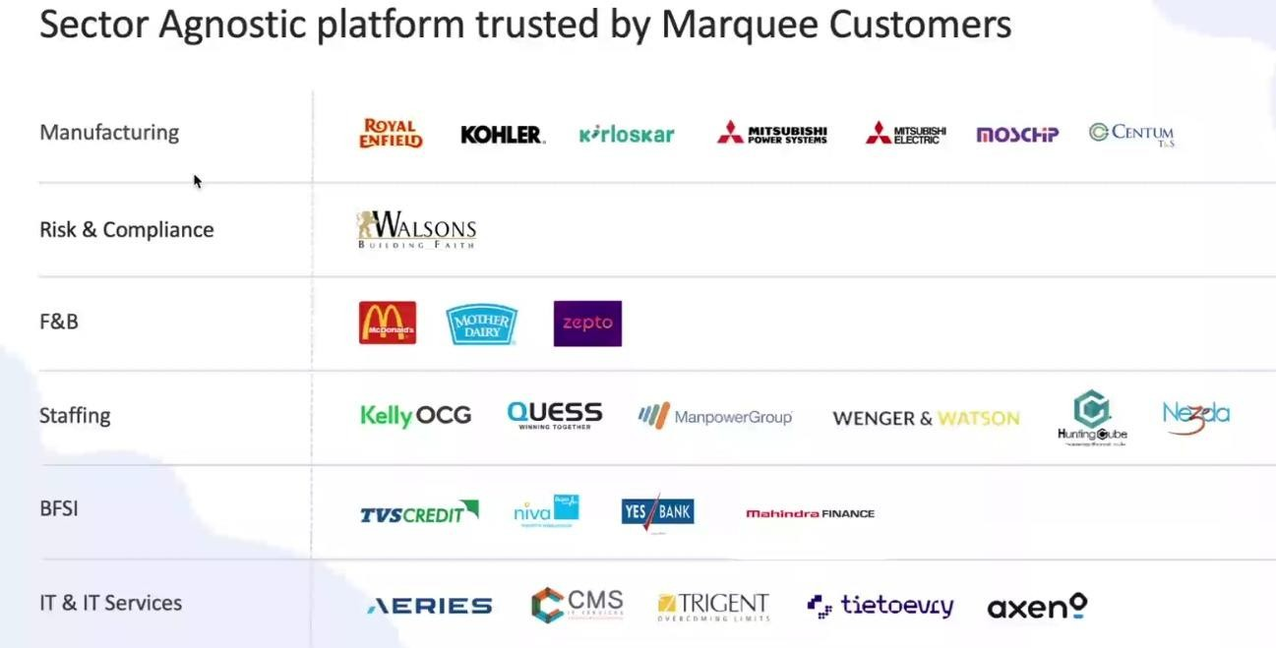
Our Clients
27-02-2026
4

Slide 5
Working domain or the technology
Artificial Intelligence (AI) for intelligent recruitment automation
Machine Learning (ML) for resume screening and candidate ranking
Natural Language Processing (NLP) for chatbot and candidate interaction
Applicant Tracking System (ATS) architecture
SaaS (Software as a Service) cloud-based platform model
Database Management Systems for candidate and job data storage
REST APIs for integration with job portals and communication tools
Chatbot Technology (ERIKA – Robotic Recruiter)
Recruitment Analytics and Reporting Dashboards
Workflow Automation Systems

Slide 6
About your team and reporting Manager
Team Structure, Project, Reporting & Technology Understanding
Our team consists of 9 members, guided by our Reporting Manager, Mr. Ashish Meridatta.
Currently, we are in the training phase on the company’s ATS (Applicant Tracking System) product.
We are learning how each technology supports the recruitment process:
Technology Understanding:
AI & ML: Helps in resume screening and candidate ranking.
NLP: Enables chatbot communication and candidate interaction.
ATS Workflow: Helps track candidates across hiring stages.
Databases: Store and manage candidate and job data.
APIs: Integrate job portals and communication tools.
Dashboards & Analytics: Provide recruitment performance insights.
This training helps us understand how technology solves real recruitment challenges.
After training, we will be assigned to live projects for practical client exposure.

Slide 7
Challenges Faced in Internship
During the initial days of my internship at TalentRecruit Software Private Limited, adapting to a new work environment and getting comfortable with new teammates was slightly challenging. Understanding the various concepts, workflows, and features of the TalentRecruit product also took some time, as it is a comprehensive recruitment platform.
Another initial challenge was managing daily travel through heavy traffic, which was tiring in the beginning. However, with time, support from the team, and regular exposure, I have adjusted well to both the work culture and the product.
Overall, TalentRecruit is a good organization with a strong and growing product. I am now comfortable with the environment and looking forward to learning more and gaining valuable experience in the coming days.

Slide 8
Objectives of the work
To understand ATS system architecture and recruitment workflows.
To support AI-based resume parsing and candidate shortlisting processes.
To assist in database validation and candidate data management.
To ensure accurate workflow automation across hiring stages.
To support API-based integrations with job portals and communication tools.
To analyze recruitment dashboards and system reports.
To help in identifying and resolving basic system-level issues.
To improve overall system efficiency and data consistency.

Slide 9
Proposed System/Work
AI-Powered Applicant Tracking System
Automated resume screening and candidate ranking
Chatbot-based candidate engagement (ERIKA)
Centralized recruitment workflow management
Tailored Analytics and insights customize to specific clients and strategic plans
Power BI and Tableau integrations as per business plans

Slide 10
Problem Statement
Organizations face challenges in managing the end-to-end recruitment process efficiently due to manual coordination, scattered candidate data, and lack of automation. The objective is to streamline hiring workflows using an Applicant Tracking System (ATS) that centralizes candidate management, automates sourcing, and improves recruitment efficiency.

Slide 11
System Requirements
Web-based ATS platform
Cloud infrastructure
Database for candidate and job data
API integrations with job portals and communication tools
Power BI and Tableau API connectivity\
Support for Advanced Analytics via REST APIs enabling real time data synchronization.
Security aspects:
Role based data Access (RBAC)
Securing data Sharing across different clients.

Slide 12
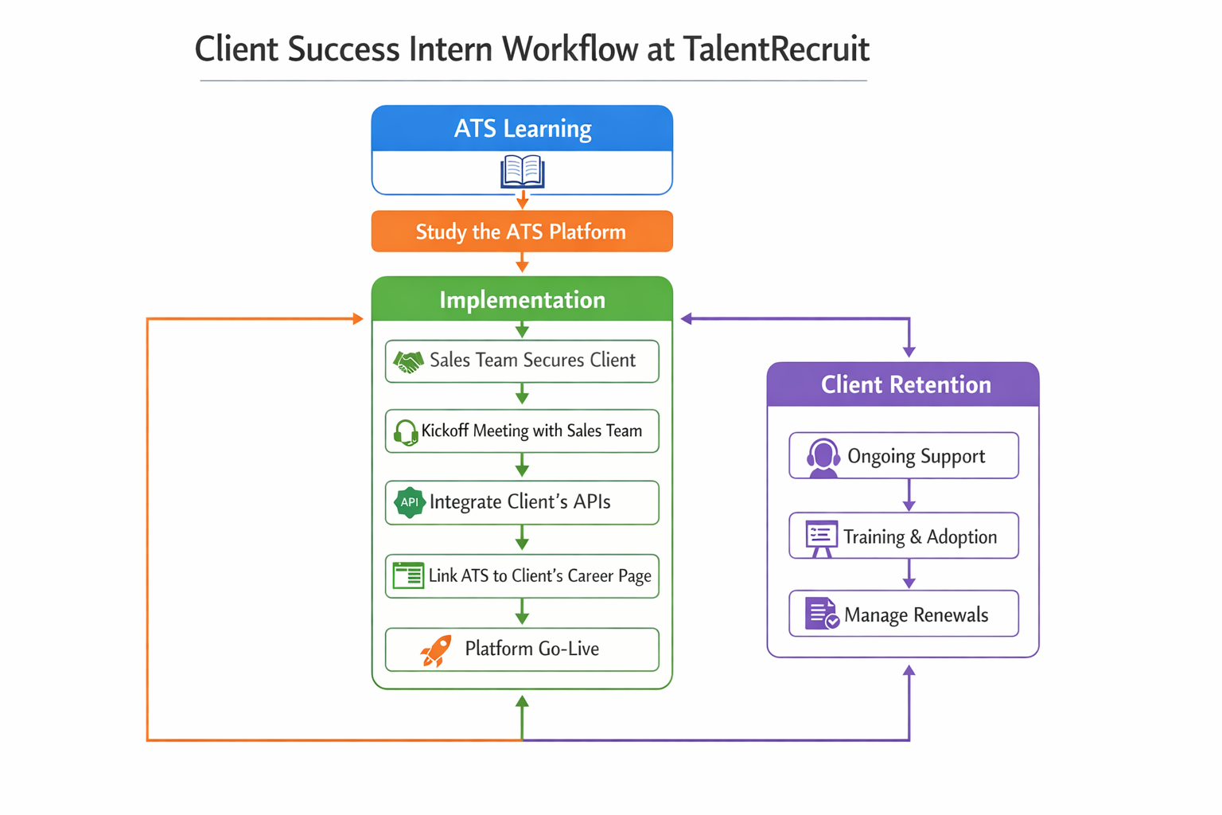

Slide 13
Advantages of proposed System/Work
Reduces manual effort in recruitment
Improves hiring accuracy and speed
Enhances candidate experience
Supports data-driven hiring decisions
Data Driven Decision Making
Actionable Insights
Predictive Modeling
Improved Client and Stakeholder Satisfaction
High Fidelity Visuals.
Bespoke Client Reporting

Slide 14
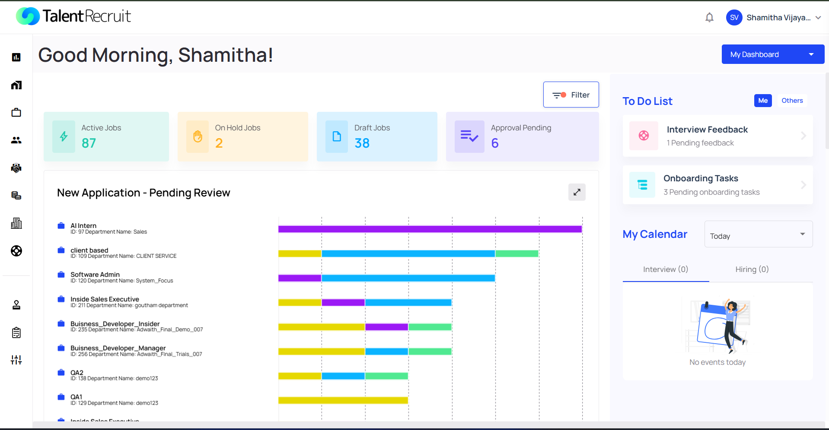
System Design

Slide 15
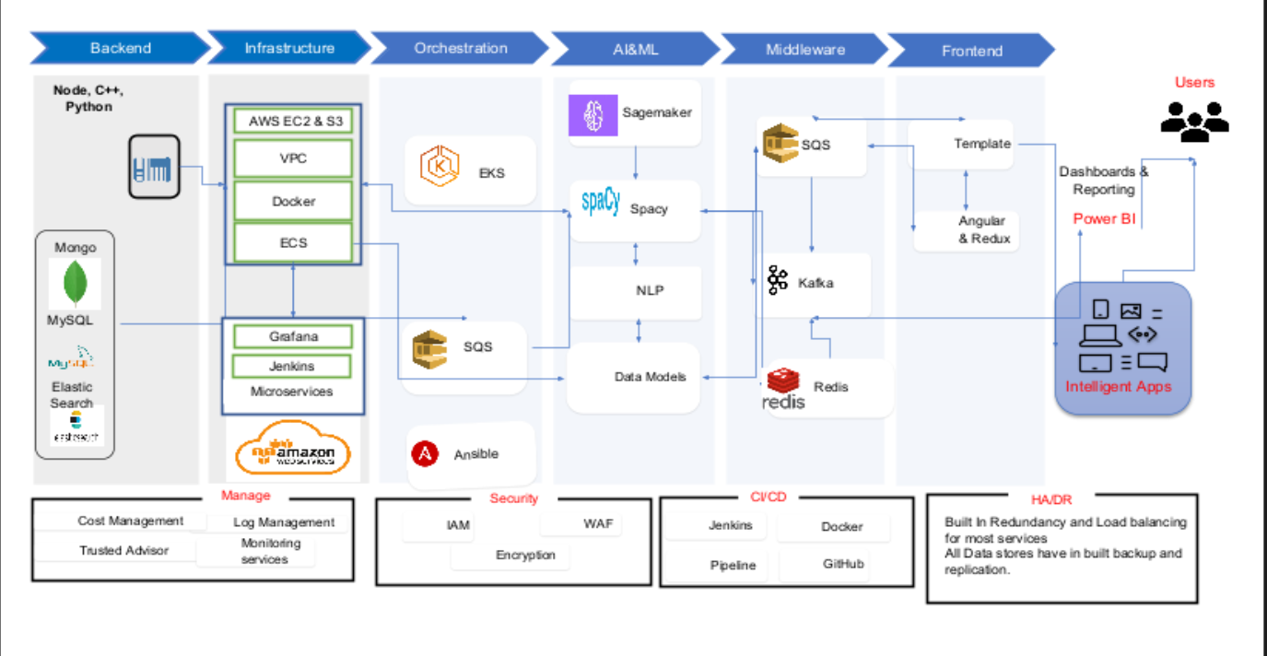

Slide 16
System Implementation
The system implementation focuses on deploying a centralized recruitment workflow that automates and manages the end-to-end hiring lifecycle through an Applicant Tracking System (ATS).
The implementation includes the following key stages:
• Job Creation and Configuration – Recruiters create job roles by defining job descriptions, required skills, and hiring criteria.
• Candidate Sourcing – Candidates enter the system through multiple sources such as career portals, employee referrals, internal job postings, and recruiter database searches.
• Candidate Screening – Applications are reviewed based on job requirements, and shortlisted candidates move to further evaluation stages.
• Interview Management – The system facilitates interview scheduling, interviewer feedback collection, and candidate evaluation tracking.
• Offer Management – Selected candidates receive offer letters through the system with approval workflows and acceptance tracking.
• Onboarding – Once the offer is accepted, the candidate progresses to onboarding activities where required documents and joining formalities are completed.
This structured workflow allows organizations to manage recruitment processes efficiently while maintaining visibility and control across all hiring stages.

Slide 17
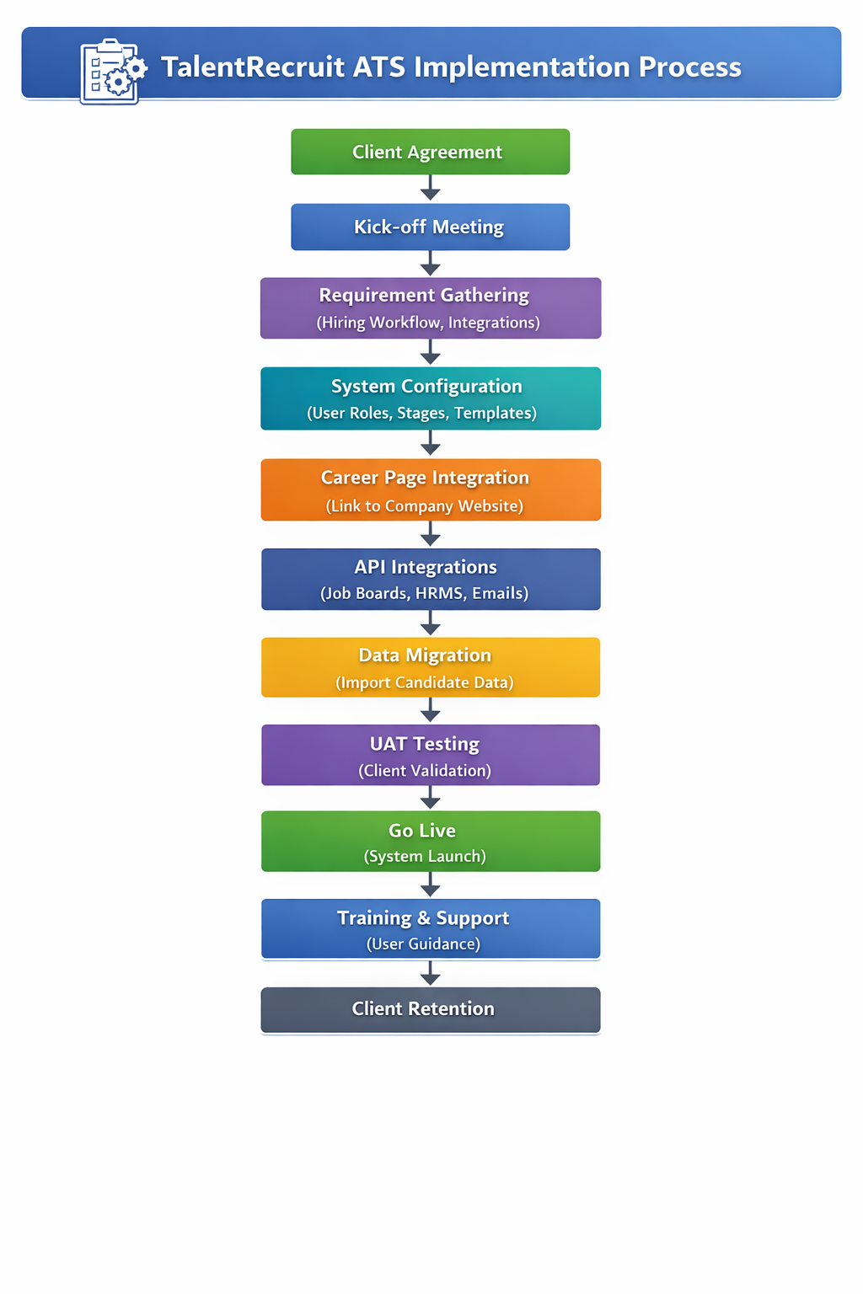

Slide 18
Internship Road Map
Note: Write in the below table what u will be achieving in each review
Final Review
Review 2
Review 3
Review 4
Review 1
Product training and understanding the mechanisms
Understanding AI modules and system integration
Progress on the working domain and technology
Progress on the working domain and technology
Submission of report
and final presentation

Slide 19
Github Link
https://github.com/shamithavij/Talentrecruit_Intership_2026

Slide 20

Q&A

Slide 21
Thank you !!

