Slide 1
CSE7302 - INTERNSHIP Review-2 Presentation CLIENT SUCCESS INTERN
Student Details
Name | SHAMITHA VIJAYAKUMAR
Roll No | 20221CSE0280
Section | 8CSE08
Under the Supervision of,
Dr. Taranath N L
Associate Professor,
Presidency School of CSE
Presidency University
Name of the Program: B.Tech CSE
Name of the HoD: Dr. Asif Mohammed
Name of the Program Internship Coordinator: Dr. Balakrishnan
Name of the School Internship Coordinator: Dr. Md Ziaur Rahman

Slide 2
Content
About Company or Organization
Working domain or the technology
About your team and reporting Manager
Challenges Faced in Internship
Objectives of the work
Literature Review
Proposed System
Problem Statement
System Requirements
Advantages of Proposed System/Work
Internship Roadmap
Github Link

Slide 3
About Company or Organization
Talent Recruit is an advanced Recruitment and Onboarding platform designed to simplify, automate, and enhance the entire hiring lifecycle. It leverages cutting-edge technologies such as Machine Learning and Artificial Intelligence to help organizations attract, screen, evaluate, and hire the right talent efficiently and accurately.
One of its key highlights is ERIKA – the 24×7 Robotic Recruiter, which automates candidate engagement, interview scheduling, follow-ups, and communication, ensuring a seamless and responsive recruitment experience for both recruiters and candidates. ERIKA reduces manual effort, improves turnaround time, and enhances candidate satisfaction through continuous availability and intelligent interaction.
Talent Recruit enables recruiters to manage job postings, track applications, shortlist candidates, conduct assessments, schedule interviews, and complete onboarding processes within a single integrated platform. Its AI-driven analytics and smart recommendations help recruiters make data-driven hiring decisions, minimize bias, and improve overall hiring quality.

Slide 4
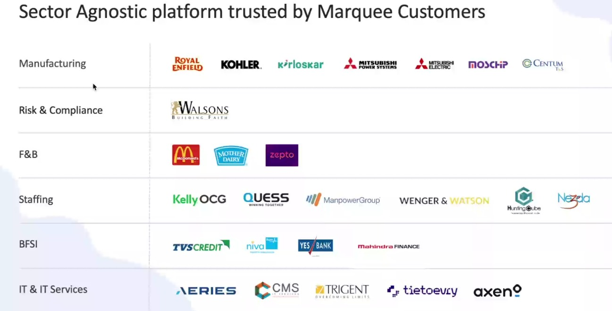
Our Clients

Slide 5
Working domain or the technology
Artificial Intelligence (AI) for intelligent recruitment automation
Machine Learning (ML) for resume screening and candidate ranking
Natural Language Processing (NLP) for chatbot and candidate interaction
Applicant Tracking System (ATS) architecture
SaaS (Software as a Service) cloud-based platform model
Database Management Systems for candidate and job data storage
REST APIs for integration with job portals and communication tools
Chatbot Technology (ERIKA – Robotic Recruiter)
Recruitment Analytics and Reporting Dashboards
Workflow Automation Systems

Slide 6
About your team and reporting Manager
Our team consists of 9 members, guided by our Reporting Manager, Mr. Ashish Meridatta.
Currently, we are in the training phase on the company’s ATS (Applicant Tracking System)
product.
We are learning how each technology supports the recruitment process.
Technology Understanding:
AI & ML: Helps in resume screening and candidate ranking.
NLP: Enables chatbot communication and candidate interaction.
ATS Workflow: Helps track candidates across hiring stages.
Databases: Store and manage candidate and job data.
APIs: Integrate job portals and communication tools.
Dashboards & Analytics: Provide recruitment performance insights.
This training helps us understand how technology solves real recruitment challenges.
After training, we will be assigned to live projects for practical client exposure.

Slide 7
Challenges Faced in Internship
During the initial days of my internship at TalentRecruit Software Private Limited, adapting to a new work environment and getting comfortable with new teammates was slightly challenging. Understanding the various concepts, workflows, and features of the TalentRecruit product also took some time, as it is a comprehensive recruitment platform.
Another initial challenge was managing daily travel through heavy traffic, which was tiring in the beginning. However, with time, support from the team, and regular exposure, I have adjusted well to both the work culture and the product.
Overall, TalentRecruit is a good organization with a strong and growing product. I am now comfortable with the environment and looking forward to learning more and gaining valuable experience in the coming days.

Slide 8
Objectives of the work
To understand ATS system architecture and recruitment workflows.
To support AI-based resume parsing and candidate shortlisting processes.
To assist in database validation and candidate data management.
To ensure accurate workflow automation across hiring stages.
To support API-based integrations with job portals and communication tools.
To analyze recruitment dashboards and system reports.
To help in identifying and resolving basic system-level issues.
To improve overall system efficiency and data consistency.

Slide 9
Proposed System / Work
AI-powered Applicant Tracking System
Automated resume screening and candidate ranking
Chatbot-based candidate engagement (ERIKA)
Centralized recruitment workflow management

Slide 10
Problem Statement
Understanding the sync and corp environment of Talent Recruit

Slide 11
System Requirements
Web-based ATS platform
Cloud infrastructure
Database for candidate and job data
API integrations with job portals and communication tools

Slide 12
Advantages of Proposed System/Work
Reduces manual effort in recruitment
Improves hiring accuracy and speed
Enhances candidate experience
Supports data-driven hiring decisions

Slide 13
Internship Road Map
Note: Write in the below table what u will be achieving in each review
Review 1
Product training and understanding the mechanisms
Review 2
Understanding AI modules and system integration
Review 3
Progress on the working domain and technology
Review 4
Final Review
Progress on the working domain and technology
Submission of report and final presentation

Slide 14
Github Link
https://github.com/shamithavij/Talentrecruit_Intership_2026

Slide 15
Q&A

Slide 16
Thank you !!

