Slide 1
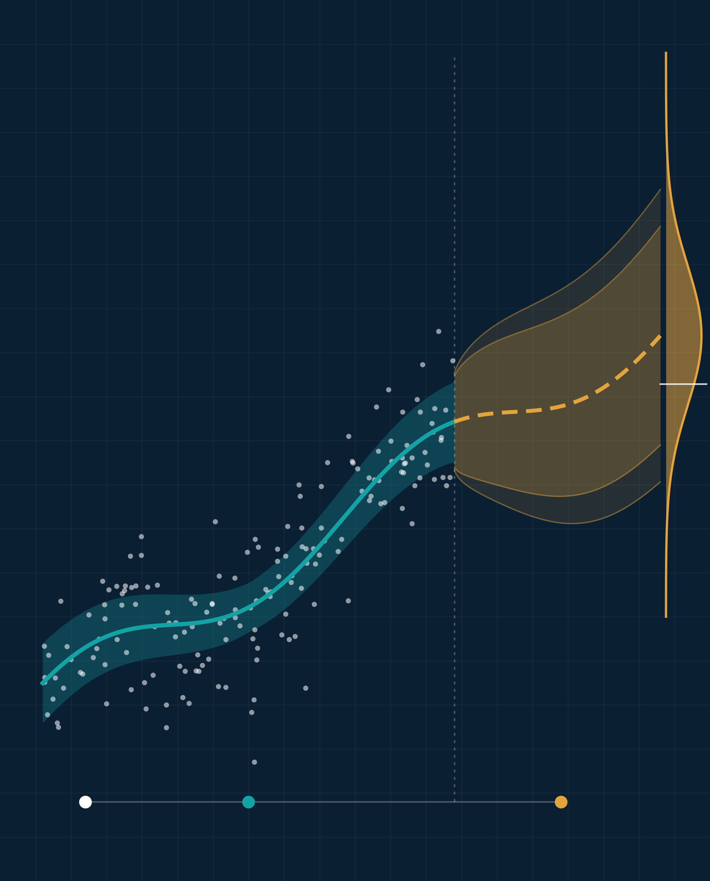
Implications of Advanced Statistics in Business and Research
Illustrative visual · simulated data
ADVANCED STATISTICS IN PRACTICE
Turning data into evidence, decisions, and discovery
PRESENTED BY [Team Name]
[Member 1 Full Name] | [Student ID]
[Member 2 Full Name] | [Student ID]
[Member 3 Full Name] | [Student ID]
[Member 4 Full Name] | [Student ID]
[Member 5 Full Name] | [Student ID]
COURSE
[Course Title] ([Course Code])
INSTRUCTOR
[Instructor Name], [Designation]
DEPARTMENT
[Department]
UNIVERSITY
[University Name]
DATE
[Presentation Date]
Data
Model + uncertainty
Forecast → decision
Notes:
Good morning. Our topic is the implications of advanced statistics in business and research. In simple words: how companies and researchers use statistics to turn data into reliable decisions. The picture on the right shows the idea: we start with data, fit a model with its uncertainty, and use a forecast to make a decision. We will cover why statistics matters, where it is used, one A/B-test example, and the main cautions.

Slide 2
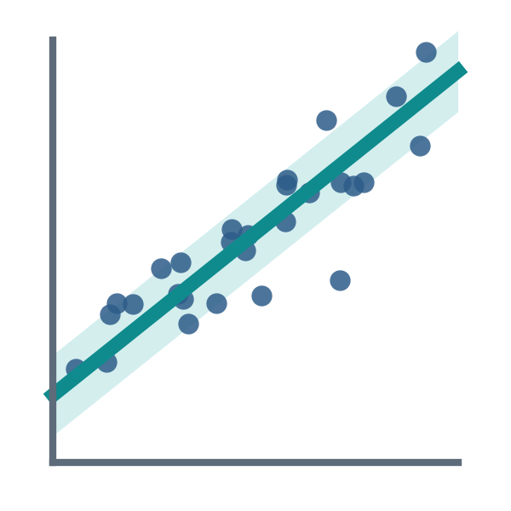
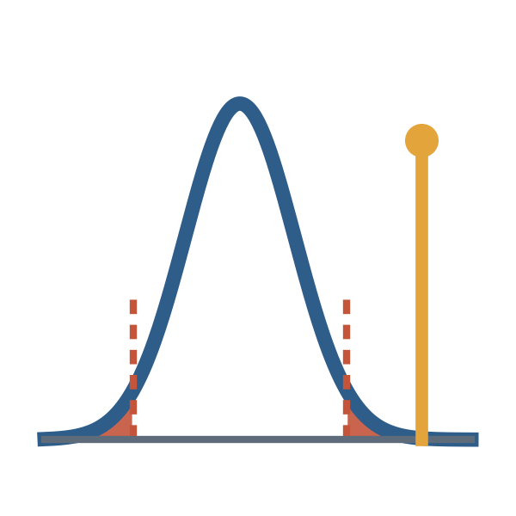
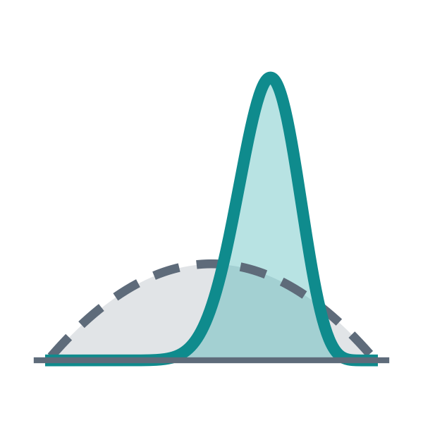
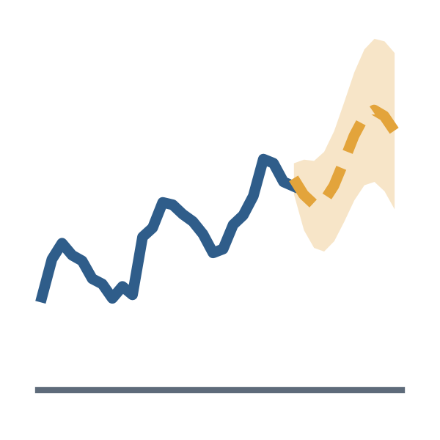
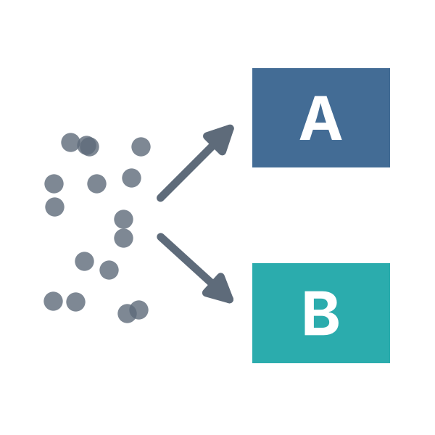
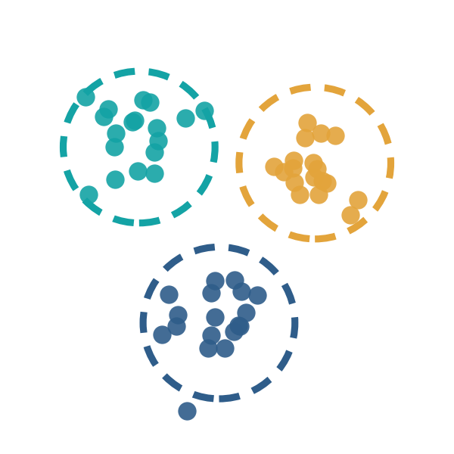
From data to decisions
01 · WHY IT MATTERS & KEY METHODS
Raw data
What was recorded?
Description
What happened?
Prediction
What is likely next?
Inference
Is it real? How sure?
Decision
What should we do?
Key methods: each answers a different question
EVIDENCE
Regression
Hypothesis tests & CIs
Bayesian inference
5–6%
How outcomes change with their drivers
Is a difference real, and how big?
Update beliefs as new data arrives
higher productivity in firms that use data-driven decision-making
Time-series forecasting
Experiments & causal inference
Clustering & multivariate
Brynjolfsson, Hitt & Kim (2011) · observational study of 179 large firms
Predict the future, with a range
What happens if we act?
Find groups in complex data
Notes:
Data alone does not give answers. Statistics moves us from raw data, to describing what happened, to predicting what comes next, to checking whether a pattern is real, and finally to a decision. Different methods answer different questions: regression links outcomes to their drivers, hypothesis tests and confidence intervals check if a difference is real, Bayesian inference updates beliefs with new data, forecasting predicts the future with a range, experiments show what happens when we act, and clustering finds groups. Evidence: firms that use data-driven decision-making are about 5 to 6 percent more productive (Brynjolfsson, Hitt and Kim, 2011). This is an observational finding, not an experiment.

Slide 3


Better decisions in business and research
02 · IMPLICATIONS
Business
Research
Demand forecasting
Customer segments
Pricing
Study design
Power analysis
Credit risk & fraud
Confidence intervals
Reproducibility
REAL CASE · BING SEARCH ADS
REAL CASE · RECOVERY TRIAL
28-day deaths in ventilated COVID-19 patients
IDEA
Show longer ad titles
METHOD
Randomized A/B test
RESULT
+12% revenue
≈ $100M a year in the U.S.
Usual care
41.4%
Dexamethasone
29.3%
Kohavi & Thomke (2017), Harvard Business Review
Randomized trial · RECOVERY Collaborative Group (2021), NEJM
Notes:
In business, statistics drives demand forecasting, customer segmentation, pricing, and credit-risk and fraud checks. Real case: Bing tested longer ad titles with a randomized A/B test. Revenue rose about 12 percent, worth more than 100 million dollars a year in the U.S. (Kohavi and Thomke, 2017). In research, statistics makes results reliable through good study design, a power analysis to choose the sample size, confidence intervals, and reproducibility. Real case: the RECOVERY randomized trial found that dexamethasone cut 28-day deaths in ventilated COVID-19 patients from 41.4 to 29.3 percent. A warning from research: when 100 psychology studies were repeated, only 36 percent gave significant results again (Open Science Collaboration, 2015).

Slide 4
A/B test: does a new product page sell more?
03 · CASE STUDY
ILLUSTRATIVE DATA hypothetical, not real company results
1
Split
40,000 visitors at random: 20,000 see the old page (A), 20,000 the new page (B).
+0.60 pp
difference (B − A)
+0.19 to +1.01 pp
95% confidence interval
2
Measure
Conversion rate = orders ÷ visitors.
p = 0.004
very unlikely to be chance
3
Test
Two-proportion z-test at the 5% level.
Meaning The new page very likely works better, but the exact gain is uncertain.
Visitors are assigned at random, so the only real difference between the groups is the page.
DECISION
Launch page B and keep monitoring results.
A: 840 / 20,000 · B: 960 / 20,000 orders
Notes:
This example uses made-up numbers to show the method. An online shop splits 40,000 visitors at random: half see the old page, half see the new page. The old page converts 4.2 percent of visitors, the new page 4.8 percent, a difference of 0.6 percentage points. The 95 percent confidence interval is 0.19 to 1.01 points and the p-value is 0.004, so the gain is very unlikely to be chance, although its exact size is uncertain. Decision: launch the new page and keep monitoring.

Slide 5






Use statistics carefully and honestly
04 · CHALLENGES & ETHICS
Biased data
Overfitting
P-hacking
Wrong or one-sided data gives wrong answers.
A model that memorizes noise fails on new data.
Running many tests guarantees some false “wins”.
Correlation ≠ causation
Significant ≠ important
Privacy & fairness
Even accurate AI predictions do not prove cause.
Always report how big the effect is.
Protect people and check models for bias.
RESPONSIBLE PRACTICE
1 Plan
2 Check
3 Estimate
4 Stress-test
5 Report
set the question first
data and assumptions
effects with uncertainty
robustness checks
honestly, with limits
Notes:
Statistics can mislead if we are careless. Six common problems: biased data, overfitting, p-hacking (running many tests until something looks significant), confusing correlation with causation (even accurate AI predictions do not prove cause), treating 'significant' as 'important', and ignoring privacy and fairness. Good practice follows five steps: plan the question first, check the data and assumptions, estimate effects with their uncertainty, stress-test the results, and report honestly with limitations.

Slide 6
Key takeaways
05 · CONCLUSION
01
02
03
04
Data becomes evidence
Test before you decide
Design drives rigor
Interpret responsibly
Statistics separates real patterns from noise.
Experiments and intervals beat opinion.
Good design and sample size make research reliable.
Effect size, transparency and fairness matter.
“The value of data lies not merely in collecting it, but in drawing reliable conclusions from it.”
Thank you · Questions?
References: Brynjolfsson, Hitt & Kim (2011), SSRN · Kohavi & Thomke (2017), Harvard Business Review 95(5) · RECOVERY Collaborative Group (2021), NEJM 384(8) · Open Science Collaboration (2015), Science 349 · Wasserstein & Lazar (2016), The American Statistician 70(2)
Notes:
Four takeaways. One: statistics turns data into evidence by separating real patterns from noise. Two: testing ideas before deciding beats opinion. Three: in research, good design and the right sample size make results reliable. Four: interpret results responsibly, with effect sizes, transparency and fairness. The value of data lies not merely in collecting it, but in drawing reliable conclusions from it. Thank you. We are happy to take questions.

