Slide 1
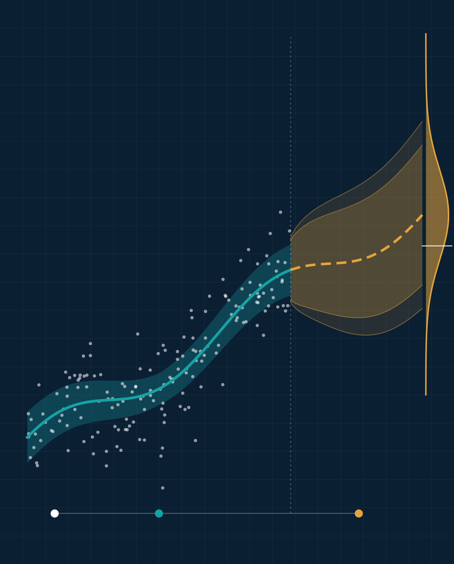
Implications of Advanced Statistics in Business and Research
Illustrative visual · simulated data
ADVANCED STATISTICS IN PRACTICE
Turning data into evidence, decisions, and discovery
PRESENTED BY [Team Name]
[Member 1 Full Name] | [Student ID]
[Member 2 Full Name] | [Student ID]
[Member 3 Full Name] | [Student ID]
[Member 4 Full Name] | [Student ID]
[Member 5 Full Name] | [Student ID]
COURSE
[Course Title] ([Course Code])
INSTRUCTOR
[Instructor Name], [Designation]
DEPARTMENT
[Department]
UNIVERSITY
[University Name]
DATE
[Presentation Date]
Data
Model + uncertainty
Forecast → decision
Notes:
OPENING (about 1 minute)
Introduce the team and the question this presentation answers: what changes when organizations and researchers move beyond simple summaries to advanced statistical methods?
The visual on the right is the story of the talk in one picture (simulated data, for illustration only): raw observations (white points), a fitted model with an uncertainty band (teal), a forecast whose interval widens with the horizon (amber), and the predictive distribution that a decision-maker compares with a threshold (the horizontal line).
Roadmap: why it matters, the key methods, business implications, research implications, a worked A/B-test case, risks and ethics, and the takeaways.
Editing: team member names and IDs are in a borderless table. Click the last cell and press Tab to add a member; right-click a row and choose Delete Rows to remove one.

Slide 2



Statistics turns data into evidence you can act on
02 · WHY ADVANCED STATISTICS MATTERS
RAW DATA
DESCRIPTION · BI
PREDICTIVE ANALYTICS
STATISTICAL INFERENCE
EVIDENCE-BASED DECISION
What was recorded?
What happened?
What is likely next?
Is it real, why, and how sure are we?
What should we do?
Transactions, sensors, surveys and trial records — noisy and incomplete.
Dashboards and averages summarize the past but cannot separate signal from noise.
Models learn patterns to forecast outcomes and score the risk of new cases.
Tests, intervals and causal designs weigh competing explanations.
Act with the expected benefit and its uncertainty made explicit.
Why intuition and simple summaries fall short
EVIDENCE FROM BUSINESS RESEARCH
5–6%
Averages hide structure
Patterns can be noise
Correlation ≠ causation
higher output and productivity in firms that use data-driven decision-making than their other investments and IT use would predict (179 large publicly traded U.S. firms).
Combined data can show the opposite trend to every subgroup (Simpson’s paradox).
Without a measure of sampling variability, chance fluctuations look like real signals.
A hidden confounder can drive both variables; only design or explicit causal assumptions resolve it.
Brynjolfsson, Hitt & Kim (2011). Observational study; instrumental variables used to address reverse causality.
Notes:
WHY IT MATTERS (about 2 minutes)
Walk the five stages left to right (each appears on click).
- Business intelligence describes what happened: dashboards, KPIs, averages. Useful, but it cannot tell you whether a change is real or random.
- Predictive analytics answers 'what is likely next?' It can be very accurate without explaining why.
- Statistical inference asks whether a pattern is real, how large it is, how uncertain we are, and which explanation the evidence favors. Causal designs go one step further and ask what happens if we intervene.
Shmueli (2010), 'To explain or to predict?', makes this distinction: explanatory, predictive and descriptive models serve different goals and are judged by different criteria.
Limits of intuition: Simpson's paradox (aggregated data can reverse a subgroup trend); sampling variability (small samples produce striking but unstable patterns); confounding (a third factor drives both variables).
Evidence: Brynjolfsson, Hitt and Kim (2011) surveyed 179 large publicly traded firms and found that firms adopting data-driven decision-making had output and productivity about 5-6% higher than expected given their other investments and IT use. Be precise: this is an observational association; the authors use instrumental-variable methods to argue against reverse causality, but it is not a randomized experiment.
Source: Brynjolfsson, E., Hitt, L. M., & Kim, H. H. (2011). Strength in numbers: How does data-driven decisionmaking affect firm performance? https://doi.org/10.2139/ssrn.1819486

Slide 3
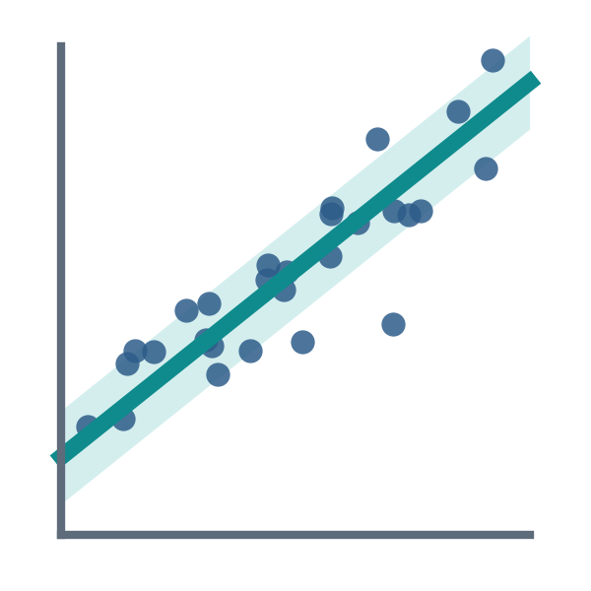
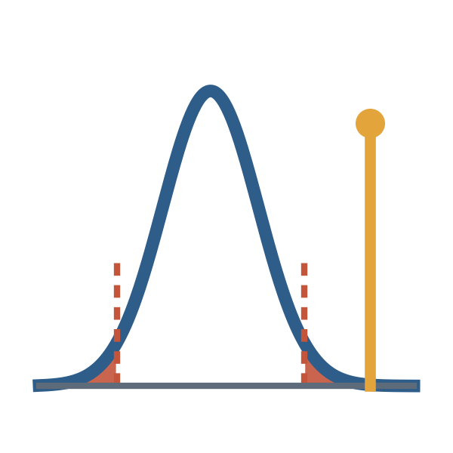
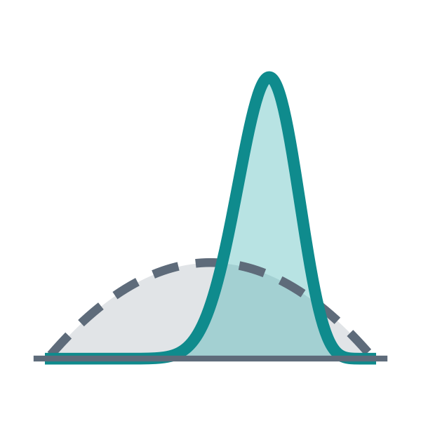
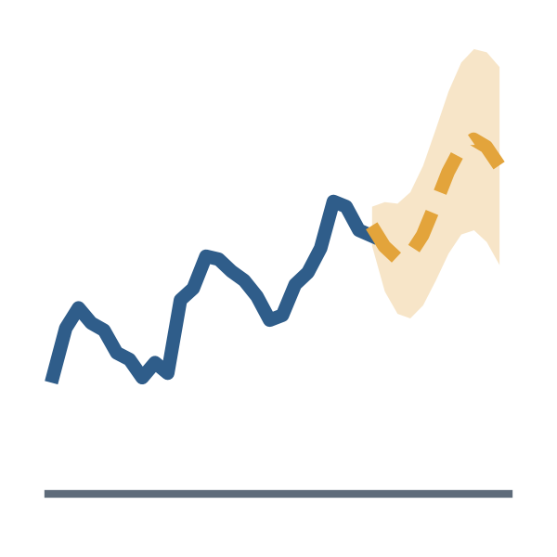
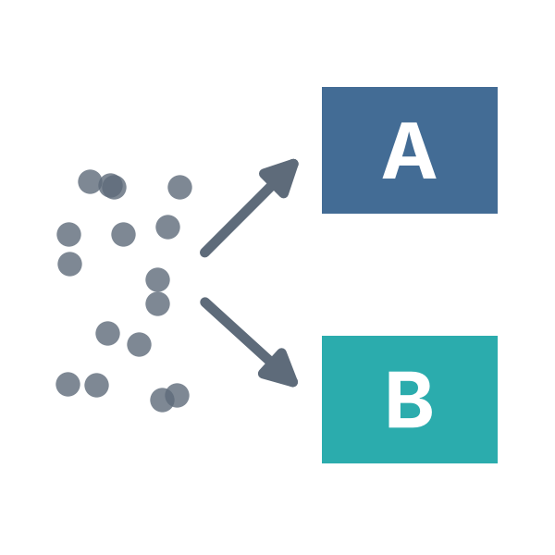

Different methods answer different questions
03 · KEY ADVANCED STATISTICAL METHODS
Regression & predictive modeling
Hypothesis tests & confidence intervals
Bayesian inference
Asks How does an outcome move with its drivers, and what will it be for a new case?
Applied Price elasticity and sales drivers; wage and dose–response studies.
Caveat Coefficients show association unless the design supports causation.
Asks Is a difference bigger than sampling noise, and how large could it plausibly be?
Applied Comparing campaigns or treatments; quality-control checks.
Caveat p < 0.05 does not prove an important effect — report effect sizes.
Asks Given prior knowledge and new data, how probable is each explanation?
Applied Updating risk estimates; adaptive clinical trials; small-sample tests.
Caveat Conclusions depend on the prior — state it and test its influence.
Time-series forecasting
Experimental design & causal inference
Multivariate analysis & clustering
Asks What comes next, given trend, seasonality and autocorrelation?
Applied Demand, inventory and cash-flow planning; economic and disease series.
Caveat Structural breaks can ruin forecasts; always show prediction intervals.
Asks What happens if we intervene, rather than merely observe?
Applied A/B tests and pricing trials; randomized controlled trials; difference-in-differences.
Caveat Needs randomization or strong, explicitly stated assumptions.
Asks What structure exists across many variables at once?
Applied Customer segments; survey scales (PCA, factor analysis); gene groups.
Caveat Clusters are descriptive and shift with variable scaling and the chosen k.
Choosing a method: research objective → data structure (scale, dependence, sample size) → assumptions → decision context
Notes:
KEY METHODS (about 2 minutes). For each method: what it does, why it is useful, how it is applied, what it supports, and its limits.
1. Regression and predictive modeling. Models an outcome as a function of predictors and quantifies each association with uncertainty. Useful for explaining variation and predicting new cases. Business: price elasticity, sales-driver analysis. Research: wage equations, dose-response. Supports pricing, budgeting and targeting decisions. Limits: omitted variables, multicollinearity, overfitting; coefficients are associations unless the design is causal.
2. Hypothesis tests and confidence intervals. Ask whether an observed difference is larger than expected from sampling variation, and give a range of effect sizes compatible with the data. Supports go/no-go decisions and scientific claims. Limits: a p-value is not the probability that the hypothesis is true and does not measure effect size or importance (ASA statement, Wasserstein & Lazar, 2016). Always report the effect size and its interval.
3. Bayesian inference. Combines a prior distribution with the likelihood of the data to give a posterior distribution, so results can be stated as probabilities of hypotheses or parameter values. Useful with small samples, sequential decisions and when prior evidence exists. Applications: credit-risk updating, adaptive clinical trials, Bayesian A/B testing. Limits: sensitivity to the prior and computational cost; report the prior and run sensitivity analyses (Gelman et al., 2013).
4. Time-series forecasting. Models trend, seasonality and autocorrelation (exponential smoothing, ARIMA) to forecast future values with prediction intervals. Supports inventory, staffing and cash-flow planning. Limits: assumes the past pattern continues; structural breaks (for example, a pandemic) can invalidate a model (Hyndman & Athanasopoulos, 2021).
5. Experimental design and causal inference. Random assignment makes groups comparable on both measured and unmeasured factors, so differences in outcomes can be attributed to the intervention. Quasi-experimental methods (difference-in-differences, instrumental variables, regression discontinuity) estimate causal effects from observational data under explicit assumptions. Supports decisions about interventions. Limits: experiments are not always ethical or feasible; quasi-experiments rest on assumptions that must be defended (Hernan & Robins, 2020).
6. Multivariate analysis and clustering. Principal component and factor analysis reduce many correlated variables to a few dimensions; cluster analysis groups similar observations. Supports segmentation and measurement design. Limits: clusters are descriptive, depend on scaling and the number of clusters, and should be validated for stability.
Key message: the question, data structure and assumptions decide the method, not the software.

Slide 4
Statistics changes how firms decide
04 · IMPLICATIONS IN BUSINESS DECISION-MAKING
VERIFIED CASE Bing search ads: one online controlled experiment, from question to outcome (Kohavi & Thomke, 2017)
1 · QUESTION
2 · DATA
3 · METHOD
4 · INSIGHT
5 · DECISION
6 · OUTCOME
Would longer ad titles raise revenue without hurting the user experience?
Users randomly assigned to the old or new ad layout; revenue and user-experience metrics logged.
Online controlled experiment (A/B test) with significance tests on each metric.
Revenue up about 12% with no harm to key user-experience metrics; result replicated.
Ship an idea that had sat in the backlog for more than six months.
Estimated at more than $100 million a year in U.S. revenue at the time.
Across business functions: question, method, decision
Function | Key question | Statistical method | Decision supported
Demand & inventory | How much will we sell next quarter, and how uncertain is that? | Time-series models (ETS, ARIMA) with prediction intervals | Set orders and safety stock from the interval, not a single point guess
Customer segmentation | Which customers behave alike, and how do the groups differ? | Cluster analysis; principal component analysis | Tailor offers, channels and product design to each segment
Pricing & revenue | How does demand respond to a price change? | Price-elasticity regression; randomized price tests | Change prices with an expected revenue effect and its uncertainty
Credit risk & fraud | How likely is default or fraud for this application? | Logistic-regression scorecards; anomaly detection | Approve, price or flag — with error rates and fairness monitored
Churn & retention | Who will leave, and does an offer change that? | Survival or classification models plus uplift experiments | Target customers the offer persuades, not just those most at risk
Notes:
BUSINESS IMPLICATIONS (about 2 minutes)
Reveal the reasoning chain one step per click.
Case (Kohavi & Thomke, 2017, Harvard Business Review): a Bing employee proposed lengthening ad title lines by merging text from the line below the title. The idea was rated low priority and sat in the backlog for more than six months. When it was finally tested in an online controlled experiment, revenue rose about 12% with no significant harm to key user-experience metrics. The result was so large that it triggered a 'too good to be true' alert, so it was checked and replicated before shipping. The authors estimated the change was worth more than $100 million a year in U.S. revenue at the time. Note: these are the authors' published figures for Bing, not our estimates.
Why statistics mattered: expert judgment had ranked the idea low. Randomization isolated the causal effect of the change; guardrail metrics checked that revenue did not come at the cost of user experience; replication protected against a false positive.
Table: each business function pairs a question with an appropriate method. Two contrasts to highlight:
- Forecasting: planning from a prediction interval rather than a point forecast is what turns a forecast into an inventory policy (safety stock).
- Churn: a churn model predicts who will leave; it does not tell you who an offer will change. Uplift (treatment-effect) modeling with randomized offers estimates the causal effect, so budget goes where the offer actually works.
Sources: Kohavi, R., & Thomke, S. (2017). The surprising power of online experiments. Harvard Business Review, 95(5), 74-82. Kohavi, R., Tang, D., & Xu, Y. (2020). Trustworthy online controlled experiments. Cambridge University Press. Hyndman, R. J., & Athanasopoulos, G. (2021). Forecasting: Principles and practice (3rd ed.). OTexts.

Slide 5
Rigor lives in the design, not just the analysis
05 · IMPLICATIONS IN SCIENTIFIC & ACADEMIC RESEARCH
1
2
3
4
5
6
Research question
Study design
Data collection
Statistical analysis
Interpretation
Conclusion
Testable hypothesis; primary outcome fixed in advance
Randomized or observational? Plan for confounding
Sample size from a power analysis; valid measures
Model matched to the data and its assumptions
Effect sizes, confidence intervals, robustness checks
Claims proportional to evidence; reproducible code and data
EVIDENCE EXAMPLE RECOVERY randomized trial: dexamethasone vs. usual care
REPRODUCIBILITY CHECK
28-day mortality, hospitalized COVID-19 patients · 6,425 randomized (2,104 vs. 4,321) · age-adjusted rate ratios
97% → 36%
Respiratory support
Dexa.
Usual care
Rate ratio (95% CI)
Invasive ventilation
29.3%
41.4%
0.64 (0.51–0.81)
of 100 published psychology studies reported significant results; only 36% of their high-powered replications did. Replication effects were about half as large.
Oxygen only
23.3%
26.2%
0.82 (0.72–0.94)
No respiratory support
17.8%
14.0%
1.19 (0.92–1.55)
All patients
22.9%
25.7%
0.83 (0.75–0.93)
Open Science Collaboration (2015), Science
Low power, flexible analysis and selective publication inflate findings; pre-registration and open data counter them.
0.5
0.75
1
1.5
Log scale. Redrawn from RECOVERY, NEJM 2021.
← favors dexamethasone
favors usual care →
Notes:
RESEARCH IMPLICATIONS (about 2 minutes)
Reveal the six workflow steps on click. Statistical thinking enters at every step, not only at 'analysis':
- Question: a falsifiable hypothesis and a pre-specified primary outcome prevent outcome-switching.
- Design: randomization balances measured and unmeasured confounders; observational designs need explicit adjustment and causal assumptions.
- Data collection: a power analysis sets the sample size. Underpowered studies miss real effects and exaggerate the ones they find (Button et al., 2013).
- Analysis: the model must fit the data type and assumptions (independence, distribution, missing-data mechanism).
- Interpretation: report effect sizes with confidence intervals, and run robustness and sensitivity analyses.
- Conclusion: claims should match the strength of evidence; share code and data so others can reproduce them.
Evidence example: RECOVERY trial (RECOVERY Collaborative Group, NEJM 2021). 2,104 patients were randomized to dexamethasone and 4,321 to usual care. 28-day mortality: 22.9% vs 25.7%, age-adjusted rate ratio 0.83 (95% CI 0.75 to 0.93; P<0.001). Ventilated patients: 29.3% vs 41.4%, RR 0.64 (0.51 to 0.81). Oxygen only: 23.3% vs 26.2%, RR 0.82 (0.72 to 0.94). No respiratory support: 17.8% vs 14.0%, RR 1.19 (0.92 to 1.55), so no benefit was shown in that group.
What statistics contributed: randomization made the comparison causal; confidence intervals show both size and precision; the subgroup pattern informed who should receive the drug. Subgroup results should be read with caution, since many subgroups increase the chance of spurious differences.
Reproducibility: the Open Science Collaboration (2015) replicated 100 studies from three psychology journals. 97% of originals had p < .05; 36% of replications did, and mean replication effect sizes were about half the original. This is a warning about weak designs and selective reporting, not a reason to distrust statistics.
Sources: RECOVERY Collaborative Group (2021), NEJM 384(8), 693-704, https://doi.org/10.1056/NEJMoa2021436. Open Science Collaboration (2015), Science 349(6251), aac4716, https://doi.org/10.1126/science.aac4716. Button et al. (2013), Nature Reviews Neuroscience 14, 365-376.

Slide 6
Does a redesigned product page lift conversion?
06 · PRACTICAL CASE STUDY
ILLUSTRATIVE DATA hypothetical, not real company results
1 Design
2 Results
3 Inference & decision
40,000 product-page visitors
Method two-proportion z-test (large samples, independent visitors, random assignment)
Random assignment, 50 / 50
+0.60 pp
+14.3%
p = 0.004
difference (B − A)
relative lift
z = 2.89, two-sided
A · Control
current page
n = 20,000
B · Treatment
redesigned page
n = 20,000
95% confidence interval for the difference
no effect
+0.19
+1.01
Hypotheses H₀: p_{B} = p_{A} H₁: p_{B} ≠ p_{A}
Test two-sided, α = 0.05
Primary metric conversion rate = orders ÷ visitors
Power 80% to detect +0.6 pp from a 4.2% baseline needs ≈ 18,740 visitors per arm → 20,000 planned
Discipline fixed test length set in advance; no stopping on interim peeks
pp
-0.5
0.0
+0.5
+1.0
+1.5
If the redesign had no effect, a gap this large would arise in only about 0.4% of repeated experiments. The true lift is plausibly anywhere from +0.19 to +1.01 pp: likely real, but its size is uncertain.
A: 840 orders / 20,000 visitors = 4.20%
B: 960 orders / 20,000 visitors = 4.80%
Axis starts at zero. Separate 95% CIs:
A 3.92–4.48% · B 4.50–5.10%
DECISION Roll out B if guardrail metrics (returns, page speed) show no harm; keep monitoring for novelty effects.
Notes:
CASE STUDY (about 2 minutes). ALL NUMBERS ON THIS SLIDE ARE HYPOTHETICAL, created to illustrate the method. They are not results from any real company.
Design: 40,000 visitors are randomly assigned 50/50. Random assignment means the two groups differ only by chance and by the page they see, so a difference in conversion can be attributed to the redesign. Hypotheses: H0: pB = pA; H1: pB != pA, two-sided, alpha = 0.05. Primary metric fixed in advance: conversion rate = orders / visitors.
Power analysis (normal approximation): to detect 4.2% -> 4.8% with 80% power at alpha 0.05 two-sided, n per arm = [1.96*sqrt(2*0.045*0.955) + 0.8416*sqrt(0.042*0.958 + 0.048*0.952)]^2 / 0.006^2 = about 18,738. We plan 20,000 per arm. The test runs for a fixed period; stopping early when p first dips below 0.05 inflates the false-positive rate.
Results (click 1): A = 840/20,000 = 4.20%; B = 960/20,000 = 4.80%.
Inference (click 2): two-proportion z-test.
Pooled p = 1,800/40,000 = 0.045. SE under H0 = sqrt(0.045*0.955*(1/20,000 + 1/20,000)) = 0.002073.
z = 0.006 / 0.002073 = 2.89; two-sided p = 0.0038, about 0.004.
95% CI for the difference uses the unpooled SE = sqrt(0.042*0.958/20,000 + 0.048*0.952/20,000) = 0.002073; 0.006 +/- 1.96*0.002073 = +0.19 to +1.01 percentage points.
Relative lift = 0.60/4.20 = 14.3%.
Interpretation (click 3): the p-value is the probability of a difference at least this large if there were truly no effect; it is not the probability that the redesign works. The confidence interval matters more for the business: the effect could be as small as 0.19 pp or as large as 1.01 pp. Assumptions: independent visitors (one count per visitor), stable traffic mix, no interference between groups.
Decision: launch B, provided guardrail metrics such as return rate and page load time show no harm. Monitor after launch, because novelty effects can fade. If the minimum worthwhile lift were, say, 0.5 pp, the interval would not settle that question and a larger test would be justified.
Method reference: Kohavi, Tang & Xu (2020), Trustworthy Online Controlled Experiments; Montgomery (2017), Design and Analysis of Experiments.

Slide 7
Sophistication without discipline misleads
07 · CHALLENGES, ETHICS & FUTURE IMPLICATIONS
Risk | What goes wrong | Safeguard
Data quality & sampling bias | Sample does not represent the population of interest | Audit data provenance; reweight or redesign the sample
Violated model assumptions | Biased estimates and wrong standard errors | Residual diagnostics; robust or alternative models
Overfitting | Model memorizes noise and fails on new data | Hold-out data and cross-validation; simpler models
Multiple testing & p-hacking | Testing many outcomes guarantees some false positives | Pre-registration; Holm or false-discovery-rate correction
Confounding | Spurious causal claims from observational data | Randomize, or use explicit causal designs and diagrams
Misreading significance | “Significant” read as “large” or “important” | Report effect sizes with confidence intervals
Privacy & fairness | Models harm individuals or disadvantage groups | Consent, data minimization, bias audits across groups
Missing domain expertise | Valid statistics answer the wrong question | Involve domain experts; report methods transparently
MACHINE LEARNING & AI
ML excels at prediction from large, complex data and increasingly complements statistical modeling. But accurate prediction does not show what would happen under an intervention: prediction is not causation (Shmueli, 2010).
Example: a widely used U.S. health algorithm predicted cost as a proxy for need, and so understated the needs of Black patients (Obermeyer et al., 2019).
RESPONSIBLE PRACTICE
1
Plan pre-specify question, outcome, analysis
2
Check data quality and model assumptions
3
Estimate effect sizes with their uncertainty
4
Stress-test robustness and hold-out data
5
Report transparently, limitations included
Notes:
CHALLENGES AND ETHICS (about 2 minutes)
Advanced methods amplify whatever goes into them. The table pairs each common failure with a practical safeguard.
- Sampling bias: a large biased sample is still biased; size does not fix representativeness.
- Assumptions: check residuals, independence, and missing-data mechanisms; use robust methods when assumptions fail.
- Overfitting: evaluate on data the model has not seen (hold-out sets, cross-validation) (Hastie et al., 2009).
- Multiple testing and p-hacking: with 20 independent tests at alpha 0.05, about one 'significant' result is expected by chance. Flexible analysis choices can push false-positive rates far above 5% (Simmons, Nelson & Simonsohn, 2011). Pre-register and correct for multiplicity.
- Confounding: causal claims need randomization or explicit causal assumptions (Hernan & Robins, 2020).
- Significance: the ASA statement (Wasserstein & Lazar, 2016) stresses that p-values do not measure effect size or importance; Amrhein, Greenland & McShane (2019) argue against dichotomizing results as significant or not.
- Privacy and fairness: Obermeyer et al. (2019, Science) showed that an algorithm using health-care cost as a proxy for health need assigned Black patients the same risk score as White patients who were less sick, because less money had been spent on their care. The statistical target, not just the model, created the bias.
- Domain expertise: statistics answers the question you asked; experts make sure it is the right question.
ML and AI: machine learning is increasingly used alongside classical statistics, especially for prediction with many variables. Statistical thinking remains essential for uncertainty, study design and causal questions.
Framework: Plan, Check, Estimate, Stress-test, Report.

Slide 8
Reliable conclusions are where data creates value
08 · CONCLUSION & KEY TAKEAWAYS
“
01
Advanced statistics turns raw data into structured evidence.
Description, prediction and inference answer different questions.
The value of data lies not merely in collecting it, but in drawing reliable conclusions from it.
02
Businesses decide better by quantifying uncertainty and testing alternatives.
Experiments and intervals replace opinion with measured risk.
03
Researchers strengthen conclusions through design and rigorous inference.
Power, randomization and robustness checks matter as much as models.
Thank you · Questions and discussion
04
Responsible interpretation matters as much as technical sophistication.
Effect sizes, transparency and fairness keep results trustworthy.
KEY REFERENCES
Brynjolfsson, Hitt & Kim (2011). Strength in numbers. SSRN 1819486.
Kohavi & Thomke (2017). The surprising power of online experiments. HBR, 95(5).
RECOVERY Collaborative Group (2021). NEJM, 384(8), 693–704.
Open Science Collaboration (2015). Science, 349(6251), aac4716.
Wasserstein & Lazar (2016). The ASA statement on p-values. Am. Stat., 70(2).
Shmueli (2010). To explain or to predict? Statistical Science, 25(3).
Full reference list with DOIs and visual sources: Appendix A (supplementary slide).
Notes:
CONCLUSION (about 1 minute)
Four takeaways:
1. Advanced statistics turns raw data into structured evidence: description, prediction and inference answer different questions.
2. Businesses decide better when they quantify uncertainty and test alternatives, as the Bing experiment showed.
3. Researchers strengthen conclusions through design (power, randomization) and rigorous inference (effect sizes, intervals, robustness), as RECOVERY showed and the replication project warned.
4. Responsible interpretation matters as much as technical sophistication: significance is not importance, prediction is not causation, and fairness and transparency are part of good practice.
Closing line: 'The value of data lies not merely in collecting it, but in drawing reliable conclusions from it.'
Invite questions. Full references are on the appendix slide after this one.

Slide 9
References and visual sources
APPENDIX A · SUPPLEMENTARY, OUTSIDE THE EIGHT-SLIDE MAIN DECK
Amrhein, V., Greenland, S., & McShane, B. (2019). Scientists rise up against statistical significance. Nature, 567, 305–307. doi:10.1038/d41586-019-00857-9
Brynjolfsson, E., Hitt, L. M., & Kim, H. H. (2011). Strength in numbers: How does data-driven decisionmaking affect firm performance? SSRN. doi:10.2139/ssrn.1819486
Button, K. S., et al. (2013). Power failure: Why small sample size undermines the reliability of neuroscience. Nature Reviews Neuroscience, 14(5), 365–376. doi:10.1038/nrn3475
Gelman, A., Carlin, J. B., Stern, H. S., Dunson, D. B., Vehtari, A., & Rubin, D. B. (2013). Bayesian data analysis (3rd ed.). CRC Press.
Hastie, T., Tibshirani, R., & Friedman, J. (2009). The elements of statistical learning (2nd ed.). Springer.
Hernán, M. A., & Robins, J. M. (2020). Causal inference: What if. Chapman & Hall/CRC.
Hyndman, R. J., & Athanasopoulos, G. (2021). Forecasting: Principles and practice (3rd ed.). OTexts. otexts.com/fpp3
Kohavi, R., Tang, D., & Xu, Y. (2020). Trustworthy online controlled experiments: A practical guide to A/B testing. Cambridge University Press. doi:10.1017/9781108653985
Kohavi, R., & Thomke, S. (2017). The surprising power of online experiments. Harvard Business Review, 95(5), 74–82.
Montgomery, D. C. (2017). Design and analysis of experiments (9th ed.). Wiley.
Obermeyer, Z., Powers, B., Vogeli, C., & Mullainathan, S. (2019). Dissecting racial bias in an algorithm used to manage the health of populations. Science, 366(6464), 447–453. doi:10.1126/science.aax2342
Open Science Collaboration. (2015). Estimating the reproducibility of psychological science. Science, 349(6251), aac4716. doi:10.1126/science.aac4716
RECOVERY Collaborative Group. (2021). Dexamethasone in hospitalized patients with Covid-19. NEJM, 384(8), 693–704. doi:10.1056/NEJMoa2021436
Shmueli, G. (2010). To explain or to predict? Statistical Science, 25(3), 289–310. doi:10.1214/10-STS330
Simmons, J. P., Nelson, L. D., & Simonsohn, U. (2011). False-positive psychology. Psychological Science, 22(11), 1359–1366. doi:10.1177/0956797611417632
Wasserstein, R. L., & Lazar, N. A. (2016). The ASA statement on p-values: Context, process, and purpose. The American Statistician, 70(2), 129–133. doi:10.1080/00031305.2016.1154108
Visual sources All charts and diagrams are original to this presentation. Title visual and method diagrams use simulated data (illustrative). Slide 5 forest plot is redrawn from published RECOVERY values. Slide 6 data are hypothetical. No third-party images are used.
Notes:
Supplementary reference slide. It sits outside the eight-slide main presentation; hide it (right-click > Hide Slide) if your course requires exactly eight slides in slideshow mode.

