Slide 1
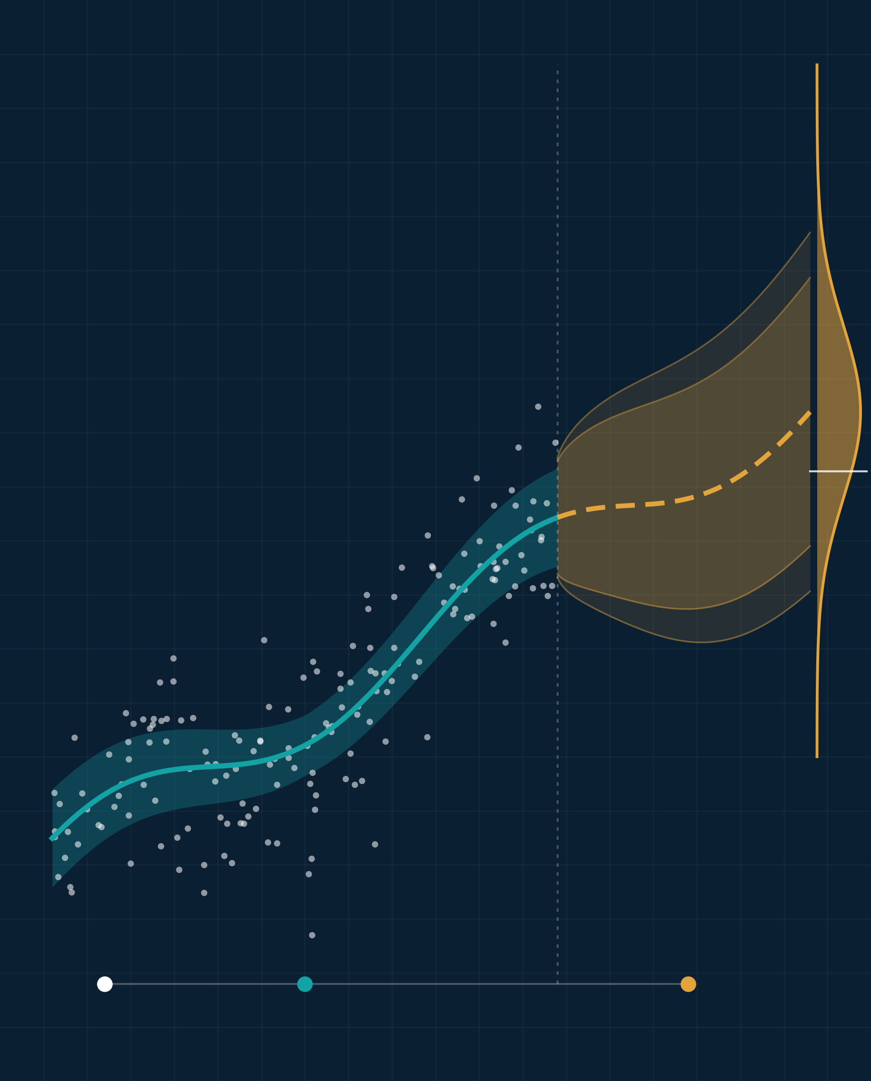
Implications of Advanced Statistics in Business and Research
Illustrative visual · simulated data
ADVANCED STATISTICS IN PRACTICE
Turning data into evidence, decisions, and discovery
PRESENTED BY [Team Name]
[Member 1 Full Name] | [Student ID]
[Member 2 Full Name] | [Student ID]
[Member 3 Full Name] | [Student ID]
[Member 4 Full Name] | [Student ID]
[Member 5 Full Name] | [Student ID]
COURSE
[Course Title] ([Course Code])
INSTRUCTOR
[Instructor Name], [Designation]
DEPARTMENT
[Department]
UNIVERSITY
[University Name]
DATE
[Presentation Date]
Data
Model + uncertainty
Forecast → decision
Notes:
Good morning. Our topic is the implications of advanced statistics in business and research. In simple words: how companies and researchers use statistics to turn data into reliable decisions. The picture on the right shows the idea: we start with data, fit a model with its uncertainty, and use a forecast to make a decision. We will cover why statistics matters, where it is used, one A/B-test example, and the main cautions.

Slide 2
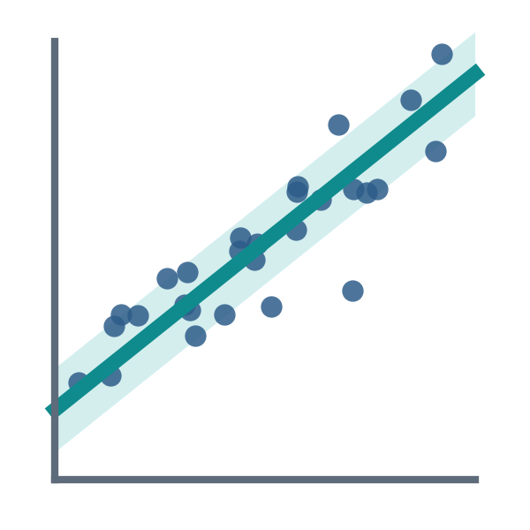
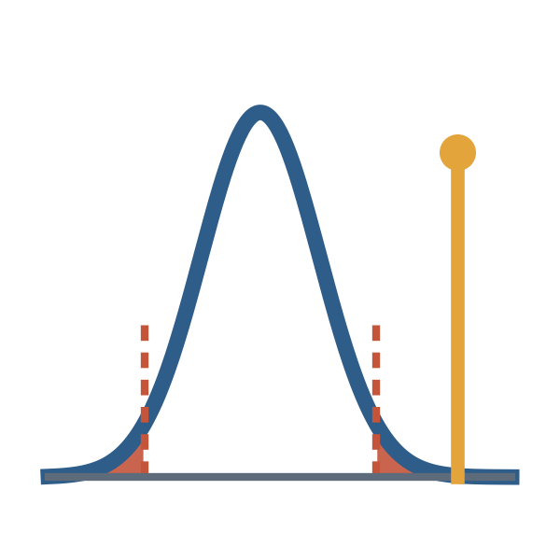
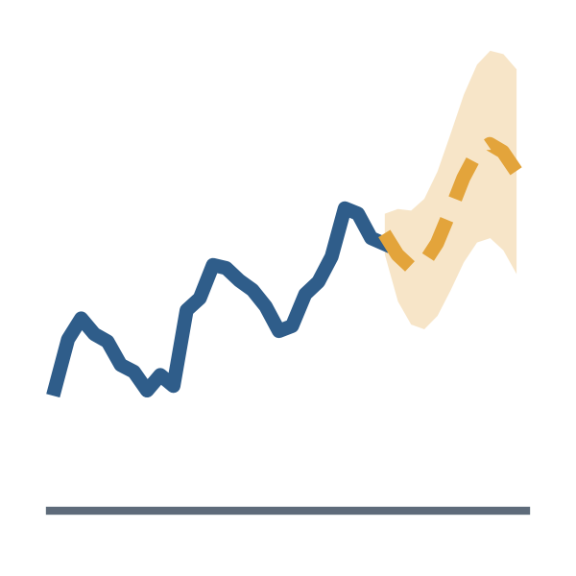
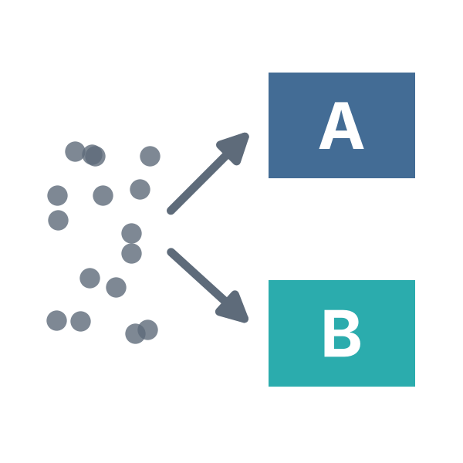
Statistics turns data into decisions
01 · WHAT & WHY
Advanced statistics helps us find real patterns, measure how sure we are, and choose with evidence instead of guesswork.
1 Collect data
2 Find patterns
3 Measure uncertainty
4 Make decisions
Four key methods
Regression
Hypothesis testing
Forecasting
A/B testing
Shows how one factor affects another, e.g. price → sales.
Checks whether a difference is real or just chance.
Predicts future values, such as demand, with a range.
Compares two options fairly using random groups.
Notes:
Data alone does not give answers. Statistics takes us from collecting data, to finding patterns, to measuring how sure we are, and finally to a decision. Four methods do most of this work: regression shows how one factor affects another; hypothesis testing checks whether a difference is real or just chance; forecasting predicts the future with a range; and A/B testing compares two options fairly by splitting people into random groups.

Slide 3


Better decisions in business and research
02 · REAL-WORLD USES
Business
Research
Sales forecasting → plan the right stock level
Study design → make comparisons fair
Customer segmentation → target the right customers
Sample size → get reliable results
Pricing → find the price that earns most
Confidence intervals → show how sure we are
Risk & fraud → approve loans more safely
Replication → build results others trust
REAL CASE
REAL CASE
Bing tested longer ad titles with an A/B test: revenue rose about 12% (≈ $100M a year in the U.S.).
RECOVERY trial: dexamethasone cut 28-day deaths in ventilated COVID-19 patients from 41.4% to 29.3%.
Kohavi & Thomke (2017), Harvard Business Review
RECOVERY Collaborative Group (2021), NEJM
Notes:
In business, statistics helps companies forecast sales, group customers, set prices and spot risky loans or fraud. A real example: Bing tested longer ad titles using an A/B test. Revenue went up about 12 percent, worth more than 100 million dollars a year in the U.S. In research, statistics makes studies fair and reliable through good design, the right sample size, confidence intervals and replication. Example: the RECOVERY trial showed that dexamethasone reduced deaths in ventilated COVID-19 patients from 41.4 to 29.3 percent.

Slide 4
A/B test: does a new product page sell more?
03 · CASE STUDY
ILLUSTRATIVE DATA hypothetical, not real company results
1
Split
40,000 visitors at random: 20,000 see the old page (A), 20,000 the new page (B).
+0.60 pp
difference (B − A)
+0.19 to +1.01 pp
95% confidence interval
2
Measure
Conversion rate = orders ÷ visitors.
p = 0.004
very unlikely to be chance
3
Test
Two-proportion z-test at the 5% level.
Meaning The new page very likely works better, but the exact gain is uncertain.
Visitors are assigned at random, so the only real difference between the groups is the page.
DECISION
Launch page B and keep monitoring results.
A: 840 / 20,000 · B: 960 / 20,000 orders
Notes:
This example uses made-up numbers to show the method. An online shop splits 40,000 visitors at random: half see the old page, half see the new page. The old page converts 4.2 percent of visitors, the new page 4.8 percent, a difference of 0.6 percentage points. The 95 percent confidence interval is 0.19 to 1.01 points and the p-value is 0.004, so the gain is very unlikely to be chance, although its exact size is uncertain. Decision: launch the new page and keep monitoring.

Slide 5





Use statistics carefully and honestly
04 · CHALLENGES
Statistics is powerful, but careless use can lead to confident and wrong decisions.
Bad or biased data
Correlation ≠ causation
“Significant” ≠ important
Privacy & fairness
If the data is wrong or one-sided, the answer will be wrong too.
Two things moving together does not prove one causes the other.
A tiny effect can still be significant. Always check how big it is.
Protect personal data and check that models are fair to every group.
WHAT ABOUT AI?
Machine learning is great at prediction, but a good prediction does not prove cause. Good practice: plan first, check the data, report results honestly.
Notes:
Statistics can mislead if we are careless. First, bad or biased data gives wrong answers. Second, correlation is not causation: two things moving together does not prove one causes the other. Third, 'significant' does not mean important; a very small effect can still be significant, so we always check its size. Fourth, we must protect privacy and make sure models are fair. Finally, AI and machine learning are very good at prediction, but prediction alone does not prove cause, so careful planning and honest reporting still matter.

Slide 6
Key takeaways
05 · CONCLUSION
01
02
03
Data becomes evidence
Better decisions
Careful interpretation
Statistics turns raw data into results we can trust.
Testing ideas and measuring uncertainty beat guesswork.
How we read results matters as much as the method.
“The value of data lies not merely in collecting it, but in drawing reliable conclusions from it.”
Thank you · Questions?
References: Kohavi & Thomke (2017), Harvard Business Review 95(5) · RECOVERY Collaborative Group (2021), NEJM 384(8) · Wasserstein & Lazar (2016), The American Statistician 70(2) · Shmueli (2010), Statistical Science 25(3)
Notes:
To conclude, three takeaways. One: statistics turns raw data into evidence we can trust. Two: testing ideas and measuring uncertainty lead to better decisions than guesswork. Three: careful interpretation matters as much as the method. The value of data lies not merely in collecting it, but in drawing reliable conclusions from it. Thank you. We are happy to take questions.

