Slide 1
Introduction
NAME: sham Kumar. V
NM ID NUMBER: astvu25025024u18026
COLLEGE NAME: SKP Arts&science college
COLLEGE CODE: 250
REGISTER NUMBER: 25024U18026
DEPARTMENT: B.sc(Computer science) 2th year
PROJECT TITLE: The SV Furniture Company

Slide 2

The SV Furniture Company

Slide 3
objectives
1.Market ExpansionFrom local (Kumbakonam) to wider Tamil Nadu & Pan-India through online presence.
2. Brand PositioningBuild identity around heritage, premium wood, and sustainable craftsmanship.
3. Customer Trust & RetentionOffer after-sales service, warranty, and customization options.Encourage referrals and repeat customers.
4. Product DiversificationExpand from dining tables/beds → modular designs, office furniture, decor.
5. Sales ChannelsLeverage Instagram, Facebook Marketplace, and Google Business for orders.

Slide 4
system requirement
1.Functional RequirementsWebsite must display:Home, About, Gallery, Contact pages.Product catalog with images, names, and prices.“Get a Free Quote” button linking to contact/order form.Customer contact details (phone, email, address).Allow customers to:Request quotes online.Call/email directly from the site.View products in gallery format (grid with images).Admin (you) should be able to:Update product images, descriptions, and prices.Add/remove new furniture items.
2. Non-Functional RequirementsPerformance: Pages must load in under 3 seconds on 4G.Availability: Website should be accessible 24/7.Scalability: Should handle 500+ users simultaneously.Security:HTTPS encryption.Form data validation (to avoid spam).Usability: Mobile-first responsive design.
3. Hardware RequirementsClient Side (User Device):Any smartphone/PC with browser support (Chrome, Safari, Edge).Min. 2 GB RAM, 1 GHz CPU.Server Side (Hosting Server):Processor: Dual Core or higher.RAM: 4 GB minimum.Storage: 50 GB SSD.Bandwidth: At least 1 TB/month.
4. Software RequirementsFrontend: HTML5, CSS3, JavaScript.Backend (optional for dynamic features): Node.js / PHP / Python Django.Database (if storing customer requests): MySQL / MongoDB.Hosting: Apache / Nginx web server.Other Tools:Git for version control.SSL for security.

Slide 5
obstacles
1. Accessibility gapsThe “☰ Menu” isn’t interactive yet (needs JS or <button> role).Color contrast of text/buttons should be checked against WCAG standards.
2. Performance The Unsplash images are very high-resolution (1880px+) and may load slowly on mobiles.Consider adding loading="lazy"

Slide 6
3. SEO issuesMissing <meta keywords> (optional, but still helpful).Could add structured data (e.g., Product schema for your furniture items).No <h1> heading defined yet — add one at the start of the hero (# Authentic Handcrafted Furniture).
4. ResponsivenessCards are good, but the grid may feel tight on smaller screens. Add some padding or a single-column layout under 480px.
5. Navigation / UXNo sticky “Contact” or “Call Now” button in the hero (users might bounce before scrolling).

Slide 7
Cover Slide
Title: The SV Furniture company Subtitle: Authentic Handcrafted Wooden Furniture Tagline: Tailored woodwork that lasts generations Logo (if any) or representative wood texture background

Slide 8
Welcome / Introduction
Message from Founder Sham Kumar. V Brief overview of company vision

Slide 9
Company History
15+ years of craftsmanship Located in Kumbakonam , Tamil Nadu Heritage woodworking background

Slide 10
Our Values
Craftsmanship, Trust & Tradition Sustainable sourcing from Tamil Nadu & Kerala Handmade quality furniture

Slide 11
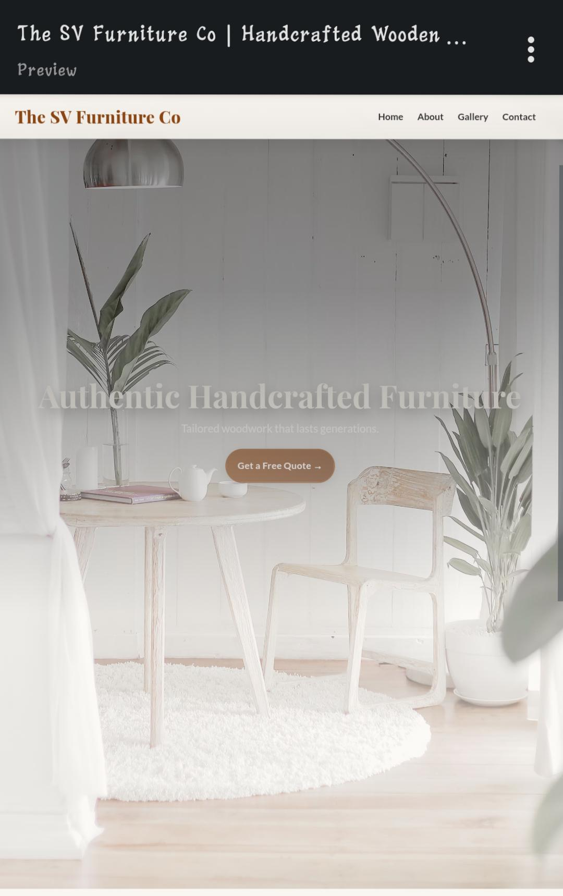
Meet the Founder
Profile of Sham Kumar. V His expertise in traditional joinery & finishing
Index page:

Slide 12
Crafting Process Overview
Step 1: Wood selection from premium mills Step 2: Hand joinery and construction Step 3: Smooth finishing and protective oils

Slide 13
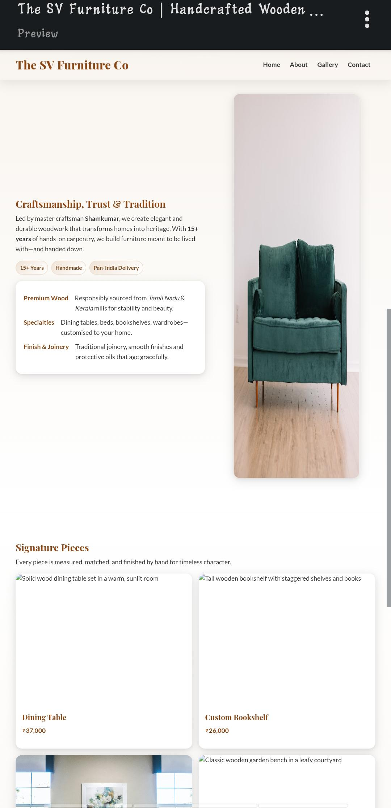
Specialty Products Introduction
Customised to your home and style

Slide 14
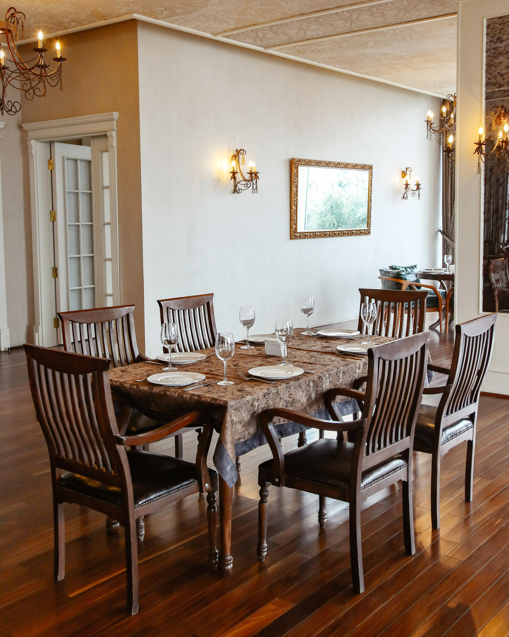
Dining Table
Image of dining table Price: ₹37,000 Features: Solid wood, handcrafted, durable finish
Image:

Slide 15
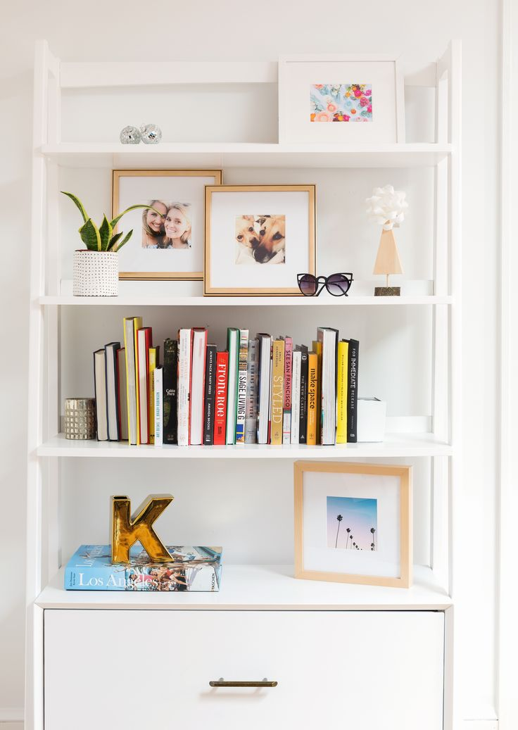
Custom Bookshelf
Image of bookshelf
Price: ₹26,000
Features: Staggered shelves, tailored design

Slide 16
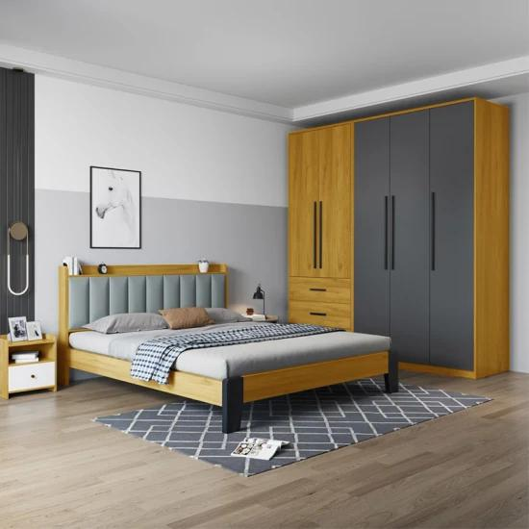
King Bed Frame
Image of bed frame
Price: ₹56,000
Features: Minimalist design, solid wood

Slide 17
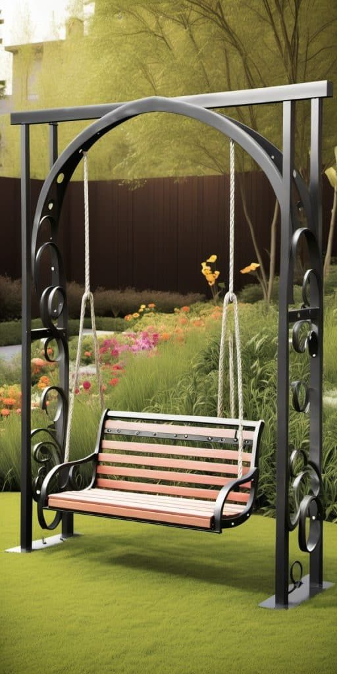
Garden Bench
Image of garden bench
Price: ₹23,000
Features: Outdoor durability, classic look

Slide 18
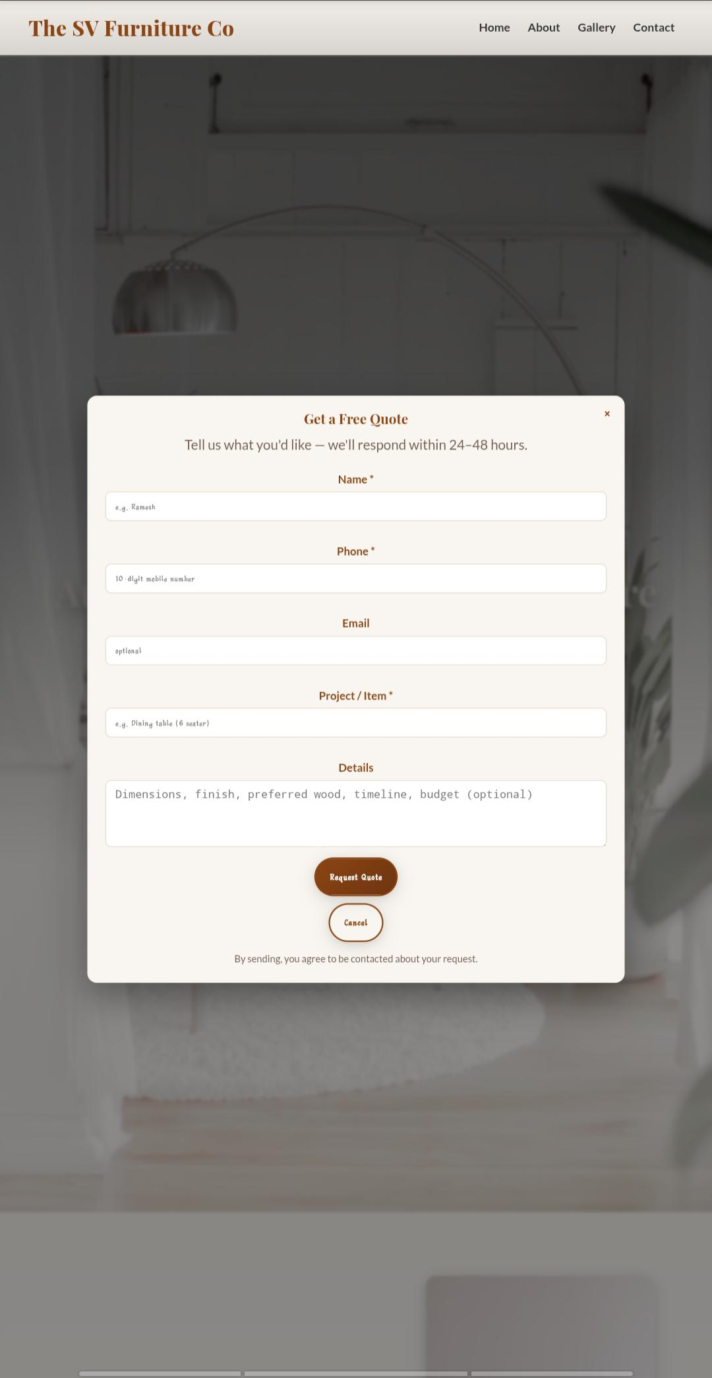
Custom Orders & Design Consults
Explanation of bespoke services
Custom sizes and finishes
Design consultation details

Slide 19
Pan-India Delivery
Explanation of nationwide shipping
Packing and delivery guarantees
Type1: After-sales Care
Maintenance tips
Customer support services
Type2: Testimonials
Customer quotes about quality and service
Type3: Notable Projects
Highlight a few large or special commissions
Type4: Design & Build Process (Detailed)
Timeline or flow chart: from consultation to delivery

Slide 20
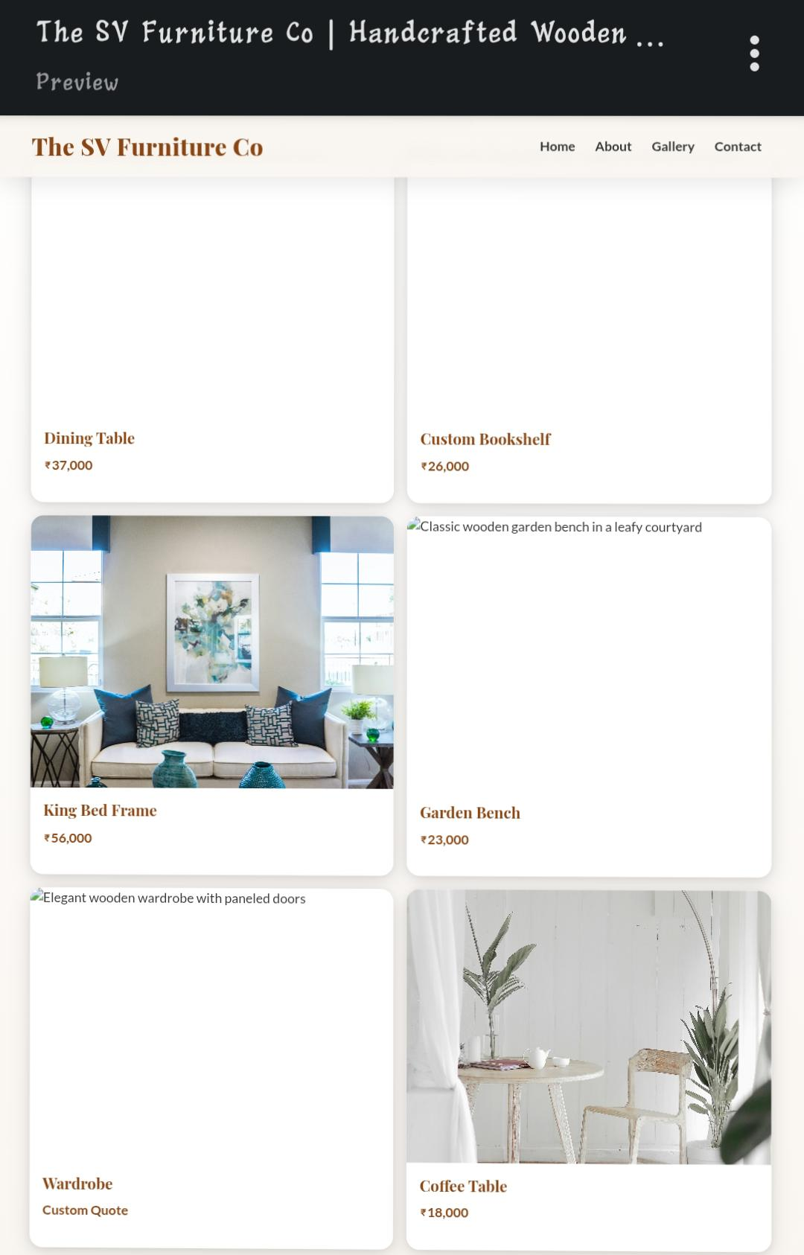
Materials & Sustainability
Details about responsibly sourced wood
Environmentally friendly finishing oils

Slide 21
Market Reach & Clients
Geographic map with coverage area
Client demographics or sectors served

Slide 22
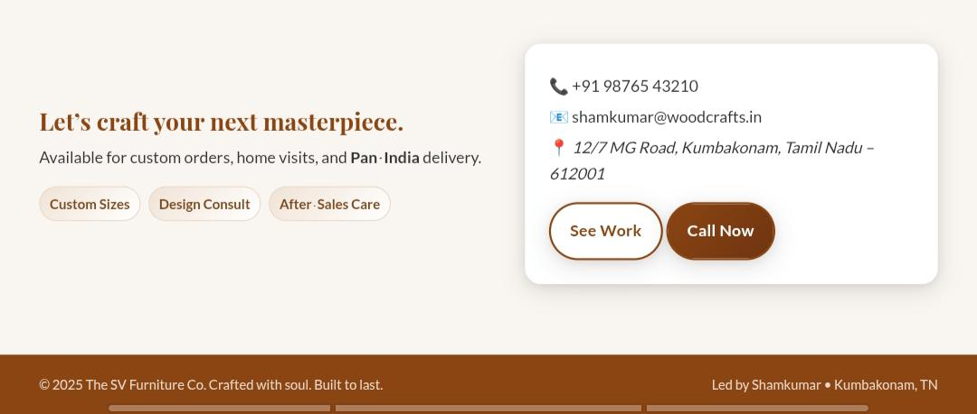
How to Order
Contact methods
Phone: +91 98765 43210
Email: shamkumar@woodcrafts.in
Website/social media (if any)

Slide 23
Visit Our Workshop
Address: 12/7 MG Road, Kumbakonam, Tamil Nadu 612001
Invitation to visit or schedule a consultation
Call to Action:
Encouraging quote and CTA buttons
“Get a Free Quote” or “See Our Work”
Brand Colors & Typography:
Showcase of company colors (wood browns, tans, ivory)
Fonts used (Playfair Display, Lato)

Slide 24
Code of a program
1. Header (Navigation Bar)Skip to contentThe SV Furniture Co ☰ Menu- Home- About- Gallery- ContactCreates a sticky top navigation bar.The company name The SV Furniture Co is shown on the left.A "Menu" (☰) icon is likely for mobile view.Navigation links (Home, About, Gallery, Contact) help users scroll to each section.

Slide 25
2. Hero Section (First impression)# Authentic Handcrafted FurnitureTailored woodwork that lasts generations.Get a Free Quote →A headline introducing the company: Authentic Handcrafted Furniture.A subheading that highlights durability: Tailored woodwork that lasts generations.A CTA button: “Get a Free Quote →” to attract customers.

Slide 26
3. About Section<section id="about" class="about"> <h2>Craftsmanship, Trust & Tradition</h2> <p>Led by master craftsman Shamkumar...</p>Explains who you are and what you do.Mentions experience (15+ years) and your craftsmanship values.Uses badges (like "15+ Years", "Handmade", "Pan-India Delivery").Highlights details like premium wood, specialties, and joinery techniques.Includes an image of a carpenter working

Slide 27
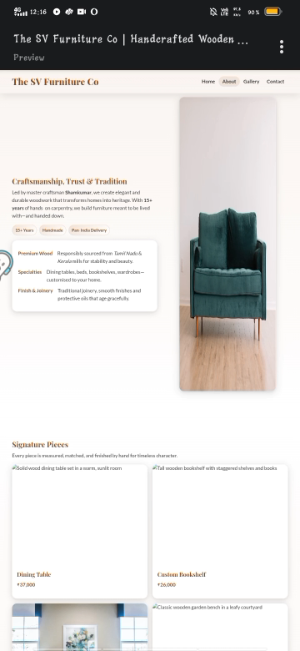
Video

Slide 28
Advantages and disadvantages
Advantage: A feature that provides a beneficial effect or makes something better in comparison to alternatives1.
Disadvantage: A feature that causes problems, limitations, or makes something less desirable in comparison to alternatives1.

Slide 29
Summary
Advantages make a product or service more attractive, offering benefits like quality, customization, and value.
Disadvantages are drawbacks, such as higher cost, time, or effort required13.

Slide 30
conclusion
The SV Furniture Co stands for craftsmanship, trust, and tradition—transforming homes with authentic, handcrafted wooden furniture. With over 15 years of expertise, a commitment to premium materials, and personalized designs, the company delivers lasting value and elegance to customers nationwide. This dedication to quality and customer care ensures every piece is not just furniture, but a heritage investment.
Thank you for exploring The SV Furniture company story and signature offerings. Let’s craft your next masterpiece together

