Slide 1
Employee Attrition Dashboard – Analysis & Insights
Presented By : SHAMLA FARHA K

Slide 2
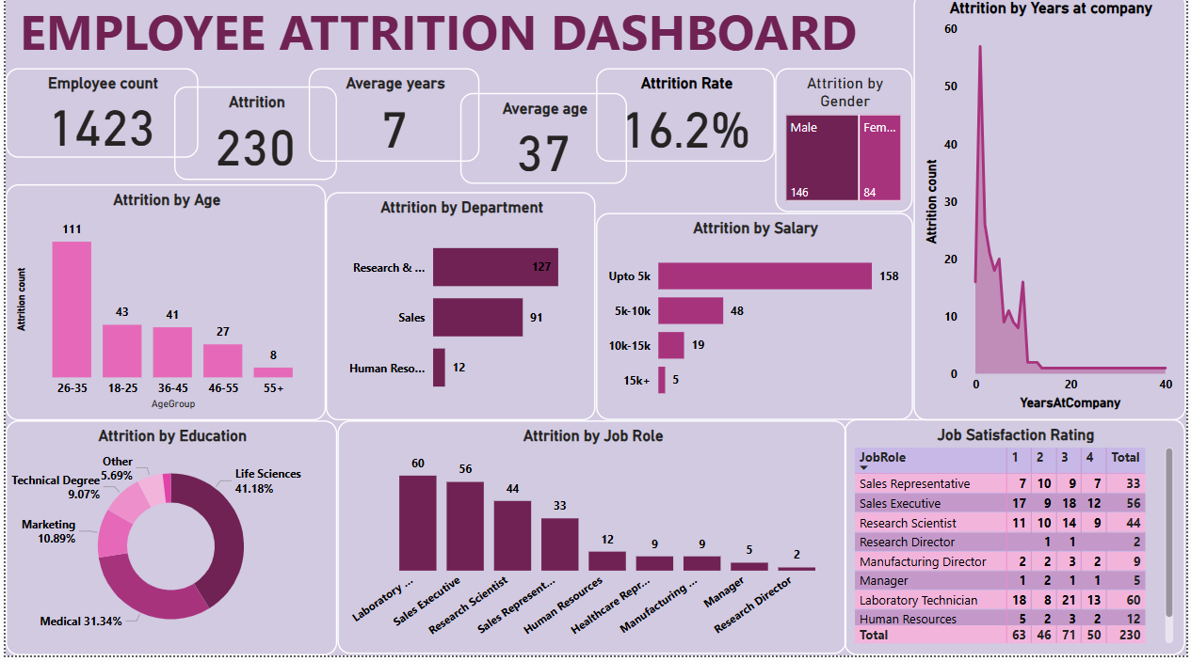
Dashboard Overview

Slide 3
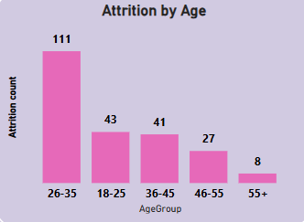
Attrition by Age
The 26-35 age group has the highest attrition with 111 employees.
Young employees aged 18-25 also show significant attrition (43 employees).
55+ age group has the lowest attrition with 8 employees.

Slide 4
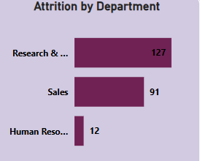
Attrition by Department
Research & Development has the highest attrition (127 employees).
Sales department also has high attrition (91 employees).
Human Resources department has lowest attrition(12 employees).

Slide 5
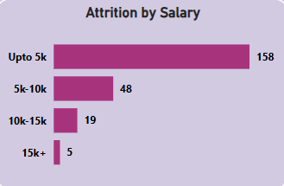
Attrition by Salary
Majority of attrition is among employees earning up to 5k (158 employees).
Higher salary bands have significantly lower attrition rates.(5 employees).

Slide 6
Key Insights and Recommendations
Most attrition occurs within the first few years.
Departments like Research and Sales need targeted retention strategies.
Recommendations:
- Enhance employee engagement programs.
- Conduct regular feedback surveys.
- Implement retention bonuses for critical departments.

Slide 7
Conclusion & Next Steps
Reducing attrition requires a multifaceted approach.
• Next steps include:
- Reviewing current HR policies.
- Addressing concerns in high-attrition departments.
- Creating a robust employee retention plan.

Slide 8
THANK YOU

