Slide 1

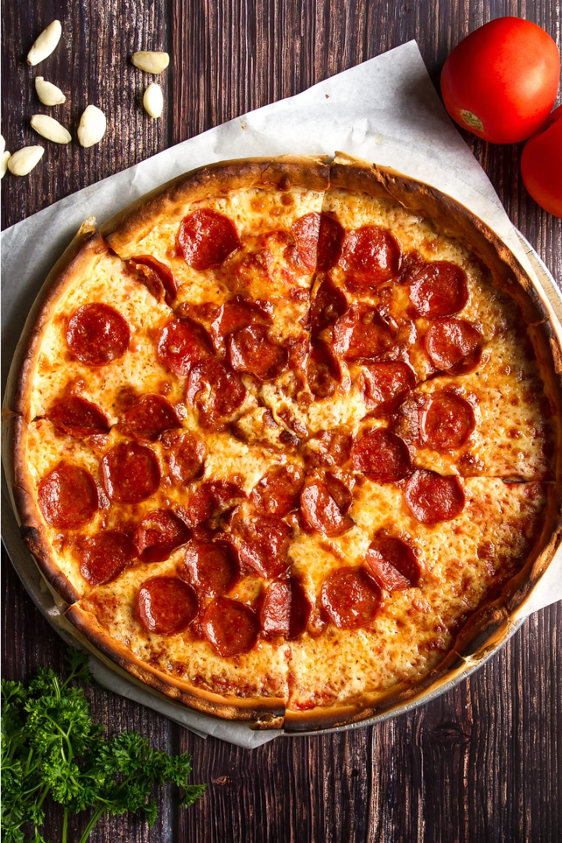
Pizza Sale Analysis
Welcome to my pizza sales analytics project !
Uncover valuable sales insights with the power of SQL queries. When it comes to analyzing key metrics like revenue and order trends, we dive deep into the data to uncover valuable insights. By examining various factors such as customer preferences, market trends, and promotional activities, we identify the key drivers of your success and highlight areas for improvement.

Slide 2

Objective
Understand Sales Trends
Identify Top Sellers
Examine how pizza sales have fluctuated over time to identify patterns and opportunities for growth.
Determine which pizza varieties and toppings are the most popular with customers.
Optimize Operations
Use insights to provide actionable recommendations for improving sales strategies

Slide 3
Key Insights
Classic category contributes to maximum sales and total orders
The Thai Chiken pizza contributes to maximum sales
Large size pizza contributes maximum sales
1
2
3
4
5
The Brie Carre Pizza contributes to minimum revenue
There are maximum orders from month of January and July

Slide 4
Recommendations
Menu Optimization
Classic Delights
Seasonal Offers
Streamline the menu by focusing on top-selling pizzas and adding new specialty options based on customer preferences.
Promote our classic category heavily as it has more sales.
Provide seasonal offers in month of January and July.

Slide 5



Conclusion
Increase Sales
Improve Operations
Delight Customers
Implement these strategies to drive pizza sales and revenue growth.
Optimize staffing and inventory to enhance customer experience and reduce costs.
Tailor the menu and services to better meet customer preferences and needs.

