Slide 1
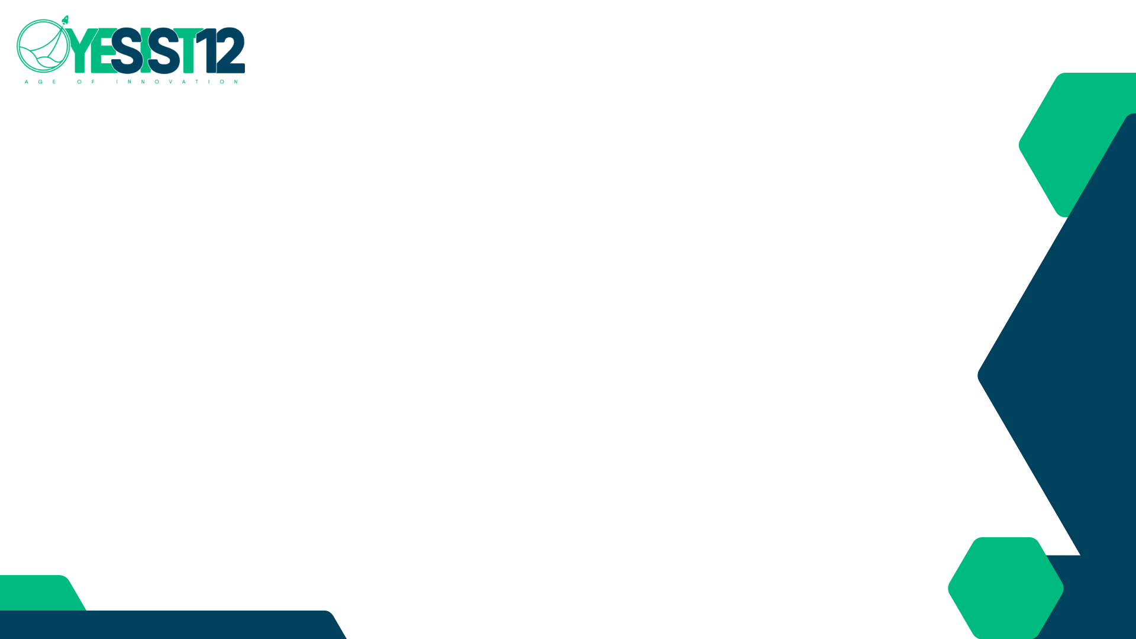
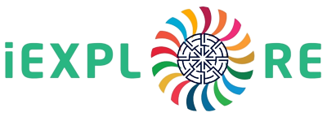
Team Name: Shamm
Project Name: Shamm: A Blockchain Based Crowdfunding Platform
Innovation Challenge
Partnerships For The Goals
Team Id: <<Team Id>>

Slide 2

Team Members
Shahiq Zaidi
Developer
Ammar Bajwa
Team lead and Developer

Slide 3
Problem Statement:
Traditional crowdfunding platforms lack transparency, security, and trust, leading to challenges in verifying the legitimacy of projects and protecting the interests of both investors and fundraisers. Additionally, existing crowdfunding platforms often have high fees and limited access, hindering the participation of certain individuals and communities. These limitations create barriers to entry and hinder the potential for innovative ideas and projects to receive adequate funding. There is a need for a blockchain-based crowdfunding platform that addresses these issues by providing a transparent, secure, and accessible solution that fosters trust among stakeholders, promotes inclusivity, and empowers individuals and communities to invest in the future they believe in.

Slide 4
Introduction:
Shamm is designed to be a transparent, secure, and inclusive crowdfunding platform that empowers individuals and communities to turn their dreams into reality. With Shamm, we aim to address the limitations of traditional crowdfunding platforms by providing a decentralized solution that fosters trust, promotes inclusivity, and removes barriers to entry. We are committed to removing barriers to entry and ensuring that everyone, regardless of their location or background, has the opportunity to participate in crowdfunding. Our vision is to create a platform that not only connects fundraisers with investors but also builds a supportive ecosystem for the growth of local communities and businesses.

Slide 5
Research Survey:
The following results are collected from 3rd party resources. The references have been mentioned at the end of the document.

Slide 6
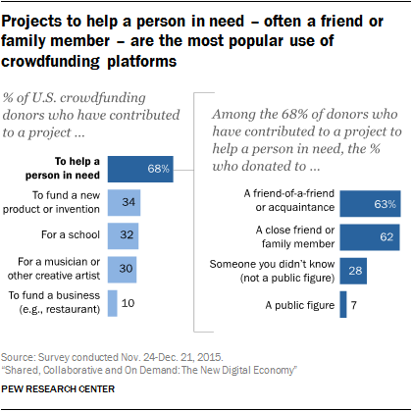

Slide 7
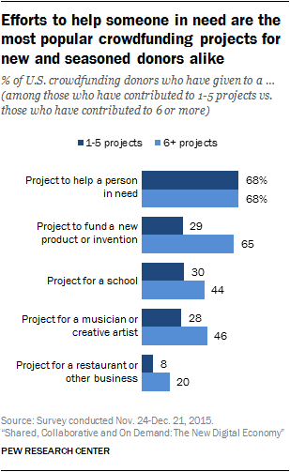
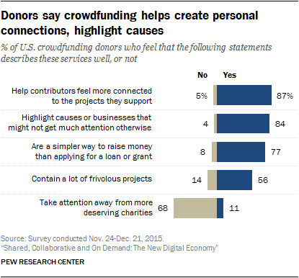

Slide 8
Investing Limits:
Jurisdiction | Limitation on investment
Australia (proposed) | A$25,000 per annum with no more than A$10,000 in a single issuer
Canada (“Québec and Ontario CF regime) | No more than CA$2,500 per investment. In Ontario, no more than CA$10,000 in total under the CF prospectus exemption in a calendar year
Japan | ¥500,000 in a single issuer per year by an investor per year. ¥100 million per year in an issuer by all the investors in total per year.
Netherlands | €40,000 for lending funding portals and €20,000 for equity/debt funding portals.
Spain | €3,000 per offering or €10,000 per year per funding portal, and equity securities cannot contain a derivative component for non-accredited investors.
United States | If either annual income or net worth is less than US$100,000, then there is a limit of the greater of US$2,000 or 5% of the lower of annual income or net worth. If both annual income and net worth are equal to or greater than US$100,000, then a limit of 10% of the lower of annual income or net worth, but not to exceed US$100,000.

Slide 9
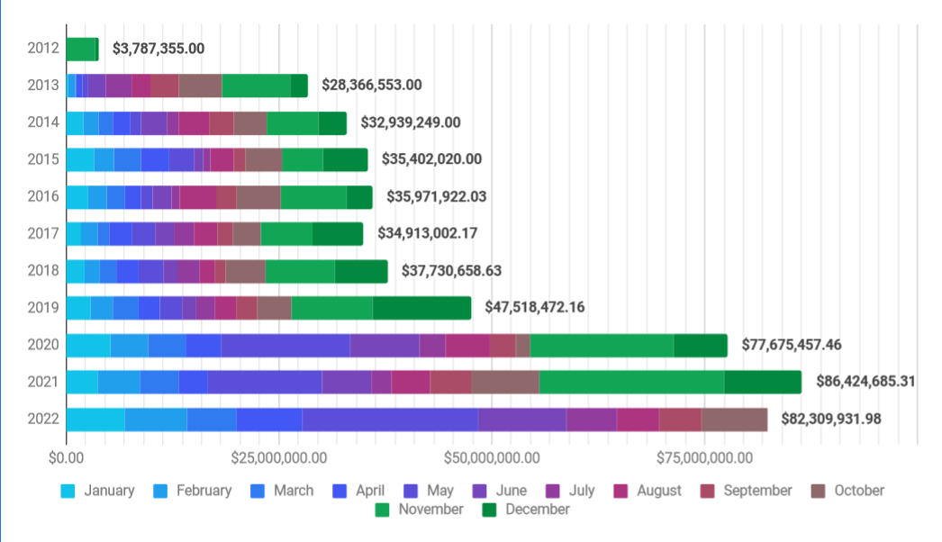
SC funding chart October 2022. Projected to hit 100 million us dollar by end of year:

Slide 10
Proposed Solution:
Transparent Transactions: Shamm utilizes blockchain's distributed ledger technology to ensure that every transaction on our platform is verifiable, tamper-proof, and publicly recorded. This ensures transparency and accountability for both fundraisers and investors, eliminating the need for intermediaries and enhancing trust.
Secure Investment: Shamm employs smart contracts to facilitate secure and automated investments. Smart contracts are self-executing contracts that automatically enforce the terms and conditions of the crowdfunding campaign, eliminating the risk of fraud or manipulation.
Global Accessibility: Shamm is designed to be inclusive, providing access to crowdfunding opportunities for individuals, communities, and businesses worldwide. Our platform breaks down geographical barriers, allowing anyone with an internet connection to participate and contribute to innovative projects.

Slide 11
Proposed Solution:
Investor + Creator first: By making Shamm a community first platform we have made sure that it’s policies and commitments will remain more inclined towards the investors and creators rather than protecting the personal milestones and achievments.
Community Collaboration: Shamm fosters a vibrant community of like-minded individuals who share a passion for innovation and progress. Our platform encourages collaboration, knowledge sharing, and networking among fundraisers, investors, and supporters, creating a supportive ecosystem that goes beyond just fundraising.

Slide 12
Prototype (if applicable):
No prototype available over internet however, live demonstration is possible over local blockchain. Waiting for the approval to be deployed over live blockchain which will be accessible to the first beta users.

Slide 13
Advantages & Disadvantages:
Advantages of Shamm:
Transparency: The use of blockchain technology in Shamm ensures transparent and verifiable transactions, providing a high level of trust and accountability for fundraisers and investors. This can help in building trust among users and increasing the confidence of potential investors.
Security: Shamm's utilization of smart contracts enhances the security of transactions by automating the execution of crowdfunding campaigns and eliminating the need for intermediaries. This reduces the risk of fraud, manipulation, and unauthorized access, providing a secure crowdfunding environment.

Slide 14
Global Accessibility: Shamm's inclusive approach allows individuals, communities, and businesses from around the world to participate in crowdfunding campaigns. This can expand the pool of potential investors and increase the chances of successfully funding projects that may have previously faced geographical limitations.
Community Collaboration: Shamm encourages collaboration and networking among fundraisers, investors, and supporters, creating a supportive community that fosters innovation and progress. This can provide valuable opportunities for knowledge sharing, mentorship, and partnerships.

Slide 15
Safeguarding Investors and Creators: Shamm's use of blockchain technology can provide increased transparency and security for both investors and creators. Smart contracts can automatically enforce crowdfunding campaign rules, such as release of funds only upon achieving campaign goals, ensuring that investors' funds are safeguarded and creators are held accountable for delivering on their promises. This can help mitigate risks and disputes between investors and creators, creating a more trustworthy and reliable crowdfunding ecosystem.

Slide 16
Disadvantages of Shamm:
Limited Adoption: While blockchain technology offers several advantages, it is still a relatively new and emerging technology. The adoption of blockchain-based crowdfunding platforms may be limited, as some users may be unfamiliar with or hesitant to use blockchain technology for crowdfunding.
Regulatory and Legal Challenges: Crowdfunding platforms, including blockchain-based ones, are subject to various regulatory frameworks and legal requirements in different jurisdictions. Compliance with these regulations, such as anti-money laundering (AML) and know-your-customer (KYC) requirements, can pose challenges and may require additional resources and efforts to ensure legal compliance.

Slide 17
Conclusion:
In conclusion, Shamm - The Blockchain-Powered Crowdfunding Platform offers a novel solution to the challenges of traditional crowdfunding platforms by leveraging blockchain technology for increased transparency, security, and trust. Through the use of smart contracts, Shamm aims to create a more reliable and accountable crowdfunding ecosystem that benefits both investors and creators. While there are potential advantages in terms of decentralized fundraising, enhanced transparency, and safeguarding of funds, there are also challenges such as scalability, regulatory compliance, and user adoption. As with any emerging technology, there are risks and limitations that need to be carefully considered and addressed. Nevertheless, with proper planning, strategy, and execution, Shamm has the potential to revolutionize the crowdfunding landscape and provide new opportunities for fundraising and innovation in the blockchain era.

Slide 18
References:
Crowdfunding 2015 Survey Responses Report by The Board Of The International Organization Of Securities Commissions (https://www.iosco.org/library/pubdocs/pdf/IOSCOPD520.pdf)
Collaborative: Crowdfunding platforms by Pew Research Center (https://www.pewresearch.org/internet/2016/05/19/collaborative-crowdfunding-platforms/)
Star Citizen Interactive Funding Dashboard (https://robertsspaceindustries.com/community-hub/post/interactive-funding-dashboard-dsd2wiwuykwjg)

Slide 19

Thank You

