Slide 1
An Overview of the Iterative Data Analysis Process

Slide 2
Iterative Data Analysis Process Parts
Ask Question(s)
Wrangle Data
Explore Data
Draw Conclusion(s)
Communicate Finding(s)
Notes:
The data analysis process underpins the flow of data analytics and science work. In simple terms, there are five iterative parts of this process. Ask Questions, Wrangle Data, Explore Data, Draw Conclusions and Communicate Findings.

Slide 3
1. Ask Question(s)
Hypothesis Generating Question
Open or “Why” Questions about present or past
Example: Why did sales rise in the past two quarters?
Notes:
We start with a business question, which we then have to translate to one or more data analysis questions. For example, the business may be asking a hypothesis generating question like -- why did sales rise in the past two quarters? In which case, we seek an explanation to an open question. Alternatively, you may get a hypothesis confirmation question like – Was the rise in sales in the past two quarters caused by Asia region sales growth? This is more of a yes/no question and the analyst needs to show specific and contextualize data to prove or disprove the hypothesis. As the analytics get more sophisticated, analysts will be asked to prediction questions like – If we increase price by 10%, how will that impact sales volume? These are what will or how will questions about the future, given some initial input.

Slide 4
1. Ask Question(s)
Hypothesis Confirming Question
Yes/No Questions about the present or past
Example: Was the rise in sales in the past two quarters caused by Asia region sales growth?
Notes:
We start with a business question, which we then have to translate to one or more data analysis questions. For example, the business may be asking a hypothesis generating question like -- why did sales rise in the past two quarters? In which case, we seek an explanation to an open question. Alternatively, you may get a hypothesis confirmation question like – Was the rise in sales in the past two quarters caused by Asia region sales growth? This is more of a yes/no question and the analyst needs to show specific and contextualize data to prove or disprove the hypothesis. As the analytics get more sophisticated, analysts will be asked to prediction questions like – If we increase price by 10%, how will that impact sales volume? These are what will or how will questions about the future, given some initial input.

Slide 5
1. Ask Question(s)
Prediction Question
“What will” or “How will” Questions about the future
Example: If we increase price by 10%, how will that impact sales volume?
Notes:
We start with a business question, which we then have to translate to one or more data analysis questions. For example, the business may be asking a hypothesis generating question like -- why did sales rise in the past two quarters? In which case, we seek an explanation to an open question. Alternatively, you may get a hypothesis confirmation question like – Was the rise in sales in the past two quarters caused by Asia region sales growth? This is more of a yes/no question and the analyst needs to show specific and contextualize data to prove or disprove the hypothesis. As the analytics get more sophisticated, analysts will be asked to prediction questions like – If we increase price by 10%, how will that impact sales volume? These are what will or how will questions about the future, given some initial input.

Slide 6
Translate to Data Analysis Question
SALES GROWTH EXAMPLE
How did sales change over the past two quarters by:
Region
Sales Office
Sales Person
Product Line
Product
Product Feature
Using the Measures: Revenue and Units
Notes:
Focusing on the hypothesis questions – we need to translate them into one or more data analysis questions like how did sales change over the past two quarters by region, by product line? This might lead you also to start your data analysis work by ensuring you have data all the way down to a salesperson in a region and all the way down to products or product parts and features to ensure you can fully answer the question. In doing so, you have translated the business question into a data analysis question and have a sense of data requirements.

Slide 7
2. Wrangle Data
Acquire and map each “column of data” from one “raw” form into another format with the intent of making it more appropriate and valuable for analysis
Notes:
Second-- we have to wrangle data, which means we acquire and map data from one "raw" form into another format with the intent of making it more appropriate and valuable for analysis. For starters, our data is mostly likely not all in one place.

Slide 8
2. Wrangling “Data Columns”
Munge Data
Change data types
Join data fields
Clean data
Calculate measures
Remove data columns that are not useful
Apply a schema or data model
Model data
Notes:
We start the wrangling part of the process, by trying to acquire data from the system owners. Most often we may find that it may be impossible within a given timeline to get all the data you need. Once we determine what data is available (and perhaps adjust our analysis question accordingly), the wrangling part of the process transitions to a series of iterative data munging and descriptive statistics steps. Data munging may involve changing data types, joining data fields, cleaning data, calculating some measures, gathering relevant metadata, and applying a schema or data model before the data is ready for analysis. Along the way, we may be applying descriptive statistics or simple data plots to review data at a column level to remove or treat outliers or identify anomalies that need to be addressed or explained.

Slide 9
2. Wrangling “Data Columns”
Calculate Descriptive Statistics or Plot Data within a Column to:
Remove or treat outliers
Identify anomalies within columns
……..
Notes:
We start the wrangling part of the process, by trying to acquire data from the system owners. Most often we may find that it may be impossible within a given timeline to get all the data you need. Once we determine what data is available (and perhaps adjust our analysis question accordingly), the wrangling part of the process transitions to a series of iterative data munging and descriptive statistics steps. Data munging may involve changing data types, joining data fields, cleaning data, calculating some measures, gathering relevant metadata, and applying a schema or data model before the data is ready for analysis. Along the way, we may be applying descriptive statistics or simple data plots to review data at a column level to remove or treat outliers or identify anomalies that need to be addressed or explained.

Slide 10


2. Wrangle Data – SALES GROWTH EXAMPLE
Sales by
Region
Sales by
Product
Acquire
Munge
Describe
Meta Data
Exchange rate
USD to Foreign
Currency
fluctuations
Accounting
System
CRM
CMS
Notes:
In our example questions, we will need sales revenue, sales quantity, product and geographic data. Our sales quantity and revenue data by product may be stored in an accounting system. Our product data may be stored in a content management server which has all the part numbers, product descriptions and features. Our sales by region may take data from both the accounting and the customer relationship management systems. We have to acquire the data and the relevant metadata, mungle it into formats that can be analyzed and do some descriptive statistics to check for outliers or inaccuracies so we are ready for exploring. Meta data is data about data. In this example, sales are all expressed in USD, but are made in local currencies. Thus, we may need to capture more fields or meta data (data about data) to understand rate changes over the past two quarters.

Slide 11
3. Explore Data
Creating Informational Views
Scatter plots
Graphs
Tables
Visual data exploration
Notes:
The third part of the data analysis process is to explore data in an effort to create informational views and use statistics to answer the data analysis questions. Exploration often starts by joining data columns to create tables, visuals or inferential statistics.

Slide 12
3. Explore Data
Using Descriptive Statistics
Mean, median, quantiles
Using Inferential Statistics
T-Tests
Correlations
……..
Notes:
The third part of the data analysis process is to explore data in an effort to create informational views and use statistics to answer the data analysis questions. Exploration often starts by joining data columns to create tables, visuals or inferential statistics.

Slide 13
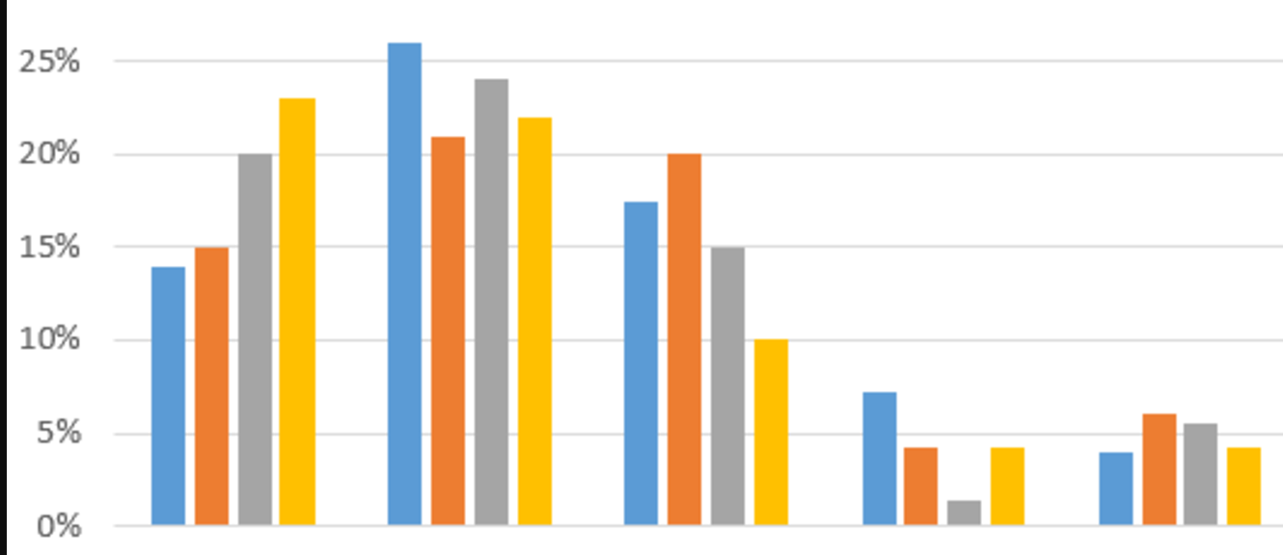


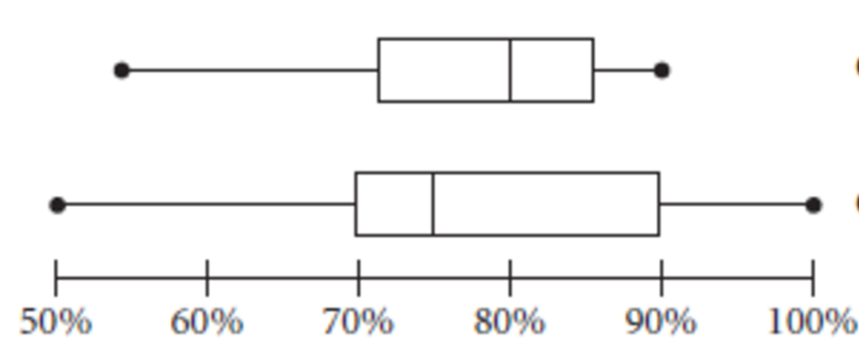
3. Explore Data – SALES GROWTH EXAMPLE
Sales by
Product
Sales by
Location
Range of Sales
Revenue Growth
By Region by Quarter
Range of Sales Growth
For Products within Three
Top Selling Product Lines
Sales by
Product Line
Sales by
Region
South
America
North
America
Asia
Europe
13
Notes:
In our hypothesis generating data exploration example - “what drove sales to increase?”, we may want to pivot around a sales revenue table by region, by product line and drill down to product or sales location or even down to a salesperson for example to find growth rates in absolute and % terms.
For our hypothesis confirming data exploration work, we will sort the data by region and sales location so we can simply confirm or refute the hypothesis. In both cases, our data exploration helps us confidently narrow down the data into digestible views or summary statistics of information we can use to draw conclusions.

Slide 14
4. Draw Conclusion(s)
Conclusion options
Hypothesis generating question
certain | qualified | uncertain
Hypothesis confirming question
accept/reject
Prediction question
expected result or best choice with a confidence level
Notes:
The fourth part of data analysis process is to draw conclusions. For a hypothesis-generating question you need to decide if you have proven beyond a reasonable doubt (certain) that your findings accurately answer the open question. Alternatively, you can offer a qualified opinion and refer to notes. Lastly, for a variety of reasons you may be uncertain about what conclusion to draw based on available data, but at least you will be able to clarify why and suggest improvements in how data is captured and shared that will allow you to answer such questions in the future.
For a hypothesis-confirming question, you either accept or reject the original hypothesis. If you reject, the hypothesis, you may instead choose to express an alternative hypothesis with your supporting data.
In drawing your conclusions, it is important to review how you got there. In other words, go back over your data analysis process work and note any issues that may influence your data driven conclusion. What data access or data quality and integrity issues did you come across that could affect your conclusion? Also in your statistical and programming methods, what biases may be present or what assumptions did you have to make as you moved through the process? You may also think forward to consider how your conclusion may influence future decisions or policy and include relevant limitations that are important to express in your notes based on this.

Slide 15
4. Draw Conclusion(s)
Review how you did your
Question translation
Data acquisition
Data wrangling work
Data exploration
Notes:
The fourth part of data analysis process is to draw conclusions. For a hypothesis-generating question you need to decide if you have proven beyond a reasonable doubt (certain) that your findings accurately answer the open question. Alternatively, you can offer a qualified opinion and refer to notes. Lastly, for a variety of reasons you may be uncertain about what conclusion to draw based on available data, but at least you will be able to clarify why and suggest improvements in how data is captured and shared that will allow you to answer such questions in the future.
For a hypothesis-confirming question, you either accept or reject the original hypothesis. If you reject, the hypothesis, you may instead choose to express an alternative hypothesis with your supporting data.
In drawing your conclusions, it is important to review how you got there. In other words, go back over your data analysis process work and note any issues that may influence your data driven conclusion. What data access or data quality and integrity issues did you come across that could affect your conclusion? Also in your statistical and programming methods, what biases may be present or what assumptions did you have to make as you moved through the process? You may also think forward to consider how your conclusion may influence future decisions or policy and include relevant limitations that are important to express in your notes based on this.

Slide 16
4. Draw Conclusion(s)
When drawing conclusions note
Data access, quality and integrity issues
Methods, hypothesis and sample bias or assumptions
that could impact accuracy
Application in the future (if any)
Notes:
The fourth part of data analysis process is to draw conclusions. For a hypothesis-generating question you need to decide if you have proven beyond a reasonable doubt (certain) that your findings accurately answer the open question. Alternatively, you can offer a qualified opinion and refer to notes. Lastly, for a variety of reasons you may be uncertain about what conclusion to draw based on available data, but at least you will be able to clarify why and suggest improvements in how data is captured and shared that will allow you to answer such questions in the future.
For a hypothesis-confirming question, you either accept or reject the original hypothesis. If you reject, the hypothesis, you may instead choose to express an alternative hypothesis with your supporting data.
In drawing your conclusions, it is important to review how you got there. In other words, go back over your data analysis process work and note any issues that may influence your data driven conclusion. What data access or data quality and integrity issues did you come across that could affect your conclusion? Also in your statistical and programming methods, what biases may be present or what assumptions did you have to make as you moved through the process? You may also think forward to consider how your conclusion may influence future decisions or policy and include relevant limitations that are important to express in your notes based on this.

Slide 17
5. Communicate Finding(s)
Communication is a two way dialogue that can lead to new questions
Typical Forms
Report
Digital Dashboard
Covered and practiced in next course!
Notes:
In this course, we will not focus on creating polished presentations for executive review or digital dashboards to enable business end users to explore and draw conclusions from interactive produced views of the data. In the next course, you will practice and apply the overall data analysis process and develop your communication skills. For now, it is important to note that communications is a two-way dialogue that can lead to new questions.

Slide 18
5. Communicate Findings– SALES GROWTH EXAMPLE
Hypothesis Confirming Question – Did Asia drive sales growth?
Answer – No
Asia had flat unit sales, but revenue grew due to exchange rate fluctuations
NE US and South America drove the most revenue and unit sales growth
Notes:
In this example, in our analysis we toggled back and forth between wrangling and exploring the data.
Somewhere along the way, we discover that favorable exchange rate fluctuations for Asia led to same unit sales generating 20% more revenue. In other words, revenue growth was due to favorable exchange rate changes, rather than unit sales growth. Thus, for the hypothesis confirming question – Was growth in Asia sales the driver of sales growth, we could report “No. And with analysis and charts we might show that, Asia had flat unit sales, but achieved revenue growth of due to exchange rate fluctuations. In particular, China and Korea in the Asia region had revenue but not much sales unit growth.” We may go on to report that actually the northeast US and South American regions contributed the most to driving sales growth both on a unit and revenue basis.”
For the same company and data set, our “generative hypothesis” may show some additional insights. We report that “sales grew the most over the past two quarters as three of the eight product line sales accounted for 80% of the revenue growth and revenue growth came mainly from four of our twenty sales offices.
This last part of the data analysis process often leads to new questions and insights that turn into fresh questions to analyze.

Slide 19
5. Communicate Findings– SALES GROWTH EXAMPLE
Hypothesis Generative Question – Why did sales increase?
Answer – 3 of our eight product lines accounted for 80% of the sales growth and four of our twenty sales offices were responsible for driving 66% of the sales growth
Notes:
In this example, in our analysis we toggled back and forth between wrangling and exploring the data.
Somewhere along the way, we discover that favorable exchange rate fluctuations for Asia led to same unit sales generating 20% more revenue. In other words, revenue growth was due to favorable exchange rate changes, rather than unit sales growth. Thus, for the hypothesis confirming question – Was growth in Asia sales the driver of sales growth, we could report “No. And with analysis and charts we might show that, Asia had flat unit sales, but achieved revenue growth of due to exchange rate fluctuations. In particular, China and Korea in the Asia region had revenue but not much sales unit growth.” We may go on to report that actually the northeast US and South American regions contributed the most to driving sales growth both on a unit and revenue basis.”
For the same company and data set, our “generative hypothesis” may show some additional insights. We report that “sales grew the most over the past two quarters as three of the eight product line sales accounted for 80% of the revenue growth and revenue growth came mainly from four of our twenty sales offices.
This last part of the data analysis process often leads to new questions and insights that turn into fresh questions to analyze.

Slide 20




THE ITERATIVE DATA ANALYSIS PROCESS
1. Ask Question(s)
5. Communicate
Finding(s)
Business
TRANSLATION
4. Draw Conclusion(s)
Analysis
2. Wrangle
Data
3. Explore
Data
Acquisition
Data
Notes:
We have walked through and clarified each part of the process and included an example, yet the presentation is titled the ITERATIVE data analysis process.
The graphic here shows the process flow more as it should be understood. Namely, we start with a question and end with some data-driven communication of our findings back to the stakeholders. The data analysis in the middle can iterate back and forth as what we learn through the process almost always causes us to go back from exploring to wrangling to revise, get different data or modify how we clean and remove outliers for instance.
Alternatively we do a preliminary analysis, draw a conclusion and communicate with the business only to find that a new question gets asked or we learn of some problem with how we drew our conclusion which leads us to reframe the data analysis question we are trying to solve and start wrangling more data.
I hope this has clarified the parts of the process, some terminology and the iterative nature of data analysis. You may also want to refer to the summary sheet of the iterative data analysis process that is posted on this lesson page.

Slide 21
Data Analysis Skills
Using Data to Scope and Design
the Data Analytics Certificate Program
Notes:
This presentation will incorporate applying the data analysis process of exploring and drawing conclusions based in part on Seattle Metro Area job posting data.

Slide 22
Iterative Data Analysis Process Parts
Ask Question(s)
Wrangle Data
Explore Data
Draw Conclusion(s)
Communicate Finding(s)
Notes:
The data analysis process underpins the flow of data analytics and science work. In simple terms, there are five iterative parts of this process. Ask Questions, Wrangle Data, Explore Data, Draw Conclusions and Communicate Findings.

Slide 23
Ask Questions
Precise questions from accurate sources

Slide 24
Business and Program Design Question(s)
What feature(s)
Skills and level?
Tools and proficiency level?
Knowledge and fluency level?
Pre-Requisites sufficient to complete program?
How to make program stackable?
Which tool sets appear to be most durable?
Notes:
As our program design team set out to revise the program from Business Intelligence to Data Analytics, we had a goal to make the curriculum more aligned to the rapidly growing field of Data Science. We found that tools and skills practiced by data scientists were maturing and moving to become more pervasively used and sought after by a broader group of analysts who had historically or were currently in roles like business intelligence managers. We also found a whole range of data-savvy professionals from analysts, engineers, administrators, researchers to developers were looking to expand their data analysis toolbox and that data analytics was a better fit for them than business intelligence tools popularized several decades ago.
So we established these hypothesis generating program design questions:
What features to include in data analytics vs. a more advanced-level data science program?
What level of skills?
What level of tools proficiency?
What level of knowledge fluency?
What Pre-requisites are required to ensure sufficient student background to complete program?
How to make the data analytics program stackable as a pre-requisite for data science, yet also teach sufficient skill levels for data analytics graduates to be well equipped for analyst level roles?
Which tool sets will provide the most durable platform to base our program on?

Slide 25
Addressing Business Questions
Sources
Articles, Blog Posts, Communities – ex. Kaggle.com
Advisory Board Members
Faculty and Instructors
Alumni
Program Students
Challenges
Conflicting data and information variability
Range of terminology, inconsistently used terms
Old technology and skills remain, yet being displaced
New tool and skillsets being adopted
Notes:
As we parsed out these business questions, we could find no shortage of articles and blog posts with bits and pieces of useful data. We also talked to advisory board members from industry and faculty. We reviewed feedback from students and talked to some alumni. We looked at what other programs were offering.
What we found was lot of variability and conflicting information. Particularly, because use of terminology is varied, new technology is being adopted, old technology and skills remain yet are being displaced. Types of skills and tools used are varied and overlapping depending on industry, function and organization.

Slide 26

Durable Data Science Skills
MATH & STATISTICS
Statistical Modeling
Experiment Design
Machine Learning
Supervised Learning:
Decision Trees
Classification
Logistic Regression
Unsupervised Learning
Clustering
……
PROGRAMMING & DATABASE
Microsoft Excel
Statistical Languages – R
Programming Languages - Python
Databases and Big Data Storage
SQL
NoSQL
Hadoop
Hive/Pig
MapReduce
Software as a Service
…..
MINDSET
Curious about data
Hacker approach
Analytical
Influence authority
Problem solver
…….
COMMUNICATION & VISUALIZATION
Translate data-driven insights into
recommendations and decisions
Digital dashboard development
Story telling skills
Visual design thinking
……..
Notes:
We assembled a high-level list of durable skills -- as you see on the slide -- which seemed within scope of two programs, but more than a single certificate program can provide.

Slide 27
Data Analysis Question
What subset of the durable data science skills would provide sufficient scope such that the data analytics program would both:
Equip graduates to put the skills into practice at the departmental level for immediate impact AND
Be a good pre-requisite for and be well aligned with Data Science
Notes:
Then we translated our business question into a data analysis question. What subset of the durable modern data science skills would provide sufficient scope such that the data analytics program would both:
Equip graduates to put their intermediate analytics skills into practice at a department or functional level for immediate impact, AND
Be a good pre-requisite for and be aligned with the broader set of data science skills
Going through this questioning process helped us establish a vision to make a data analytics program that would serve as both an “end” and a “means” for engineer, developer, analysts, administrator, researchers or other data savvy professionals who are seeking advancement and must work effectively within increasingly data driven/data science oriented organizations.
One of the data sources we used to address this data analysis question is a subscription-based Labor Insights dashboard provided by a company called Burning Glass. This company is a great example of the many new businesses emerging in the field of data science.

Slide 28
Wrangle Data
Job Postings

Slide 29
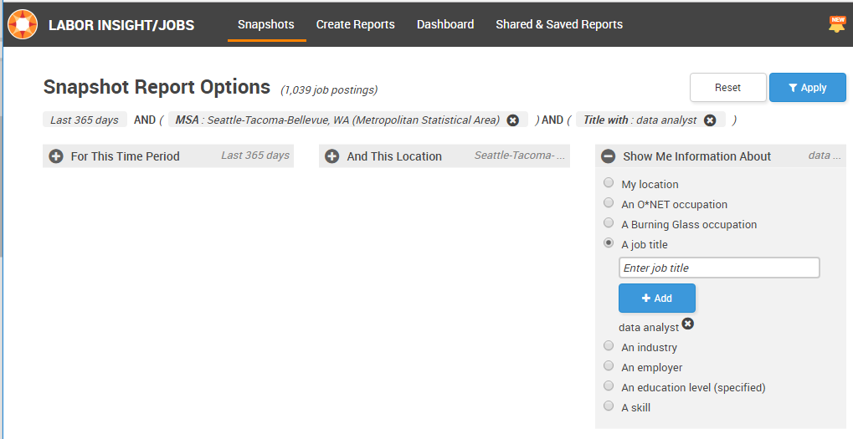
Burning Glass –
Labor Insight/Job Dashboard
Notes:
Like most efforts to acquire data, the dashboard of data views and reports we could access was more limited than we would have liked, but at least provided a fairly consistent and comprehensive view of what data analytic and science skills employers were looking to hire based on job postings. In other words, Burning Glass had done all the difficult data acquisition by scraping web sites filled with job postings and WRANGLING the data into a data warehouse that clients can EXPLORE via their Labor Insights web dashboard and reporting tool to DRAW CONCLUSIONS. For purposes of our analysis, we focused on the Seattle metro area which is one of the most advanced labor markets for this field.
Here is a summary of our data analysis wrangling and exploring journey and our conclusions:
Starting to EXPLORE the data by job title proved difficult, as organizations do not follow any standards in publishing titles in job postings that involve data analysis or data science. Additionally, when we tried to run queries across years or job titles in the Seattle Metro Area to get answers for questions like:
Which skills and tools were both growing as well as pervasive in usage?
Which sets of skills and tools differentiated a data analytics professional from a more advanced data scientist?

Slide 30
Labor Insights – Data Wrangling Issues
No higher level job categories
for example all analysts
No skill level included
(ex. Excel novice = Excel expert)
Lack relative importance of skills in each job posting
Omission of key data like salary level for many postings
Growth rates are likely exaggerated over time
Notes:
Even when you start exploring data, you often go back to data wrangling level. In our case, we found the accuracy and completeness of data was an issue. After sharing our results and asking questions to Labor Insight staff, we noted the following data issues:
All the various types of data analysis jobs did not show up in reports that were limited to 200 items and no higher level categorization of analyst titles was listed
The relative importance of skills in each job posting is not weighted, so using raw counts may be misleading
The level of skills is not provided in the data set - ex. XL novice = XL expert
There are omissions on some job postings of key data like salary, so averages are likely off and may be biased to the low end
Growth rates may be exaggerated if looking back to 2007, as their ability to collect a higher share of job postings has improved over the last 10 years
So as often happens, we set our sights on first answering some simple higher-level questions and then moved to address more complex or detailed questions.

Slide 31
Explore Data
From Seattle Metro Area

Slide 32
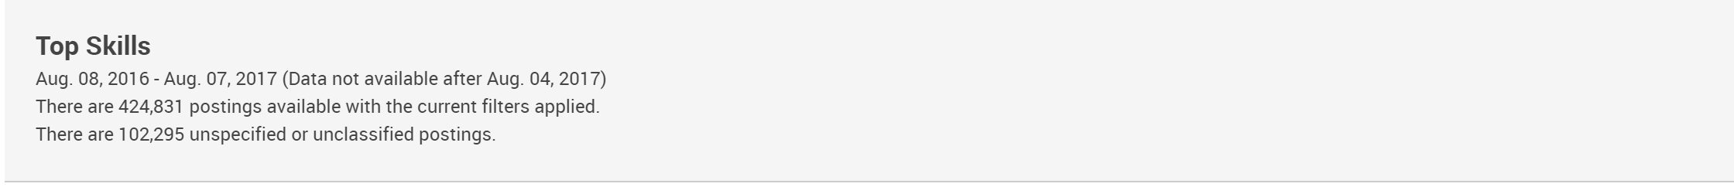
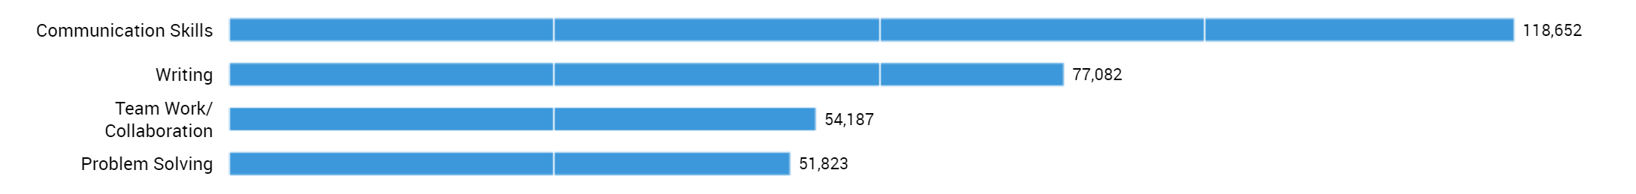


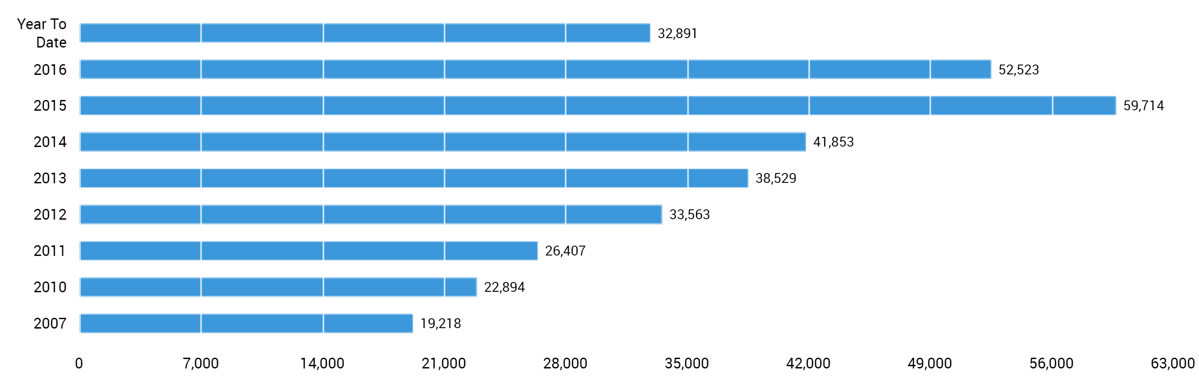
Five Most Sought After Skills
Microsoft Excel is the
5th most sought after
job skill overall!
While still a very widely sought after skill, XL appears to have plateaued in terms of the frequency it is mentioned
on job postings/
Microsoft Excel - Number of Postings per Year
Notes:
Starting at the highest level, we see a total of 424,831 job postings that Burning Glass had found, scraped off the web and published into their data warehouse for the last 12 months. In pivoting this data to show most sought after skills, it turns out that the 5th most sought after skill for all positions in Seattle was Microsoft Excel which is actually also true nationally.
However, as we looked at the related data views in the dashboard, it appeared that XL skills remain in high volume and are in demand, yet had seem to be plateauing or perhaps was being listed less often given the popularity of the tool.

Slide 33
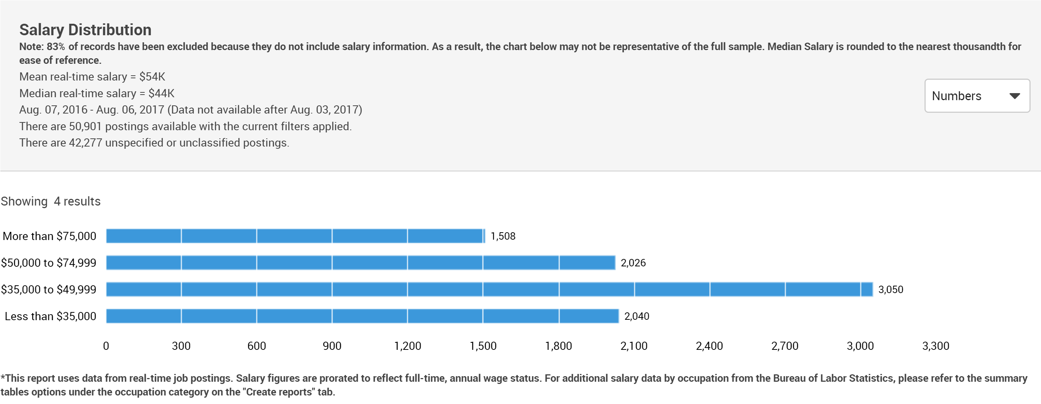
Salary Levels for Excel Skills
50% of the jobs pay $44K or less
Issue: No differentiation in Excel skill level
Notes:
Microsoft XL is primarily used for data analysis and reporting purposes, however the level of skill required varies and is skewed towards lower level positions. In particular, the median ($44K) is way below the mean ($54K) salary rate. Further, the median salary rate of $44K indicates that 50% of the positions advertised -- with published salary levels and listing Excel as a skill -- pay $44,000 or less. As such, if our graduates only learn XL, their skills will be clearly less valued than a more complete data science skill set.

Slide 34
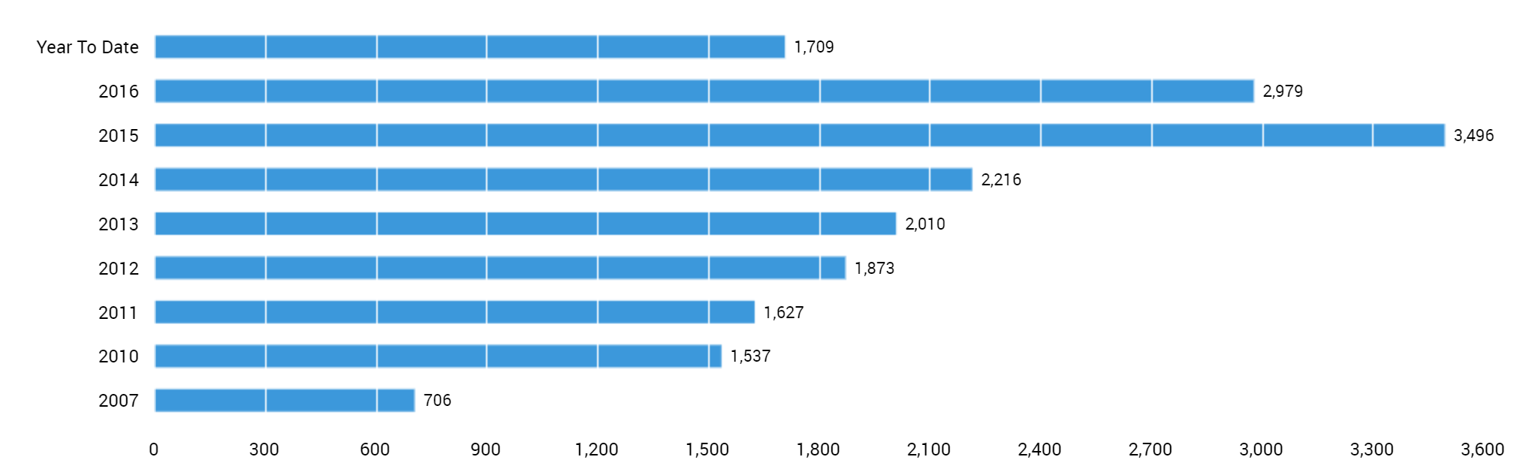
SQL & Data Analysis Skill Postings
Microsoft SQL + Data Analysis Skilled Job Postings
Postings that concurrently listed SQL and Data Analysis more than doubled in 5 years [2010 – 2015]
Notes:
Next, we looked at SQL skills. SQL database and query language is used for many purposes including operations, administration and analysis, so we filtered SQL just to include postings with both SQL and Data Analysis skills listed. The number of postings appears to be on the decline which is concerning since data analysis skills are on the rise.
This led us to wonder if being a SQL-savvy data analyst is enough? Was the move to cloud based applications with bundled in analytic packages impacting demand for SQL skills for data analysts? Or are new data storage technologies and products eating into the demand for using SQL for data analysis and data science?
We did not find definite answers. However, we did note that the number of postings for Big Data storage technologies like Hadoop, No SQL or Hive were ramping up substantially . Neverthe less, we noted these other data storage platforms were most often co-listed with SQL skills.

Slide 35
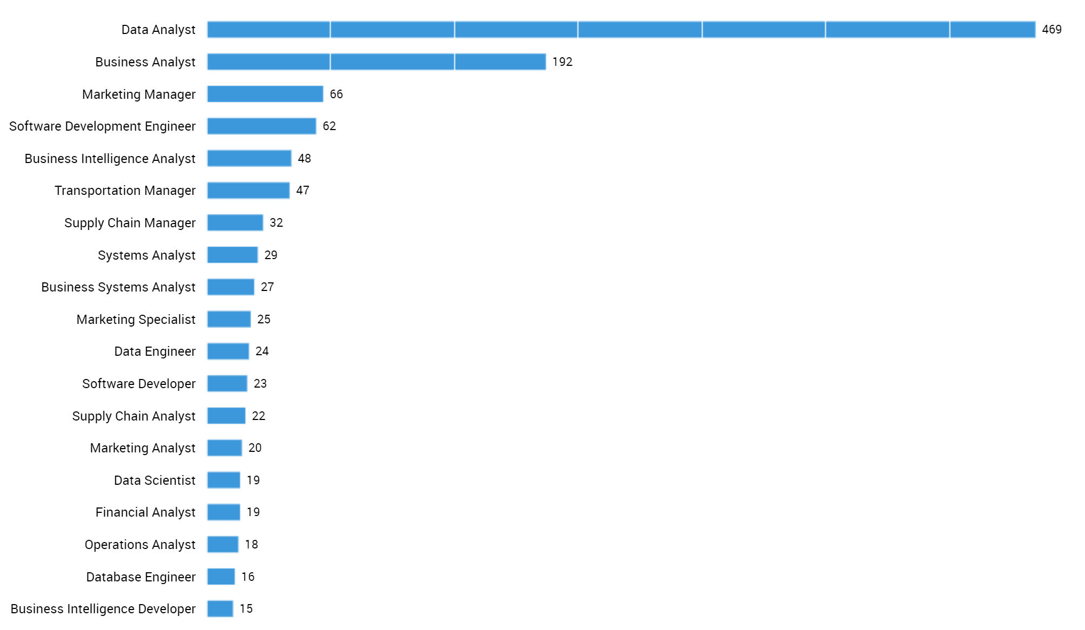
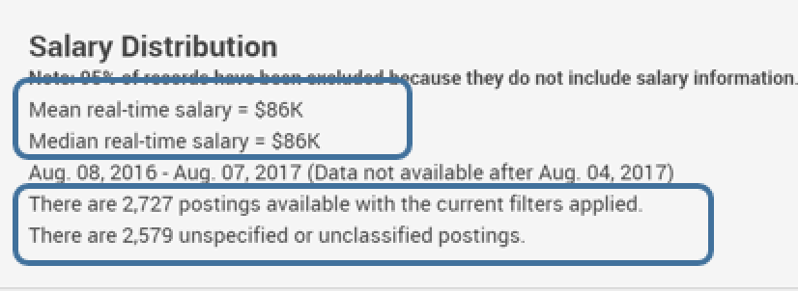
SQL & Data Analysis Skill Postings
Job Titles
Excel median pay $44K
SQL & Data Analysis median pay 86K
Notes:
When we explored the job titles associated with postings that listed both SQL and Data Analysis skills, we found the kinds of positions and average salary levels that were more in the realm of what our students were looking for. The job titles are mostly analysts, managers, engineers and developers with over 2,700 job postings per year. The median pay range rose from $44K for XL to $86K for SQL and Data Analysis.

Slide 36
Ask more questions
Ask Questions ← →Explore Data

Slide 37
What about new or more advanced tools?
Statistical Languages
R vs. SAS, SPSS or S
Programming Languages
Python vs. Julia, Matlab, C, Java
Machine Learning Algorithms
What are the trends?
How do these technologies improve salary outlook?
Notes:
What about new, more advanced data analytics and science skills and tools? We explored R, Machine Learning and Python job posting data and looked for trends and how these technologies could improve salary outlook.

Slide 38
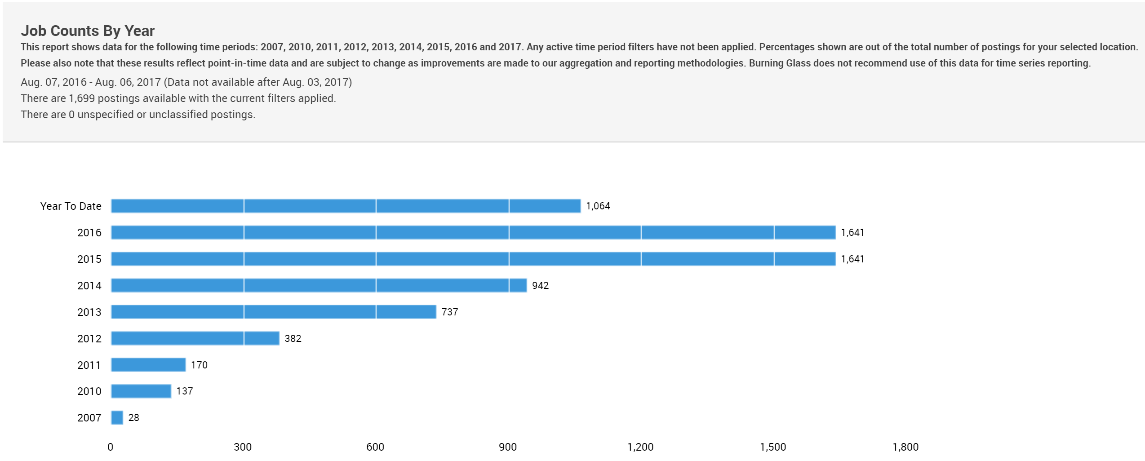

Growth in R Programming
737 jobs in 2013, 1641 jobs in 2015
Notes:
What we found was job postings for R more than doubled between 2013 and 2015. While growth rates have slowed more recently, we see increasing numbers of postings seeking R skills for positions outside of scientist and statistician roles.
The R language has matured, stabilized and become more accessible. A complete suite of statistical packages is now available called tidyverse and is becoming more of a standard in industry making it easier for programming novices and SQL aficionados to learn R programming. Moreover, the use of R can greatly increase the speed and agility of the data analyst.
The salary for these roles is another level up from SQL and Data Analysis. Over half the positions advertised in the past year, offered annual salaries in excess of six figures.

Slide 39
Implications for R Programming
Increasing number of job postings
R language is mature, stabile, accessible.
Statistical packages in tidyverse library
Easy for novices to learn.
Increases speed and agility of the analyst
Notes:
What we found was job postings for R more than doubled between 2013 and 2015. While growth rates have slowed more recently, we see increasing numbers of postings seeking R skills for positions outside of scientist and statistician roles.
The R language has matured, stabilized and become more accessible. A complete suite of statistical packages is now available called tidyverse and is becoming more of a standard in industry making it easier for programming novices and SQL aficionados to learn R programming. Moreover, the use of R can greatly increase the speed and agility of the data analyst.
The salary for these roles is another level up from SQL and Data Analysis. Over half the positions advertised in the past year, offered annual salaries in excess of six figures.

Slide 40
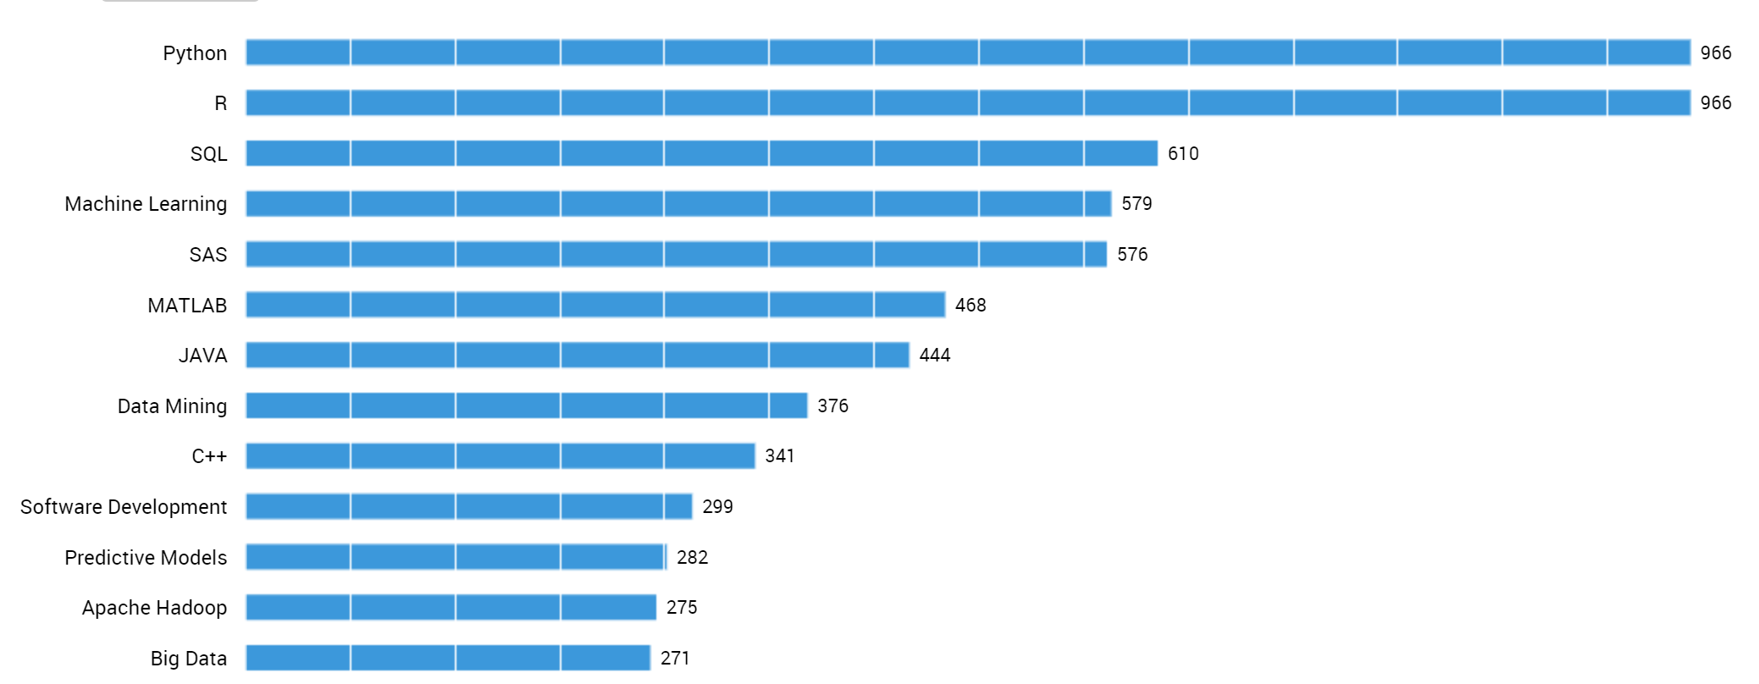
Python and R Co-Occurring Skills
7.6k jobs with Data Analysis skills
1.4k jobs with Data Science skills
966 positions requiring both R and Python skills
Notes:
While there are over 7.6K jobs posted a year in Seattle metro area with data analysis skill listed, there were only 1.4K with data science skills listed (5 times smaller). As we drilled down on the data science and engineering skilled postings, about 70% or 966 positions required both R and Python skills. Setting a goal to significantly advance students programming skills in two languages is too much to teach in a single certificate program.
Moreover, you can see the need to have Machine Learning skills was almost as highly ranked as SQL skills (579 vs. 610 job postings or over 60%). Taking an advance program in Machine Learning like our Certificate in Machine Learning requires Calculus and Linear Algebra which is beyond what the broader market of analyst and data savvy professionals need to fill the equally well paying opportunities identified earlier.

Slide 41
Draw Conclusions
Combine the answers and apply to original question

Slide 42
Data Analytics Topics:
Covered | Introduced |Deferred
MATH & STATISTICS
Statistical Modeling
Experiment Design
Machine Learning
Supervised Learning:
Decision Trees
Classification
Logistic Regression
Unsupervised Learning
Clustering
……
PROGRAMMING & DATABASE
Microsoft Excel
Statistical Languages – R
Programming Languages - Python
Databases and Big Data Storage
SQL
NoSQL
Hadoop
Hive/Pig
MapReduce
Software as a Service
…..
MINDSET
Curious about data
Hacker approach
Analytical
Influence Authority
Problem Solver
…….
COMMUNICATION & VISUALIZATION
Translate data-driven insights into
recommendations and decisions
Digital dashboard development
Story telling skills
Visual design thinking
……..
Notes:
After consulting with experts in the field, we decided that it was best to focus on R in the data analytics program and teach the basics of Machine Learning. We require some R and significant programming experience as pre-requisites to enter into the Data Science Certificate program which goes on to teach more advanced data analysis and machine learning in Python programming language.
Thus, we set off to build a data analytics program that gives students the subset of data science skills showing in part or in full on this color chart.

Slide 43
Iterative Data Analysis Process Parts
Ask Question(s)
Wrangle Data
Explore Data
Draw Conclusion(s)
Communicate Finding(s)
Notes:
The data analysis process underpins the flow of data analytics and science work. In simple terms, there are five iterative parts of this process. Ask Questions, Wrangle Data, Explore Data, Draw Conclusions and Communicate Findings.

Slide 44
Data Analysis Skills
An applicable exercise in Data Analysis Process

