Slide 1
Excel, Power BI, and R
Positioning of Excel, Power BI and R in This Course
Notes:
This presentation will incorporate positioning of Excel, Power BI and R in this course.

Slide 2
Expectation of Experience
 | Excel | SQL | R
CSV
Data Tables
Graphs
Notes:
Let me talk a moment about how we are positioning Excel and R in this course. This course is targeted toward professionals with existing Excel experience but with no R or programming experience of any kind.

Slide 3
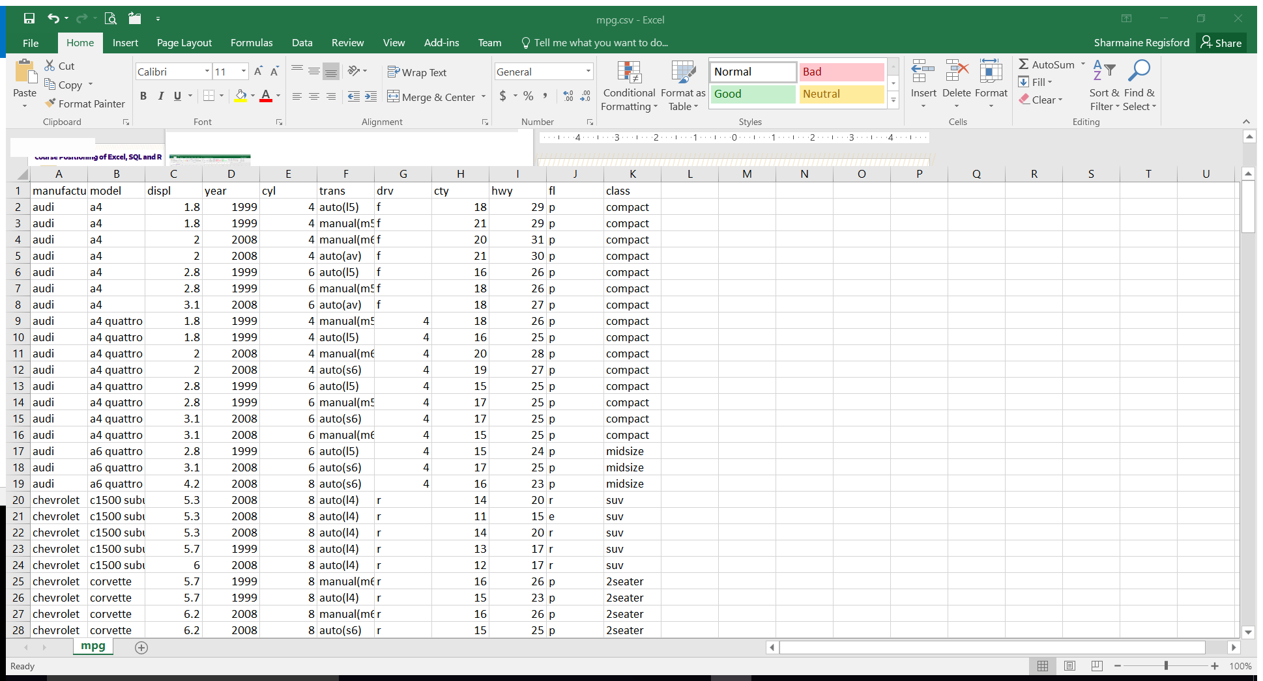
Excel 2016
Existing Excel skill and experience
Exercises in both Excel and R to compare and contrast
Excel to confirm R solution is correct
Excel phased out during course
Notes:
We’ll do some exercises in both Excel and R. You can decide which order you want to do them in, but do them in both. I find that when learning R, Excel can be used as a confirmation that what I am doing in R is correct. Also, since R has a steep learning curve, the data analysis portion may get overlooked as your mental bandwidth is spent wrestling with the R syntax and not data analysis. Excel can bring that focus back to the data analysis. I also find that knowing which tool is best for which task is a real, time saver.

Slide 4

Structured Query Language
Existing SQL skill and experience
Image source: SQL Documentation
Notes:
Let me talk a moment about how we are positioning Excel and R in this course. This course is targeted toward professionals with existing Excel experience but with no R or programming experience of any kind.
The course was designed to leverage your existing Excel and SQL experience to help with this knowledge transfer to R.
Image source: https://docs.microsoft.com/en-us/sql/#pivot=main&panel=analytics

Slide 5

R Programming Language
No prior R experience
No programming experience
Import from Excel and SQL into R
Image source: R.project.org
Notes:
Even though I use R for many things, I find myself still using Excel. Being able to compare and contrast how each tool performs a task can be helpful. With that said, the exercises in this course focus on starting from ‘I never heard of R before’ to ‘Look, I am doing data analysis using R!’. The R code and instructions will be explained in detail. For Excel, however, there won’t be click by click instructions, but rather general direction, key formulas and, of course, solution files for you to review. As we get to more sophisticated data analysis, Excel exercises will be phased out and only performed in R.

Slide 6

Power BI
No Power BI in this course
Power BI is the focus of Data Visualization course
Integration with R
Data visualization using ggplot
Data wrangling using dataframe
Image source: PowerBI Microsoft
Notes:
If you are a Power BI fan, your R skills will take your Power BI reports to the next level. Excel works better with Power BI. Since Power BI will be covered in the Data Visualization course, the Excel solutions in this course won’t use Power BI.
One exciting thing about Power BI is that there is R integration with it. The R code you learn in this course, can be incorporated into Power BI in two ways. It can run ggplot code and display visualizations never thought possible in Power BI. It can run R code from data transformation to modeling algorithms and used as the data source for Power BI. This will all be covered in the next course.
Image source: Microsoft

Slide 7
Jupyter Notebook & Virtual Lab Environment

Slide 8
Jupyter Notebooks
We will be using R programming through an interactive environment called Jupyter Notebook. Jupyter Notebooks allow instructors to present each R exercise in one single document where students can see the instructions for the exercise, fill in the blank or replace ??? with the correct R command, and run their R code.
Notes:
The Jupyter environment includes markdown and code, so instructions can be provided inline.

Slide 9
Vocareum Virtual Lab
Vocareum virtual lab is a web-based virtual environment where all the R code exercises and assignments are hosted. It has Jupyter notebooks you need to do your R exercises and assignments, and also has R studio for some of the assignments. You won't need to install anything on your computer, you just need a web browser. Each student will get his or her own virtual environment. Instructions on how to access Vocareum Virtual Lab will be included with each exercise and assignment.
Notes:
The Jupyter environment includes markdown and code, so instructions can be provided inline.

Slide 10
Summary
Have fun learning how to program in R.
Rely on your Excel skills for understanding what things will look like.

