Slide 1
Getting Started With Data Analysis - Overview
Introducing graphical data analysis
Notes:
This presentation will incorporate introducing graphical data analysis.

Slide 2
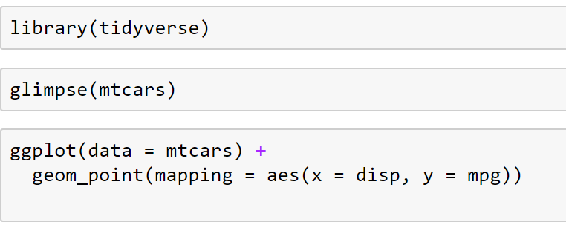
Recall from ggplot Lab
Notes:
Recall the three lines of R code we executed in the prior exercise. Library(tidyverse), glimpse(mpg), and ggplot(). I want to pause for a moment and look at each line of code one at a time. Those three lines of code are doing a great deal of work and I want us to get a bit more comfortable with what each line is doing. We’ll discuss each of them and give some additional background information over the next few videos.
The first line of code is a library statement. However, that only works if R has the right packages installed first.

Slide 3
R Packages and Libraries
Understanding R packages and libraries
Notes:
This presentation will incorporate understanding R packages and libraries.
Let me talk a bit about R and packages and how they relate to libraries.

Slide 4
R Background
Programming language for statistical computing
Open source
Ported in 1992 from New S
New S was released in 1987
Original S started in 1975 at Bell Labs for internal use
Notes:
R is an open source programming language for statistical computing. It was ported over in 1992 from the ‘New S Language’ released in 1987 which came from S originally developed at Bell Labs in 1975 for internal data science use. So, R is quite an old language when you consider its roots.

Slide 5
Packages
R is made up of packages
Packages contain functions and extend R
Basic R installation contains only small set of packages
Typical to install additional packages
Coding statement
install.packages(“package name”)
Packages installed once
CRAN mirrors for installation source
(Comprehensive R Archive Network)
Notes:
R is made up of packages, each containing functions we can call from our code. There are thousands of packages, often extending or overriding functions from other packages. The basic R installation includes only a basic set of packages. It is typical to install additional packages based upon your needs.
Execute ‘install.packages(“package name”) with the name of the package in quotes to install a package. Packages are installed from CRAN (Comprehensive R Archive Network) mirrors.

Slide 6
Library()
Loads packages into memory (RAM)
Packages must be installed first
Coding statement at top of source file
library(package name)
Simplifying R to help understanding
Notes:
Once the packages are installed on your computer, you can use them, or load them into memory by using the library statement. You won’t need to use the functions from all of your installed packages for a given project. You tell R what packages to load into memory for use, by executing library(package name). It is common convention to not put the package name in quotes for the library command.
By the way, I will often gloss over or omit minor technical details that aren’t important and might detract from learning the core concepts. For example, packages and libraries *can* be slightly different with a package referring to the code files and the library referring to the dynamic linked libraries (DLL) or shared libraries making it possible for libraries to have different names from the package names and packages could contain more than one library. We won’t concern ourselves with minor technical details like these in this course. I bring it up because you will hopefully go on to discover more and more of the richness of R. We will be just scratching the surface of the capabilities of R, and that is plenty to be productive analyzing data.

Slide 7
Library Best Practices
Loading is needed for each new R session
Only load what is needed
Saves RAM
Avoids naming conflicts
Load most important packages last
Alternate way to call functions
package_name::function_name()
Notes:
Getting back to the library statement, often you will group all your library commands at the top of your code project, but that isn’t required. The library just has to be loaded before you call a function from that library. This is a side effect of R being an interpreted language as opposed to a compiled language. This means that you can interact with R one line at a time and don’t need to rerun the entire program if you make a change to the code.
You might be asking, why not just install all the packages and load them all with library statements and that would be one less thing to worry about? This is not advised for two reasons. The first is that R is, for the most part, an in-memory app, meaning that all the data and operations it performs on the data need to all be in RAM. Loading libraries take up memory that could otherwise be used for your data.
The second and more important reason is that packages may use the same function names as other packages. This creates conflicts. If you look back at the output from library(tidyverse), there were two conflicts listed at the bottom, filter() and lag(). It is stating that if your code calls either of these functions, it will use the tidyverse, more specifically the dpyr library version of them instead of the stats version of them. I have definitely run into trouble when the wrong version of a function was used in my code than the one I intended. So, you can install as many packages as you want, but only load the ones you need for your project and load them in the order such that any function conflicts are using the package you want. In other words, load those libraries last. While libraries need to be loaded each time to start an R session, packages only need to be installed once.

Slide 8
Welcome to the Tidyverse
Using the tidyverse packages
Notes:
This presentation will incorporate using the tidyverse packages.

Slide 9

Tidyverse
Suite of R packages
Designed to work together
R packages are diverse in open source community
Tidyverse creator, Hadley Wickham
Free eBook: R for Data Science: Import, Tidy, Transform, Visualize, and Model
Coding statement
library(tidyverse)
Notes:
Let’s talk about the tidyverse. The tidyverse is a suite of R packages that have been designed to work together. This is important because there are so many ways to do the same thing in R, it can get very confusing very quickly, especially when you start searching on the internet forums for help. The tidyverse visionary, Hadley Wickham, created a consistent set of functions, a consistent style of how to use these functions, and a philosophy called tidy data, that makes data wrangling and visualizing more straightforward and consistent. I encourage you to read his book, R for Data Science: Import, Tidy, Transform, Visualize, and Model Data co-authored by Garrett Grolemund. Both authors work for RStudio, a popular development environment for R. Loading tidyverse is a convenient way to load several libraries together.

Slide 10
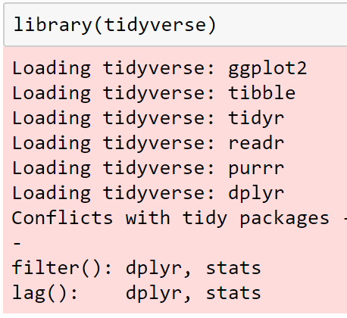
Tidyverse Output
Notes:
You can see these listed in the output window.

Slide 11
Tidyverse Solutions Preferred
Initial learning the tidyverse way
Avoiding base R way
Books and References favor base R
Dependencies on ‘3rd’ party packages is necessary and recommended
Be consistent, don’t mix and match
The right tool (package) for the right job
Example: ggplot
Notes:
We will stick to the tidyverse as much as we can. If there is a tidyverse way of doing things, I will show that way over others. That includes base R as well. So, don’t be alarmed if you pick up an R book and find different ways of doing the same thing. I remember being very confused in the beginning about all of this. I thought that I would try and stick to the base R set of functions as much as possible. I thought that it would be simpler to learn, and I wouldn’t create any ‘dependencies’ on ‘3rd party’ packages. After I got a bit of experience with R, I changed my mind. Often additional packages make things easier to do than base R. And you cannot get around having to install and load additional libraries. R would be very limiting if you couldn’t load libraries. In fact, the world-class plotting that R is renowned for, ggplot, is not in base R. And yes, we can thank Hadley Wickham for ggplot. It is part of the tidyverse.

Slide 12
Coding Conventions
Library statements grouped at top of program file
Load most important packages last to manage conflicts
Calling package hidden by conflict
package_name::function_name()
Notes:
So, we now have the background we need for the first line of code, the library statement. As a convention, I will group these at the top of my program and order the most important ones last. If I do have a function conflict and I really want to use the version of the function that has been hidden, I can fully qualify the function call with package name followed by two colons followed by the function name.

Slide 13

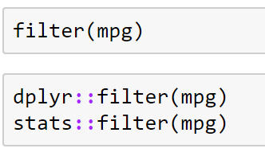
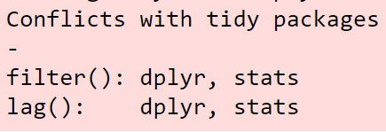
Explicitly Specifying Package
The library
Both libraries have a filter command.
Notes:
Let me change the glimpse function call to include its library name, dplyr. If a function named glimpse was defined in another package and loaded after dplyr, this fully qualified statement would ensure that the dplyr version of the function would be called.
Some data scientists fully qualify all their function calls like this to remind them what package they came from and reduce the possibility of calling the wrong function in the future. I won’t do this here, but I have had to fully qualify functions because some packages depend on other package functions. When those are overridden, the results don’t work well.
There are two very common and very similar packages, but yet different enough to cause problems.

Slide 14
plyr and dplyr
plyr – data manipulation package
dplyr – tidyverse version replacing plyr
Don’t load plyr
Use plyr::function when necessary
Prefer tidyverse packages
Prefer Hadley Wickham tidyverse-like packages
Notes:
They are plyr and dplyr. They both perform basic data manipulation, and many programs will use one or the other. We will use dplyr as it is part of the tidyverse. As a result, I do my best to try to keep plyr from being loaded. That is easier said than done. I guess I forgot to mention this, loading a library can load other dependent libraries. So, libraries can be inadvertently loaded. The same is the case for installing packages, and there could be problems there too when one package assumes a particular version of a dependent package and that dependent package has been recently updated. This is a side effect of a vibrant open source community without heavy governance.
We’ll stick to the tidyverse and Wickham authored packages and only a handful of other packages. Hopefully that will keep us out of trouble.

Slide 15
The Dataframe and the Tibble
Understanding the Dataframe and the Tibble
Notes:
This presentation will incorporate understanding the data frame and the tibble.

Slide 16
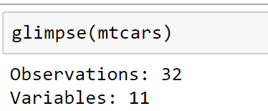
Dataframe and the Glimpse Function
dataframe defined
data types
rows and columns
glimpse() displays above info plus some data
row names
convert row names to columns if required
Notes:
Now that we understand the library function, let’s move on to the second line of code. Glimpse.
The glimpse function is used to print out the structure and the first set of values contained in the data variable.
The type or class of this variable is called a data frame. It is a very popular class used in R. It simply is a rectangular collection of variables often called columns and a number of observations often called rows.
The columns have names that you can refer to. The rows can optionally have names, but that doesn’t work well in the tidyverse so it is good practice that if you want to name each row with a metadata name, consider just making it a full-fledged column instead.

Slide 17
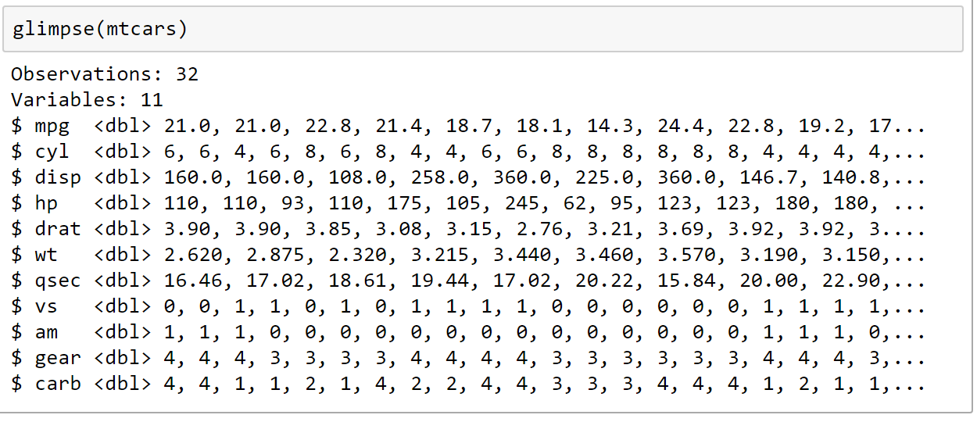
Glimpse() Output
Observations = rows
Variables=columns

Slide 18
Inheriting and Extending the Dataframe
R is object oriented functional language
similar to Lisp and Scheme
R behaves differently than modern object oriented languages
Packages can inherit other object classes
Objects can belong to multiple classes at once
Dataframe is common to inherit and extend
Notes:
R is object-oriented in novel and strange ways. R being based on New S, it inherited some powerful constructs from Lisp and Scheme language, making R both a functional language and a object-oriented one.
I mention this for two reasons.
One is that R may behave differently than other modern programming languages especially its internals.
The second is because it is not uncommon for packages to extend this powerful data frame class and add more functionality or override functions that act on data frames.
In fact, it is also common that an object can belong to multiple classes at the same time.

Slide 19
Tibble – An Extension of Dataframe
Tibble is the tidyverse extension of the dataframe
Acts as a dataframe for non-tibble aware packages
Contains additional metadata used by the tidyverse
Can convert to and from a tibble explicitly but often not required
Notes:
This happens in the tidyverse. The tidyverse version of a data frame is a tibble.
It is a data frame and for non-tibble aware functions, it looks and acts like a data frame.
However, in the tidyverse, tibbles are enhanced versions of data frames. As we move data into the tidyverse, we may need to convert it into a tibble. On rare occasion, we might need to strip away the tibble specific metadata and get back to a basic data frame.

Slide 20
Managing Enhanced Dataframe Objects
Tibble is an enhanced dataframe
Use tibble whenever possible for data storage
Variable naming convention ‘df_’ for dataframe
Functions act different depending upon the class of an object
Use class function to see object class
class(object_name)
Notes:
As you may be starting to see, R has a lot of complexities under the hood. As a result, many consider R to be one of the more challenging programming languages to master. However, R is also one of the most rewarding languages to use once you get the hang of it.
Since the class of the variable often dictates what functions you can use with it, I do two things to help me remember my variable’s class. First, I often preface my variable name with ‘df_’ to indicate it is a data frame (or data frame derivative). Secondly, there is a class function that can be used to print the name of the class or classes it belongs to. Let me execute class on the mpg data frame.
First notice that the Jupyter code blocks can contain multiple lines of code. When you run the block, it runs all the lines of code in that block. Looking at the output of class, it has three classes, tbl_df, tbl and data.frame so it, in fact, is a data frame…and a bit more.
To make things easy on your brain, try to stick to just a few key classes to store my data, the data frame or tibble being your ‘go to’ class for rectangular, non-time series data.

Slide 21
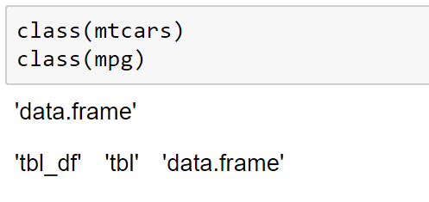
Class() Output

Slide 22
Grammar of Graphics
Using ggplot to Visualize and Analyze Data
Notes:
This presentation will incorporate using ggplot to visualize and analyze data

Slide 23
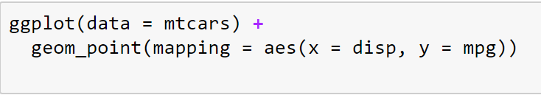
Grammar of Graphics
Coherent system for describing and building graphs
Similar to grammar of spoken language
Published paper: Graph-Theoretic Scagnostics (2005),Wilkinson, Anand, and Grossman
Reference paper: A Layered Grammar of Graphics (2010), Wickham
Notes:
The third line of code is ggplot. GG stands for grammar of graphics, a coherent system for describing and building graphs.
If you think about it, just like there is a grammar for spoken language governing what words make sense together, there is a similar underlying grammar for graphics. If you want to create a scatter plot, you need a data value for each axis otherwise it wouldn’t work just like combining random words together might end up as nonsense.
A paper published by Hadley Wickham, the ggplot author, called A Layered Grammar of Graphics, goes into more detail on this.

Slide 24
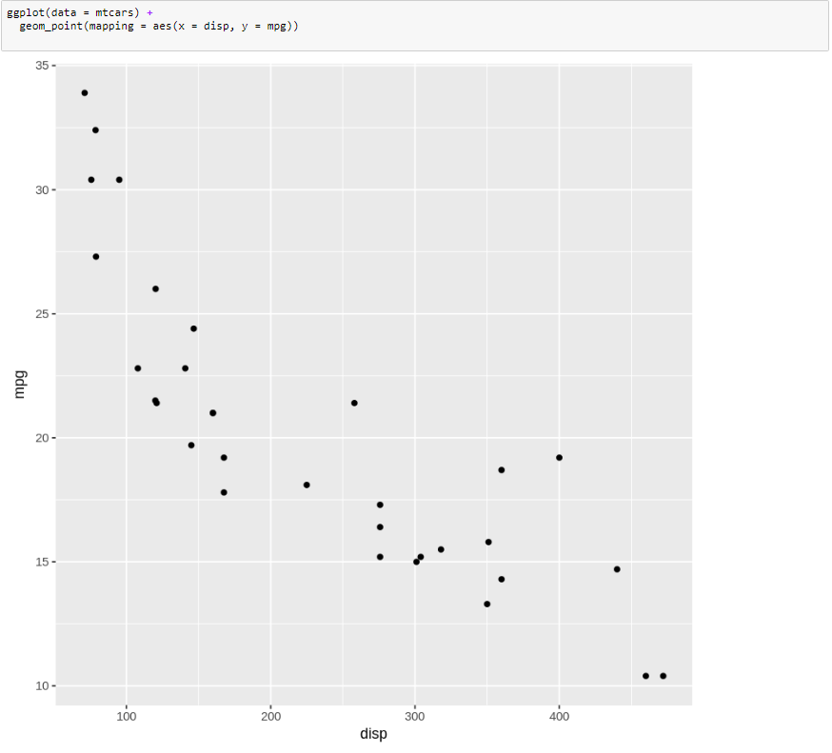
ggplot Output

Slide 25
ggplot
Implemented in ggplot2 package by Hadley Wickham
Premier data visualization tool for analysis and presentation
Non-interactive visualizations
See newer version ggvis for interactivity (outside the scope of this course)
Can be run within Power BI
Course focus is analysis not presentation
Notes:
We’ll start to build an intuition around ggplot, throughout this course. In this course, we will concern ourselves with using visualization for data analysis and won’t spend much time polishing the charts to make them publish quality…although rest assured knowing that ggplot has all the capability needed to do this. The next course in this track, Data Visualization, will go into much more depth around this.

Slide 26

ggplot
Data source is the dataframe
Build up layer by layer
Use the plus ‘+’ operator to chain or pipeline
R is case sensitive and but not code indent
ggplot code template:
Notes:
In our ggplot command, we started with the ggplot function and passed it a data frame. Then we used the plus operator to keep building this up layer by layer. The plus operator chains plot properties together. It is typical convention to have each layer or object to be on a separate line. Make sure the plus sign is at the end of the previous line. It won’t work if it is at the beginning of the next line. Remember R is an interpreted language, so we need to communicate to R that we are not done with the line of code, so the plus acts as a signal of ‘wait there’s more coming’.
The simple ggplot template is as follows:
The first line contains the function ggplot with a parameter: data equals the data frame variable enclosed in parenthesis, and a plus at the end of the line. Each line thereafter can be a geometry where you map columns from the data frame to visual aesthetics. The template here is geom underscore then the name of the geometry. In parenthesis have mapping = aes followed by a comma separated list of name / value pairs of aesthetic to data column name. Make sure with every parenthesis you open, you also have a matching closing parenthesis. Keep adding a plus sign at the end of the line except for the last line. There are other ggplot statements other than geometries that we will see later.
Also, R is case sensitive so be careful with that. The tidyverse uses snake case which is all lowercase characters and an underscore as a separator such as geom underscore point. I’ll try to be consistent with this style for my variable names as well. You don’t need to worry about code indent or whitespace. You should indent your code for readability, but R doesn’t rely on any spacing consistency to run your code. I like to put spaces around the operators like equals, for readability but that is a matter of coding style.

Slide 27
Coding Style and Column Naming
Variable naming, code indent, comments
Data column naming balance between source traceability and business terminology
Turn Boolean columns to descriptive strings
Example: IsMale {0, 1}
Column rename to Gender
Data type change from logical to character
Data change to {“Female”, “Male”}
ggplot uses column names for labels
Notes:
This does bring up a point about coding style and naming convention, not just for the code you write, but also for the column names in the data you are using. Often these column names come from the data sources in all shapes and sizes. There is a balance you will have to decide on, among using the source names which facilitate traceability back to the data source systems, your coding style such as snake case and how verbose or terse you want to be in naming your columns, and the business terminology, the names the business uses to describe this data.
Having business-friendly column names makes it less work in the charts as the column names will show up by default in the charts. Otherwise you may need to override them in ggplot. As we will see, this extends even further to data itself. You might consider, for example, changing a gender Boolean column containing 1 or 0, to a string column instead, containing the values ‘male’ and ‘female’.

Slide 28
Summary
Loading a library
library(___)
Understanding a dataframe
glimpse(___)
The grammar of graphics
ggplot(___)

