Slide 1
Learning Requires Practice
Using Repetition and Scaffolding to Learn R
Notes:
This presentation will incorporate using repetition and scaffolding to learn R.

Slide 2
Learning a New Language
Difficult, challenging and time consuming
Incremental building up of vocabulary
Reinforce with practice and repetition
Time spacing between practice sessions
Take breaks frequently
Fluency changes focus from vocabulary to grammar and style
Notes:
As with learning any new language, it takes practice to become fluent. Imagine you are visiting a faraway land where the spoken language is foreign to you. You came equipped with a dictionary to look up words, but you quickly find that attempting to have a conversation is very difficult as you have to pause and consult the dictionary then attempt to pronounce the word. Communication is slow and difficult and painful. Once you have a handful of keywords and phrases committed to memory, things become much easier. It is just a matter of time and practice.
It is the same when learning a programming language. It will be confusing and difficult at first. Whether learning new languages comes natural or not, it requires practice over time. By practice I mean typing at the keyboard, using the dictionary to find the right word, reusing those words in different ways until you commit them to memory. No this isn’t a course on typing or memorizing, but it is about repetition and reinforcement over time. In fact, this isn’t just for learning R, it is also for learning data analysis.
As I became more fluent in data analysis, I started seeing the data differently. Just like learning a new language, the focus starts out with vocabulary and definitions and pronunciation. Later it changes to grammar and then on to dialect, style, and emotion. Data analysis is like this too. There are many different degrees of analysis and a beginner will focus on certain aspects while more experienced analysts might be drawn to something else.

Slide 3
Where to Find Help
Challenging but not frustrating
Use help
‘?’,
library(help=“package name”)
CRAN documentation and package PDFs
Be careful of forum posts
Notes:
So, when we ‘practice’ we will discover new things about R and about the data that were there all along yet revealed to you only when you are ready to see it. That makes these exercises extremely important for you to work through. Don’t rush. Don’t do a cramming marathon session to get it all done at once. Instead, take frequent mental break between exercises. Allow your mind to internalize…and forget things. It is okay and expected to reopen and review prior exercises to recall what you did. It is okay and encouraged to use the CRAN documentation. CRAN stands for Comprehensive R Archive Network and is the place to go to install R and its packages and is the official documentation source.
It is normal to consult the function usage documentation. Since R has such a wide variety of package authors, each with their own style and naming convention, I am always looking up the specific usage details. You can get this in Jupyter by executing ‘?’ followed by the function name in a code block. This opens reference documentation which can be pretty difficult to learn from, but it is good for a reminder of what that parameter is called. And most have helpful example code at the end.
Be careful of forum posts. They are a source of amazing knowledge, but they can be quite overwhelming when first starting to learn R.

Slide 4
Student Starter Code
Starter code has help comments and blanks ___
# denotes comments
Replace the blanks
Use solution code or videos if needed
Review solution code and/or videos after completion
Notes:
As we continue throughout the course, I will include more conceptual material at the top the Jupyter notebook exercise files. This is great summary of the video information and allows for details that make more sense in text form than in video lecture form.
I will include code comments. R ignores anything after the # (pound sign). I’ll include instructions and hints here too.
I’ll also put in placeholder underscores as part of the code that is meant for you to replace it with the appropriate code.
By the way, the length of the underscore doesn’t match the exact number of characters to replace it with. You could be replacing it with something small or something large. It is just a placeholder to help focus what to change.
Lastly, when all else fails, there is the solution file. Don’t feel back looking at the solution if you can’t get it to work yourself. That is what it is there for! After all, if you already came up with the solution, you wouldn’t need the solution file.
I want to make this as frustration free as possible. Challenging but not painful. It is all part of the learning process. And yes, it will get more challenging at the course continues, and yes you will be able to learn and understand it, and yes you will become a data analytics GURU by the end of this course.

Slide 5
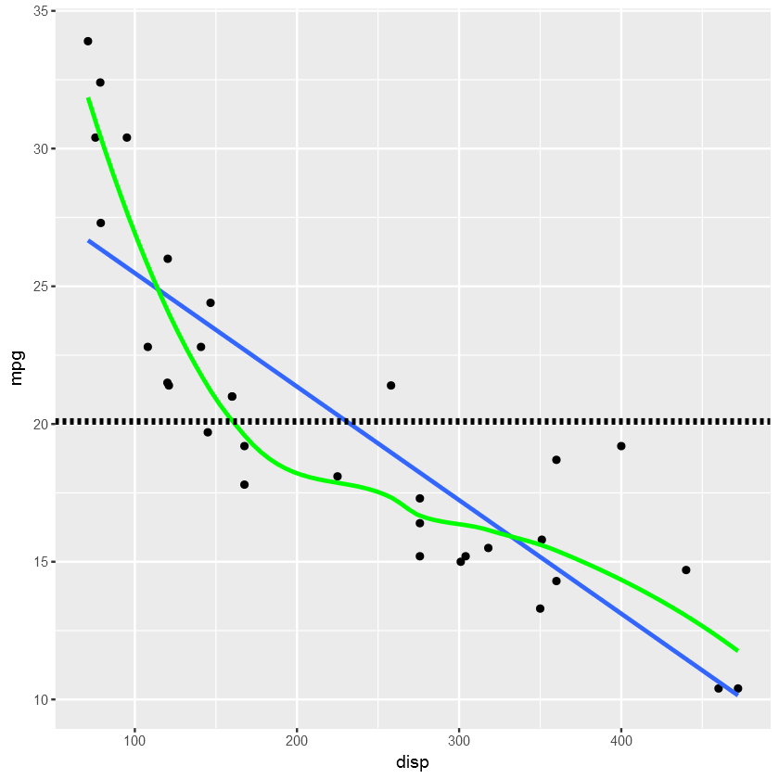
Which line is the best trend line to represent mpg vs. disp?
Notes:
This is a lead in slide to the next topic.

