Slide 1
Trend Lines
Using trend lines to analyze data
Notes:
This presentation will incorporate using trend lines to analyze data.

Slide 2
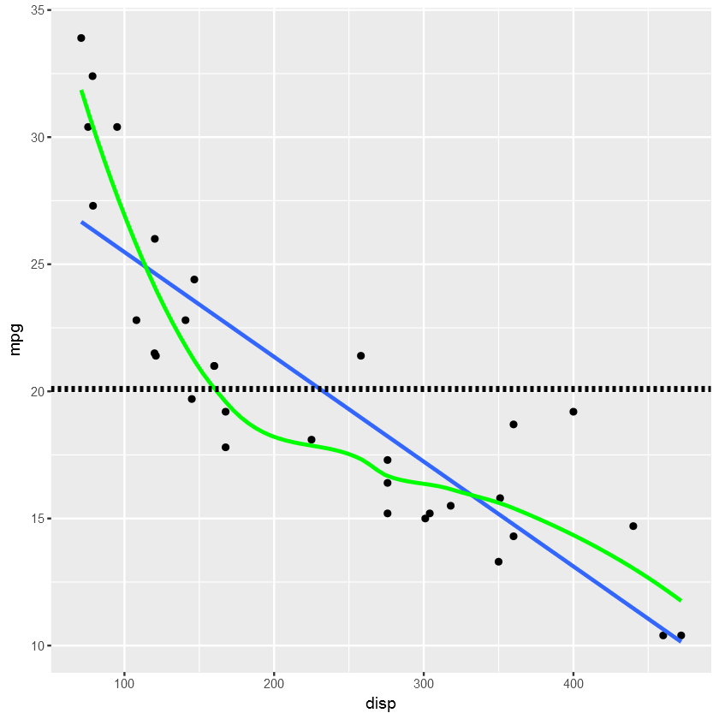
Trend Lines
Trend lines defined
straight line
best fit to the data points
concise summary of the data
Dimensionality
Notes:
We have been talking about trend lines, casually. That is very natural for analysis. Let’s discuss a bit more about trend lines and how they help us with analysis. When someone mentions ‘trend line’ in casual conversation, I conjure up an image of a straight line that sort of fits the data the best like this blue line here. However, all three lines are mathematical summaries of the data. They vary in their dimensionality, their flexibility in how much they can wiggle.

Slide 3
Be Careful with Trendlines
Dotted black = mean average
Blue straight line =least squared fit line
Green curve = LOESS
fits the data in smaller segments and creates a smooth line connecting them
Notes:
Actually, all three lines represent a summarization of the data. The horizontal line is the mean average. The blue straight line is the least squared fit line. The green curve is called LOESS which fits the data in smaller segments and creates a smooth line connecting them. In casual conversation, I would lean toward the straight line being the trend *line*, but the larger point is that these lines are a summary of the underlying pattern of the data and that can be done in many ways to support different analytical purposes. So, is there a best answer? In my opinion there are better and worse answers for any give analysis context.
The mean could be the best answer…if I was looking for vehicles with better and worse fuel economy, I might subtract the mean value from every point and plot the % difference from the mean. This would give me a sense of which vehicles have a much higher than average mpg and which are much lower than average.
The straight line could be the best answer…if I was looking for vehicles that had better gas mileage given a certain engine size. I would create the same % difference as I would for the mean, but this time for the line. In this plot, those 2-seater sports cars would stand out as having high fuel efficiency for the size of engine they have.
The curved line could be the best answer…if I was designing a new vehicle and wanted to know what a competitive mpg it would need to meet as compared to others in the its local area or engine class. Also, if I were to predict mpg of vehicle I hadn’t seen before based upon it’s displacement, I think this LOESS curved line would give a more accurate prediction on average than the other two…but there are many other non-linear options to choose from when it comes to machine learning. We will learn more about this at the end of this course and it is the focus of the Data Mining course.

Slide 4
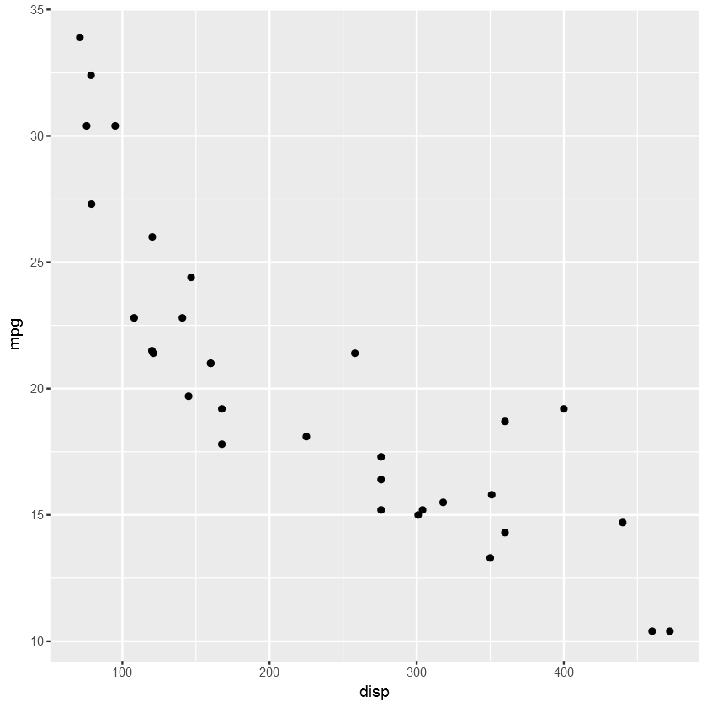
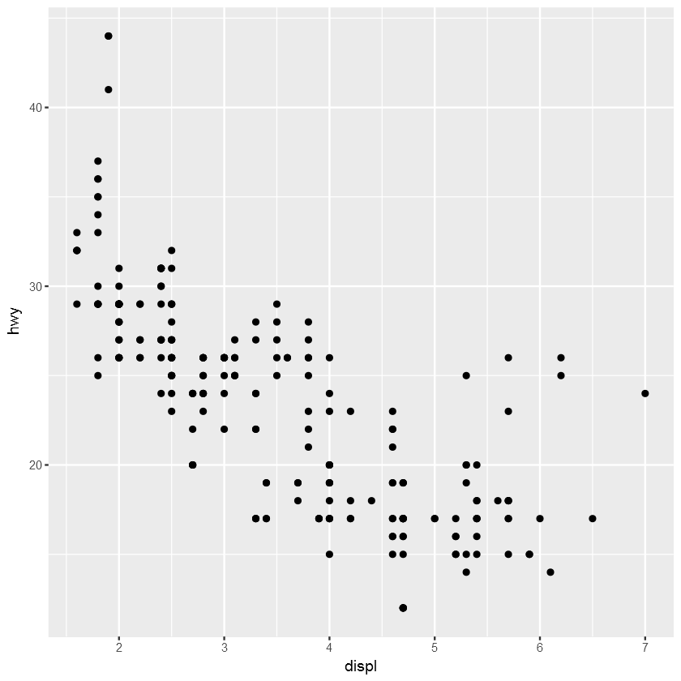
If you could imagine a trend line for the plots so far, what was the slope of them?
Notes:
If you could imagine a trend line for the plots in the prior exercise, what was the slope of them?
All the fuel efficiency chart slopes were negative (decreasing)

Slide 5
Trendlines Demonstration
geom_smooth()
using method loess
With lm parameter
Without confidence interval se
With geom_point()
mapping()in ggplot
Notes:
See solution file: lesson02-2-solution-trendlines

Slide 6
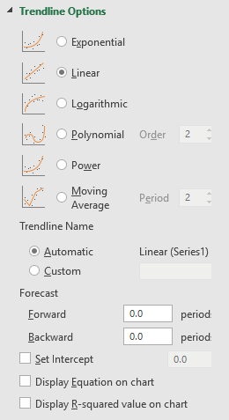
Algorithms
least squared regression
LOESS (local regression)
mean( )
moving average
function (polynomial, exponential, log)
Notes:
The horizontal line is the mean or average of mpg, while the green curvy line uses the same fitting method as the blue one that we will come to know as least squared regression, except that it does this multiple times over a small section of the data points connecting them together into a curve. The method is called LOESS, but these details are unimportant right now.
We’ll discuss more about the underlying statistics in a future lesson. For now, we just want to see how we can draw these lines on our graphs and help us visualize the relationship of the data.

Slide 7
Summary
Use the built in R help: ?
Glimpse the data for
Using ggplot can create best-fit lines
geom_smooth
Loess
In excel use , Trendline Options

