Slide 1
Categorical Variables
Using Categorical Variables for Visual Data Analysis
Notes:
This presentation will incorporate using categorical variables for visual data analysis.

Slide 2
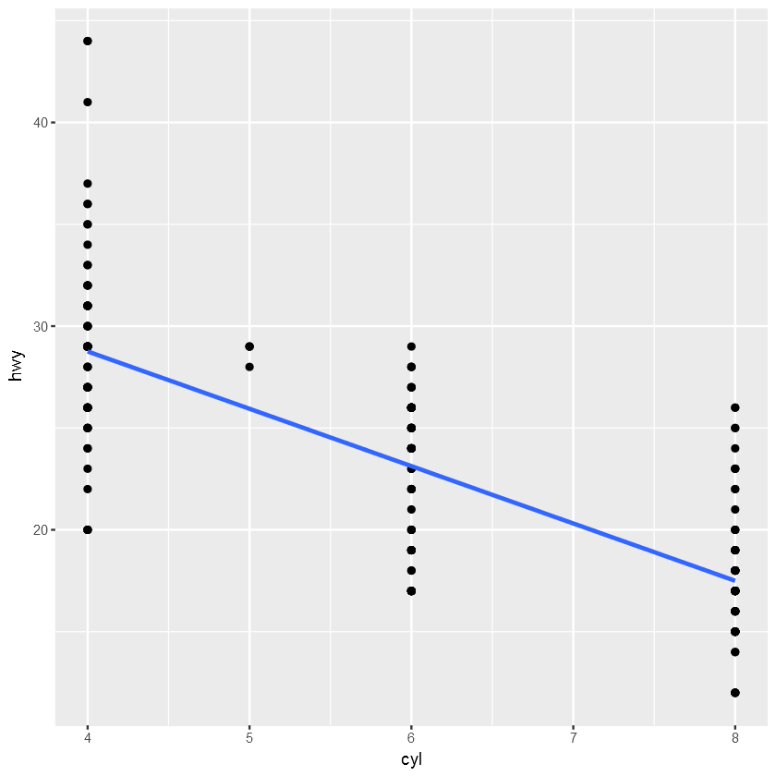
Categorical Variables
One of a limited number of values
Fixed number of possible values
Examples: Engine cylinders, Gender
Notes:
As we can see in the plot of the number of engine cylinders, this variable is different than the others we explored so far. This is because this variable is considered a categorical variable. A categorical variable is a variable that can take on one of a limited, and usually fixed, number of possible values. In this case the number of cylinders of an engine has to be an integer. You cannot have ½ of a cylinder. And in practice, there are some common engine designs limiting the number of cylinders to 4, 6, and 8. Sure I see a few outliers of 5 and I saw some exotic vehicles with 10 and 12 cylinders, but even including these, it still meets the definition of ‘a limited and usually fixed’ number of values.
Doesn’t categorical mean it is categorizing something like Male-Female, Red-White-and-Blue, etc? Yes! Definitely. Things that don’t naturally have numbers are likely categorical…even if we give them numbers in the database.

Slide 3
Context Dependent
Can be both categorical and non-categorical depending upon analysis context
Example: Age
Measured in age range buckets
Measured in integer years
Measured in elapsed time since birth (seconds)
Notes:
However, even things that do have number like cylinders, could be considered categorical. It is more about what you want to do with the variable that helps to determine whether you “consider it” categorical.
Take age, for example. Let’s say it was captured in years as in the age in years in a user profile. It does take on a limited, and usually fixed number of possible values. I’ll say 0 to 120. Clearly it is categorical. But wait, did I *make* it categorical by the way I captured the data? By capturing years, I limited the values to 121 as whole numbers. What if I changed it to months? What if I had the exact birth date and calculated their current age with the precision of a second, or a millisecond. Now the numbers are not very limited anymore. So maybe age is non-categorical.

Slide 4
Continuous Variable
Continuous defined
Free to take on any value
Floating point, decimal numbers
Rational and irrational numbers
Called non-categorical
Notes:
The opposite of categorical is often called continuous. A continuous variable is one that is free to take on any value. Think floating point decimal numbers…a ‘real’ number. However, I tend to use non-categorical because of the confusion with discrete variables.

Slide 5
Discrete Variable
Discrete – categorical-like
Opposite of continuous
Limited set of values
Can be infinite but must be countable
Categorical is a subset of discrete
Example: Age can be both categorial and continuous
Notes:
I think of discrete variables as the opposite of continuous in that there are gaps between values and that the total possible number of values must be countable. So categorical is a subset of discrete because mathematically discrete variables can be infinite. Can you count an infinite number of discrete values? Yes, but it is very time consuming. As you can see, we can quickly get into the murky waters of math…which we will get into a bit later in the course.
Back to our example of age. We can treat it both as a categorical variable, and as a continuous variable. For analysis purposes, it is about the analysis we want to make and the mathematical algorithms we choose to use. If we want to group by age as in year, then we are using it categorically. If we want to put it more clearly in the categorical space, we can group age in years into age ranges like 0 – 18, 19-25, etc. or birth year into generations like Millennials and Digital, and Baby Boomers, etc.

Slide 6
Scale of Measurement
Based on the intrinsic properties of the measurement.
Nominal
Ordinal
Interval
Ratio
Notes:
But age is also a scale of measurement. People get most confused when a variable is discrete and a level of measurement higher than nominal. Level or scale of measurement is based upon the intrinsic properties of the measurement. There are four levels, nominal, ordinal, interval, and ratio. Different math functions are valid for each scale, and the higher scale is a superset of all of the scales below it.
Nominal scale means that you can use it for classification. When someone mentions categorical, they often mean nominal. Examples are: gender, nationality, ethnicity, language, and genre.
Ordinal scale can be sorted or ranked. An example is survey opinions from completely agree, to somewhat agree…down to completely disagree.
Interval scale includes the difference between items. Examples are Fahrenheit and Celsius, and human calendar dates. The reason I didn’t simply say temperature and date is because of the final and highest scale, Ratio scale.
Ratio scale has a non-arbitrary zero point making temperature in Kelvin a ratio scale, with 0 being absolute zero. Other examples of ratio scale are mass, length, and duration.

Slide 7
Scale of Measurement
Nominal scale
Classification only.
Examples: gender, nationality, ethnicity, language, genre
Notes:
But age is also a scale of measurement. People get most confused when a variable is discrete and a level of measurement higher than nominal. Level or scale of measurement is based upon the intrinsic properties of the measurement. There are four levels, nominal, ordinal, interval, and ratio. Different math functions are valid for each scale, and the higher scale is a superset of all of the scales below it.
Nominal scale means that you can use it for classification. When someone mentions categorical, they often mean nominal. Examples are: gender, nationality, ethnicity, language, and genre.
Ordinal scale can be sorted or ranked. An example is survey opinions from completely agree, to somewhat agree…down to completely disagree.
Interval scale includes the difference between items. Examples are Fahrenheit and Celsius, and human calendar dates. The reason I didn’t simply say temperature and date is because of the final and highest scale, Ratio scale.
Ratio scale has a non-arbitrary zero point making temperature in Kelvin a ratio scale, with 0 being absolute zero. Other examples of ratio scale are mass, length, and duration.

Slide 8
Scale of Measurement
Ordinal scale
Sorted or ranked
Examples: survey opinions from completely disagree to completely agree
Notes:
But age is also a scale of measurement. People get most confused when a variable is discrete and a level of measurement higher than nominal. Level or scale of measurement is based upon the intrinsic properties of the measurement. There are four levels, nominal, ordinal, interval, and ratio. Different math functions are valid for each scale, and the higher scale is a superset of all of the scales below it.
Nominal scale means that you can use it for classification. When someone mentions categorical, they often mean nominal. Examples are: gender, nationality, ethnicity, language, and genre.
Ordinal scale can be sorted or ranked. An example is survey opinions from completely agree, to somewhat agree…down to completely disagree.
Interval scale includes the difference between items. Examples are Fahrenheit and Celsius, and human calendar dates. The reason I didn’t simply say temperature and date is because of the final and highest scale, Ratio scale.
Ratio scale has a non-arbitrary zero point making temperature in Kelvin a ratio scale, with 0 being absolute zero. Other examples of ratio scale are mass, length, and duration.

Slide 9
Scale of Measurement
Interval scale
Differences between items
Examples: Fahrenheit, Celsius, human calendar dates
NOT temperature or date
Notes:
But age is also a scale of measurement. People get most confused when a variable is discrete and a level of measurement higher than nominal. Level or scale of measurement is based upon the intrinsic properties of the measurement. There are four levels, nominal, ordinal, interval, and ratio. Different math functions are valid for each scale, and the higher scale is a superset of all of the scales below it.
Nominal scale means that you can use it for classification. When someone mentions categorical, they often mean nominal. Examples are: gender, nationality, ethnicity, language, and genre.
Ordinal scale can be sorted or ranked. An example is survey opinions from completely agree, to somewhat agree…down to completely disagree.
Interval scale includes the difference between items. Examples are Fahrenheit and Celsius, and human calendar dates. The reason I didn’t simply say temperature and date is because of the final and highest scale, Ratio scale.
Ratio scale has a non-arbitrary zero point making temperature in Kelvin a ratio scale, with 0 being absolute zero. Other examples of ratio scale are mass, length, and duration.

Slide 10
Scale of Measurement
Ratio scale
Non-arbitrary zero
Examples: Kelvin, mass, length, duration
Notes:
But age is also a scale of measurement. People get most confused when a variable is discrete and a level of measurement higher than nominal. Level or scale of measurement is based upon the intrinsic properties of the measurement. There are four levels, nominal, ordinal, interval, and ratio. Different math functions are valid for each scale, and the higher scale is a superset of all of the scales below it.
Nominal scale means that you can use it for classification. When someone mentions categorical, they often mean nominal. Examples are: gender, nationality, ethnicity, language, and genre.
Ordinal scale can be sorted or ranked. An example is survey opinions from completely agree, to somewhat agree…down to completely disagree.
Interval scale includes the difference between items. Examples are Fahrenheit and Celsius, and human calendar dates. The reason I didn’t simply say temperature and date is because of the final and highest scale, Ratio scale.
Ratio scale has a non-arbitrary zero point making temperature in Kelvin a ratio scale, with 0 being absolute zero. Other examples of ratio scale are mass, length, and duration.

Slide 11
Nominal Scale as Categorical
Can turn other scales into nominal
In this course, categorical = nominal
R does have provisions for other scales but beyond the scope of this class
Course focus: categorical (nominal, ordinal) and continuous (interval, ratio)
Notes:
Although we will cover statistics is pretty good detail in this course, these scales of measurement and whether something is categorical or continuous or discrete is often more academic than analytical.
What is quite important that we will cover in this course is turning variables into categorical variables and moving variables down on the measurement scale to ordinal as a way of dealing with data that is outside a typical range, popularly called outliers.

Slide 12
Another look at Engine Cylinders
Ratio scale
Discrete
Treat as nominal categorical
Notes:
Let’s take another look at engine cylinders.
We will treat cylinders as a categorical variable meaning that we should be using it to separate or group the data as opposed to being a part of the trend line. Also, notice the highway miles per gallon values. The dots are all equally spaced. They have been discretized. Is discretized actually a word?
They have been rounded to integer whole number values. That probably doesn’t matter much, and I don’t really care about the continuous vs discrete debate, but I am worried about one thing. Could there be more points than the ones I am actually seeing because they are plotted on top of each other? That will affect my interpretation of the chart. For example, I thought there were only two 5-cylinder vehicles, but that might not be the case. We need to be very careful with variables that take on *limited* values when using graphical data analysis.
This problem is called overplotting. There are two ways that come to mind helping solve it.
The first is to find a way to move the dots around a little bit, nudging each point a small random amount so they are not plotted exactly on top of one another.
The second is to make the dots a little bit see through so if one is plotted on top of another, you might be able to see it.

Slide 13
Overplotting
And ways to solve it

Slide 14
Overplotting discrete data
Overplotting
plotting multiple points at the same location
Solutions
Move the points around a small amount
Make points somewhat transparent
Notes:
Could there be more points than the ones I am actually seeing because they are plotted on top of each other? That will affect my interpretation of the chart. For example, I thought there were only two 5-cylinder vehicles, but that might not be the case. We need to be very careful with variables that take on *limited* values when using graphical data analysis.
This problem is called overplotting. There are two ways that come to mind helping solve it.
The first is to find a way to move the dots around a little bit, nudging each point a small random amount so they are not plotted exactly on top of one another.
The second is to make the dots a little bit see through so if one is plotted on top of another, you might be able to see it.

Slide 15
Summary
Mapping categorical variables
Easy & helpful for visual analysis
Fix overplotting
Use jitter and transparency to “see the datapoints”
Use color to depict categorical data
Use facet.wrap and facet.grid for more plots

