Slide 1
Intro to Regression
Supervised machine learning algorithms

Slide 2
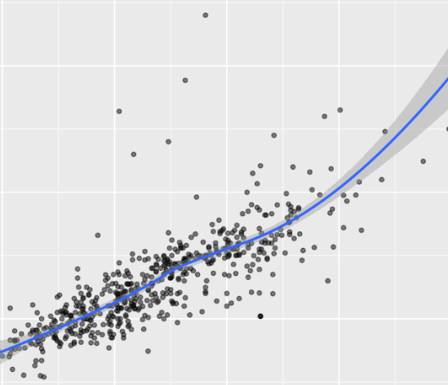
Recall Regression Models
used to predict a numerical value or score
Regression models can be linear or nonlinear.

Slide 3
Properties of Regression Models
Map a set of features (predictor or independent variable) values to predict a label (dependent variable).
A supervised learning model, where the model is trained using marked cases with a known label value.
Regression models minimize the error between the predicted score and the known label.
Notes:
Regression models are supervised machine learning algorithms, which have the following properties:
Are used to predict a numerical value or score.
Map a set of features (predictor or independent variable) values to predict a label (dependent variable).
Is a supervised learning model, meaning that the model is trained using marked cases with a known label value.
Regression models minimize the error between the predicted score and the known label.
Regression models can be linear or nonlinear.

Slide 4
Overview
Linear single regression models
Evaluation of regression models
Prune features to reduce overfit
Transform features
Linear multiple regression models
Notes:
Linear single regression models, with one feature used to predict a label value.
Performance metrics and fit evaluation methods used to evaluate regression models.
Determine if a model is overfit and how to prune features to reduce overfit.
Transform features to make them suitable for linear models.
Linear multiple regression models, which use multiple features to predict the label value.

Slide 5
Basics of Linear Regression
Measuring 2 Variables
Notes:
Let's have a look at the simplest case of a regression model for a straight line.
From the notebook: Intro to Regression

Slide 6
Understanding the Lingo
Find a relationship between variables to predict the value of the second variable given a value of the first variable:
Create a model based on a predictor variable
Feature: first variable, x
Label: second variable, y
What we want to predict
Notes:
For example, the first variable could be past customer spending and the other variable is the amount the customer spends in response to a coupon. We want to find a relationship between these variables so that we can predict the value of the second variable given a value of the first variable. In technical terms we want to model offer response based on a predictor variable of past spending.
Let's call the first variable xx or the feature. The features are the variables we use as the inputs to our predictive model. We will call the second variable yy, or the label. The label is the variable we wish to predict.

Slide 7
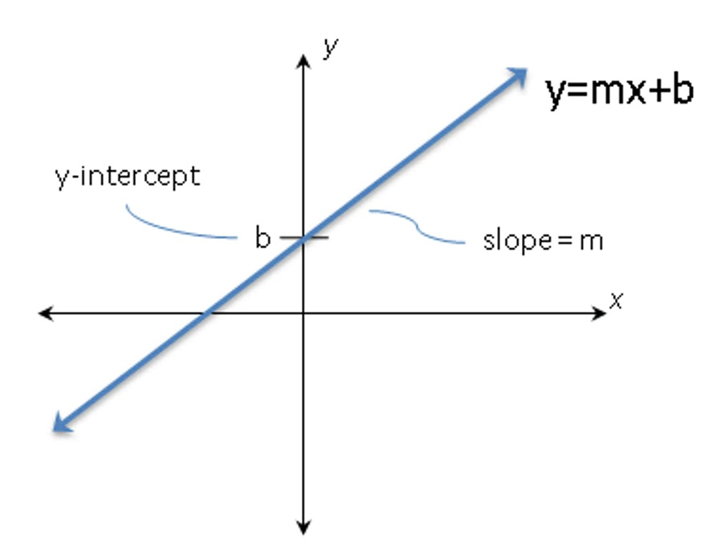
Equation of a straight line
y = mx + b
m= slope = rise/ run
b = y-intercept.
Where the line crosses the y-axis
Notes:
The simplest linear regression model determines the equation of a straight line. We can write the equation of a straight line as follows:
Y=mX+b where slope=m=rise /run and y=b at x=0 or b=the intercecpt
We can illustrate this relationship as: (see figure)

Slide 8
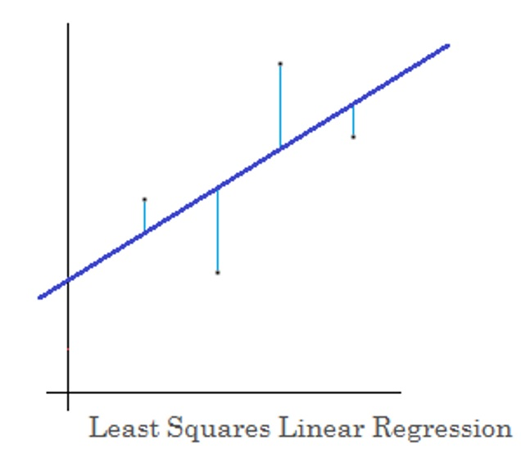
Where does the line come from?
Training data with paired values of x_{i} , y_{i}
The line becomes:
y_{i}=mx_{i}+b+ϵ_{i} where ϵ_{i}=error
m and b are model coefficients
Notes:
We have a training data set with paired values, xi,yixi,yi. Using these training data we can define a line that best fits these data. If we have a number of values pairs, xi,yixi,yi, we can write the equation for the line, including errors as:
yi=mxi+b+ϵi where ϵi=error
We call the two parameters m and b the model coefficients.
We can visualize these errors, ϵi, as shown in the figure.

Slide 9
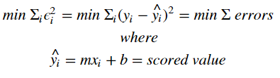
Best Fit Line – Method of Least Squares
Minimize the sum of the squared errors
Errors = difference between predicted (scored) value) and the actual label value.
Also called residuals
Notes:
The question now is what do we mean by the best fit to the data? For most regression models we want to find the model which minimizes the sum of the squared errors. The errors are the difference between the predicted values or the scored values, and the actual label values. These errors are also known as residuals. This type of regression model is known as the method of least squares.
We want to solve for m and b by minimizing the error, ϵi. We can write this out as follows.

Slide 10
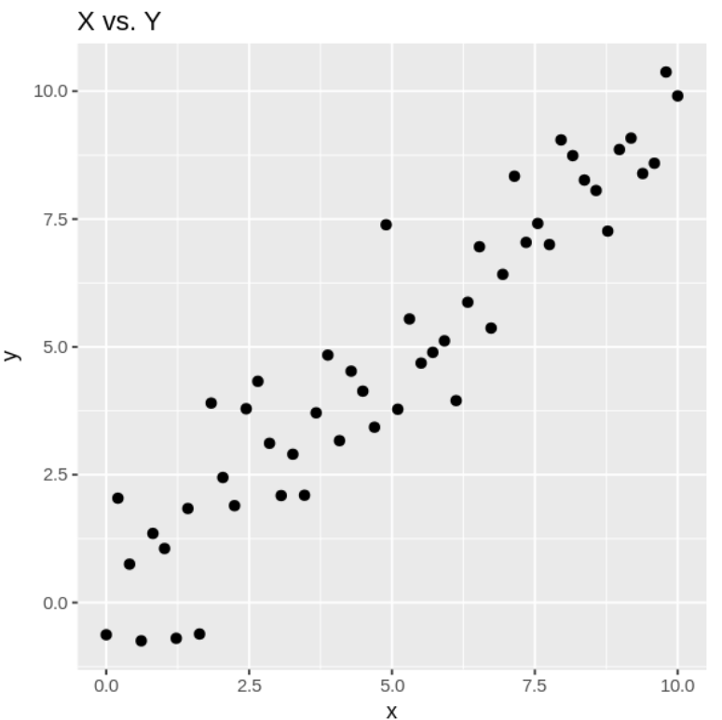
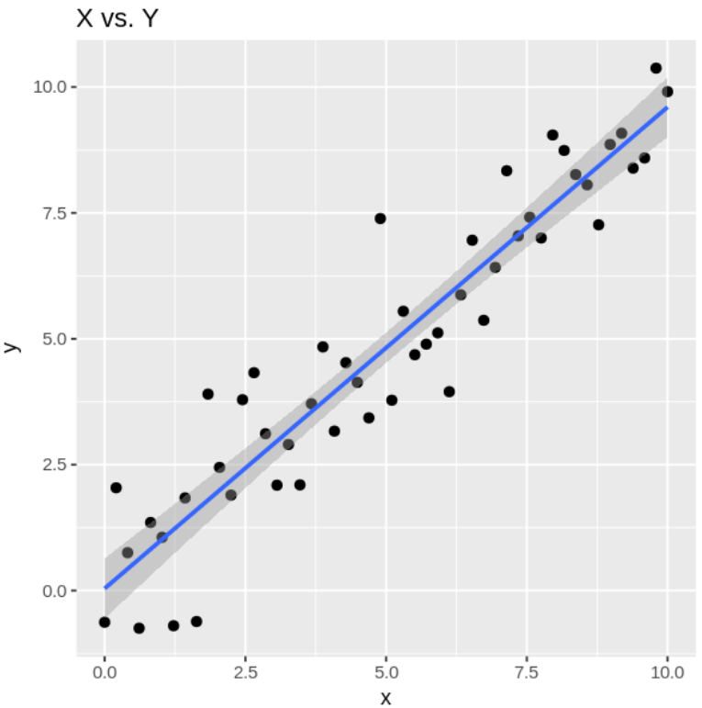
Modeling in R
If this is your plot, what do we do to show the regression line?
geom_smooth (method=“lm”)
What is the grey section?
Notes:
Recall `geom_smooth()` using method = 'lm'

Slide 11
Modeling in R
~ symbol means “modeled by”
dependent variable ~ independent variables
or label ~ features
read as: label is modeled by the features
Notes:
Models in R are defined by an equation using the ∼ symbol to mean modeled by. In summary, the variable to be modeled is always on the left. The relationship between the variable to be modeled on the right. This basic scheme can be written as shown here.
dependent variable ~ independent variables or label ~ features read as: label is modeled by the features

Slide 12
Computing a model: y ~ x
The lm function computes a linear regression model using the model formula as the first argument.
The lm function creates an R model object for a linear regression model.
mod = lm(y ~ x, data = reg.data)
Notes:
The R lm function computes a linear regression model using the model formula as the first argument. The lm function creates an R model object for a linear regression model. The model object contains a great deal of information which we will investigate in this lesson.
Reg.data is some computed data in the example notebook.

Slide 13
Scoring the model with predict
compute the scores or predicted values (of y) using the predict method
Method = function that uses the attributes of an object
reg.data$score <- predict(mod, data = reg.data)
predict is a generic function for predictions from the results of various model fitting functions.
Notes:
Once an R model object is computed, we can compute the scores or predicted values using the predict method. A method is a special type of function that uses the attributes of an object.
Use the model object to compute scores (predicted values) for the dependent variable y. In this case, we just use the data that was originally used to compute the model. In a more general case, you can use other data to make predictions from the model.

Slide 14
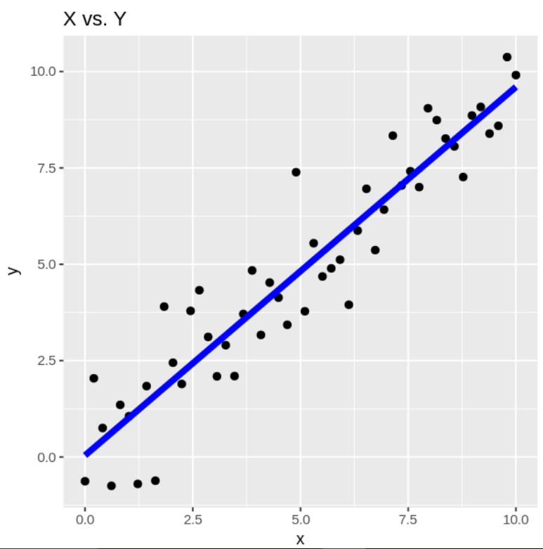

Examining Regression results
The blue line represents the predicted values:
y = mx + b
for new points (x, score)
model coefficients -m & b
Notes:
Let's have a look at the predicted values or scores from our model and the data values we used to fit the model. The code in the cell below plots the original data, along with the predicted values shown as a line. Execute the code and examine the result.
It appears that the model is a fairly good fit to the data we synthesized. We can further investigate the properties of our regression model by looking at the model coefficients.

Slide 15
Visualizing Regression results
Compute the residuals or errors for the model.
Difference between predicted and actual
reg.data$resids <- reg.data$y - reg.data$score
The differences vary greatly.
Is this good or bad?
Notes:
In the foregoing section, we have seen that our linear regression model seems to work fairly well qualitatively. However, we need methods to quantitatively evaluate the performance and compare the performance of regression models.
As a first step, let's compute the residuals or errors for the model. The code in the cell below adds the residuals to the data frame and prints the head of the data frame. Execute this code and examine the label, y, the score, and the residuals.
You can see that the residuals have a wide range of value, both positive and negative.

Slide 16
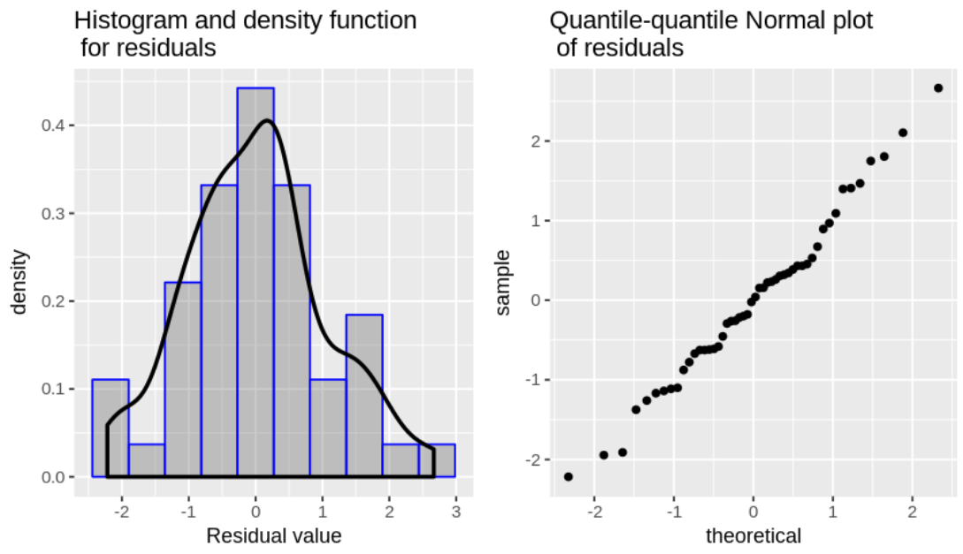
Normal distribution of residuals
Plot a histogram and a quantile-quantile graph
residuals are approximately Normally distributed
points fall close to a straight line
Notes:
Let's plot the residuals to examine their distribution properties. Ideally, the residuals from a linear regression model should have a Normal distribution.
A histogram and density estimation plot, which show the distribution of the residuals.
A quantile-quantile Normal plot or qq-plot which plots the quantiles of a standard Normal distribution on the x axis and the quantiles of the residuals on the y axis. Ideally, the points on the qq-plots should fall along a straight line. If the points fall close to a straight line, this indicates that the residuals are approximately Normal.
The histogram and density plot show that the residuals are approximately Normally distributed, with a few deviations. The points on the qq-Normal plot fall close to a straight line, indicating that the distribution of the residuals are close to Normal.

Slide 17
Diagnostic Check of residuals
Homoscedastic = distribution of residuals is constant with fitted values.
Regression model is a good fit
Heteroscedastic = structure in the residuals plotted against fitted values.
Model is not a good fit.
Notes:
An important diagnostic is to check if the residuals are homoscedastic with respect to the fitted or scored values. By homoscedastic, we mean that the distribution of the residuals is constant with the fitted values. This condition indicates the regression model is a good fit, since the model error should not depend on the fitted value.
However, if there is structure in the residuals when plotted against the fitted values, we can infer that there is some kind of problem with the regression model. We call this condition heteroscedastic residuals. Heteroscedastic residuals indicate the model is not a good fit.

Slide 18
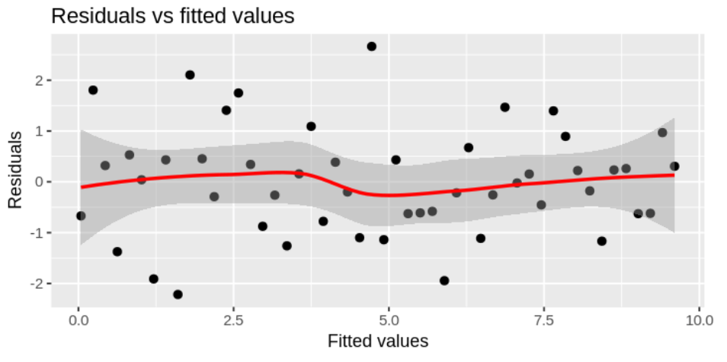
Nonlinear regression: loess
the loess line is close to 0 and nearly straight
Notes:
A nonlinear regression, known as loess, is used to highlight the fit between the residuals and the fitted values.
Notice that the residuals have a fairly constant distribution with respect to the fitted values. Also, the loess line is close to 0 and nearly straight. These conditions indicate that the residuals are homoscedastic and our model is a good fit.

Slide 19
Regression model statistics
Summary statistics summary(mod)
95% Confidence interval confint(mod)
Is the model overfit? Yes, if
Model coefficients = not significant
Standard error > coefficient
Small t-value, large p-value
Confidence interval includes 0
Notes:
We have looked at several possible diagnostic plots for the residuals of our linear model. There are also summary statistics we can look at to evaluate the performance of our model. The summary method prints a set of useful summary statistics. We will discuss the output of the summary method in the next few paragraphs.
Additionally, the confint method prints the 95% confidence interval of the
When interpreting the output of the summary method and the confidence intervals, keep in mind that overfitting is a major problem with any machine learning model. Most of the output of the summary and confint methods help you to determine if a model is overfit.

