Slide 1
Multivariate Regression Models
Also known as Multiple Regression Models
Notes:
The model we created and evaluated in the foregoing example, was univariate or a single regression model. There is only one predictor or feature in a single regression model.
However, most real-world regression problems have multiple features which can be used to train the model and predict the label. We call these models multivariate regression models or multiple regression models.

Slide 2
Multiple Regression
Adding in more features to the model
Explore the data
Transform the data
Normalize the data
Train the model
Evaluate the model performance
Notes:
In a nutshell here are the steps to creating a multiple regression model

Slide 3
Upgrading to Multiple Regression
Multiple features to train the model
Add more model coefficients
One for each new feature
dv ~ var1 + var2
2 features here
Notes:
The extension from single regression to multiple regression is conceptually simple. As we add more features we add more model coefficients, one for each new feature. All of the model coefficients are estimated using the method of least squared errors.
This is the same approach we used for our single regression model.
The R formula language is easily extended to multiple regression problems. For example, if we wish to predict a feature, dv, using two features, var1 and var2, the model formula will be:
dv∼var1+var2

Slide 4
Exploring the Data
Take a dataset, and glimpse
What features look promising?
Look at a distribution of the label (known value)
Histogram and density estimate
Is it normally distributed?
Notes:
In this lesson we will not dive deeply into the exploratory analysis of these data. We will only examine aspects of the features we need to create a multiple regression model.
Our first exploration is to look at the distribution of the label and some of the numeric features. The code in the cell below plots the histogram and density estimate for each feature specified.

Slide 5

Preparing and Transforming Data
To get better distributions, use transformations
Like logarithms, square roots, squares, exponentiation
Compare distributions of these new features:
Notes:
It is common practice to try various transformations of variables to find better distributional properties. Examples of these transformations include logarithms, square roots, squares, exponentiation, and other power transformations.
In this case, we will preform a log transformation on the price and engine size. We will also try a square root transformation of engine price. These transformations are performed by the code in the cell below. Execute this code to compute the transformations and visualize the results.

Slide 6
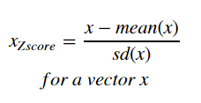
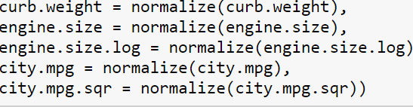
Data Normalization
The importance should not depend on the range of numeric values.
Zscore normalization
Normalizes features for 0 mean, and unit (1.0) variance
Notes:
Our next step is to normalize these numeric features. Normalization is essential whenever you are building a machine learning model with numeric features. If numeric features are not normalized the features with the largest numeric values can dominate the training of the model. In other words, the importance of features should not depend on the range of numeric values. Normalization addresses this problem.
In this case we will use a method known as Zscore normalization. Zscore normalization standardizes a feature so that it has 0 mean and unit (1.0) variance. This process can be written for a feature vector, xx, as:
xZscore=x−mean(x) / sd(x)for a vector x
The code in the cell below Zscore normalizes the numeric features of interest. A square root transformation is also performed on the city mpg as well. Execute this code.

Slide 7

Training the Model & check statistics
Create the model:
View the model statistics:
Is it overfit?
Coefficients are not significant
Notes:
With the data prepared, we can now create a linear regression model. The code in the cell below computes a linear regression model using 5 numeric features, both raw and computed. Execute this code and examine the printed the summary of the model.
Note: We are constructing a linear model. However, we have included features with nonlinear transformations. Thus, just because we are using a linear model does not mean we are limited to models of straight lines.

Slide 8

Evaluate the Model – check residuals
Predict a score
Compute the residuals
Actual value – score (computed value)
Plot the histogram & qq Normal of residuals
Plot residuals versus fitted values
Notes:
Let's have a first look at the results of the model. The code in the cell below does the following using a dplyr operator chain:
A first dplyr mutate operator computes the score using the predict method for the model.
A second mutate operator in the chain computes the residuals and the predicted value on the non-log scale.
The first 10 rows of the last 8 columns of the data frame are printed.

Slide 9
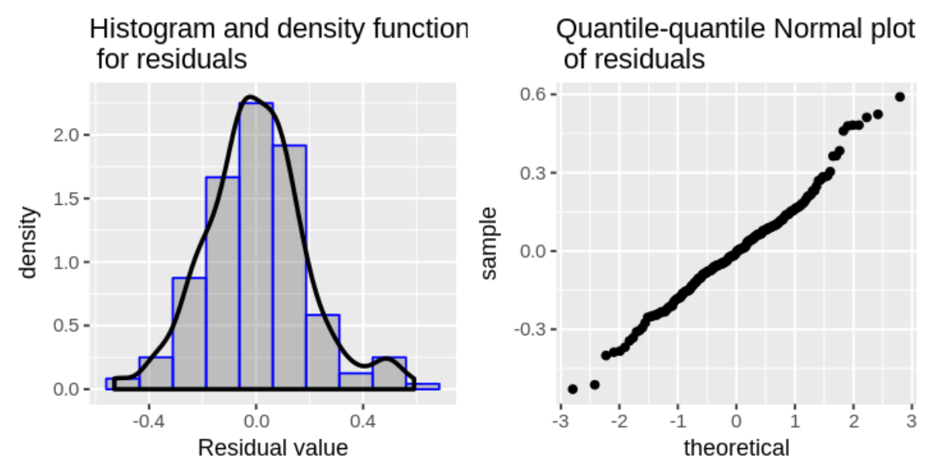
Is it normal?
Notes:
Is it normal, is it straight?
Notice that the residuals have some deviation from the ideal Normal, paticularly at the high end. This means that the price of certain autos are being significantly underestimated.

Slide 10
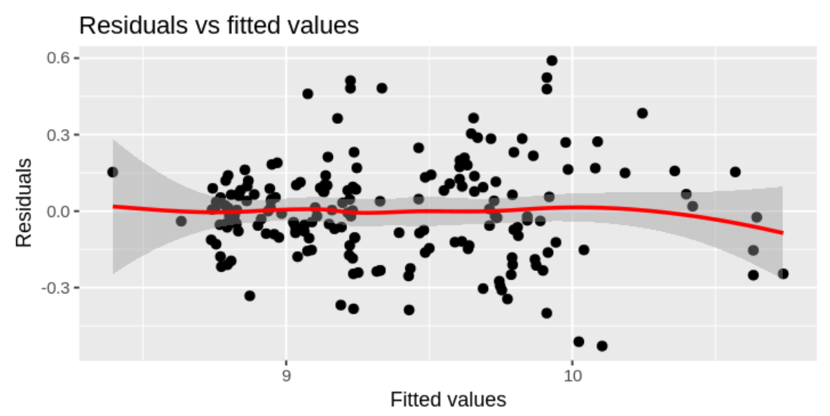
Is this homoscedastic?
Notes:
Is it straight and close to zero?
Also, the loess line is close to 0 and nearly straight. These conditions indicate that the residuals are homoscedastic and our model is a good fit.
These residuals are appear fairly constant with the changes in (log) fitted values. The large positive residuals are visible in the middle of the range of fitted values. It appears that the predicted values of some higher priced cars are not being correctly predicted.
Overall, these results are not too bad, despite the over-fit model.

Slide 11
Summary
Linear Regression is a best-fit line
Multiple regression just has more coefficients determining the best-fit line.
Train the model with existing data
Evaluate the model with the residuals
Is the model over fit? Will it generalize?
Notes:
Created a single regression model using synthetic data.
Evaluated residuals of the model.
Evaluated the single regression model, to determine if the model is over-fit.
Explored and transformed the auto pricing data to prepare it for model building.
Explored and evaluated a multiple regression model for auto price.

