Slide 1
Tokenizing/Lexing (breaks code into small chunks)
Compilation Phase
Parsing (understands the tokens
and creates abstract syntax tree (AST))
Code generation

Slide 2
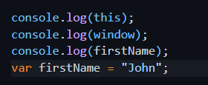
Compilation Phase
Global scope
firstName
1. Early error checking
2. Determining appropriate scope for variables

Slide 3
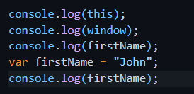
1
Global Execution Context
Creation Phase
Code Execution Phase
2
Code Execution
Phase
1
Global Memory or
Creation Phase
Console
{ window }
{ window }
Undefined
“John”
First line is executed
Second line is
Executed
3. Third line
4. Fourth line – this will
change the value of
firstName in Global
Memory to “John”
5. Fifth line executed
window: { }
firstName: Undefined
this: window

Slide 4


Folder and file structure
Folder symbol
javascript-module
app.js
index.html
utils
age.js
fname.js

