Slide 1

Image Steganography
By
Praveen Kumar D and Sham Prasad P.S.
Under the guidance of
Mrs. Usha BA
R.V. College of Engineering,
Department of Computer Science,
Bangalore - 560059

Slide 2
Image steganography is a technique of concealing confidential data that needs to be transmitted in digital cover images such that presence of data is hidden from third party other than sender and receiver.
The purpose of Image steganography is to enhance the communication security by embedding different data files into digital cover images and to prevent an adversary from extracting the data.
Data encryption can also provide secure communication but it reveals that the data is encrypted and may contain some valuable information.
Some common steganography techniques:
Least Significant Bit substitution (LSB)
JPEG steganography
Inverted Pattern Approach
All of the above techniques have been exploited and steganographic images are easily detectable by histogram analysis and other statistical methods. Hence use of the above methods are vulnerable to leakage of information.
This calls for the implementation of image steganography using a not so well known algorithm, that not only hides data efficiently but also decreases the possibility of steganogrphic image as a secret data carrier.

Slide 3
Proposed algorithm:
In this algorithm it is planned to introduce a method that embed 2 bits information in a pixel and alter only one bit from 4 LSBs but the message does not necessarily place in the least significant bit of pixel. The second less significant bit plane and fourth less significant bit plane can also host the message.
Since in our method for embedding two bits message we alter just one bit plane, fewer pixels would be manipulated during embedding message in an image and it is expected for the steganalysis algorithm to have more difficulty detecting the covert communication. It is clear that in return complexity of the system would increase.

Slide 4
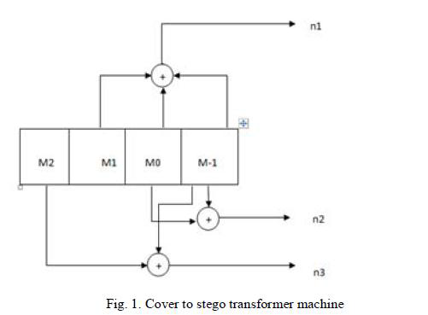
This convolution decoder helps us to generate the stego pixels from a cover image based on the incoming secret data.
Let n2, n3 are the values obtained from the pixel of the cover image. If n2, n3 be the same as consecutive bits of hidden information, then there is no need to manipulate the original image. If not, then we should change the original image in a way to cause the output of the decoder be equal to the hidden message.

Slide 5
An example (1):
Let last 4 LSBs of cover image be 0011. Let incoming bits from data to be hidden be 10.
Now XORing b0 with b1 of cover image produces 0 (n2), and XORing b0 with b3 produces 1 (n3).( n2n3 = 01 is not equal to incoming data 10).
So we have to manipulate the 4 LSBs such that n2 and n3 matches 1 and 0 respectively.
Starting from the left we change b3 to 1. This now produces n2n3 = 00. When we change b1 to zero we get n2n3 = 11. And when we change b0 to 0 we get n2n3 = 10 which is equal to the bits of incoming data.
Hence the last 4 LSBs will have to be changed to 0010 from 0011.

Slide 6
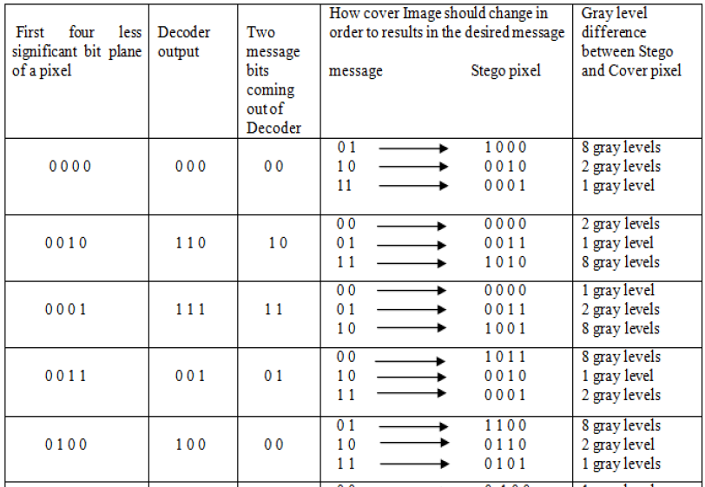
Table showing bit manipulation for a few stego pixels as input.

Slide 7
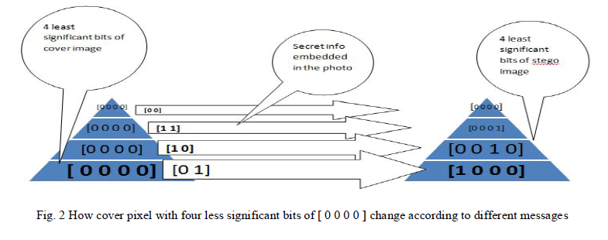
Example (2):
A pixel with LSBs as 0000 and their transformations for various incoming bit values.
In each transformation of a pixel only one bit will vary but this variation can cause in an increase or decrease in gray level of the pixel by one, two or eight levels.

Slide 8
Secret things that are stored in stego images:
File size (first 3 pixels)
File name with file extension
Data of the secret file that is stored.
y
Original pixels of cover image
x
An x*y resolution uncompressed image.

Slide 9
Some other features of this application:
This project also provides data encryption before embedding it to the image. The standard AES encryption that uses 128 bit key is used. This module is implemented according to the NIST standards.
To provide key length independence md5 algorithm is implemented to generate 128 bit hash code for any length key that is given by the user.
The cover images can be any of bmp, jpeg or ppm formats. The generated stego images will be of same format as cover image except for jpegs; that will be converted to ppm format.
The secret file that is to be embedded can be any small file (max of 600kb for a 1024*768 resolution cover image.
Secret file can be of any format a jpeg, a pdf, mp3, .exe or anything.
Generates the output quiet fast when run on todays modern machines. (core 2 duo and higher processors).

Slide 10
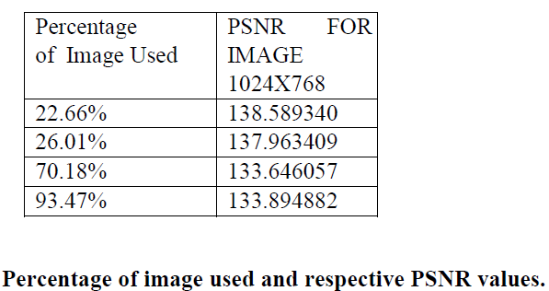
Experimental Results:
The number of bits embedded per pixel is 6 bits which achieved by using R, G and B components of each cover image pixel. The distortion in cover image depends upon the change in value of pixels and number of pixels of cover image used for embedding which are in turn depending upon the number of components of the pixel used and amount of input data.
PSNR is used to evaluate the quality of an image .
Normally, human’s eyes find it hard to distinguish between the distortions on a stego image compared to original image when its PSNR value is greater than 30 dB.
If almost all the pixels of original cover image (93.47%) are used for embedding then value of PNSR is equal to 133.894 dB, which is higher than threshold value (30dB) required.

Slide 11
Conclusion:
An overview of the design and development of a Steganography system is presented in this report. Data hiding techniques embed the important data into multimedia data such as images, videos or sounds.
Digital images are considered good cover carriers because of their insensitivity to human visual system. It embeds the secret message in the cover image to hide the existence of the message.
Image Steganography is often used in secret communication.
Future Enhancements:
Every project has certain limitations due to various reasons.
Separate and more efficient compression techniques can be used for compressing files which will result in fewer amounts of data to be embedded.
While embedding data to cover image, lossless images are used. Use of lossy images will minimize the amount of data to be sent across the network.

