Slide 1
INTERNSHIP PROGRESS REPORT
By: SHAMRUTHA S
BATCH 5

Slide 2
Core Concepts Learned:
Artificial Intelligence Fundamentals:
Key differences between AI, Machine Learning, and Deep Learning.
Large Language Model (LLM) Architecture:
Understanding the Transformer model and Attention.
Key concepts: Tokenization, Prompting, and Parameters.
NLP Word Vectorization:
Moving from words to numbers.
Techniques: TF-IDF, Word2Vec, GloVe.

Slide 3
Practical Application: Streamlit Chatbot
New Tool: Streamlit
A Python framework for building data apps fast.
Learned to use widgets, state management, and layout.
Project: ClauseEase AI based Contract Language Simplifier
Goal: Build a functional, interactive chat interface.
Result: A working web app that manages and displays a conversation.

Slide 4
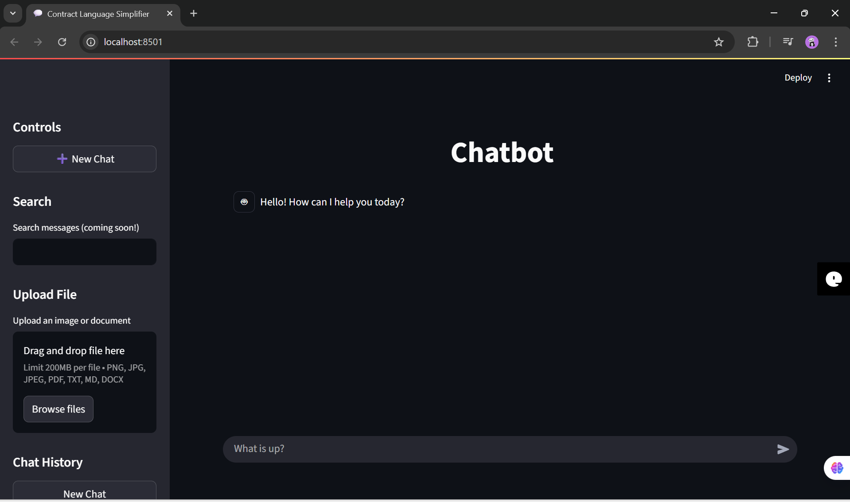
Screenshot of the Chatbot UI:

