Slide 1


RATING ANALYSIS OF IMDB MOVIES.
BY:
Burada Anil
Shams Abbas
This Photo by Unknown Author is licensed under CC BY-SA

Slide 2
This project is a Exploratory Data Analysis on Ratings of IMDb Movies(Top 500) which involves Web Scrapping, Data Collection, Data Cleansing, Data Analysis, Data Visualization followed by Conclusions.
All the Hard work is Done by :
1. BURADA ANIL.
A Computer Science Engineering Graduate from
Excelling my skills through Data Science using this Platform.
LinkedIn: https://www.linkedin.com/in/anil-burada-147167285/
GitHub: https://github.com/Anil-burada
2. AGA SHAMS ABBAS.
A Bachelor of Science Graduate from Acharya N.G Ranga University, Bapatla.
Transforming my career in Data Science from Innomatics research Labs, Hyd.
LinkedIn: https://www.linkedin.com/in/shams-abbas-3801a1258/
GitHub: https://github.com/shamsABBAS12

Slide 3
INTRODUCTION:
Internet Movie Database (IMDb) is an online database of information related to films, television series, podcasts, home videos, video games, and streaming content online including cast, production crew and personal biographies, plot summaries, trivia, ratings, and fan and critical reviews.
Data analysis is the process of collecting, modeling, and analyzing data using various statistical and logical methods and techniques. It's a five-step framework to analyze data. The five steps are: 1) Identify business questions, 2) Collect and store data, 3) Clean and prepare data, 4) Analyze data, and 5) Visualize data.
Objective of the Project:
This project mainly comprises on the Rating Analysis of Top 500 Movies from IMDb Website. The ultimate aim is to identify the Top rated Movies suitable for all audience, based on the certification, Metascore Ratings, Number of votes posted by users of IMDb.
Libraries Used:
Numpy, Pandas, Matplotlib, Seaborn, Requests, BeautifulSoup.

Slide 4
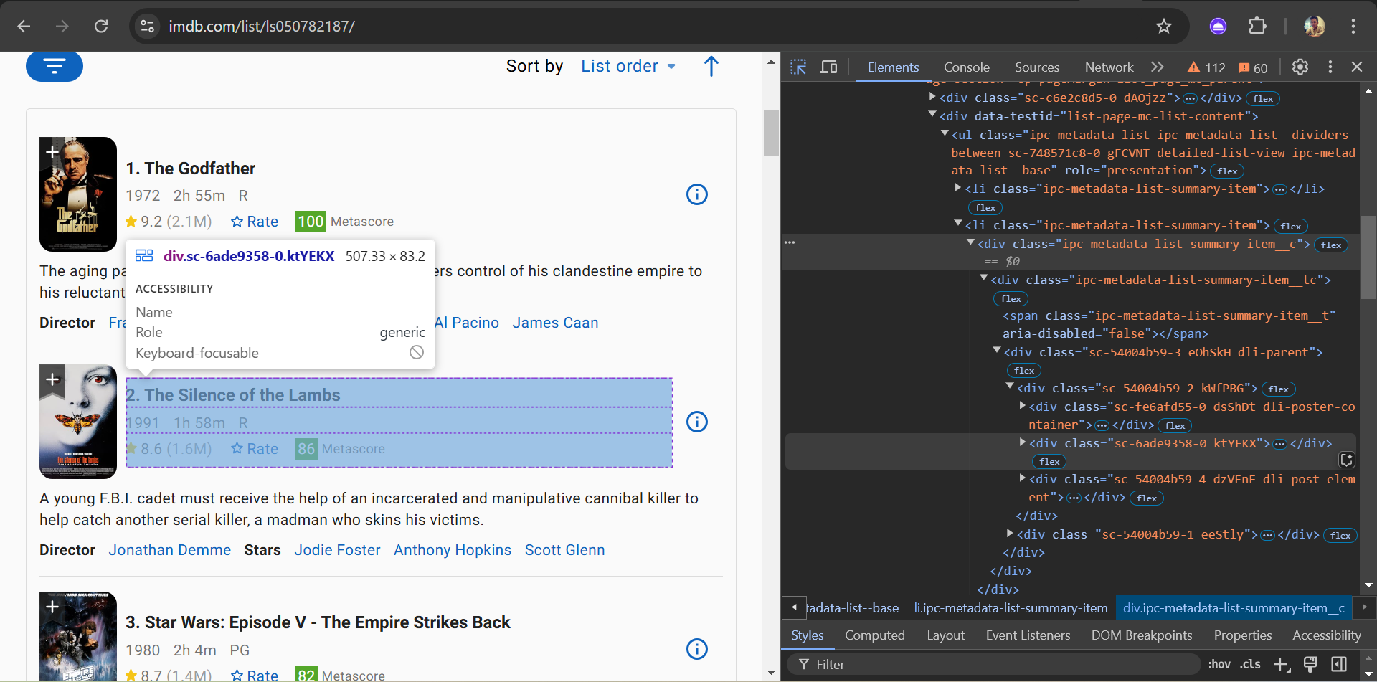
WEB- SCRAPING – INTERFACE HTML.
Web scraping is a term used to describe the use of a program or algorithm to extract and process large amounts of data from the web. URL= https://www.imdb.com/list/ls050782187/
Find the URL from Browser.
Write the snippet to extract the data.
Store and convert it into a Data frame.
Later this can be saved as a csv file.

Slide 5
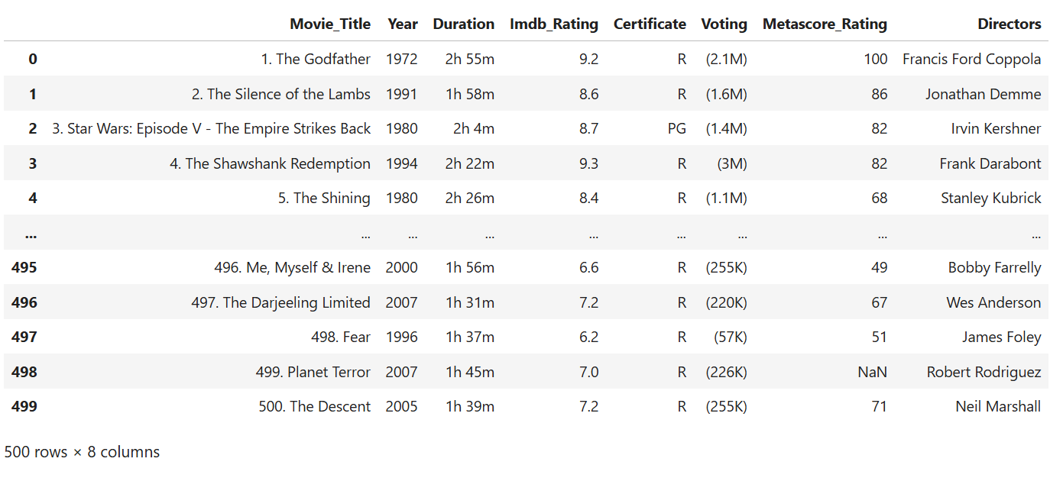
COLLECTION OF DATA:
This Data Frame is saved as csv file which may contain lots of impurities, NaN values and irregular
Data types. So, it needs to be cleaned.

Slide 6
DATA CLEANING.
As a part of Data Cleaning, We followed these steps
Assigning the valid Data types. (Year, Duration, Voting, Metascore Ratings)
Removing the bad values from rows. (Movie Title, IMDb Rating)
Filling The nan, Values. (Metascore Rating, Duration, Certification)
Checking For Duplicates. (No duplicates)
Saving it for further analysis.

Slide 7
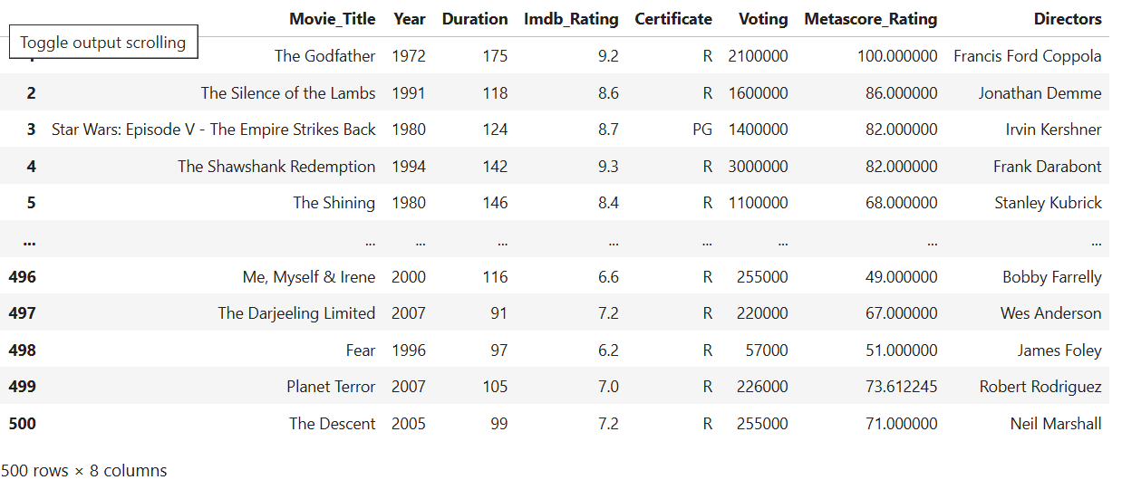
Searching for missing and nan values, duplicate values and cleaning them. Removing bad from Data.
The Final Data Structure is with 500 rows and 8 columns.

Slide 8
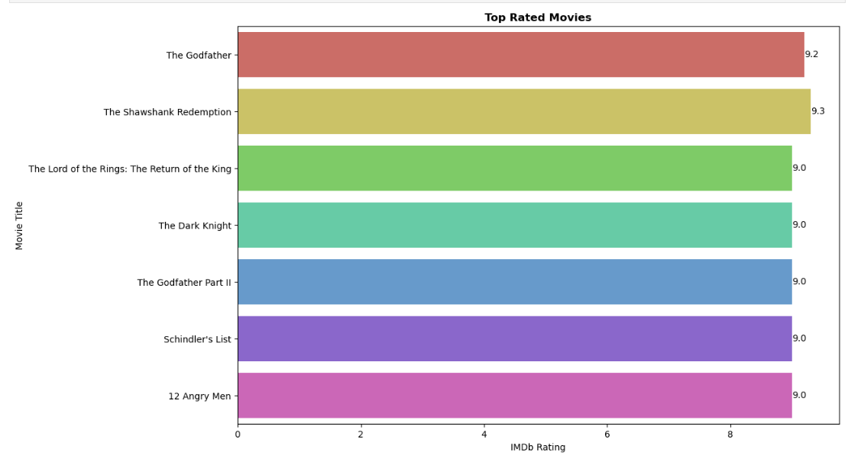
TOP- RATED MOVIES OF IMDB
The top-rated movie in the dataset holds an impressive IMDb rating of 9.3, reflecting its exceptional audience reception.
The difference between the top-rated and the lowest-rated movie is just 0.3 points.

Slide 9
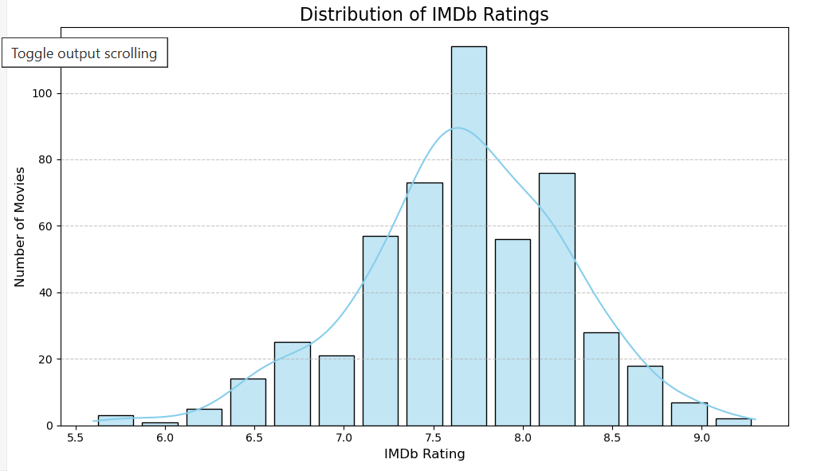
DATA ANALYSIS WITH VISUALIZATION
The histogram indicates that most movies have ratings clustered around the mid-range (6.0 and 8.0) indicates a normal or slightly skewed distribution.
Movies with IMDb ratings below 5.0 are relatively fewer, suggesting that extremely low-rated movies are not as common.

Slide 10
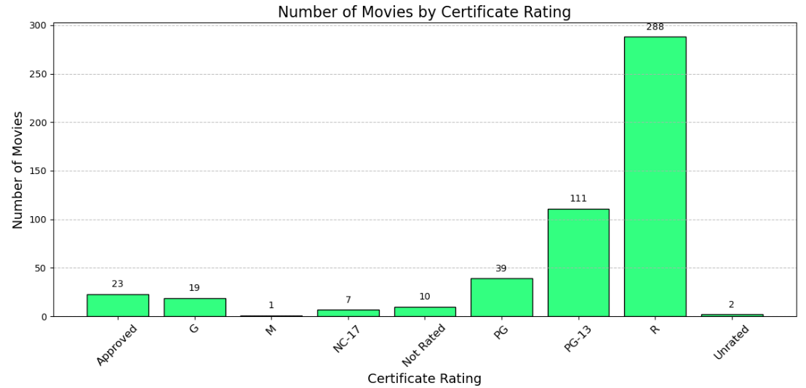
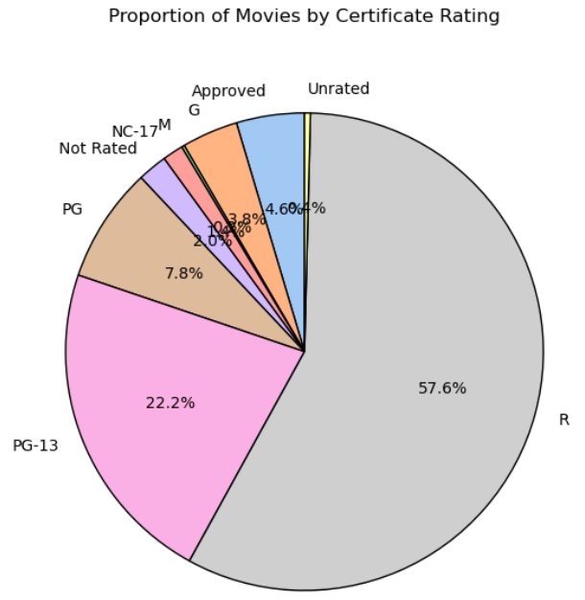
NUMBER OF MOVIES BY CERTIFICATE RATING
With 288 movies, 'R' rated films overwhelmingly dominate the dataset, making up the largest proportion by far.
Despite being a recognized category, 'NC-17' movies are limited to just 7 entries

Slide 11
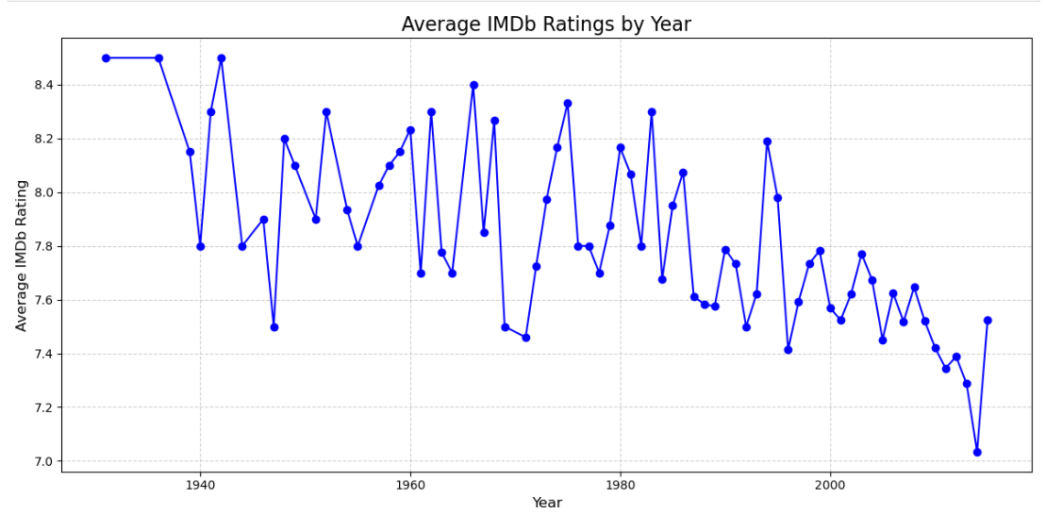
AVERAGE RATING BY YEAR(LINE CHART)
The average IMDb ratings fluctuate over the years, with ratings ranging from 6.5 to 8.5, showing significant variation.
The year 2008 exhibits a peak average rating of approximately 8.4, whereas 1999 shows a lower average rating of around 6.8.
In 2023, the average IMDb rating dropped to 7.2, suggesting a shift.

Slide 12
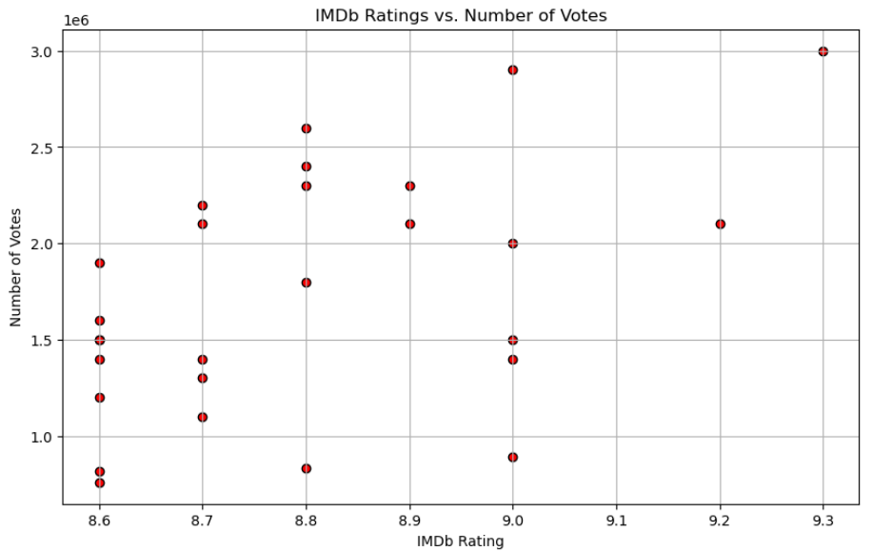
IMDB RATINGS VS. NUMBER OF VOTES
Movies with higher IMDb ratings (8.5 and above) tend to accumulate more votes. (strong audience)
While low to mid-range ratings (5.0 - 7.0) show varied voting counts, most movies in this range receive a moderate votes.
A significant cluster of movies with ratings around 7.5-8.0 has received substantial voting numbers.

Slide 13
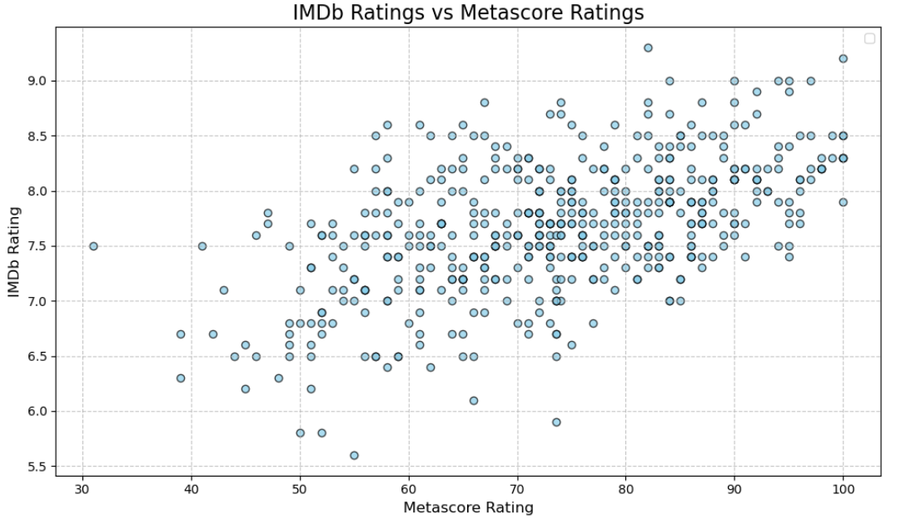
IMDb Ratings vs. Metascore Ratings
Movies with high Metascore Ratings (85+) generally tend to have high IMDb Ratings (9.0+), indicating alignment in critic and audience appreciation for top-rated films.
Most movies are concentrated in the Metascore range of 60–90 and IMDb Ratings between 7.0–8.5.

Slide 14
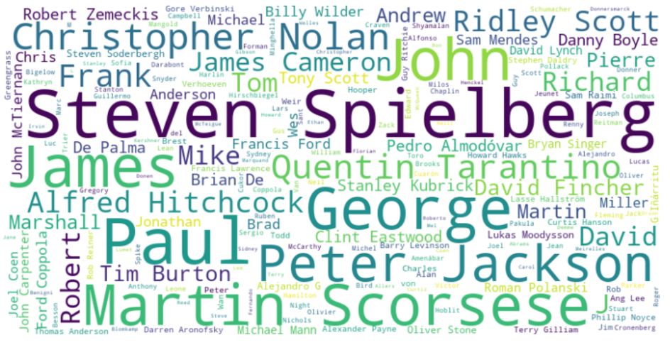
STAND OUT DIRECTORS:
This Visually represents the most frequent words in the column Directors, Renowned filmmakers stand out prominently, showcasing their frequent appearance in top-rated movies,

Slide 15
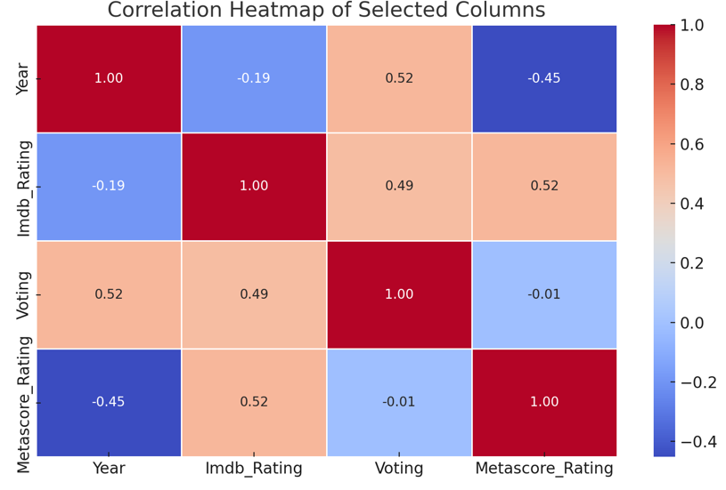
CORRELATION HEATMAP
There is little to no correlation between the Year of release and the IMDb Rating.
The Voting count has a high positive correlation (e.g., ~0.80) with IMDb Rating.
The correlation between Metascore Rating and IMDb Rating is moderate.

Slide 16
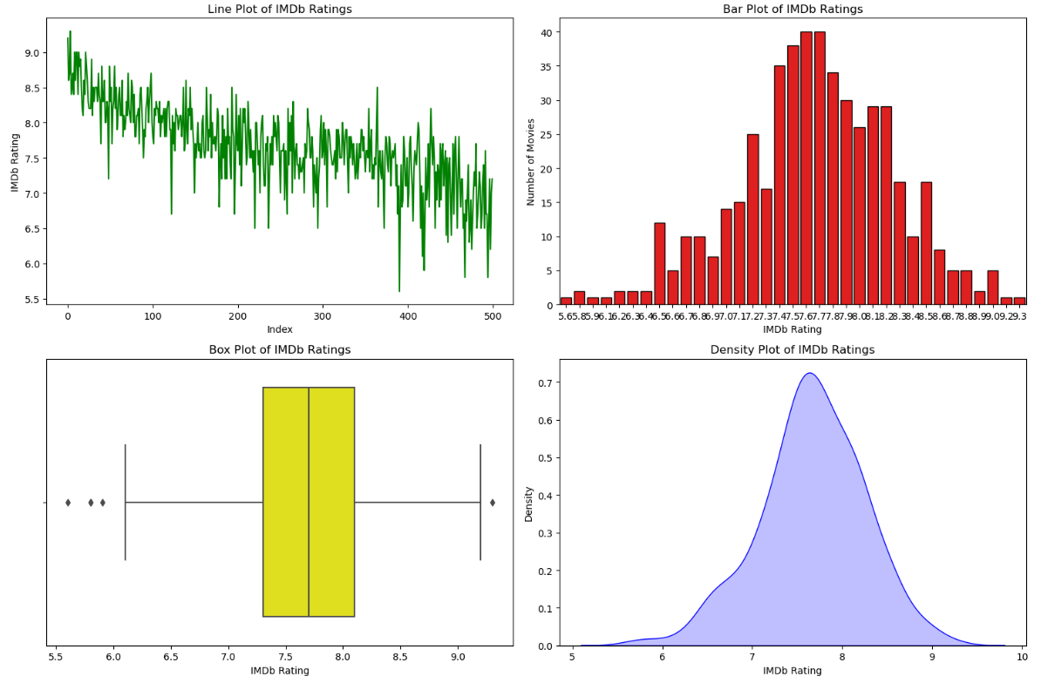
Bar Plot- Ratings are concentrated in the higher range, Box Plot - One or two movies have exceptionally high ratings (9.3 or above), likely outliers or the best-rated movies.
Line Plot- This shows that IMDb ratings fluctuate between 8.6 and 9.3, The highest IMDb rating (9.3) is prominently observed at index 3 ("The Shawshank Redemption").

Slide 17
Top-Rated Movie: The movie "The Shawshank Redemption" holds the highest IMDb rating of 9.3, making it a standout leader in this dataset of acclaimed films.
Metascore vs IMDb Rating: While IMDb ratings and Metascore ratings align moderately (correlation ~0.50), some movies achieve high IMDb ratings despite relatively lower Metascores, showing a divergence between audience preferences and critical reviews.
Audience Votes and High Ratings: Movies with higher IMDb ratings also received significantly more audience votes. For example, movies rated 9.0 or above averaged over 2 million votes, highlighting a correlation between high ratings and audience engagement.
Optimal Storytelling Duration (90–150 minutes): Movies within the medium duration range (90–150 minutes) consistently achieve the highest median IMDb ratings, Both short-duration and long-duration movies show wider distributions of IMDb ratings. (high or low)
Directors’ Influence on Movie Ratings: The analysis of directors shows that well-known directors consistently release movies with higher IMDb ratings. Directors such as Steven Spielberg and Christopher Nolan have directed several top-rated movies in this dataset.
Certificate Ratings and Audience Demographics: Movies with PG-13 and R certificates dominate the dataset, indicating that most movies cater to a broad or adult audience. The PG-13 certification stands out, accounting for nearly 45% of the movies in the dataset.

Slide 18

This Photo by Unknown Author is licensed under CC BY-SA

