Slide 1

Estimating Species Tree from Gene Trees by Minimizing Duplications
Md. Shamsuzzoha Bayzid, Siavash Mirarab, Tandy Warnow
Department of Computer Science
University of Texas at Austin

Slide 2
Contents
Background
Our Contributions
Future Work

Slide 3
Gene trees and species tree
Species tree – pattern of branching of species lineages via speciation.
Gene tree – A phylogenetic tree that depicts how a single gene has evolved in a group of related species.

Slide 4
Discordance
Species tree
Gene trees don’t necessarily show the same branching pattern as their containing species tree
D
C
B
A
Gene tree

Slide 5
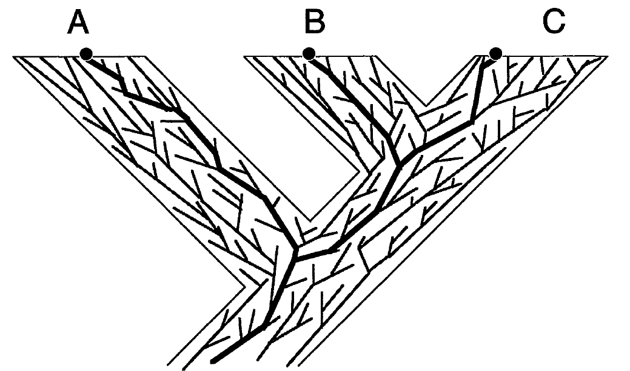
Gene trees in species tree

Slide 6
Challenges in constructing species trees
The estimation of species trees typically involves the estimation of trees and alignments on many different genes, so that the species tree can be based upon many different parts of the genome.
Species tree estimations need to take causes of discord between gene trees and species trees into consideration, in order to produce reasonably accurate estimates of the species tree.

Slide 7
Processes of discordance
Discord can arise from -
  Horizontal Gene Transfer (HGT)
  Deep Coalescence
  Gene Duplication/Extinction
Estimation error may also introduce discordance.

Slide 8
Gene Duplication/Loss
Duplication
A gene might get duplicated and both copies descend and evolve independently.
Discordance can occur if some sampled copies come from one locus and others come from another locus
D
C
B
A
1 Duplication and 3 losses

Slide 9
Problem definition (MGD)
Problem: Minimize Gene Duplication (MGD)
  Input: A set of rooted binary gene trees with each species having a single copy of a gene.
  Output: A species tree ST that minimizes total number of duplications.
A
B
C
D
A
B
C
D
A
B
C
D
gt₁
gt₂
gt_{k}
C₁
C₂
C_{k}
ST
∑C_{i} is minimized

Slide 10
Optimal reconciliation
Duplication
Duplication
D
C
B
A
1 Duplication and 3 losses
2 Duplication and 5 losses

Slide 11
Optimal Reconciliation (LCA mapping, M)
Duplication
A
B
C
D
D
C
B
A
gt
ST
Theorem [1,2]
An internal node u of gt is a duplication node
if and only if M(v) = M(w) for some child w of v.

Slide 12
Available Softwares
Available softwares to solve MGD
  DupTree (available in iGTP package)
    An efficient heuristic to infer species phylogeny by minimizing duplications. DupTree first builds an intitial species tree using a stepwise addition algorithm. Next, DupTree searches for a better species tree using a standard search heuristic of choice starting from the initial species tree.

Slide 13
Contents
Background
Our Contributions
Future Work

Slide 14
Our Goal
An efficient exact algorithm to solve MGD.
  NP-hard!
  Exponential time
Solving a constrained version exactly
  Polynomial time solvable

Slide 15
Alternate definition of Duplication
Subtree-bipartition
  For an internal node u in a binary-rooted tree T,
SBP(u) = cluster(T_{L})|cluster(T_{R})
A|BCD
B|CD
C|D
A
B
C
D

Slide 16
Domination
Domination
  X|Y is dominated by P|Q (or P|Q dominates X|Y)
X ⊆ P and Y ⊆ Q
Examples
is dominated by
A|CD
AB|CD
is not dominated by
AC|D
AB|CD

Slide 17
Alternate definition of Duplication
Theorem
An internal node of gt is a speciation node if it is dominated by
some subtree-bipartition in ST. Otherwise, this is a duplication node
AC|DEF
ABC|DEF
A
C
D
E
F
B
A
C
F
D
E
gt
ST
Notes:
Now our alternate definition goes like this.

Slide 18
Alternate definition of Duplication Contd.
Theorem
An internal node of gt is a speciation node if it is dominated by
some subtree-bipartition in ST. Otherwise, this is a duplication node
AC|DEF
ABD|CEF
A
C
D
E
F
B
A
C
F
D
E

Slide 19
Example
A|BCD
A|BCD
B|CD
D|BC
C|D
C|B
A
B
C
D
D
C
B
A

Slide 20
Compatibility
Compatibility
  X|Y and P|Q are compatible if they can “co-exist” in a binary rooted tree.
Two subtree-bipartitions are compatible if
one contains the other
or they are disjoint
Disjoint
Containment

Slide 21
Maximizing dominated subtree-bipartitions
Input: A set of rooted binary gene trees
Output: A species tree ST that minimizes total number of duplications.
Goal
A species tree ST that minimizes total number of duplications.
A species tree ST that maximizes total number of dominated
subtree-bipartitions in input gene trees.
A set of (n-1) compatible subtree-bipartitions
that maximizes total number of dominated
subtree-bipartitions in input gene trees.

Slide 22
Clique-based algorithm
ab|c
a|b
a|c
b|c
a
b
c
a
c
b
b
c
a
gt₁
gt₂
gt₃
Find the maximum weight clique of size n-1 (3-1)
Construct a compatibility graph
b|c
1
a|c
a|b
1
1
3
3
Disjoint
ab|c
3
ac|b
Containment
bc|a

Slide 23
Constrained Version
Empirical evidence [Than et al.] suggests that clusters in the optimal species tree that optimizes MDC tend to appear in at least one of the input gene trees. It may be also likely for MGD.
Instead of considering all possible subtree-bipartitions, we can only consider the subtree-bipartitions present in the gene trees. That makes the problem polynomial-time solvable.
k input gene trees with n taxa
  k(n-1) subtree-bipartitions.
  O(3^{n}) possible subtree-bipartitions.

Slide 24
Constrained Version (Example)
a
b
c
d
a
b
c
d
d
c
b
a
gt₁
gt₂
gt₃
a|b
c|d
2
2
ab|c
cd|b
1
1
3
3
abc|d
3
bcd|a
ab|cd

Slide 25


Dynamic Programming approach
Maximum Clique problem is NP-hard!
DP-based approach would be more efficient.
u
T_{L}
T_{R}
weight(T) = weight(T_{L}) + weight(T_{R}) + weight(u)
The DP algorithm will compute a rooted, binary tree T_{A} for every cluster A such that T_{A} maximizes the sum, over all gene trees t, of the number of subtree-bipartitions in t that are dominated by some subtree-bipartition in T_{A}. We will denote this total number by value(A).

Slide 26
Dynamic Programming Contd.
weight(X|Y) = #sbp in gene trees dominated by X|Y
value(A) = weight (a₁|a₂); if A ={a₁,a₂} (base case)
value(A) = max{value(A₁) + value(A-A₁) + weight(A₁|A-A₁)};
_{if |A| > 2 (recursive step)}
(A₁|A-A₁)
Global Optimal Solution - if we allow any subtree-bipartition on A
Constrained version - if (A₁|A-A₁) has to come from input gene trees

Slide 27
Running Time
Depends on the number of subtree-bipartitions.
Let S be the set of subtree-bipartition.
  O(n|S |²) for finding the domination relationships (for every pair).
  value(A) can be computed in O(|S |) time, since at worst we need to look at every subtree-bipartition in S.
  Running time is O(n|S |²).
Globally Optimal Solution
  |S| = O(3^{n})
Constrained Version
  |S| = k(n-1)

Slide 28
Future Work
Algorithms for Duplication + Loss.
Handling different cases where gene trees might be -
  Unrooted
  Non-binary
  Incomplete
  Multicopy

Slide 29
References
M. Goodman, J. Czelusniak, G. Moore, E. Romero-Herrera, and G. Matsuda. Fitting the gene lineage into its species lineage: a parsimony strategy illustrated by cladograms constructed from globin sequences. Syst. Zool., 28:132–163, 1979.
R. Guigo, I. Muchnik, and T. Smith. Reconstruction of ancient molecular phylogeny. Mol. Phylog. and Evol., 6(2):189–213, 1996.
C. V. Than and L Nakhleh. Species tree inference by minimizing deep coalescences. PLoS Comp Biol, 5(9), 2009.

Slide 30
Thank You
Questions
??

