Slide 1

Estimating Species Tree from Gene Trees
Md. Shamsuzzoha Bayzid, Siavash Mirarab, Tandy Warnow
Department of Computer Science
University of Texas at Austin

Slide 2
Gene trees and species tree
Species tree – pattern of branching of species lineages via speciation.
Gene tree – A phylogenetic tree that depicts how a single gene has evolved in a group of related species.
Notes:
Gene tree. Shows the evolutionary history of a single gene. It shows how a particular gene evolves through time within different species. Gene trees continue to branching and descending through time within the branches of species tree…. One might expect that sister species would have sister copies in the gene tree.

Slide 3
Discordance
Species tree
Gene trees don’t necessarily show the same branching pattern as their containing species tree
D
C
B
A
Gene tree
Notes:
One might expect that sister species would have sister copies in the gene tree. However, this is not the case. When gene copies are sampled from various species, the gene tree relating these copies might disagree with the species philogeny.

Slide 4
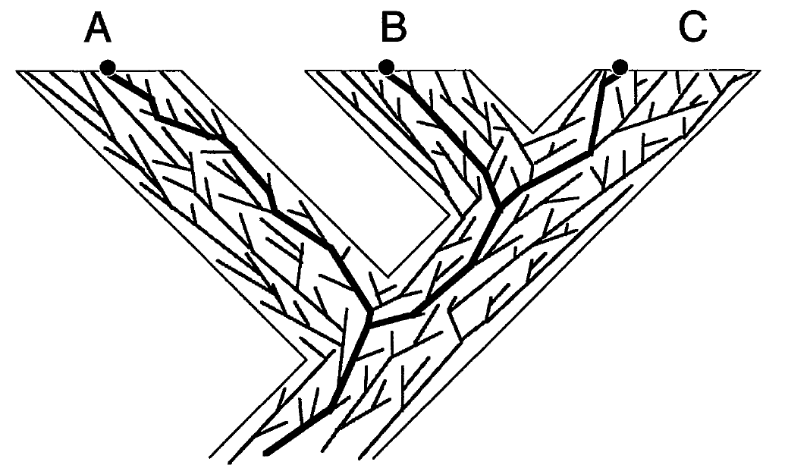
Gene trees in species tree
Notes:
Gene trees continue to branching and descending through time within the branches of species tree…. And a gene tree may or may not agree with the containing species trees

Slide 5
Challenges in constructing species trees
The estimation of species trees typically involves the estimation of trees and alignments on many different genes, so that the species tree can be based upon many different parts of the genome.
Species tree estimations need to take causes of discord between gene trees and species trees into consideration, in order to produce reasonably accurate estimates of the species tree.
Notes:
no individual gene tree is necessarily a good estimate of the true species tree. This introduces some challenges in constructing species tree.

Slide 6
Processes of discordance
Discord can arise from -
Horizontal Gene Transfer (HGT)
Deep Coalescence
Gene Duplication/Extinction
Estimation error may also introduce discordance.
Notes:
In this paper, we assume that there is no estimation error

Slide 7
Gene Duplication/Loss
Duplication
A gene might get duplicated and both copies descend and evolve independently.
Discordance can occur if some sampled copies come from one locus and others come from another locus
D
C
B
A
1 Duplication and 3 losses
Notes:
Although you already know about duplication, deep coalescence etc. I would like to show you with an example how gene duplication and loss works and gives rise to discordance.

Slide 8
Challenges in constructing species trees
The estimation of species trees typically involves the estimation of trees and alignments on many different genes, so that the species tree can be based upon many different parts of the genome.
Species tree estimations need to take causes of discord between gene trees and species trees into consideration, in order to produce reasonably accurate estimates of the species tree.
Notes:
no individual gene tree is necessarily a good estimate of the true species tree. This introduces some challenges in constructing species tree.

Slide 9
Problem definition
Input: A set of rooted binary gene trees
Output: A species tree ST that minimizes total number of duplications.
A
B
C
D
A
B
C
D
A
B
C
D
gt₁
gt₂
gt_{k}
C₁
C₂
C_{k}
ST
∑C_{i} is minimized
Notes:
The optimization problem can be stated as follows.

Slide 10
Optimal reconciliation
Duplication
Duplication
D
C
B
A
1 Duplication and 3 losses
2 Duplication and 5 losses

Slide 11
Optimal Reconciliation (LCA mapping)
A
B
C
D
D
C
B
A
gt
ST
One duplication is required to reconcile
Notes:
There is an easy way to find the optimal number of duplication and loss and this is based on LCA Mapping. LCA stands for lowest common ancestor.

Slide 12
Optimal Reconciliation (LCA mapping)
D
A
B
C
B
D
D
A
C
B
A
C
gt
ST
One duplication is required to reconcile

Slide 13
Gene Duplication/Loss
Duplication
D
C
B
A
1 Duplication and 3 losses

Slide 14
Alternate definition of Duplication contd.
Subtree-bipartition
For an internal node u in a binary-rooted tree T,
SBP(u) = cluster(T_{L})|cluster(T_{R})
A|BCD
B|CD
C|D
A
B
C
D

Slide 15
Alternate definition of Duplication
Domination
X|Y is dominated by P|Q (or P|Q dominates X|Y)
X \ss P and Y \ss Q
Examples
is dominated by
A|CD
AB|CD
is not dominated by
AC|D
AB|CD

Slide 16
Alternate definition of Duplication
Theorem
An internal node of gt is a speciation node if it is dominated by
any subtree-bipartition in ST. Otherwise, this is a duplication node
AC|DEF
ABC|DEF
A
C
D
E
F
B
A
C
F
D
E

Slide 17
Alternate definition of Duplication
Theorem
An internal node of gt is a speciation node if it is dominated by
any subtree-bipartition in ST. Otherwise, this is a duplication node
AC|DEF
ABD|CEF
A
C
D
E
F
B
A
D
F
C
E

Slide 18
Alternate definition of Duplication
A|BCD
A|BCD
B|CD
D|BC
C|D
C|B
A
B
C
D
D
C
B
A

Slide 19
Maximizing dominated subtree-bipartitions
Input: A set of rooted binary gene trees
Output: A species tree ST that minimizes total number of duplications.
Goal
A species tree ST that minimizes total number of duplications.
A species tree ST that maximizes total number of dominated
subtree-bipartitions in input gene trees.
A set of subtree-bipartitions compatible to a binary species
tree ST that maximizes total number of dominated
subtree-bipartitions in input gene trees.

Slide 20
Clique-based algorithm
ab|c
a|b
a|c
b|c
a
b
c
a
c
b
b
c
a
gt₁
gt₂
gt₃
Find the maximum weight clique of size n-1
Construct a compatibility graph
b|c
1
a|c
a|b
1
1
3
3
ab|c
3
ac|b
bc|a

Slide 21
Clique-based algorithm
ab|c
a|b
a|c
b|c
a
b
c
a
c
b
b
c
a
gt₁
gt₂
gt₃
Find the maximum weight clique of size n-1
Construct a compatibility graph
b|c
1
a|c
a|b
1
1
3
3
ab|c
3
ac|b
bc|a

Slide 22
Dynamic Programming approach
Maximal clique problem is NP-hard!
u
T_{L}
T_{R}
weight(T) = weight(T_{L}) + weight(T_{R}) + weight(u)
value(A) = max{value(A₁) + value(A-A₁) + weight(A₁|A-A₁)}
Running time is still exponential. But much better than searching (2n-3)!! binary rooted trees.
Notes:
If we want to know how many subtree-bipartition this tree dominates, we can find the sum of the weight of all the subtree-bipartitions in TL and TR . Then weight of T is TL + TR + weight (root).

Slide 23
Constrained version
It is likely that clusters of the species tree come from any of the input gene trees. So we can constrain our search among those species trees that have clusters from gene trees.
Instead of considering all possible subtree-bipartitions, we can only consider the subtree-bipartitions present in the gene trees. That makes the problem polynomial-time solvable.
k input gene trees with n-taxa
k(n-1) subtree-bipartitions
O(2^{n}) possible subtree-bipartitions.

Slide 24
Alternate definition of Duplication
a
b
c
d
a
b
c
d
d
c
b
a
gt₁
gt₂
gt₃
a|b
c|d
2
2
ab|c
cd|b
1
1
3
3
abc|d
3
bcd|a
ab|cd

Slide 25
Thank You …
Questions
??

Slide 26
Horizontal Gene Transfer
Renegade genes somehow break the confines of the species lineages and moved horizontally across the phylogeny.
Species history – more complex?
Network instead of a tree
D
C
B
A
Notes:
1. A gene tree that agrees. But if a branch of the gene tree jumps between species lineages and the receiving species lineage goes extinct or not sampled, then there will be discordance. One might argue that this is not discordance but the species history is more complex than just a tree. It might be a network.

Slide 27
Discordance by Deep Coalescence
D
C
B
A

Slide 28
How CS is related to Phylogeny?
Morphological data
Form and structure of organisms and their specific structural features.
Number of legs, color of the eye etc.
Biomolecular sequences
DNA, RNA, amino acids etc.
AAGACTT
AAGGCCT
TGGACTT
AGGGCAT
TAGCCCT
AGCACTT
AGGGCAT
TAGCCCA
TAGACTT
AGCACAA
AGCGCTT
a
b
c
d
e
Evolutionary History

Slide 29
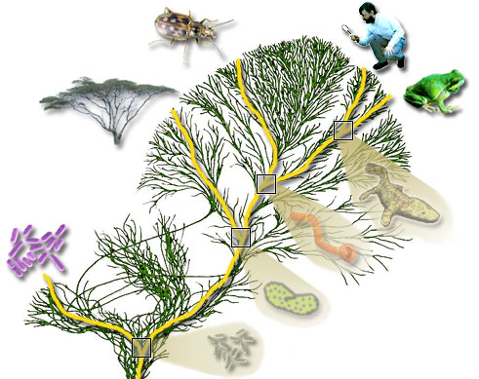
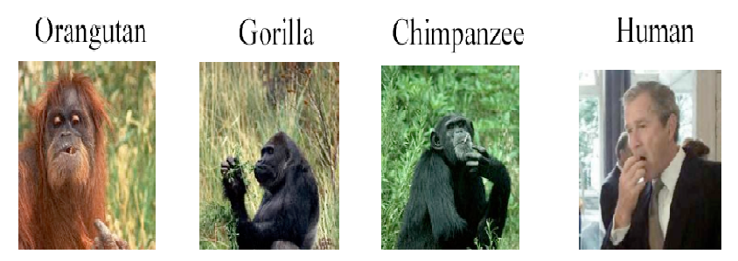

Phylogeny
What is a ?
Study of evolutionary relatedness among a group of organisms

