Slide 1

Statistical Binning
Siavash Mirarab, Md. Shamsuzzoha Bayzid, Tandy Warnow
Department of Computer Science
University of Texas at Austin
Notes:
a new technique to improve the accuracy of coalescent-based species tree methods.

Slide 2
Outline
Background
Gene tree discordance
Species tree estimation
Binning
Naïve Binning (Bayzid and Warnow, Bioinformatics 2013)
Statistical Binning (Mirarab, Bayzid, Warnow, in prep.)
Future Work
Notes:
Before describing our binning technique, I will talk about gene tree discordance and different species tree estimation techniques. Prof. warnow has discussed these topics in the last class. But I will touch these very briefly just to refresh your memories.

Slide 3

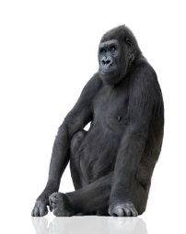
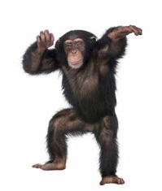

Gene trees and species tree
Species tree – pattern of branching of species lineages via speciation.
Gene tree – A phylogenetic tree that depicts how a single gene has evolved in a group of related species.
Hemoglobin
@
Orangutan Gorilla Chimpanzee Human
Orangutan Gorilla Chimpanzee Human
Notes:
Gene tree. Shows the evolutionary history of a single gene. It shows how a particular gene evolves through time within different species. Gene trees continue to branching and descending through time within the branches of species tree…. One might expect that sister species would have sister copies in the gene tree.

Slide 4
Discordance
Species tree
Gene trees don’t necessarily show the same branching pattern as their containing species tree
D
C
B
A
Gene tree
Notes:
One might expect that sister species would have sister copies in the gene tree. However, this is not the case. When gene copies are sampled from various species, the gene tree relating these copies might disagree with the species philogeny.

Slide 5
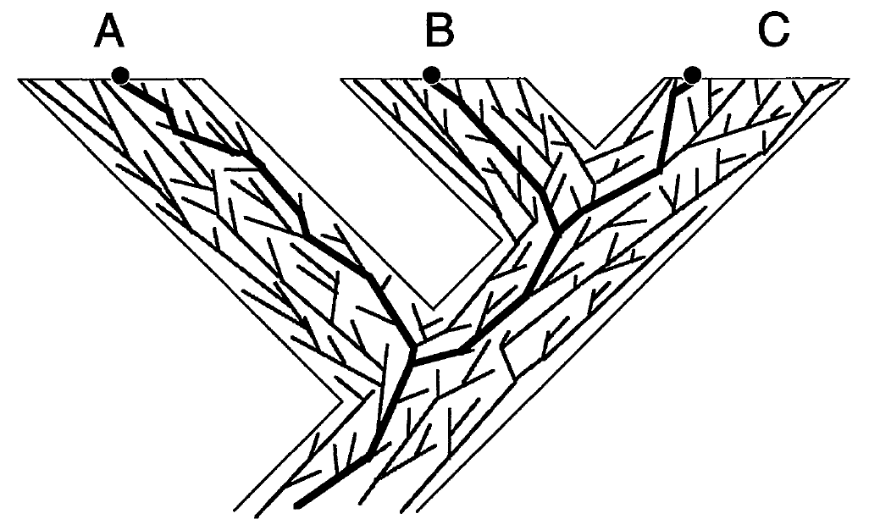
Gene trees in species tree
Maddison, WP, Syst. Biol., 1997
Notes:
Gene trees continue to branching and descending through time within the branches of species tree…. And a gene tree may or may not agree with the containing species trees. Here we can see a species tree a bunch of gene trees within these species. Some of them agree with the species tree while others don’t. In that sense, species history should be a meaningful summary of the gene histories.

Slide 6
Causes of Gene Tree Discordance
Discord can arise from -
Horizontal Gene Transfer (HGT)
Incomplete Lineage Sorting (Deep Coalescence)
Gene Duplication/Extinction
Estimation error may also introduce discordance.
Notes:
In this paper, we assume that there is no estimation error

Slide 7
Gene Duplication/Loss
Duplication
A gene might get duplicated and both copies descend and evolve independently.
Discordance can occur if some sampled copies come from one locus and others come from another locus
D
C
B
A
1 Duplication and 3 losses
Notes:
Although you already know about duplication, deep coalescence etc. I would like to show you with an example how gene duplication and loss works and gives rise to discordance. If you trace back the gene history, you can see that B and C are no longer sister copies, rather C and D are sister copies. So the gene tree looks like this

Slide 8
Deep Coalescence
Gene copies fail to coalesce in the speciation point. Gene copies at a single locus extends deeper than the speciation events
Coalescence theory visualizes the process as if it operated backwards in time.
Population size
Generation
Notes:
Common ancestry extends deeper than the speciation events

Slide 9
Deep Coalescence (cont.)
Population size
Smaller population size and longer branch increases the possibility of coalescence.
Generation

Slide 10
Deep Coalescence (cont.)
Population size
Larger population size and shorter branch increase the chances that gene copies will fail to coalesce
Generation

Slide 11
Discordance by Deep Coalescence
D
C
B
A

Slide 12
Species Tree Estimation
Combined Analyses (Concatenation): Combining genes to create a “supergene”
Summary Methods: summarizing individual Gene trees.
Notes:
no individual gene tree is necessarily a good estimate of the true species tree. This introduces some challenges in constructing species tree.First… Second we need to consider the reasons of discordance into account so that the species that we are constructing does make sense

Slide 13
Combined Analyses
g₁
g₂
g₃
g₄
g₅
g₆
g₇
g₈
g₉
Supergene alignment g*
Sequence based tree estimation method
Species Tree

Slide 14
Summary Methods
g₁
g₂
g₃
g₄
g₅
g₆
g₇
g₈
g₉
Gene Tree Parsimony, ML etc.
Species Tree

Slide 15
Concatenation vs. summary methods
Concatenation provides the advantage of high level of signal.
Concatenation in the presence of gene tree discordance creates model misspecification and can result into wrong answer.
Species tree estimation from a set of gene trees can take into account the gene tree discordance.
But suffers poor signal per gene.
Notes:
However, since sequence evolution models assume a single underlying tree, concatenation in the presence of gene tree discordance creates model misspecification and can result into wrong answer

Slide 16
Naïve Binning
g₁
g₂
g₃
g₄
g₅
g₆
g₇
g₈
g₉
Bin1
Bin2
Bin3
Super-gt₁
Super-gt₂
Super-gt₃
ST
Notes:
The basic idea is we are trying to combine genes that are similar if not identical.

Slide 17
Statistical Binning
g₁
g₂
g₃
g₄
g₅
g₆
g₇
g₈
g₉
Bin1
Bin2
Bin3
Combining genes that are “similar”
Super-gt₁
Super-gt₂
Super-gt₃
ST

Slide 18
Basic Idea: binning criteria
Trees that have clear differences in their topologies should not be combined.
We do not bin two genes together if they have any conflicting edge with statistical support above a given threshold (T).
Controlling the threshold (T) enables more aggressive or conservative binning.
Notes:
We evaluate the discordance at a support level which we call a threshold. If two genes have a conflicting edge and their support value is higher than a particular threshold, we call those gene trees conflicting at that level.

Slide 19
Statistical Discordance/Conflict
compatible
conflict
abc|d
abc|d
ab|cd
ac|bd
60%
55%
a
b
c
d
a
c
b
d
Threshold = 50%
Threshold = 75%
Combinability
We allow two genes to be in the same bin if their contracted
versions (collapsing edges with support < T) are compatible.

Slide 20
Algorithm: Statistical Binning
4
3
4
1
2
3
1
2
4
Incompatibility Graph
Notes:
I will show you the algorithmic construct of the statistical binning with an example

Slide 21
Algorthm: Statistical Binning
Input: A set of gene trees with support value and a threshold value (T)
Algorithm
Collapse all edges with support <= T
Construct the Incompatibility Graph G
Each node corresponds to a gene. There is an edge between two nodes if the corresponding gene trees are incompatible (after contracting the low support edges)
Find the independent sets from G.
Vertex Coloring.
Each color defines a bin (containing the genes with that particular color).

Slide 22
Balanced vs. Unbalanced Bins
We try to avoid unbalanced bin sizes
Some very small, and some very large bins.
Unbalanced bins are problematic
Large bins are problematic due to the undesirable properties of concatenation
Small bins would not provide increased signal.
1
3
1
1
2
2
3
Balanced bins
Unbalanced bins
1
New vertex is added to the smallest subset that it can be added to
Vertex to be colored

Slide 23
Impact of threshold
Not expected with significant amount of discordance.
Expected
Error
T= 0 (combining only identical genes)
T= 100
Aggressive Binning
Unbinned
Conservative binning
Concatenation

Slide 24
Results

Slide 25
Results contd.

Slide 26
Gene tree estimation error

Slide 27
Future Work
Theoretical analyses of the impact of the threshold and how to pick a suitable threshold for a given datasets.

Slide 28
Thank You
Questions
??

Slide 29
Collapse all the edges below threshold. Then check if they are compatible.
4
1
2
3
1

Slide 30
Summary Methods
g₁
g₂
g₃
g₄
g₅
g₆
g₇
g₈
g₉
Gene Tree Parsimony, ML etc.
Species Tree

Slide 31
Two trees are statistically conflicting if one tree has at least one conflicting edge that has support more than the threshold. After showing the figure say something like the threshold is to contorl how strict or flexible we are when comparing two trees
compatible
ab|cd
ac|bd
Supergene alignment g*
60%
55%
a
b
c
d
a
c
b
d

Slide 33
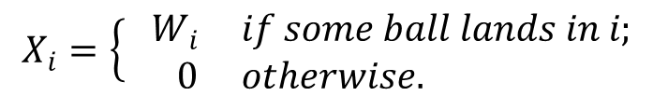
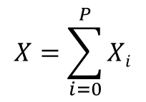
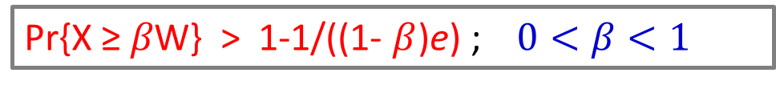
Balls and Bins Problem
3
1
2
P
1
2
3
. . .
P
W₁
W₂
W₃
W_{P}
$$X_{i}=\left\{\begin{aligned} W_{i} & if some ball lands in i; \\ 0 & otherwise.\end{aligned}\right.$$
$$X=\sum_{i=0}^{P}{Xi}$$
Pr{X ≥ $β$W} > 1-1/((1- $β$)e) ; $0<β<1$

Slide 34
Acknowledgements
Fulbright, Guggenheim, and NSERC
Joint work with Siavash Mirarab and Tandy Warnow
Nam Nguyen, Andrei Margea, Jimmy Yang, Kevin Liu.

Slide 35
Thank You
Questions
??

Slide 36
Performance study

Slide 37
Running Time
 | 100-taxon | 500-taxon
iGTP | 58.9 | > 86,400
MGD | 0.4 | 34.6

Slide 38
Challenges in constructing species trees
The estimation of species trees typically involves the estimation of trees and alignments on many different genes, so that the species tree can be based upon many different parts of the genome.
Species tree estimations need to take causes of discord between gene trees and species trees into consideration, in order to produce reasonably accurate estimates of the species tree.
Notes:
no individual gene tree is necessarily a good estimate of the true species tree. This introduces some challenges in constructing species tree.First… Second we need to consider the reasons of discordance into account so that the species that we are constructing does make sense

Slide 39
Our Goal
Lack of efficient algorithms has limited the use of the GTP approach
for phylogenetic analyses of large-scale genomic data sets.
The biggest dataset analyzed by any GTP approach contains 18,896
gene trees with only 136 taxa.
An efficient exact algorithm to solve MGD.
NP-hard!
Exponential time
Solving a constrained version exactly
Polynomial time solvable
Notes:
We are developing an efficient exact algorithm for this problem. However, since this problem is NP-hard, solving it exactly is computationally intense. So we have designed a constrained version where instead of searching through the entire tree-space, we restrict our search within a subset of all possible species trees. We find the optimal species tree within this restricted search space

Slide 40
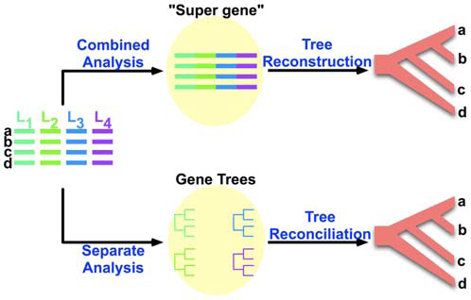
Estimating Species Tree
Old style
One gene – one species tree
New style
Many genes – species tree
on “supergenes”
Most recent approach
Many genes - many trees
Species tree from
gene trees, taking the
reasons of discordance
into account .
(Gene Tree Parsimony).
NP-hard problems!
We focus on developing an efficient approach to solve
GTP problems.
Notes:
no individual gene tree is necessarily a good estimate of the true species tree. This introduces some challenges in constructing species tree.First… Second we need to consider the reasons of discordance into account so that the species that we are constructing does make sense

Slide 41
Alternate definition of Duplication
Subtree-bipartition
For an internal node u in a binary-rooted tree T,
SBP(u) = cluster(T_{L})|cluster(T_{R})
A|BCD
|
B
CD
C|D
A
B
C
D
Notes:
To design an efficient DP based algorithm, we give an alternative definition of Duplication. For this we need some terminologies. Everybody here knows what is a bipartitions. .. Since a binary tree with n leaves has n-1 internal nodes, we can characterize this tree with n-1 subtree-bipartitions

Slide 42
Alternate definition of Duplication
Subtree-bipartition
For an internal node u in a binary-rooted tree T,
SBP(u) = cluster(T_{L})|cluster(T_{R})
A|BCD
B|CD
C|D
A
B
C
D
Notes:
To design an efficient DP based algorithm, we give an alternative definition of Duplication. For this we need some terminologies. Everybody here knows what is a bipartitions.

Slide 43
Compatibility
Compatibility
X|Y and P|Q are compatible if they can “co-exist” in a binary rooted tree.
Disjoint
Containment
If the common ancestry of two genes-copies can be traced
back to a specieation event, they are orthologous.
If the traced back to a duplication event, they are paralogous.s
Notes:
diffe

Slide 44
Optimal Reconciliation (LCA mapping)
D
A
B
C
B
D
D
A
C
B
A
C
gt
ST
One duplication is required to reconcile

Slide 45
Horizontal Gene Transfer
Renegade genes somehow break the confines of the species lineages and moved horizontally across the phylogeny.
Species history – more complex?
Network instead of a tree
D
C
B
A
Notes:
1. A gene tree that agrees. But if a branch of the gene tree jumps between species lineages and the receiving species lineage goes extinct or not sampled, then there will be discordance. One might argue that this is not discordance but the species history is more complex than just a tree. It might be a network.

Slide 46
Deep Coalescence
Gene copies fail to coalesce in the speciation point. Gene copies at a single locus extends deeper than the speciation events
Coalescence theory visualizes the process as if it operated backwards in time.
Population size
Generation
Notes:
Common ancestry extends deeper than the speciation events

Slide 47
Deep Coalescence (cont.)
Population size
Smaller population size and longer branch increases the possibility of coalescence.
Generation

Slide 48
Deep Coalescence (cont.)
Population size
Larger population size and shorter branch increase the chances that gene copies will fail to coalesce
Generation

Slide 49
Discordance by Deep Coalescence
D
C
B
A

Slide 50
How CS is related to Phylogeny?
Morphological data
Form and structure of organisms and their specific structural features.
Number of legs, color of the eye etc.
Biomolecular sequences
DNA, RNA, amino acids etc.
AAGACTT
AAGGCCT
TGGACTT
AGGGCAT
TAGCCCT
AGCACTT
AGGGCAT
TAGCCCA
TAGACTT
AGCACAA
AGCGCTT
a
b
c
d
e
Evolutionary History

Slide 51
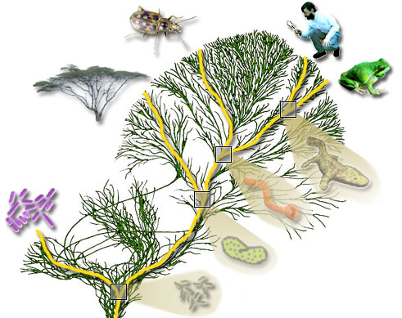
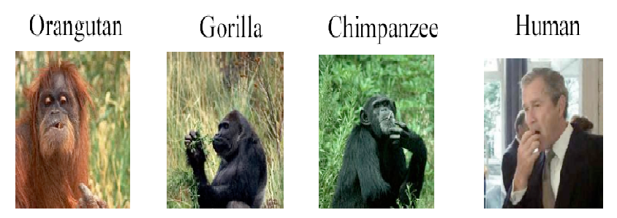

Phylogeny
What is a ?
Study of evolutionary relatedness among a group of organisms

