Slide 1

Estimating Species Trees from Gene Trees
Md. Shamsuzzoha Bayzid
Department of Computer Science
University of Texas at Austin

Slide 2
Outline
Background
Gene tree and species tree
Species tree estimation
My contributions
Future Work

Slide 3
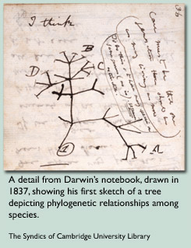
The origin and evolution of species has always been a mystery and fascinating research area to the scientific community.
In his book, The Origin of Species, published in 1859, Charles Darwin compared the lives on the planet to a tree.
Notes:
In his book, the origin of species, published in 1859, Charles Darwin compared the evolution of lives on the planet to a great tree. Darwin realized that the process of evolution implied shared ancestry – going all the way back to the beginning of life. This figure has been taken from Darwin’s notebook where he related the evolution of different species in tree. Ever since Darwin, scientists have attempted to reconstruct the historical relationships among species. And this is what we call phylogeny.

Slide 4
Phylogeny
What is ?
Notes:
What is a phylogeny? Phylogeny represents the evolutionary history of a group of organisms. That means, its all about inferring similarity of dissimilarity among different species and how they evolved through time. For example, let us consider this 4 species. For many reasons, it is believed that Human is more closely related to chimp than gorilla or orangutan. Again, Human and Chimp are more closely related to Gorilla than Orangutan. So the phylogeny of these 4 species looks like what is seen in this cartoon.
Evolution does not describe the creation of species, but trace back the history.
Human from Monkey?
One example of evolution is insects developing a resistance to pesticides over the period of a few years.

Slide 5

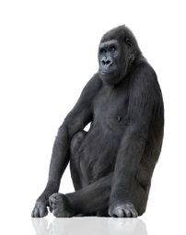


Phylogeny
Phylogenetic tree – represents the evolutionary history of a group of organisms.
Orangutan Gorilla Chimpanzee Human
Notes:
What is a phylogeny? Phylogeny represents the evolutionary history of a group of organisms. That means, its all about inferring similarity of dissimilarity among different species and how they evolved through time. For example, let us consider this 4 species. For many reasons, it is believed that Human is more closely related to chimp than gorilla or orangutan. Again, Human and Chimp are more closely related to Gorilla than Orangutan. So the phylogeny of these 4 species looks like what is seen in this cartoon.
Evolution does not describe the creation of species, but trace back the history.
Human from Monkey?
One example of evolution is insects developing a resistance to pesticides over the period of a few years.

Slide 6
Phylogeny Reconstruction
Morphological data
Form and structure of organisms and their specific structural features.
Number of legs, color of the eye etc.
Biomolecular sequences
DNA, RNA, amino acids etc.
AAGACTT
a
AGGGCAT
b
TAGCCCA
AAGGCCT
TGGACTT
c
TAGACTT
d
AGCACAA
AGGGCAT
TAGCCCT
AGCACTT
e
AGCGCTT
AGGGCAT
TAGCCCA
TAGACTT
AGCACAA
AGCGCTT
a
b
c
d
e
Input Sequences
Evolutionary History
Present day organisms are placed at the leaves
Internal nodes are the hypothetical ancestors
Edges denote evolutionary relationships
Notes:
When biomolecular sequences were not available, scientists used morphological data to infer phylogeny. Morphological characteristics refer to the physical structure of different species. For example, how many legs a species has, what is the color of its eye, whether it has a tail or not etc. Based on these morphology it is possible to infer similarity or dissimilarity. But ever since whole genome sequence was discovered, biologists started to rely on biomolecular sequences. Since DNA encodes the full heredity information of a species, phylogeny based upon DNA sequence is much more reliable than that constructed from morphology. On the otherhand use of sequence data has extremely complicated the process. The high level picture of phylogeny reconstruction is – we begin with the sequence data of group of organism and tries to infer a tree that fits the input sequence (max parsimony, mas likelihood etc). This is a not trivial task and of course, a NP-hard task.

Slide 7
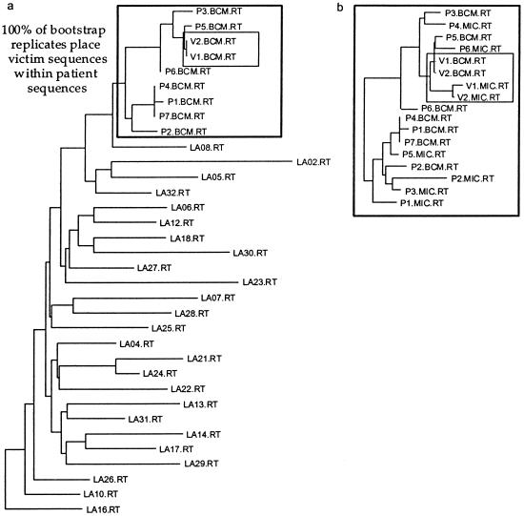
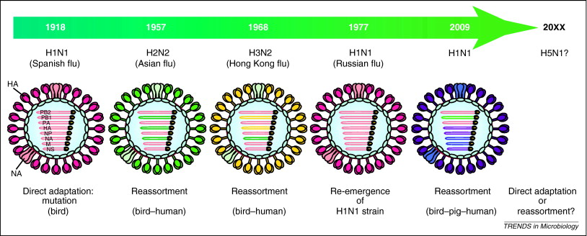


Applications
Is the whole purpose of phylogeny just to satisfy the curious minds about the evolution of species?
Gene function identification
Track the evolution of disease
Investigation of criminal case.
gene
gene1
gene2
gene3
gene4
Notes:
The purpose of evolution is not just get to know some interesting facts about the history. The uses of phylogenies, beyond elucidating the evolutionary relationships of biological species, are many and growing; such as…
Disease: The “Spanish” influenza pandemic killed over 20 million people in 1918 and 1919, making it the worst infectious pandemic in history.
Each year's flu vaccine is actually a cocktail of vaccines for a few different flu strains (generally three) that World Health Organization scientists predict will spread during that year's flu season.
Crime: most famously, in a case where a
doctor in Louisiana was accused of having deliberately infected his girlfriend with HIV [MMLPGH02].
The phylogenetic evidence featured prominently in the trial and the doctor was ultimately convicted
of attempted second degree murder.
A gastroenterologist was convicted of attempted second-degree murder by injecting his former girlfriend with blood or blood-products obtained from an HIV type 1 (HIV-1)-infected patient under his care. Phylogenetic analyses of HIV-1 sequences were admitted and used as evidence in this case, representing the first use of phylogenetic analyses in a criminal court case in the United States. Phylogenetic analyses of HIV-1 reverse transcriptase and env DNA sequences isolated from the victim, the patient, and a local population sample of HIV-1-positive individuals showed the victim's HIV-1 sequences to be most closely related to and nested within a lineage comprised of the patient's HIV-1 sequences. This finding of paraphyly for the patient's sequences was consistent with the direction of transmission from the patient to the victim.
Dr Richard J. Schmidt, 1998¹⁷ ,¹⁸ : Richard Schmidt was a doctor from Louisiana, USA, who was accused of infecting his lover, a nurse called Janice Trahan, by injecting her with HIV infected blood. Trahan alleged that Schmidt had injected her with the blood of one of his positive patients in an act of vengeance after she tried to end their relationship. DNA samples of the virus in Trahan's blood and that of the positive patient in question were found to be very similar, but Schmidt's defence team insisted that 'very similar' was not scientifically accurate enough. HIV rapidly mutates and changes its DNA structure once it enters another person's body meaning comparisons can be difficult. However, using a new technique called ' phylogenetics' (or 'evolutionary analysis'), scientists were able to determine that Schmidt's patient was extremely likely to have been the source of the virus found in Trahan. Schmidt was found guilty and sentenced to 50 years.

Slide 8
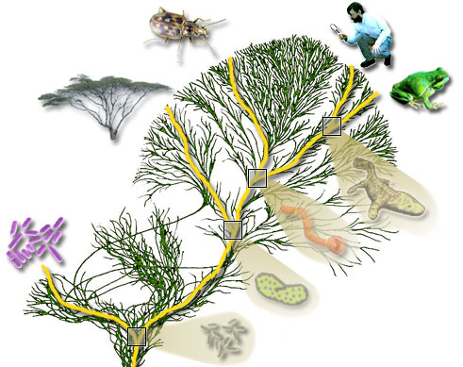
Tree of Life
It is to biology what periodic table is to chemistry
Notes:
The ultimate goal this community is to construct a phylogenetic tree relating all living species. That is called the tree of life project initiated by NSF. That means, we need to deal with tens of thousands of species and the DNA seq of each species itself is extreemley long. Available methods cannot handle such large datasets. Even the fastest computer of this world won’t be able to run phylogeny reconstruction method on such a large datasets.

Slide 9
Outline
Background
Gene tree and species tree
Species tree estimation
My contributions
Future Work

Slide 10
Gene trees and species tree
Species tree – pattern of branching of species lineages via speciation.
Gene tree – A phylogenetic tree that depicts how a single gene has evolved in a group of related species.
Hemoglobin
@
Orangutan Gorilla Chimpanzee Human
Orangutan Gorilla Chimpanzee Human
Notes:
Gene tree. Shows the evolutionary history of a single gene. It shows how a particular gene evolves through time within different species. Gene trees continue to branching and descending through time within the branches of species tree…. One might expect that sister species would have sister copies in the gene tree.

Slide 11
Discordance
Species tree
Gene trees don’t necessarily show the same branching pattern as their containing species tree
D
C
B
A
Gene tree
Notes:
One might expect that sister species would have sister copies in the gene tree. However, this is not the case. When gene copies are sampled from various species, the gene tree relating these copies might disagree with the species philogeny.

Slide 12
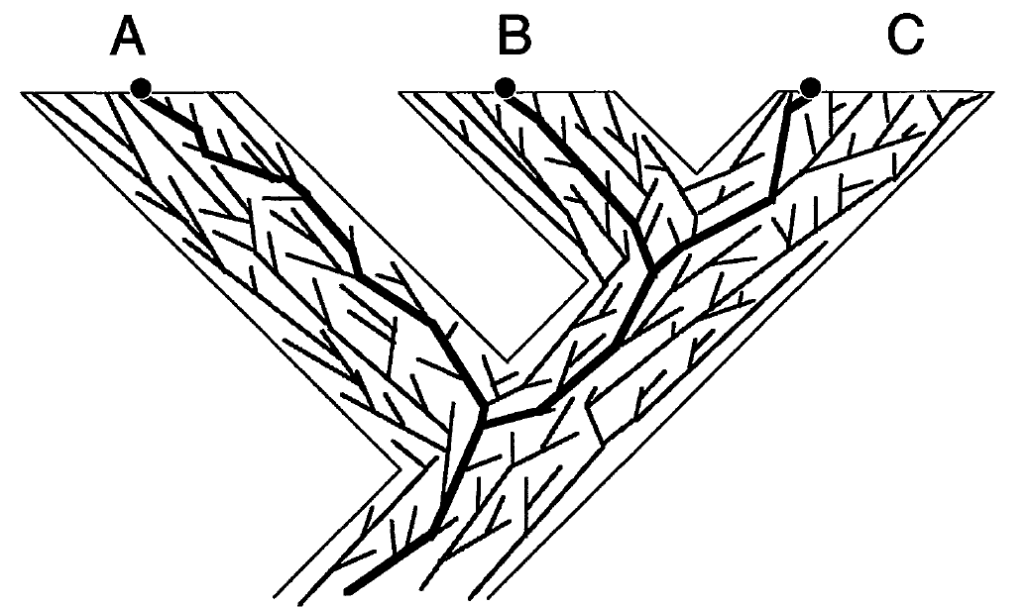
Gene trees in species tree
Notes:
Gene trees continue to branching and descending through time within the branches of species tree…. And a gene tree may or may not agree with the containing species trees. Here we can see a species tree a bunch of gene trees within these species. Some of them agree with the species tree while others don’t. In that sense, species history should be a meaningful summary of the gene histories.

Slide 13
Causes of Gene Tree Discordance
Discord can arise from -
Deep Coalescence (ILS)
Gene Duplication/Extinction
Horizontal Gene Transfer (HGT) etc.
Estimation error may also introduce discordance.

Slide 14
Deep Coalescence
Gene copies fail to coalesce in the speciation point. Gene copies at a single locus extends deeper than the speciation events
Coalescence theory visualizes the process as if it operated backwards in time.
Population size
Generation
A
B
Notes:
Common ancestry extends deeper than the speciation events

Slide 15
Deep Coalescence (cont.)
Population size
Smaller population size and longer branch increases the possibility of coalescence.
Generation

Slide 16
Deep Coalescence (cont.)
Population size
Larger population size and shorter branch increase the chances that gene copies will fail to coalesce
Generation

Slide 17
Discordance by Deep Coalescence
D
C
B
A

Slide 18
Gene Duplication/Loss
Duplication
A gene might get duplicated and both copies descend and evolve independently.
Discordance can occur if some sampled copies come from one locus and others come from another locus
D
C
B
A
1 Duplication and 3 losses
Notes:
Although you already know about duplication, deep coalescence etc. I would like to show you with an example how gene duplication and loss works and gives rise to discordance. If you trace back the gene history, you can see that B and C are no longer sister copies, rather C and D are sister copies. So the gene tree looks like this

Slide 19
Outline
Background
Gene tree and species tree
Species tree estimation
My contributions
Future Work

Slide 20
Gene Tree Estimation
Gene sequence
A
B
C
D
ATCGCCTACGGTCAT
ACTGCCTGCTACCTG
GCTGCGTACTAGGAT
ATCCGTACCTGATGT
Species
INPUT
Maximum Likelihood
Maximum Parsimony
A
B
C
D
Phylogenetic Tree

Slide 21
Species Tree Estimation
Combined Analyses (Concatenation): Combining genes to create a “supergene”
Summary Methods: summarizing individual Gene trees.
Notes:
no individual gene tree is necessarily a good estimate of the true species tree. This introduces some challenges in constructing species tree.First… Second we need to consider the reasons of discordance into account so that the species that we are constructing does make sense

Slide 22
Combined Analyses
g₁
g₂
g₃
g₄
g₅
g₆
g₇
g₈
g₉
Supergene alignment g*
Sequence based tree estimation method
Species Tree

Slide 23
Summary Methods
g₁
g₂
g₃
g₄
g₅
g₆
g₇
g₈
g₉
Gene Tree Parsimony, ML etc.
Species Tree

Slide 24
Summary Methods
Gene Tree Parsimony: Finds the most parsimonious tree with respect to a distance measure (duplication and loss, deep coalescence).

Slide 25
Cost: Duplication and loss
Duplication
Cost of reconciling a gene tree into a species tree is measured by the number of duplication and loss
D
C
B
A
1 Duplication and 3 losses
Notes:
Although you already know about duplication, deep coalescence etc. I would like to show you with an example how gene duplication and loss works and gives rise to discordance. If you trace back the gene history, you can see that B and C are no longer sister copies, rather C and D are sister copies. So the gene tree looks like this

Slide 26
Cost: Deep coalescence/ILS
Cost of reconciling a gene tree into a species tree is measured by the number of extra lineages.
D
C
B
A
Cost: 1 extra lineage

Slide 27
Problem definition (MGD)
Problem: Minimize Gene Duplication (MGD)
Input: A set of rooted gene trees with each species having a single copy of a gene.
Output: A species tree ST that minimizes total number of duplications.
A
B
C
D
A
B
C
D
A
B
C
D
gt₁
gt₂
gt_{k}
C₁
C₂
C_{k}
ST
∑C_{i} is minimized
Notes:
The optimization problem can be stated as follows.
PUT REFERENCES to ORiGINAL PAPER FORMULATING THIS PROBLEM???

Slide 28
Summary Methods
Gene Tree Parsimony: Finds the most parsimonious tree with respect to a distance measure (duplication and loss, deep coalescence).
Maximum Likelihood: Finds the tree that maximizes the likelihood of observing the input gene trees under a particular tree evolution model.

Slide 29
Concatenation vs. summary methods
Concatenation provides the advantage of high level of signal.
Concatenation in the presence of gene tree discordance creates model misspecification and can result into wrong answer.
Species tree estimation from a set of gene trees can take into account the gene tree discordance.
But suffers poor signal per gene.
Notes:
However, since sequence evolution models assume a single underlying tree, concatenation in the presence of gene tree discordance creates model misspecification and can result into wrong answer

Slide 30
Measure of Accuracy
False Negative (FN) rate
x
w
u
x
u
w
FN
v
y
v
y
True tree
Estimated tree
False Negative (FN): an edge in the true tree that is missing from the estimated tree
Notes:
Now the question is, what is the measure of accuracy? How do we compare two tree? One measure is number of quartets satisfied. Since our goal is to maximize satisfied quarts, this is a natural matric for evaluation. This doesn’t involve comparing with the model tree. The metric that we use for comparing with the model tree is FN rate. We call an edge FN if this is present in the true tree but not in the estimated tree (if someone ask why? An internal edge defines a partition, which in turn defines two clusters of the species. That means which ones are closely related. Note that partitions defined by the internal nodes represent the phylogeny. So the higher number of internal edges we can reconstruct, the better the quality of the estimated tree) This is the most accepted metric in computation biology community.

Slide 31
Outline
Background
Gene tree and species tree
Species tree estimation
My contributions
Future Work

Slide 32
My research
Estimating species trees from gene trees by taking the reasons for discordance into account.
Gene duplication and loss, ILS.
How to handle various challenges, which arise frequently in phylogenomic data

Slide 33
Challenges in Phylogenomics
Gene tree discordance is the fundamental challenge
Incomplete gene trees: not all the genes contain sequences for all the species
Optimal completion of a gene tree
Optimal species tree from incomplete gene trees
Poorl phylogenetic signal: The gene trees are poorly estimated
A
B
C
D
E
Gene tree error propagates to the species tree
Species tree
A
C
E
A
B
C
D
B
C
E
g₁
g₂
g₃

Slide 34
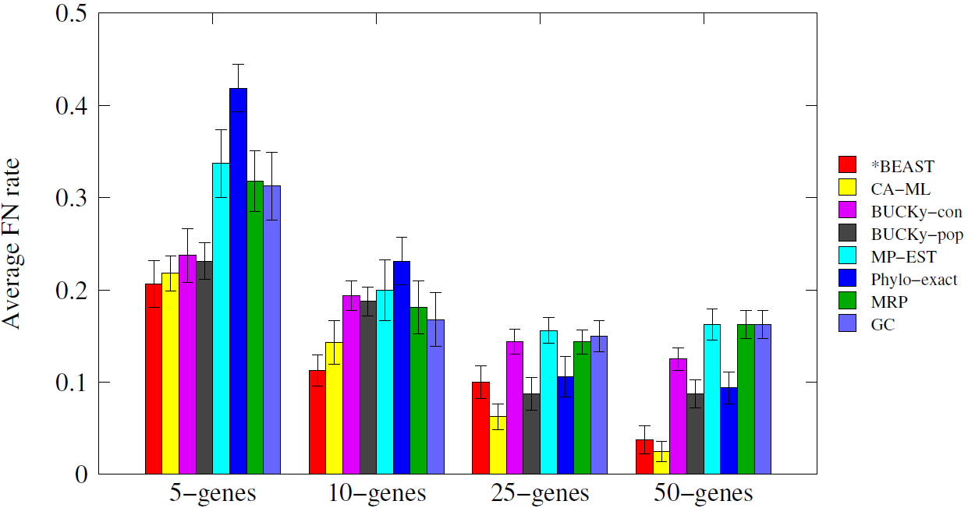
Simulation Study (Bayzid & Warnow, Bioinformatics 2013)

Slide 35
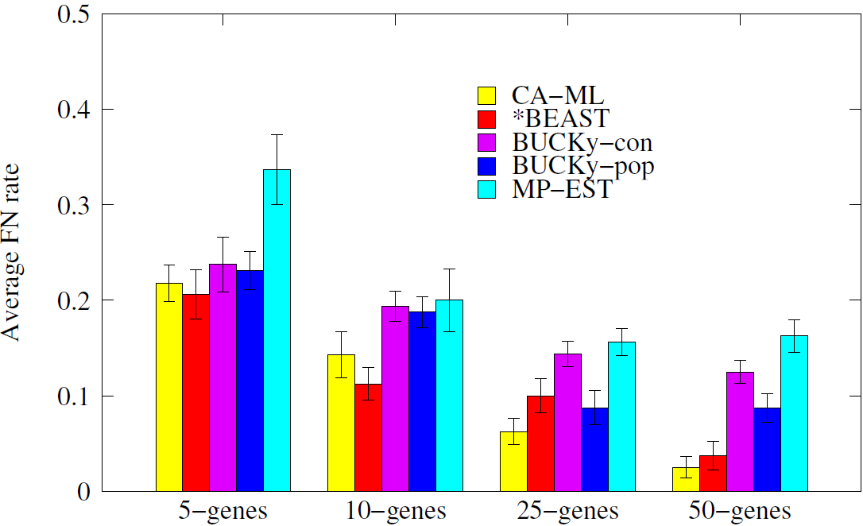
Simulation Study (Bayzid & Warnow, Bioinformatics 2013)

Slide 36
Why *BEAST is so good?
g₁
g₂
g₃
gt₁
gt₂
gt₃
(RAxML, FastTree)
Gene tree estimation
g₄
g₅
g₆
gt₅
gt₆
gt₄
Summary
methods
*BEAST
Co-estimation
Species tree

Slide 37
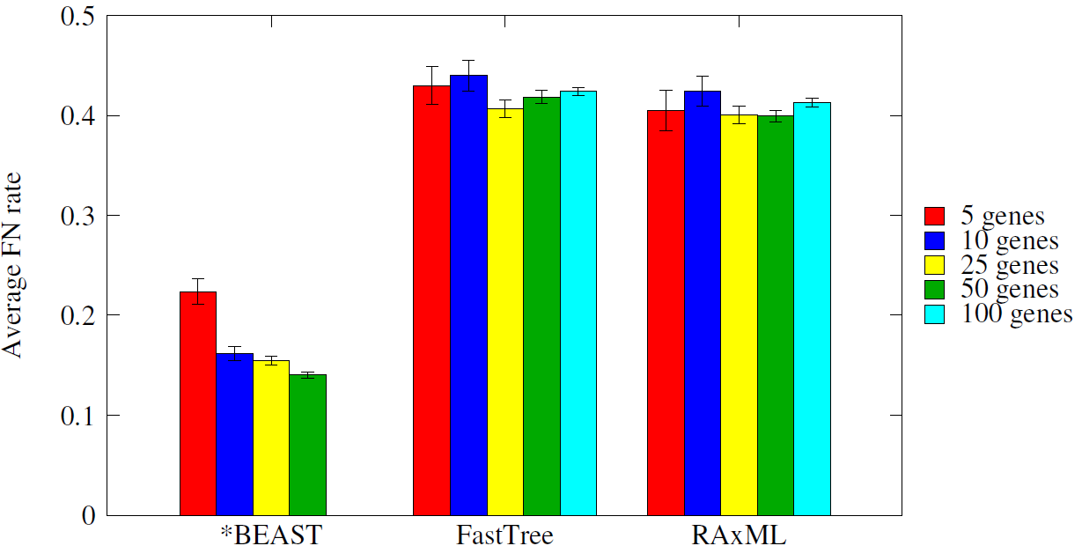
Why *BEAST is so good?
Gene tree accuracy: *BEAST produces much more accurate gene trees than the most popular likelihood based methods RAxML and FastTree

Slide 38
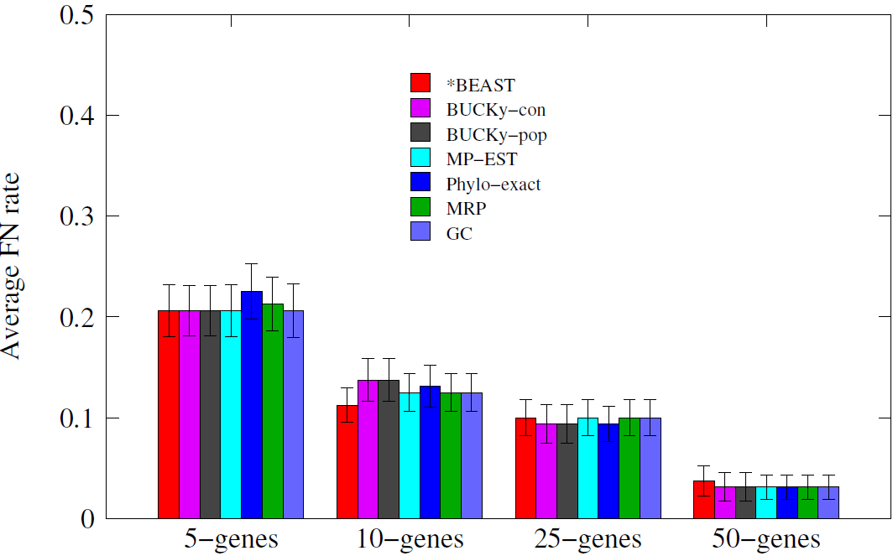
Why *BEAST is so good?
Even the simplest methods like greedy consensus produces as good species tree as *BEAST given the gene trees estimated by *BEAST

Slide 39
Our findings
Highly accurate species tree of *BEAST is the result of highly accurate gene trees
Species tree estimation methods are very sensitive to the gene tree error
Simple methods can estimate highly accurate species tree given highly accurate gene trees
What can we do to overcome the problem of poorly estimated gene trees?

Slide 40
Naïve Binning (Bayzid & Warnow, Bioinformatics 2013)
g₁
g₂
g₃
g₄
g₅
g₆
g₇
g₈
g₉
Bin1
Bin2
Bin3
Super-gt₁
Super-gt₂
Super-gt₃
ST
Notes:
The most recent idea is something in between. Instead of combining everything, what if we combine some of them

Slide 41
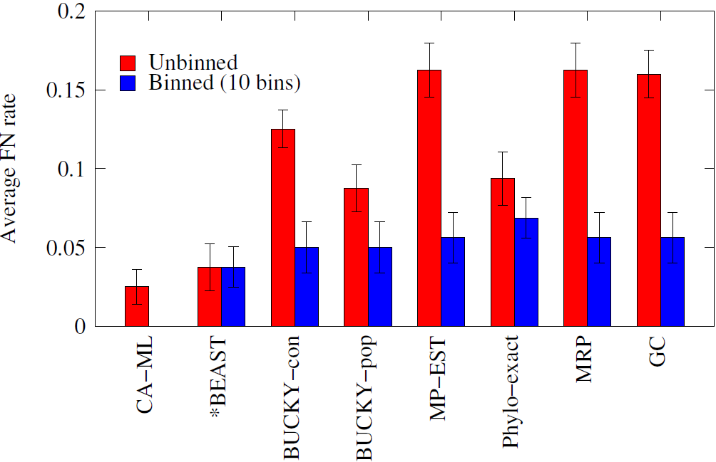
Naïve Binning (Bayzid & Warnow, Bioinformatics 2013)
Naïve binning improves the summary methods substantially!
Model violation (combining genes randomly)

Slide 42
Future Work
» New binning techniques
We (Mirarab et al., 2014, under review) developed statistical binning
New binning approaches using unsupervised clustering techniques
» Classification in phylogeny
Application of supervised classification techniques in the context of phylogenetics.
Predicting the reason of discordance: ILS or HGT?
» Large scale phylogeny
Divide and conquer based meta method to make existing techniques scalable to large number of species.

Slide 43
Thank You
Questions
??

Slide 44
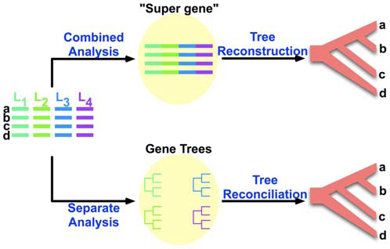
Estimating Species Tree
Old style
One gene – one species tree
New style
Many genes – species tree
on “supergenes”
Proposed new approach
Many genes - many trees
Species tree from
gene trees, taking the
causes for discord
into consideration
(e.g. Gene Tree Parsimony).
NP-hard problems!
Notes:
no individual gene tree is necessarily a good estimate of the true species tree. This introduces some challenges in constructing species tree.First… Second we need to consider the reasons of discordance into account so that the species that we are constructing does make sense

Slide 45
Causes of Gene Tree Discordance
Discord can arise from -
Horizontal Gene Transfer (HGT)
Deep Coalescence
Gene Duplication/Extinction
Estimation error may also introduce discordance.
Notes:
In this paper, we assume that there is no estimation error

Slide 46
Optimal reconciliation
Duplication
Duplication
D
C
B
A
1 Duplication and 3 losses
2 Duplication and 5 losses
Notes:
To deal with this problem, we need to know how to calculate the minimum number of duploss required to reconcile a gene tree against a species tree. We have already seen that…. But there may be some other different reconciliations. We need to find the optimal reconciliation.

Slide 47
Gene Duplication/Loss
Duplication
Cost of reconciling a gene tree into a species tree is measured by the number of extra lineages.
D
C
B
A
1 Duplication and 3 losses
Notes:
Although you already know about duplication, deep coalescence etc. I would like to show you with an example how gene duplication and loss works and gives rise to discordance. If you trace back the gene history, you can see that B and C are no longer sister copies, rather C and D are sister copies. So the gene tree looks like this

Slide 48
Optimal Reconciliation (LCA mapping, M)
Duplication
A
B
C
D
D
C
B
A
gt
ST
Theorem [Guigo et al. 1,2]
An internal node u of gt is a duplication node
if and only if M(v) = M(w) for some child w of v.
Notes:
There is an easy way to find the optimal number of duplication and loss and this is based on LCA Mapping. LCA stands for lowest common ancestor.

Slide 49
Problem definition (MGD)
Problem: Minimize Gene Duplication (MGD)
Input: A set of rooted binary gene trees with each species having a single copy of a gene.
Output: A species tree ST that minimizes total number of duplications.
A
B
C
D
A
B
C
D
A
B
C
D
gt₁
gt₂
gt_{k}
C₁
C₂
C_{k}
ST
∑C_{i} is minimized
Notes:
The optimization problem can be stated as follows.
PUT REFERENCES to ORiGINAL PAPER FORMULATING THIS PROBLEM???

Slide 50
Available Software
DupTree (available in iGTP package)
Reference: (where, when published)
A heuristic to infer species phylogeny by minimizing duplications.
DupTree first builds an initial species tree.
Next, DupTree searches for a better species tree using a standard search heuristic of choice starting from the initial species tree. It scores each candidate species tree with respect to the input gene trees using the MRCA mapping.
Has been cited XXX times and used in YYY studies
Notes:
There is an easy way to find the optimal number of duplication and loss and this is based on LCA Mapping. LCA stands for lowest common ancestor.

Slide 51
Problem and Our Goal
Lack of efficient algorithms has limited the use of the GTP approach for phylogenetic analyses of large-scale
genomic data sets.
The biggest dataset analyzed by any GTP approach so far contains only 136 taxa with many gene trees. (reference)
Our goal: new algorithmic approach that can analyze
large datasets quickly and with high accuracy
Notes:
iGTP is a heuristic based on local search technique that might be fine for smaller datasets, but may not be a practical tool for large-scale biological datasets. The biggest dataset analyzed…So this limits the use of GTP analysis. Our goal is to come up with a novel approach to solve this problem efficiently and quickly.

Slide 52
Outline
Background
Our Contributions
Future Work

Slide 53
Our Algorithms
Exact algorithms to solve NP-hard MGD and MGDL
Exact algorithms for constrained versions of the
MGD and MGDL problems that run in polynomial time
We have initial implementations and have tested them on simulated and biological datasets.
We conjecture that our methods will enable analyses of datasets with thousands of taxa, and be able to obtain highly accurate results quickly (faster than iGTP).
Future work will investigate this.
Notes:
We are not done with extensive experimental study. But the results that we have so far suggests that our tool would be a prcctical tool for large-scale datasets.

Slide 54
Today’s talk
Exact algorithms to solve NP-hard MGD (binary-rooted, single copy, complete), and its constrained version that runs in polynomial time.
Not shown
Corresponding algorithms for unrooted, incomplete, multi-copy
Empirical results.
Notes:
We are not done with extensive experimental study. But the results that we have so far suggests that our tool would be a prcctical tool for large-scale datasets.

Slide 55
Alternate definition of Duplication
Subtree-bipartition
For an internal node u in a binary-rooted tree T,
SBP(u) = cluster(T_{L})|cluster(T_{R})
A|BCD
|
B
CD
C|D
A
B
C
D
Notes:
To design an efficient DP based algorithm, we give an alternative definition of Duplication. For this we need some terminologies. Everybody here knows what is a bipartitions. .. Since a binary tree with n leaves has n-1 internal nodes, we can characterize this tree with n-1 subtree-bipartitions

Slide 56
Domination
Domination
X|Y is dominated by P|Q (or P|Q dominates X|Y)
X ⊆ P and Y ⊆ Q
Examples
is dominated by
A|CD
AB|CD
is not dominated by
AC|D
AB|CD

Slide 57
Alternate definition of Duplication
Theorem
An internal node of gt is a speciation node if it is dominated by
some subtree-bipartition in ST. Otherwise, this is a duplication node
AC|DEF
ABC|DEF
A
C
D
E
F
B
A
C
F
D
E
gt
ST
Notes:
Now our alternate definition goes like this.

Slide 58
Alternate definition of Duplication Contd.
Theorem, Bayzid et al.
An internal node of gt is a speciation node if it is dominated by
some subtree-bipartition in ST. Otherwise, this is a duplication node
AC|DEF
ABD|CEF
A
C
D
E
F
B
A
C
F
D
E
gt
ST

Slide 59
Example
A|BCD
A|BCD
B|CD
D|BC
C|D
C|B
A
B
C
D
D
C
B
A
gt
ST

Slide 60
Compatibility
Compatibility
X|Y and P|Q are compatible if they can “co-exist” in a binary rooted tree.
Two subtree-bipartitions are compatible if
one contains the other
or they are disjoint
Containment
Disjoint

Slide 61
Maximizing dominated subtree-bipartitions
Input: A set of rooted binary gene trees
Output: A species tree ST that minimizes total number of duplications.
Goal
A species tree ST that minimizes total number of duplications.
A species tree ST that maximizes total number of dominated
subtree-bipartitions in input gene trees.
A set of (n-1) compatible subtree-bipartitions
that maximizes total number of dominated
subtree-bipartitions in input gene trees.
Notes:
Our objective is to construct a species tree with … having the alternate definition of duplication, our goal is equivalent to looking for ST that maximizes… (two sbp are compatible if they can co-exist in a tree. A binary tree with n-taxa has n-1 internal nodes and hence n-1 sbp. So n-1 compatible sbp correspond to a binary species tree with n-taxa)
All of these 3 are equivalent

Slide 62
Clique-based algorithm
ab|c
a|b
a|c
b|c
a
b
c
a
c
b
b
c
a
gt₁
gt₂
gt₃
Find the maximum weight clique of size n-1 (3-1)
Construct a compatibility graph
b|c
1
a|c
a|b
1
1
3
3
Disjoint
ab|c
3
ac|b
Containment
bc|a
Notes:
We have designed a clique-base algorithm to solve the problem exactly. I am gonna show you how our algorithm works with an example. Firs we need to construct a compatibility graph. In a compatibility graph, each vertex corresponds to a subtree-bipartition. Here we have 6 possible sbp– so we have 6 vertices. There will be an edge between two vertices if they are compatible, that means they can coexist in a single tree. Two sbp can coexist in a single tree if they are disjoint or one of them contains the other. To illustrate this fact, lets consider this tree and take any two nodes. Notice that… SO for any two subtree-bp in a binary rooted tree – either one contains the other or they are disjoint. That how we put edges between the sbp in the compatibility graphs.

Slide 63
Constrained Version
Empirical evidence [Than et al.] suggests that clusters in the optimal species tree that optimizes MDC tend to appear in at least one of the input gene trees. It may be also likely for MGD.
Instead of considering all possible subtree-bipartitions, we can only consider the subtree-bipartitions present in the gene trees. That makes the problem polynomial-time solvable.
k input gene trees with n taxa
O(k(n-1)) subtree-bipartitions belonging to these gene trees.
O(3^{n}) possible subtree-bipartitions.
Notes:
Empirical evidence suggests that the optimal species tree under MDC contains clusters that appear in some input gene trees.

Slide 64
Constrained Version (Example)
a
b
c
d
a
b
c
d
d
c
b
a
gt₁
gt₂
gt₃
a|b
c|d
2
2
ab|c
cd|b
1
1
3
3
abc|d
3
bcd|a
ab|cd

Slide 65
Dynamic Programming approach
Maximum Weight Clique problem is NP-hard!
DP-based approach solves this exactly (and faster than generic max clique algorithm)
u
T_{L}
T_{R}
weight(T) = weight(T_{L}) + weight(T_{R}) + weight(u)
The DP algorithm will compute a rooted, binary tree T_{A} for every cluster A such that T_{A} maximizes the sum, over all gene trees t, of the number of subtree-bipartitions in t that are dominated by some subtree-bipartition in T_{A}. We will denote this total number by value(A).
Notes:
If we want to know how many subtree-bipartition this tree dominates, we can find the sum of the weight of all the subtree-bipartitions in TL and TR . Then weight of T is TL + TR + weight (root).

Slide 66
Dynamic Programming Contd.
weight(X|Y) = #sbp in gene trees dominated by X|Y
value(A) = weight (a₁|a₂); if A ={a₁,a₂} value(A) = 0; if A ={a₁}
(base case)
value(A) = max{value(A₁) + value(A-A₁) + weight(A₁|A-A₁)};
_{if |A| > 2 (recursive step)}
(A₁|A-A₁)
Global Optimal Solution - if we allow any subtree-bipartition on A
Constrained version – if each (A₁|A-A₁) has to come from input gene trees
Notes:
If we want to know how many subtree-bipartition this tree dominates, we can find the sum of the weight of all the subtree-bipartitions in TL and TR . Then weight of T is TL + TR + weight (root).

Slide 67
Running Time
Depends on the number of subtree-bipartitions.
Let S be the set of subtree-bipartition.
O(n|S |²) for finding the domination relationships (for every pair).
value(A) can be computed in O(|S |) time, since at worst we need to look at every subtree-bipartition in S.
Running time is O(n|S |²).
Globally Optimal Solution
|S| = O(3^{n})
Therefore the global optimum can be found in O(n3^{2n})
Constrained Version
|S| = k(n-1)
Therefore the constrained version is solved in O(n³k²)
Notes:
If we want to know how many subtree-bipartition this tree dominates, we can find the sum of the weight of all the subtree-bipartitions in TL and TR . Then weight of T is TL + TR + weight (root).

Slide 68
Summary, and Work in Prgress
Bayzid et al., in preparation:
Exact algorithms (exponential time) for MGD and MGDL on binary gene trees, including unrooted, incomplete, and multi-copy
Exact algorithms that run in polynmial time for MGD and MGDL on binary gene trees, including unrooted, incomplete, and multi-copy.
Work in progress: handling unresolved (non-binary) gene trees.

Slide 69
References
M. Goodman, J. Czelusniak, G. Moore, E. Romero-Herrera, and G. Matsuda. Fitting the gene lineage into its species lineage: a parsimony strategy illustrated by cladograms constructed from globin sequences. Syst. Zool., 28:132–163, 1979.
R. Guigo, I. Muchnik, and T. Smith. Reconstruction of ancient molecular phylogeny. Mol. Phylog. and Evol., 6(2):189–213, 1996.
C. V. Than and L Nakhleh. Species tree inference by minimizing deep coalescences. PLoS Comp Biol, 5(9), 2009.

Slide 70
Acknowledgements
Fulbright, Guggenheim, and NSERC
Joint work with Siavash Mirarab and Tandy Warnow
Nam Nguyen, Andrei Margea, Jimmy Yang, Kevin Liu.

Slide 71
Performance study

Slide 72
Running Time
 | 100-taxon | 500-taxon
iGTP | 58.9 | > 86,400
MGD | 0.4 | 34.6

Slide 73
Challenges in constructing species trees
The estimation of species trees typically involves the estimation of trees and alignments on many different genes, so that the species tree can be based upon many different parts of the genome.
Species tree estimations need to take causes of discord between gene trees and species trees into consideration, in order to produce reasonably accurate estimates of the species tree.
Notes:
no individual gene tree is necessarily a good estimate of the true species tree. This introduces some challenges in constructing species tree.First… Second we need to consider the reasons of discordance into account so that the species that we are constructing does make sense

Slide 74
Our Goal
Lack of efficient algorithms has limited the use of the GTP approach
for phylogenetic analyses of large-scale genomic data sets.
The biggest dataset analyzed by any GTP approach contains 18,896
gene trees with only 136 taxa.
An efficient exact algorithm to solve MGD.
NP-hard!
Exponential time
Solving a constrained version exactly
Polynomial time solvable
Notes:
We are developing an efficient exact algorithm for this problem. However, since this problem is NP-hard, solving it exactly is computationally intense. So we have designed a constrained version where instead of searching through the entire tree-space, we restrict our search within a subset of all possible species trees. We find the optimal species tree within this restricted search space

Slide 75
Estimating Species Tree
Old style
One gene – one species tree
New style
Many genes – species tree
on “supergenes”
Most recent approach
Many genes - many trees
Species tree from
gene trees, taking the
reasons of discordance
into account .
(Gene Tree Parsimony).
NP-hard problems!
We focus on developing an efficient approach to solve
GTP problems.
Notes:
no individual gene tree is necessarily a good estimate of the true species tree. This introduces some challenges in constructing species tree.First… Second we need to consider the reasons of discordance into account so that the species that we are constructing does make sense

Slide 76
Alternate definition of Duplication
Subtree-bipartition
For an internal node u in a binary-rooted tree T,
SBP(u) = cluster(T_{L})|cluster(T_{R})
A|BCD
|
B
CD
C|D
A
B
C
D
Notes:
To design an efficient DP based algorithm, we give an alternative definition of Duplication. For this we need some terminologies. Everybody here knows what is a bipartitions. .. Since a binary tree with n leaves has n-1 internal nodes, we can characterize this tree with n-1 subtree-bipartitions

Slide 77
Alternate definition of Duplication
Subtree-bipartition
For an internal node u in a binary-rooted tree T,
SBP(u) = cluster(T_{L})|cluster(T_{R})
A|BCD
B|CD
C|D
A
B
C
D
Notes:
To design an efficient DP based algorithm, we give an alternative definition of Duplication. For this we need some terminologies. Everybody here knows what is a bipartitions.

Slide 78
Compatibility
Compatibility
X|Y and P|Q are compatible if they can “co-exist” in a binary rooted tree.
Disjoint
Containment
If the common ancestry of two genes-copies can be traced
back to a specieation event, they are orthologous.
If the traced back to a duplication event, they are paralogous.s
Notes:
diffe

Slide 79
Dynamic Programming approach
Maximal clique problem is NP-hard!
DP-based approach would be more efficient.
u
T_{L}
T_{R}
weight(T) = weight(T_{L}) + weight(T_{R}) + weight(u)
value(A) = max{value(A₁) + value(A-A₁) + weight(A₁|A-A₁)}
Running time is still exponential. But much better than searching (2n-3)!! binary rooted trees.
Notes:
If we want to know how many subtree-bipartition this tree dominates, we can find the sum of the weight of all the subtree-bipartitions in TL and TR . Then weight of T is TL + TR + weight (root).

Slide 80
Optimal Reconciliation (LCA mapping)
D
A
B
C
B
D
D
A
C
B
A
C
gt
ST
One duplication is required to reconcile

Slide 81
Horizontal Gene Transfer
Renegade genes somehow break the confines of the species lineages and moved horizontally across the phylogeny.
Species history – more complex?
Network instead of a tree
D
C
B
A
Notes:
1. A gene tree that agrees. But if a branch of the gene tree jumps between species lineages and the receiving species lineage goes extinct or not sampled, then there will be discordance. One might argue that this is not discordance but the species history is more complex than just a tree. It might be a network.

Slide 82
Deep Coalescence
Gene copies fail to coalesce in the speciation point. Gene copies at a single locus extends deeper than the speciation events
Coalescence theory visualizes the process as if it operated backwards in time.
Population size
Generation
Notes:
Common ancestry extends deeper than the speciation events

Slide 83
Deep Coalescence (cont.)
Population size
Smaller population size and longer branch increases the possibility of coalescence.
Generation

Slide 84
Deep Coalescence (cont.)
Population size
Larger population size and shorter branch increase the chances that gene copies will fail to coalesce
Generation

Slide 85
Discordance by Deep Coalescence
D
C
B
A

Slide 86
How CS is related to Phylogeny?
Morphological data
Form and structure of organisms and their specific structural features.
Number of legs, color of the eye etc.
Biomolecular sequences
DNA, RNA, amino acids etc.
AAGACTT
AAGGCCT
TGGACTT
AGGGCAT
TAGCCCT
AGCACTT
AGGGCAT
TAGCCCA
TAGACTT
AGCACAA
AGCGCTT
a
b
c
d
e
Evolutionary History

Slide 87
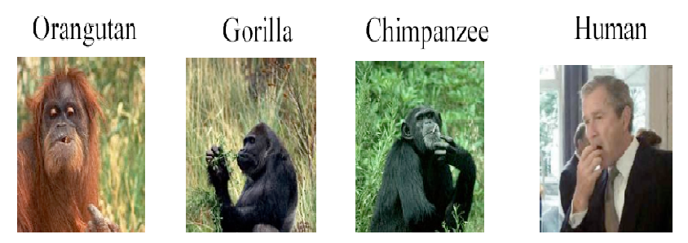

Phylogeny
What is a ?
Study of evolutionary relatedness among a group of organisms

Slide 88
a
b
c
d
a
b
c
d
d
c
b
a
gt₁
gt₂
gt₃
a|b
c|d
2
2
ab|c
cd|b
1
1
3
3
abc|d
3
bcd|a
ab|cd

Slide 89
Why *BEAST is so good?
g₁
g₂
g₃
gt₁
gt₂
gt₃
Gene tree estimation
g₄
g₅
g₆
gt₅
gt₆
gt₄
Gene tree estimation
Summary
methods
*BEAST
Co-estimation
Summary
methods

