Slide 1

On the Patient Level Prediction (PLP) Working Group in OHDSI
Md. Shamsuzzoha Bayzid
Slides are adapted from the one presented in PLP meeting
University of Texas at Austin
Notes:
We have been exploring the works done by OHDSI community with a focus to identify interesting and demanding research problems that we can work on.

Slide 2
OHDSI
The Observational Health Data Sciences and Informatics (OHDSI) program is a multi-stakeholder, interdisciplinary collaborative to create open source solutions that bring out
the value of observational health data through Large scale analytics.
OHDSI has established an international network of researchers and observational health databases with a central coordinating center housed at Columbia University
Notes:
This community is trying to provide open source solutions for various health related problems using the

Slide 3
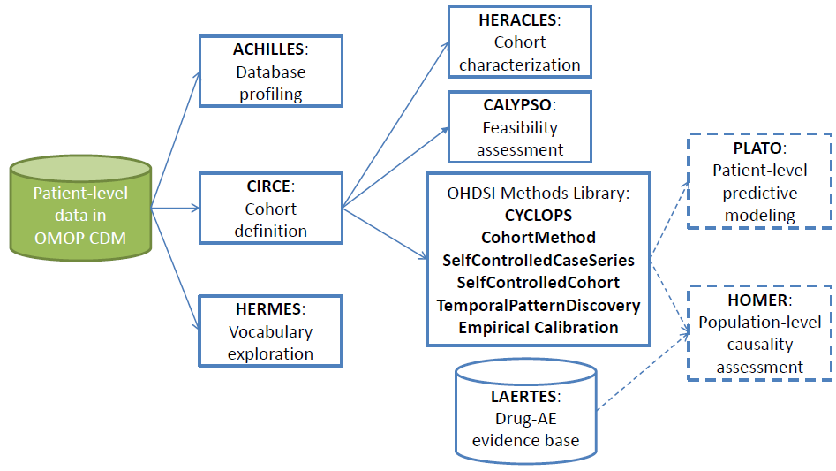
Software tools

Slide 4
Patient Level Prediction Work-Group
The overall objective of this WG is to establish a standardized
process for developing accurate and well-calibrated patient-centered
predictive models that can be utilized for multiple outcomes
of interest and can be applied to observational healthcare data
from any patient subpopulation of interest
Lead: Peter Rijnbeek p.rijnbeek@erasmusmc.nl
Co-lead: Jenna Reps Jreps@ITS.JNJ.com
Notes:
standardize the format and content of the observational data, so standardized applications, tools and methods can be applied to them

Slide 5
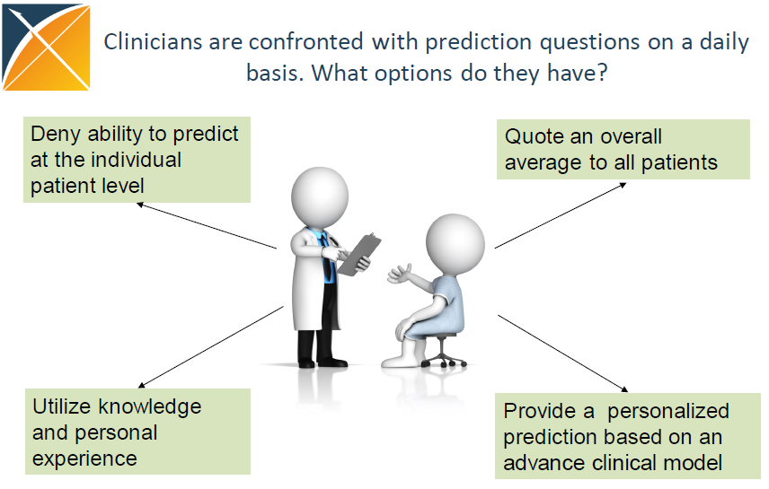
Notes:
I will be presenting different tools developed by OHDSI community and also different papers published by this community.

Slide 6
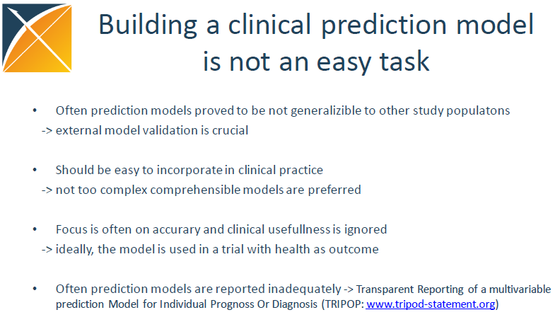
Notes:
They have already developed some software tools. Aand they are working on some others. I am going to talk about four of them.

Slide 7
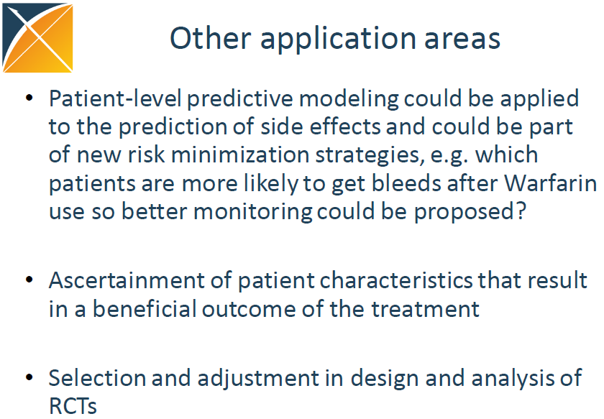
Notes:
They have already developed some software tools. Aand they are working on some others. I am going to talk about four of them.

Slide 8
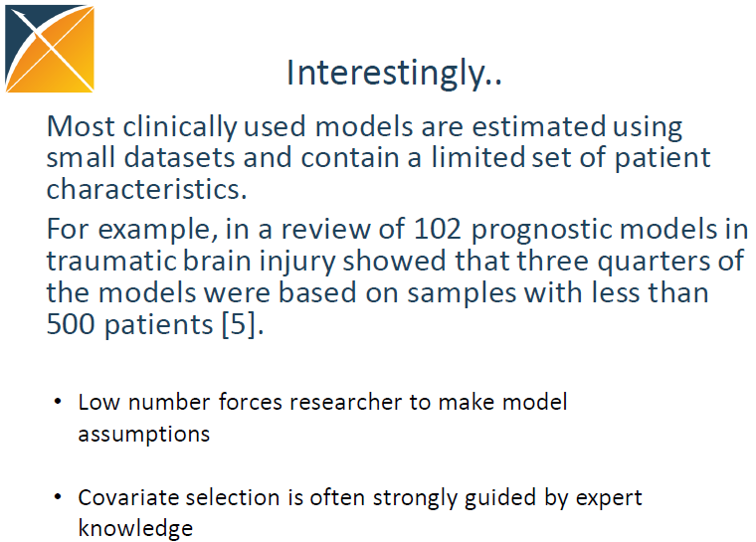
Notes:
They have already developed some software tools. Aand they are working on some others. I am going to talk about four of them.

Slide 9
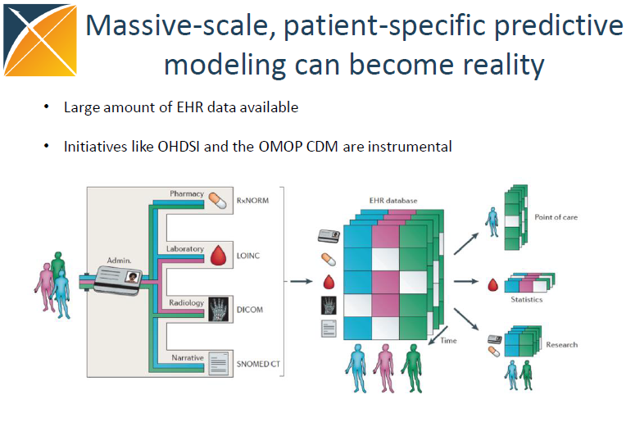
Notes:
They have already developed some software tools. Aand they are working on some others. I am going to talk about four of them.

Slide 10
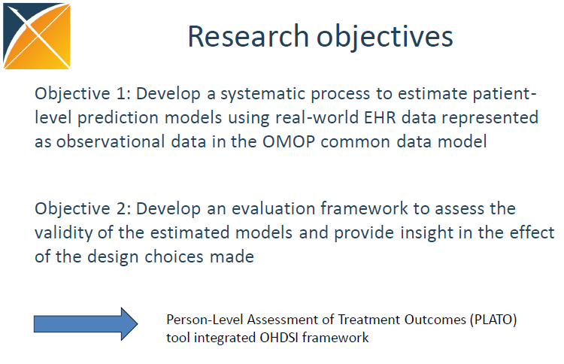
Notes:
In general the research objectives is to …on top of the CDM. And Next develop evaluation framework. The ultimate goal is then to build a family of methods called PLATO.

Slide 11
PLP Package
An R package for building patient level predictive models
using data in
OMOP Common Data Model format.
Notes:
They have already developed some software tools. Aand they are working on some others. I am going to talk about four of them.

Slide 12
PLP Package
Takes a cohort and outcome of interest as input
Extract necessary data from the database in OMOP model
Use a large set of covariates including for example all drugs, diagnoses, procedures, as well as age, comorbidity, etc.
Large scale regularized regression (CYCLOPS package) to fit the predictive models
Includes functions for evaluating the predictive models
Supported outcome models are: logistic, survival etc.

Slide 13
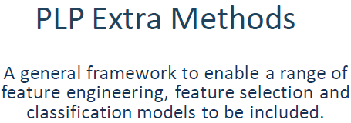
Notes:
They have already developed some software tools. Aand they are working on some others. I am going to talk about four of them.

Slide 14
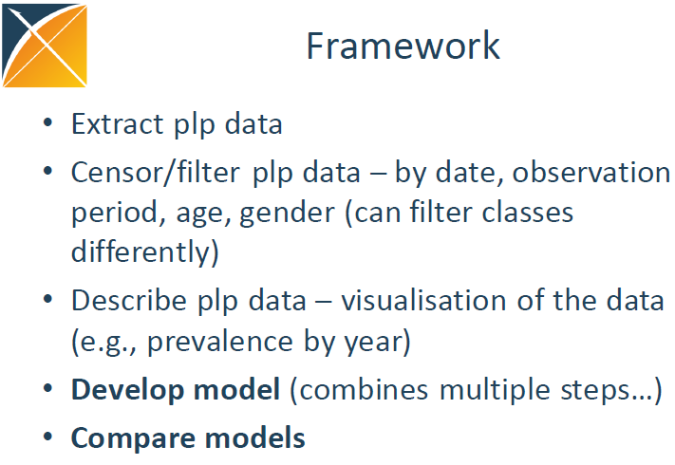
Notes:
They have already developed some software tools. Aand they are working on some others. I am going to talk about four of them.

Slide 15
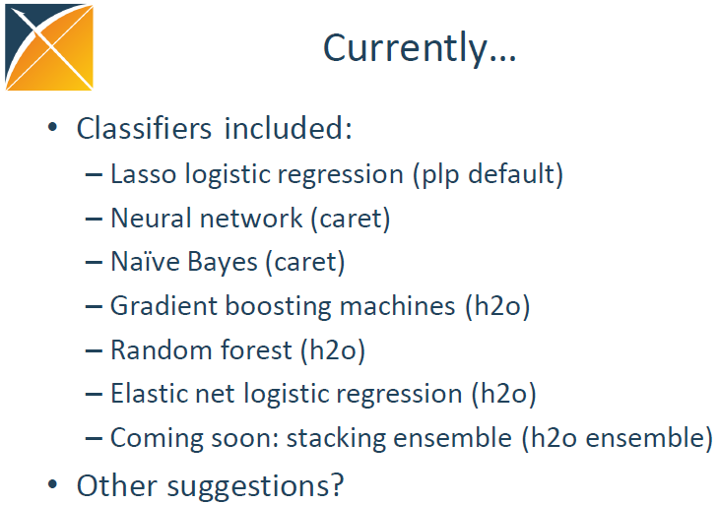
Notes:
They have already developed some software tools. Aand they are working on some others. I am going to talk about four of them.

Slide 16
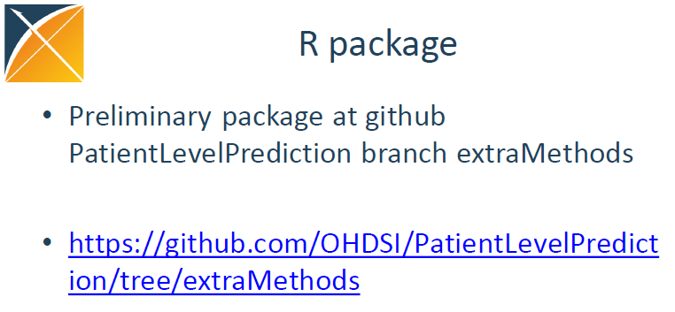
Notes:
They have already developed some software tools. Aand they are working on some others. I am going to talk about four of them.

Slide 17
Thank You

Slide 18
Notes:
They have already developed some software tools. Aand they are working on some others. I am going to talk about four of them.

Slide 19
PLP Package
Given a cohort of interest and an outcome of interest,
the package can use data in the Common Data Model
to build a large set of features. These features can then be
used by the Cyclops package to fit a predictive model.
Also included are function for evaluating the predictive models

Slide 20
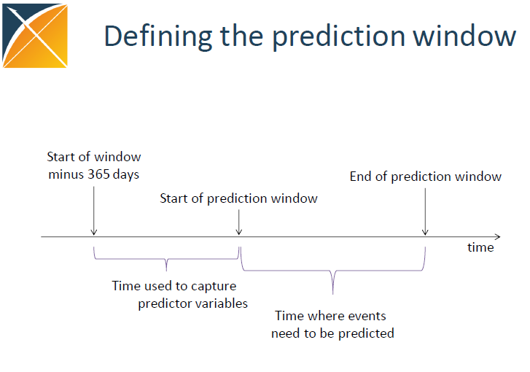
Notes:
They have already developed some software tools. Aand they are working on some others. I am going to talk about four of them.

Slide 21
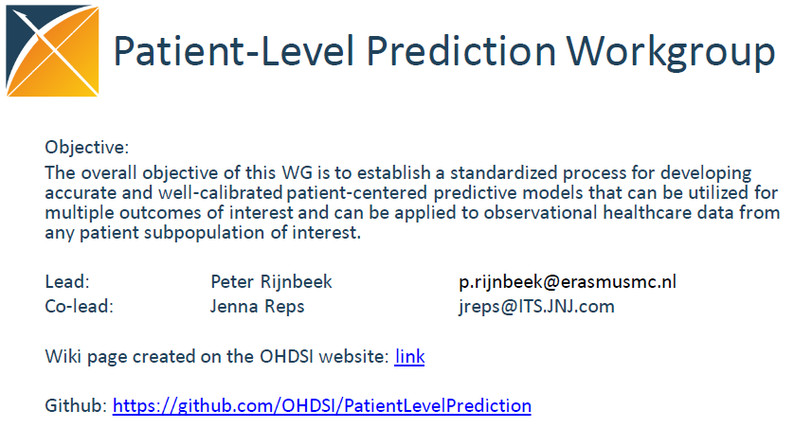
Notes:
standardize the format and content of the observational data, so standardized applications, tools and methods can be applied to them

Slide 22
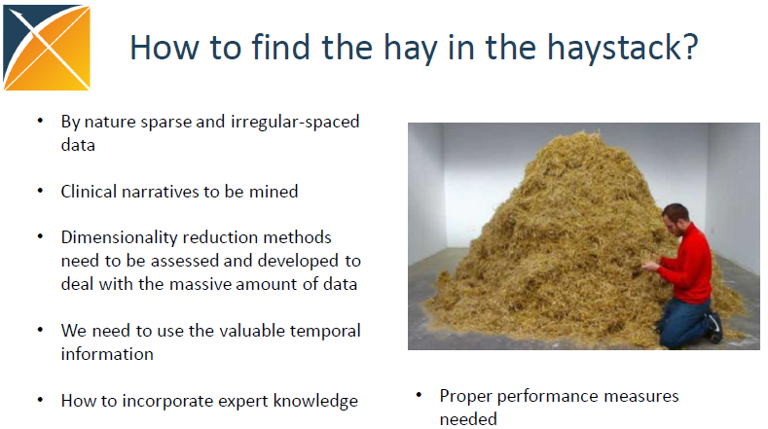
Notes:
They have already developed some software tools. Aand they are working on some others. I am going to talk about four of them.

Slide 23
OHDSI
Clinical characterization
Natural History: Who are the patients who have diabetes? Among those patients, who takes metformin?
Quality improvement: what proportion of patients with diabetes experience disease-related complications?
Population-level estimation
Safety surveillance: Does metformin cause lactic acidosis?
Comparative effectiveness: Does metformin cause lactic acidosis more than glyburide?
Patient-level prediction
Personalized medical care: Given everything you know about me and my medical history, if I start taking metformin, what is the chance that I am going to have lactic acidosis in the next year?

Slide 24
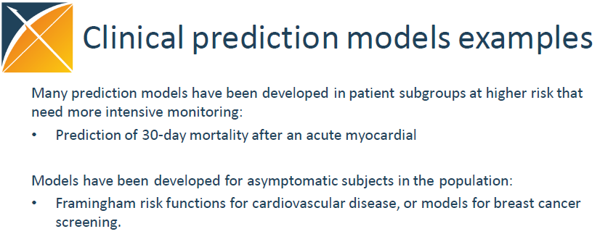
Notes:
They have already developed some software tools. Aand they are working on some others. I am going to talk about four of them.

Slide 25
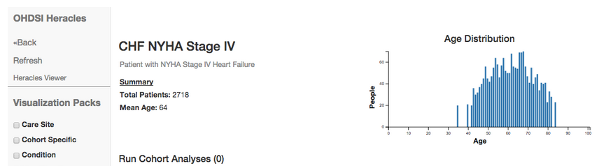
HERACLES: Quality of care
» Health Enterprise Resource and Care Learning Exploration System (HERACLES) - descriptive statistics about a cohort
cohort summarization and visualization tool
Notes:
Although they said this is for quality of care, I am not sure how it is directly related to quality of care. This is simply a summarization and visualization tool. It provides various descriptive statistics about a cohort.

