Slide 1

Cohort Discovery for Randomized Clinical Trials
Md. Shamsuzzoha Bayzid
Department of Computer Science
University of Texas at Austin
Notes:
I am gonna present a lit. review on clinical trial patient recruitment system. I will discuss the main classes of approaches used in identifying patients for a particular clinical trial

Slide 2
Outline
Randomized Clinical Trail (RCT)
Cohort Discovery
Challenges
Main classes of approaches

Slide 3
Randomized Clinical Trial (RCT)
A RCT is a planned experiment designed to asses the
efficacy of an intervention in human beings by comparing
the intervention to a control condition
» Subjects/cohorts in a population are randomly allocated into groups, usually called study/case and control groups to receive and not receive an experimental preventive or therapetuic procedure, maneuver, or interventition
Notes:
Gold Standard for testing therapies or new diagnosis techniques.

Slide 4




Cohort Discovery
Randomized Partition (Case and Control)
Medical Intervention to Case
Follow up and Compare
Randomized Clinical Trials
Prospective
ELIGIBLE
Nov, 2014
V
Cohorts
Random
Treatment
Case
Control
End

Slide 5

Cohort Discovery
Randomized Partition (Case and Control)
Medical Intervention to Case
Retrospective RCT
Randomized Clinical Trials
Retrospective
ELIGIBLE
2005
V
Cohorts
Random
Treatment
Case
Control
2014
Notes:
reviewing and appraising the findings of previous RCTs

Slide 6
Framingham Heart Study
1948
1960
Cigarette smoking
1961
Cholesterol and ECG abnormalities
1974
Diabetes: cardiovascular disease
More milestones: https://www.framinghamheartstudy.org/

Slide 7
Patient Cohorts
Cohorts
A group of patients that share a common set of clinical
characteristics of interest to the investigator.
Even though a study may be very well designed
and well funded, it cannot bring a drug to market without
the availability of suitable subjects

Slide 8
Cohort discovery
» Eligibility criteria
Set of characteristics shared by all participants which define the features of the population of interest
age, gender, medical history etc.
» Sample size
Sufficiently large group of cohorts are required to give statistical power for analyses.
Generalizability
Narrow eligibility criteria
Small group of cohorts
Less generalizable
Relaxed eligibility criteria
Confounding factors
Notes:
The two most important parameters that must be decided early in the design of a CT are
the population of interest, which determines the eligibility criteria of the trial, and the
sample size required to give sufficient statistical power for analysis.
A well-focused, sharply defined eligibility criteria will result into a small group of cohorts. Reduced sample size reduces the power of the study, but relaxing eligibility
criteria to allow a larger population of interest (and hence a larger pool from which to
recruit) introduces a confounding bias where factors that are not the prime focus of the
study cannot be excluded.

Slide 9



Cohort discovery
Well designed eligibility criteria
Sufficiently large group of cohorts
Human supervision
Expensive
Time consuming
80% of global trials fail to enroll within the budget and time
Notes:
The recruitement process is a particular point of weakness for clinical trials.. Many CTs fail to achieve their recruitment objectives , which in turn makes the CT a complete failure

Slide 10
Automated Cohort Discovery
Notes:
Huge effort is currently under way to optimize the process
most CTs are run at multiple centres and involve multidisciplinary actors. New strategies are necessary to efficiently recruit patients from a population, at a large
scale, in a cost effective way. The development of IT in medicine, and EHR offer a good
opportunity to support and improve the recruitment process.

Slide 11
Data sources
» Electronic Health records (EHR)
Structured
Demographics
Laboratory results
Medications
Diagnoses
ICD-9
Unstructured
Physician’s notes
Radiology report
Discharge summary
Insurance claim
HL7 message
Notes:
ICD-9 codes have been widely used for patient recruitment

Slide 12
Evaluation criteria
» Manually reviewed data as the ground truth
Compare
Method annotated
Expert annotated
The recruitment procedure should also be evaluated
for their ultimate impact on the outcome of the RCT
Notes:
The outcome of RCT depends on the group of cohorts. So some sort of qualitative evaluation should be done.

Slide 13
Classes of approaches
Rule based
Natural language processing (NLP)
Machine learning and statistical analyses
Hybrid

Slide 14

Rule based
» Logical constraints to discrete values
Example: age > 40 & insulin > 5 µIU/mL
» Rule generation
Clinical judgment
Automatically generated
Notes:
Rule based system is the simplest approach to identify cohorts. Here a set of logical constraints are applied to structured data. Basically there are two ways of deriving the rules. One is clinical judgment. Most of the studies derived rules using the clinical judgment of physicians or expert opinions. Very few studies generated rules in an automated fasion.

Slide 15
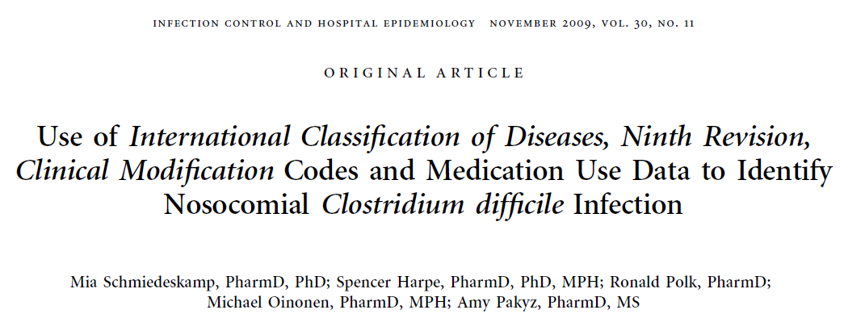
Rule based (clinical judgment)
» Nosocomial CDI patients
Multiple data sources: ICD-9 and medication reports to achieve better results
Notes:
Clostridium difficile (C. difficile) is a bacterium that causes diarrhea and more serious intestinal conditions. It can seriously spread inside a hospital. A patient can develop CDI as a consequence antimicrobial treat during hospitalization. And this is called nosocomial CDI. This study aims to find the nosocomial CDI patients.
Icd-9 code alone cannot identify nosocomial CDI. In this study they supplement the icd-9 with medication reports. And derived rules based on what sort of medication are responsible for nosocomial CDI.
Antimicrobial treatment during hospitalization , gastrointestinal surgery
Metronidazole and Oral vancomycin

Slide 16
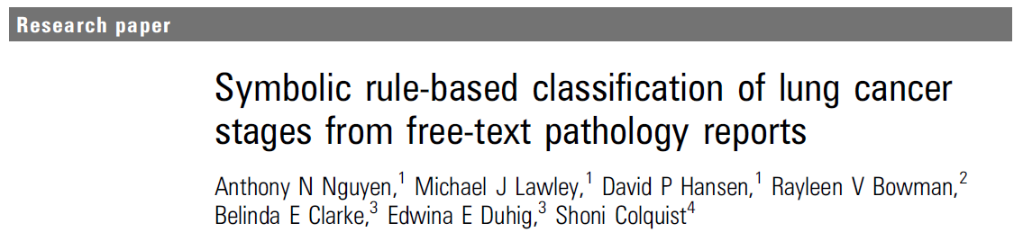
Rule based (clinical judgment)
Lung cancer prediction based on text occurrences
Comparable to SVM-based classification
Notes:
Ngune et al built a sysmbolic rule-based classification system for cancer stage annotation.

Slide 17
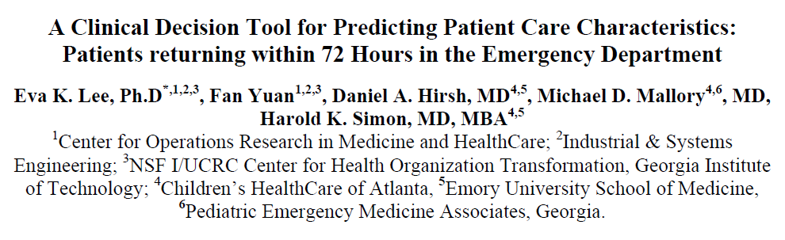
Rule based (automatically generated)
Relevant features using feature selection algorithm.
Discriminatory analyses model (DAMIP) to identify classification rule
Requires training data
Notes:
Very few studies generated rules in an automated fashion.
Found relevant features using feature selection algorithm.
These features are then analyzed by a Discriminatory Analyses Model to identify a classification rule.

Slide 18
Rule based
» Advantages
Easy to interpret
Easy to implement
Judgment based technique do not require training data
Highly discriminatory rues could be developed using a small fraction of the training data.
» Disadvantages
Not suitable for unstructured data
Problematic for complex eligibility criteria based on multiple data sources
Not generalizable: different rules for different questions
Notes:
in contrast with the traditional machine learning techniques – with high annotation overhead
Give good results on limited datasets.

Slide 19
Classes of approaches
Rule based
Natural language processing (NLP)
Machine learning and statistical analyses
Hybrid

Slide 20
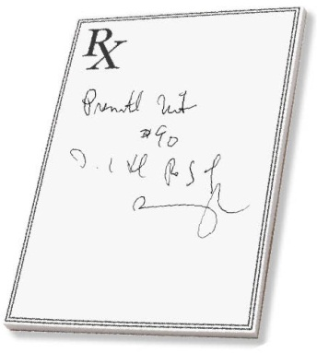
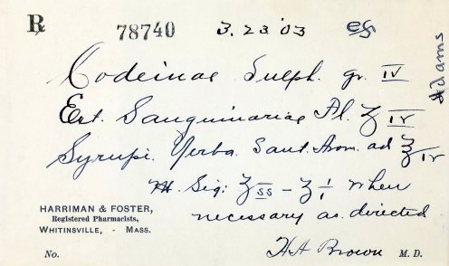
Natural language processing
» Unstructured data: clinical reports
contain important phenotypic information that cannot be
obtained from other data sources.
» NLP can extract relevant features from the unstructured data
Machine learning techniques , rule-based methods on the extracted features.
» Hurdles
Ambiguity, redundancy, misspellings
Notes:
Unstructured data like physician’s notes, progress report, and even the insurance claims are valuable sources of patient information. Often they are the only source of some important phenotypic characteristics, which cannot be obtained from other data sources. But traditional machine learning techniques or rule-based approach cannot be directly applied to unstructured text reports. NLP is really useful in this regard. .. But sometimes this is not that easy to parse physician’s notes amguity, re

Slide 21
NLP (term extraction)
Map textual elements to create Unified Medical Language System (UMLS)
A vocabulary of clinical terms
Extracted term | UMLS Concept
Pneumonia continue | H1N1
Positive h1n1 | Influenza
Continue oseltamivir | Pneumonia
Notes:
One application of NLP is to create a UMLS form unstructured data – a vocubulary of clinical terms. The idea is to extract n-grams form clinical notes. N-gram is the sequence of n consequtive words. N =2 means extracting all the consecutive terms. And then these term are mapped to the related medical concepts. For example,…mapped to. Once we have the vocubulary, we can rank the relevance of these terms to the phenotype of our interest.

Slide 22
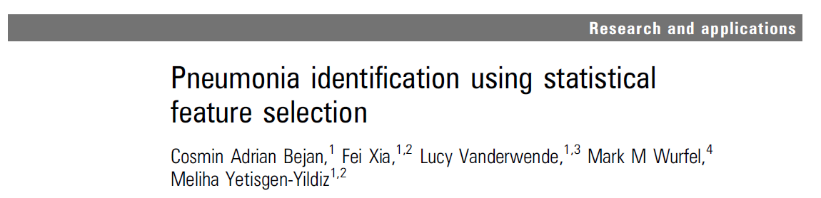
NLP (term extraction)
Unigram and bigram (single word, sequence of two words) from clinical reports and ranked the relevance to pneumonia identification
Eight types of reports: admit note, daily progress report, ICU note etc.
Statistical feature selection using training data
Notes:
This is an example where NLP was used to identify relevant keywords related to pneumonia patients. They used eight types of unstructured data that includes admit note, discharge summary etc. They extract all the unigrams and bigrams, ranked their relevance to pneumonia and found the most relevant ones using supervised feature selection algorithm.
Feature vector for each patient

Slide 23
NLP (keywords)
Clinical knowledge or heuristics to identify keywords specific to the phenotype of interest.
Extract the keywords from unstructured clinical notes
Machine learning or Rule-based approach on the keywords to classify cohorts
Notes:
Another application is to identify only the keywords of interest instead of all n-grams. Then apply ML or rule-based technique
Once we have the relevant texts, keyword extracted from unstructured data, rule-based or machine learning technique can be used to classify the cohorts.

Slide 24
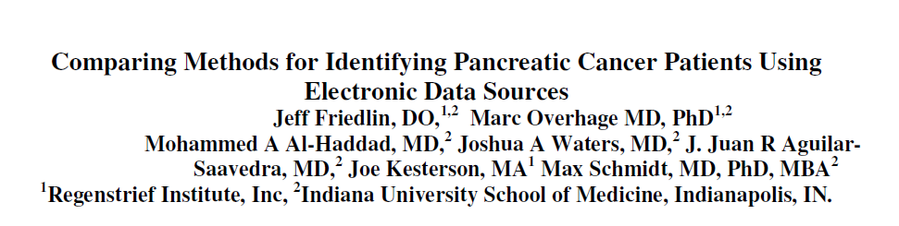
NLP (keywords)
Regular expression based key word extraction for pancreatic cancer cohorts
Better than ICD-9 based classification
Notes:
They proposed a regular expression based key word extraction from clinical text reports followed by a rule-based system to identify cohorts with pancreatic cancer. It performed better than ICD-9 based classification

Slide 25
Classes of approaches
Rule based
Natural language processing (NLP)
Machine learning and statistical analyses
Hybrid

Slide 26
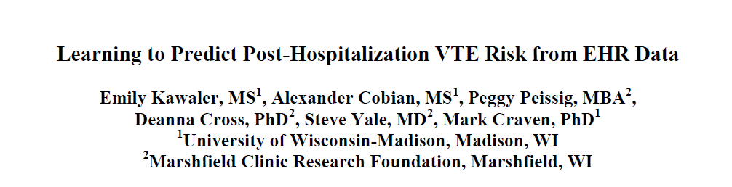
Machine learning and statistical analyses
Many studies compared popular machine learning techniques
in the context of cohort identification
» Naïve Bayes, k-nearest neighbor, SVM, C4.5, random forest
Naïve Bayes, SVM obtained the best results
Bagging and boosting did not improve the results
Notes:
Many studies compared popular machine learning techniques in the context of cohort identification.
Meta method like bagging and boosting did not help
SVM with radial basis

Slide 27
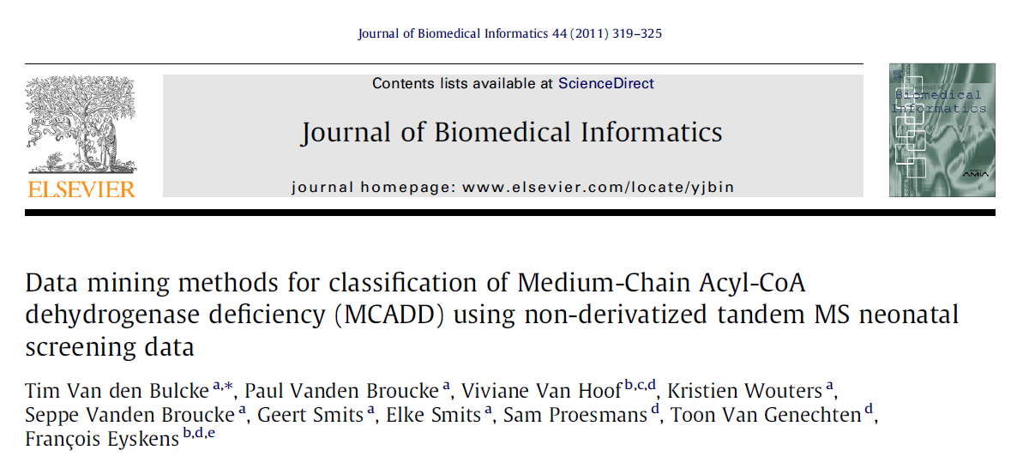
Machine learning and statistical analyses
» Regression model (logistic and ridge) performed better than C4.5 decision trees
Notes:
Meta method like bagging and boosting did not help

Slide 28
Classes of approaches
Rule based
Natural language processing (NLP)
Machine learning and statistical analyses
Hybrid

Slide 29
Hybrid approaches
» Combination of rule-based, machine learning and NLP techniques
Typically a machine learning algorithm is fed with features
that are a collection of rules and
NLP-extracted attributes from clinical text
Multi-modal approaches using heterogeneous data sources generally perform better than single-mode approach.
Notes:
Hybrid systems make use of rule-based ml and NLP. The main advantage of this approach is it allows to use heterogenous data sources.

Slide 30
Limitations
Customized: not easy to apply to various cohort studies
Dependent on training data: human supervision
Notes:
Owing to the sensitive nature of patient data, administrative roadblocks, and collaboration overhead, most institutions have developed their own system to address their own research questions using their own data.
Human supervision was the particular point of weakness in the recruitment process. The objective is to reduce the human supervision as much as possible to make the recruitment process less costly and less time consuming. Pure rule based system based on clinical judgment do not require training data. But others.

Slide 31
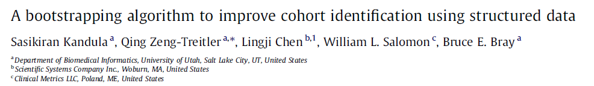
No training data
ICD-9 codes
No prior information about the true class of cohorts is required
Approximately labeled training set
Updated
class labels
Lab results + medication
SVM
Notes:
They used ICD-9 code to initially label the patients. Since ICD-9 based classification can lead to significant number of misclassification. They call it approximately labeled training set. Then they use the svm to update the labels.
Then they repeat the process untill the number of changes in the labels between two subsequent iterations satisfy a pre difined threshold.

Slide 32
Other approaches
Graph based semi-supervised learning (SSL)
Semantic web
Google search appliance
Notes:
GSA for retrospective analyses. GSA did not provide a significant advantage over conventional database queries

Slide 33
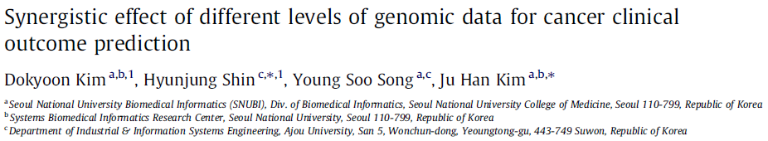
Graph-based SSL
» Since cancer is related to alterations in the genes, molecular-based diagnostics are promising
DNA methylation
Gene expression data
miRNA
Copy number alteration (CNA)
Notes:
There is an interesting paper that used genome level data to predict cancer. …genomic data should be useful for cancer prediction. They used different types of genomic data.

Slide 34
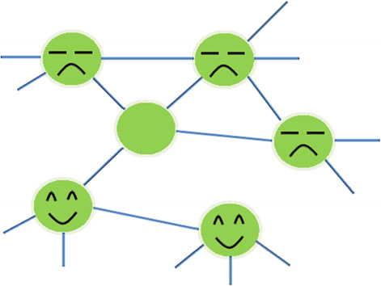
Graph-based SSL
» The learning time of graph-based SSL is nearly linear with the number of graph edges
Cancer
Cancer
Cancer
?
Normal
Normal
A graph model of relationships between patient samples.

Slide 35





Cohort Identification Systems
STRIDE
CDW-H
i2b2
MedTAS
DESCERN

Slide 36
Thank You
Questions
??

Slide 37
1948:start of the Framingham Heart Study
1960:cigarette smoking found to increase risk of heart disease
1961:cholesterol, blood pressure, and ECG abnormalities found to increase risk of heart disease
1965:first Framingham Heart Study report on stroke
1967:physical activity found to reduce risk of heart disease; obesity to increase the risk
1970:high blood pressure found to increase the risk of stroke
1974:diabetes found to be associated with cardiovascular disease
More milestones: www.framingham.com/heart/timeline.htm

Slide 42
Outline
Current situation:
Eligible patients to enrollment to CT
1.7% of the cancer patients were included in the
5% adult
14% in UK
A recent study shows that recruitement takes increasing amount of CT timeline and investigators have to stop trials because recruitement tartges cannot be achieved
System or organizational barriers : lack of access to health data.
Individual barriers: lack of time in physician’s schedule
CT design related barriers: complex design

Slide 43
Hard to compare different studies
system design, research question, scope, data source, assessment methodology vary significantly between papers
NLP er disad: disambiguation, context representation
Omics science: use genomic data to supplement the HER data
Genomic data are more structured and more easily machine-processable

Slide 44
Decision tree-based algorithms
Few studies based on decision tree
Give picture of Bulcke et al.
Regression tree was found to be better than C4.5 decision trees in some particular cases.
Classification and regression trees and random forest models with three other machine learning techniques:
linear classifier, kernel-based method, rule learners.
for breast tumor patient cohorts, tree-based models is better on imaging data. Regression models are better for other sources of data.
tree-based models outperformed others for type II diabetes

Slide 45
If the target sample
size is not achieved, the trial has less statistical
power to detect potentially important clinical
differences between the groups, so the results may
be less useful.7 In addition, if recruitment has to
be extended to reach the required sample size, the
trial will cost more and take longer, delaying the
use of the results in clinical practice.
Cohort Discovery
Randomized Partition (Case and Control)
Medical Intervention to Case
Follow up
Suggia theke eligibility criteria complex hobar shomporke likho
Randomized Clinical Trials

Slide 46






Random
Random

Slide 47



Slide 48
Cohort Discovery
ELIGIBLE
V
Cohorts
Random
Treatment
Case
Control

Slide 49
Outline
CTs are the gold standard for testing therapies or new diagnosis techniques.
They rely on adequate sample sizes. It is common for CTs to fail in their objectives because of the difficulty of meeting the necessary recruitement targets in effective time and reasonable cost
Most CTs are run at multiple centers and involve multidisciplinary actors. New strategies are necessary to efficiently recruit
The recruitement process is a particular point of weakness for clinical trials
Is the bottleneck. Huge effort is currentl under way to optimize the process

Slide 50

V

