Slide 1

Estimating Species Trees from Gene Trees
Md. Shamsuzzoha Bayzid
Department of Computer Science
University of Texas at Austin

Slide 2
Outline
Background
Gene tree and species tree
Species tree estimation
Naïve binning
Large scale phylogenomic analyses
Notes:
Here is the outline of my talk. First I will give a brief introduction about phylogenetic tree, gene tree and species tree. Next I will drill a little bit deeper into the species tree estimation, which is the main topic of my research.

Slide 3




Gene tree and species tree
Species tree – Pattern of branching of species lineages via speciation.
Gene tree – A phylogenetic tree that depicts how a single gene has evolved in a group of related species.
Hemoglobin
@
Orangutan Gorilla Chimpanzee Human
Orangutan Gorilla Chimpanzee Human
Notes:
Gene tree. Shows the evolutionary history of a single gene. It shows how a particular gene evolves through time within different species. Gene trees continue to branching and descending through time within the branches of species tree…. One might expect that sister species would have sister copies in the gene tree.

Slide 4
Discordance
Species tree
Gene trees don’t necessarily show the same branching pattern as their containing species tree
D
C
B
A
Gene tree
Notes:
One might expect that sister species would have sister copies in the gene tree. However, this is not the case. When gene copies are sampled from various species, the gene tree relating these copies might disagree with the species philogeny.

Slide 5

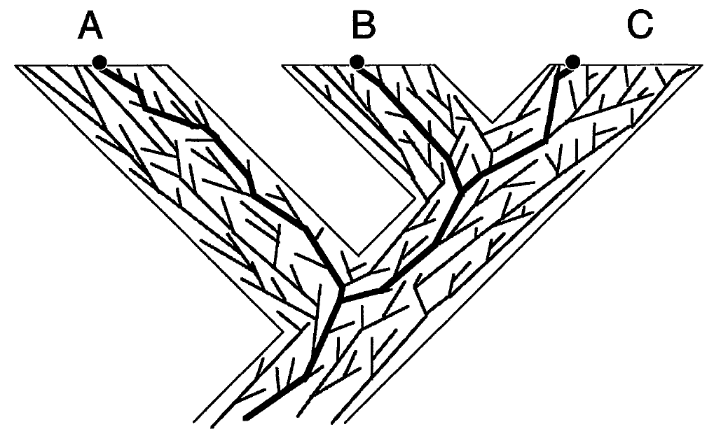
Gene trees in species tree
gene-k
…
gene-2
gene-1
[Maddison, Syst.biol., 1997]
Notes:
There are many genes in the whole genome, and they evolve independently. They do not necessarily share the same evolutionary histories. But since they are contained within the species, that means they evolve within the species branches. In this figure, we can see that many gene trees descend within the species tree. Some of tem may agree with the species tree while some other may not.

Slide 6
Species tree estimation
Combined Analyses (Concatenation): Combining genes to create a “supergene”
Summary Methods: summarizing individual Gene trees.
Notes:
no individual gene tree is necessarily a good estimate of the true species tree. This introduces some challenges in constructing species tree.First… Second we need to consider the reasons of discordance into account so that the species that we are constructing does make sense

Slide 7
Combined Analyses
g₁
g₂
g₃
g₄
g₅
g₆
g₇
g₈
g₉
Supergene alignment g*
Sequence based tree estimation method
Species Tree

Slide 8
Summary methods
g₁
g₂
g₃
g₄
g₅
g₆
g₇
g₈
g₉
Gene Tree Parsimony, ML etc.
Species Tree

Slide 9
Concatenation vs. summary methods
Concatenation provides the advantage of high level of signal.
Concatenation in the presence of gene tree discordance creates model misspecification.
Species tree estimation from a set of gene trees can take into account the gene tree discordance.
But suffers poor signal per gene.
Notes:
Seq evol model assumes that given a sequence alignment, there is a single underlying tree within which the sequence has been evolved. In the prsenece of gene tree discordance, we cannot just combine all the gene sequences and asssume that it has been evolved down a single tree.
However, since sequence evolution models assume a single underlying tree, concatenation in the presence of gene tree discordance creates model misspecification and can result into wrong answer

Slide 10
Statistical consistency
Species tree estimation error
Number of true gene trees
Given sufficiently large number of true gene trees, species tree estimation error approaches to zero with probability close to one
Gene tree estimation error
Notes:
Is statistically significant if it can reconstruct the true species tree with high probability given sufficiently large number of true gene trees.

Slide 11
Outline
Background
Gene tree and species tree
Species tree estimation
Naïve binning
Large scale phylogenomic analyses
Notes:
Here is the outline of my talk. First I will give a brief introduction about phylogenetic tree, gene tree and species tree. Next I will drill a little bit deeper into the species tree estimation, which is the main topic of my research.

Slide 12
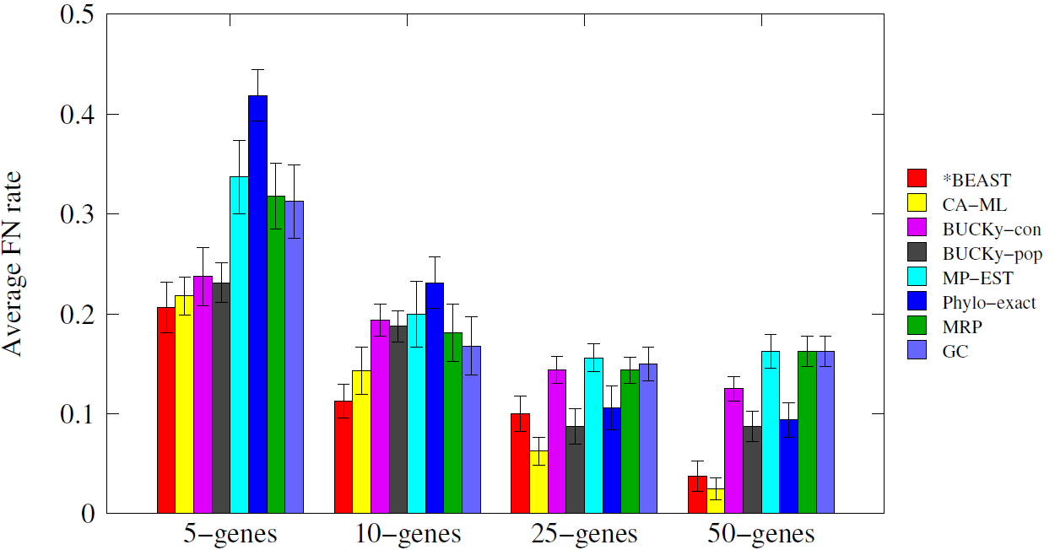
Simulation Study [Bayzid & Warnow, Bioinformatics 2013]
11 taxa, gene trees differ due to ILS

Slide 13
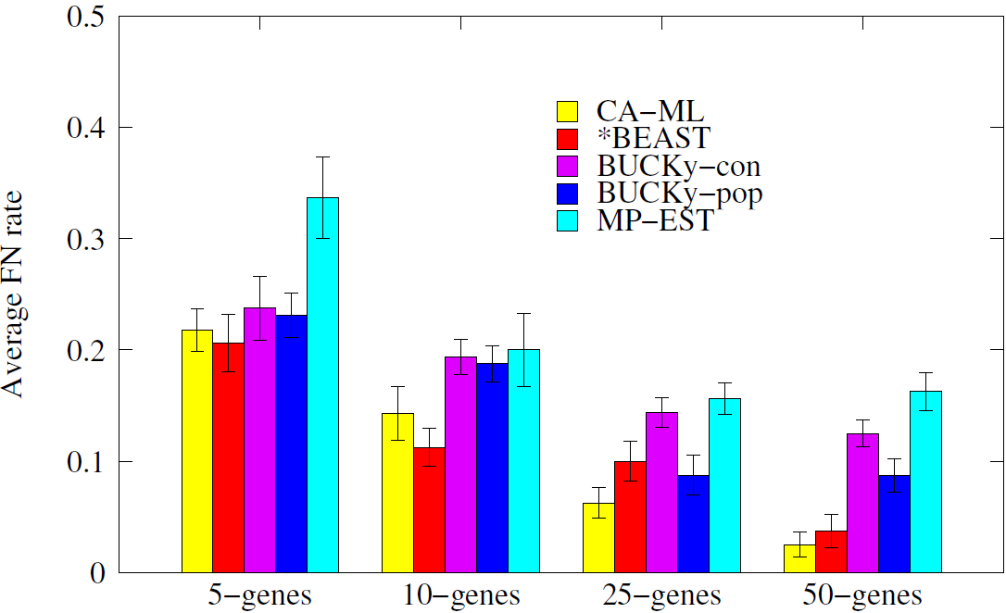
Simulation Study [Bayzid & Warnow, Bioinformatics 2013]

Slide 14
Why is *BEAST so good?
g₁
g₂
g₃
gt₁
gt₂
gt₃
(RAxML, FastTree)
Gene tree estimation
g₄
g₅
g₆
gt₅
gt₆
gt₄
Summary
methods
*BEAST
Co-estimation
Species tree

Slide 15
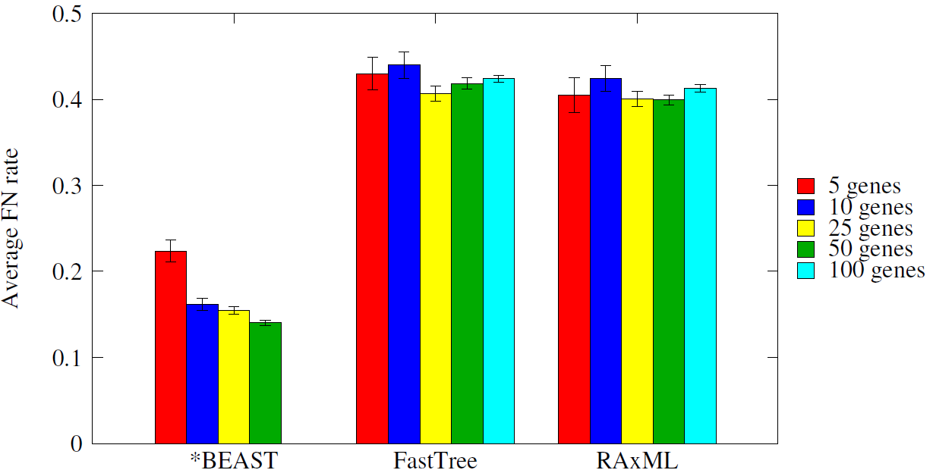
Why is *BEAST so good?
Gene tree accuracy: *BEAST produces much more accurate gene trees than the most popular likelihood based methods: RAxML and FastTree

Slide 16
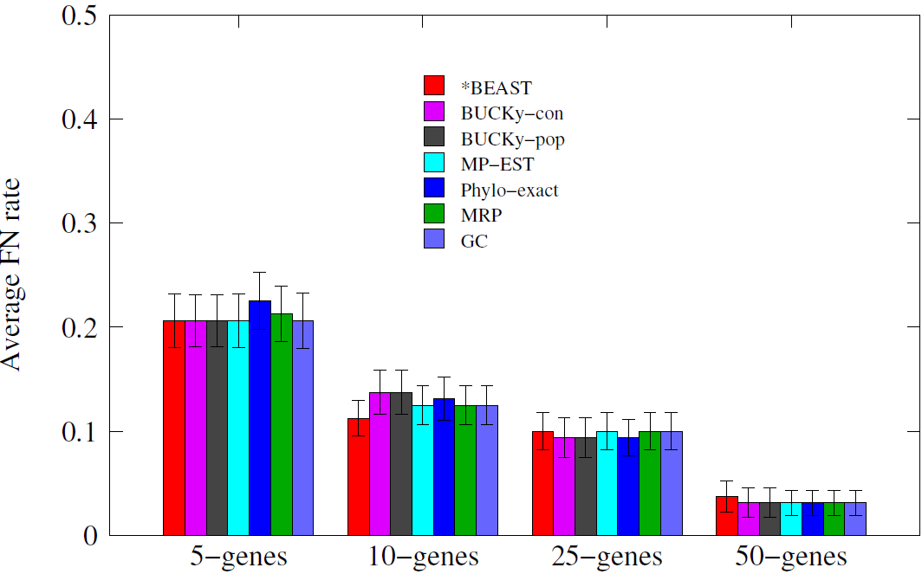
Why is *BEAST so good?
Even the simplest methods like greedy consensus produce as good species tree as *BEAST given the gene trees estimated by *BEAST

Slide 17
Our findings
Highly accurate species tree of *BEAST is largely due to the highly accurate gene trees
Species tree estimation methods are very sensitive to the gene tree error
Simple methods can estimate highly accurate species tree given highly accurate gene trees
What can we do to overcome the problem of poorly estimated gene trees?
Notes:
So we found that *BEAST is doing a very good job in

Slide 18
Naïve Binning (Bayzid & Warnow, Bioinformatics 2013)
g₁
g₂
g₃
g₄
g₅
g₆
g₇
g₈
g₉
Bin1
Bin2
Bin3
Super-gt₁
Super-gt₂
Super-gt₃
ST
Notes:
The most recent idea is something in between. Instead of combining everything, what if we combine some of them

Slide 19
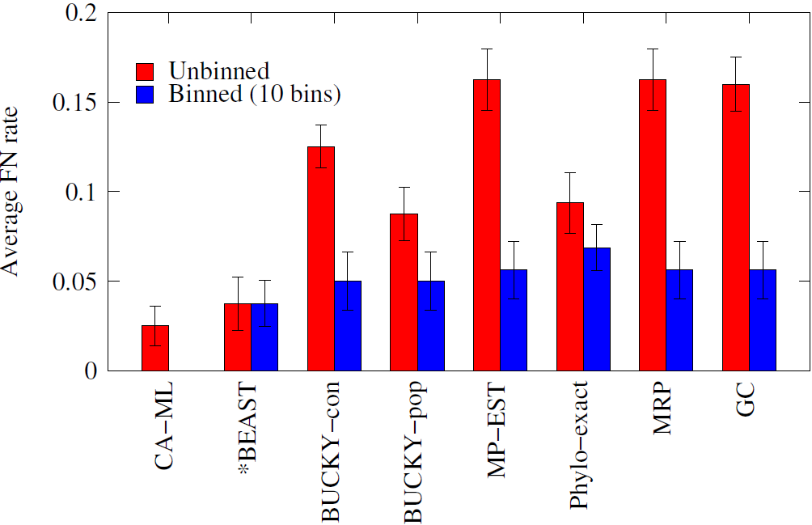
Naïve Binning (Bayzid & Warnow, Bioinformatics 2013)
Naïve binning improves the summary methods substantially!
Model violation (combining genes randomly)
Statistical binning

Slide 20
Outline
Background
Gene tree and species tree
Species tree estimation
Naïve binning
Large scale phylogenomic analyses
Notes:
Here is the outline of my talk. First I will give a brief introduction about phylogenetic tree, gene tree and species tree. Next I will drill a little bit deeper into the species tree estimation, which is the main topic of my research.

Slide 21
Motivation
Existing statistically consistent methods are computationally intensive
*BEAST failed to converge on a dataset with 11-taxa and 100 genes (200 million MCMC iterations that took about a week)
[Bayzid & Warnow, Bioinformatics, 2013].
MP-EST failed to converge on a dataset with 100 taxa and 800 genes after 1 day of computation.

Slide 22
Divide-and-conquer based meta method
Divide: divide the original problem into smaller subproblems (divide the set of taxa into overlapping subsets)
Highly accurate species tree estimation method on the smaller subproblems.
Conquer: combine the species trees estimated on the subsets to get a single species tree on the full set of taxa

Slide 23
Divide-and-conquer Pipeline
Estimate the species tree
Decompose the guide tree
Combine the species trees into a single species tree on the full set of taxa
Repeat the process for a user specified number of iterations
Restrict the gene trees
Estimate species trees from the restricted gene trees
Gene trees
…
gt₁
gt₂
gt_{k}
…
…
Species tree
…
…
Restricted gene trees

Slide 24
Preliminary Results
Used MP-EST as the base species tree estimation method
Used SuperFine+MRL as the supertree method
Performed five iterations.
Simmulated mammalian datasets
37 taxa
Varied the amount of ILS (low, moderate, high)
Varied the number of genes (100 - 800)
20 replicates of data for each model condition
Notes:
We have performed preliminary experiment to evaluate the meta method.

Slide 25
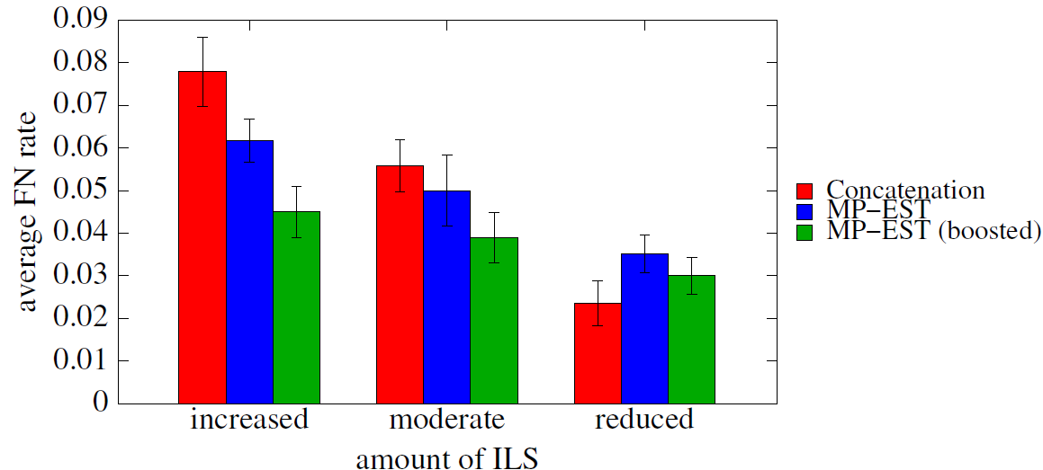
Preliminary Results
» Varied the amount of ILS
Reported the FN rate of the tree estimated at the final iteration

Slide 26
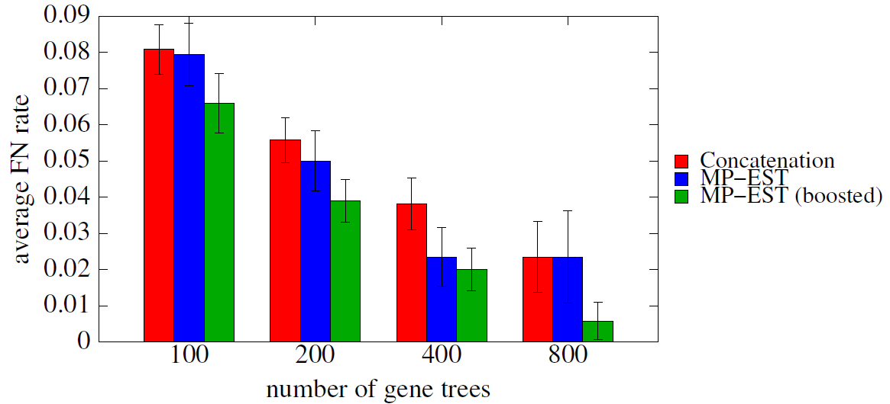
Preliminary Results
» Varied the number of genes
Reported the FN rate of the tree estimated at the final iteration

Slide 27
Future work
» Finding the best tree based on an optimality criterion
Likelihood
Quartet support
The most frequent quartet is the true species tree given large number of true gene trees [Degnan, 2013]
» Analyzing large datasets

Slide 28
Thank You
Questions
??

Slide 29
Summary
» *BEAST produces dramatically more accurate gene trees than ML analyses on the alignments.
» Summary methods are very sensitive to the gene tree estimation error.
» Binning can improve the accuracy and scalability of the species tree estimation methods.
Model violation (combining genes randomly)
Statistical binning

Slide 30
Binning (contd.)
g₁
g₂
g₃
g₄
g₅
g₆
g₇
g₈
g₉
Bin1
Bin2
Bin3
Combining genes that are “similar”
Super-gt₁
Super-gt₂
Super-gt₃
ST
Notes:
The basic idea is we are trying to combine genes that are similar if not identical.

Slide 31
Statistical binning [Mirarab, Bayzid, Boussau, Warnow, Science, (in revision)]
Combinability test: whether any pair of gene trees have conflicting edges with high support (w.r.t a threshold t).
Create an incompatibility graph
Use vertex coloring
Statistical binning improves:
Gene tree accuracy
Species tree accuracy
Species tree branch length estimations

Slide 32
Statistical binning (contd.)
» Better species tree topology and branch length estimation
Better gene trees
Better gene trees
Notes:
1 is what we expect. The ratio is closer to one if estimated branch length is closer to true branch length

Slide 33
Statistical binning (contd.)
Statistical binning requires bootstrap gene trees.
Time consuming: more than 1 year of serial computation on the 48 taxa avian datasets with ~14000 genes.

Slide 34
Proposed work
New binning techniques
Less computationally expensive than the statistical binning, but at least as accurate as statistical binning.
Large scale phylogenomic analyses
Divide-and-conquer based approach to make the existing species tree estimation methods scalable to large number of species

Slide 35
Binning using unsupervised learning techniques
Clustering
Partition the gene trees into a set of clusters so that
similar genes are grouped together
Notes:
Here we are trying to use clustering techniques to partition the gene trees into a set of clusters so that the similar gene trees are grouped together.

Slide 36
Datasets (induced triplets)
» Data matrix of the vector/feature representations of the objects
(gene trees)
Decompose each of the input gene trees into its induced triplets
Triplets: Rooted tree with three leaves (species).
The most basic piece of phylogenetic information
The most likely triplet is identical to the species tree [Degnan et al.,2013]
Triplet
Notes:
We are using triplet decompsition. A triplet is a tree with three leaves. The idea is to decompose the gene trees into their induced triplets.

Slide 37
Datasets (induced triplets)
For every three species, find the induced subtree (triplet)
A, B, C
A
B
C
D
E
Notes:
Triplet decomposition is pretty straight forward. We have a tree, and for every three species, we find the induced subtree containing these thee species.

Slide 38
Datasets (induced triplets)
For every three species, find the induced subtree (triplet)
A, C, E
A, B, C
A
B
C
D
E
B
C
A

Slide 39
Datasets (induced triplets)
For every three species, find the induced subtree (triplet)
A, C, E
A
B
C
D
E
B
C
A
A
C
E

Slide 40
Triplet matrix
Rows correspond to a gene tree
Columns correspond to the triplets
Presence (1) and absence (0) of a triplet in the genes are represented.
t₁
t₂
t₃
t₄
…
t_{k}
g₁
1 0 1 1 0 1 0 0 1 1 0
g₂
0 0 1 0 1 1 0 0 1 0 1
g₃
0 1 1 0 0 1 0 1 1 0 0
g₄
1 1 1 0 0 0 0 1 1 0 0
g₅
0 1 1 0 1 0 1 0 1 0 1

Slide 41
Clustering Techniques
K-means Clustering
We did PCA for dimensionality reduction since neighborhood-based analyses are prone to ``curse of dimensionality’’.
Applied k-means on the PCA transformed data.
Hierarchical clustering
Takes a distance matrix between each pair of gene
Hierarchical clustering is done by considering pairwise distances

Slide 42
Number of bins
» Clustering techniques require the number of clusters to be specified
Used the number of bins produced by statistical binning
» Model based clustering techniques
High memory requirement
Notes:
For most of the clustering techniques we have to specify the number of clusters as an input

Slide 43
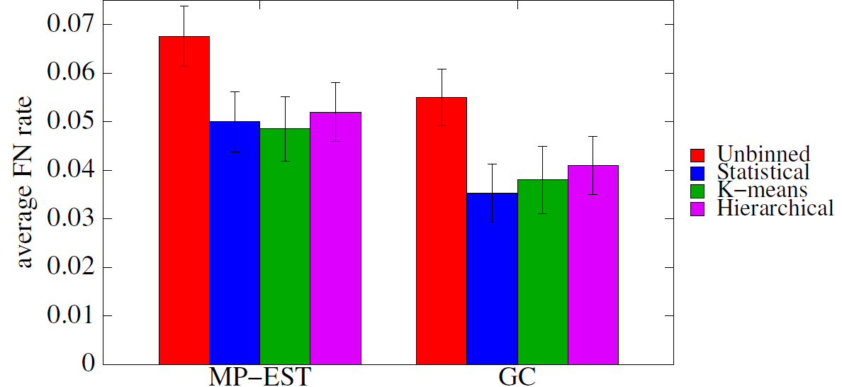
Preliminary results
Simulated mammalian datasets: 37 taxa, 200 genes, moderate ILS
Notes:
These are the preliminary results I have comparing different binning approaches…I am showing the fn rates of Mpest and gc with/without binning

Slide 44
Future work
» Number of bins
» Extensive study on PCA
» Comparison to Naïve and statistical binning
» Extensive evaluation
Gene tree accuracy
Species tree branch length
» Improve upon statistical binning

Slide 45
Proposed work
New binning techniques
Less computationally expensive than the statistical binning, but at least as accurate as statistical binning.
Large scale phylogenomic analyses
Divide-and-conquer based approach to make the existing methods scalable to large number of taxa
Improved accuracy

Slide 46
Handling large data
Existing statistically consistent methods are computationally intensive
*BEAST failed to converge on a dataset with 11-taxa and 100 genes (200 million MCMC iterations that took about a week)
[Bayzid & Warnow, Bioinformatics, 2013].
MP-EST failed to converge on a dataset with 100 taxa and 800 genes after 1 day of computation.

Slide 47
Divide-and-conquer based meta method
Divide: divide the original problem into smaller subproblems (divide the set of taxa into overlapping subsets)
Highly accurate species tree estimation method on the smaller subproblems.
Conquer: combine the species trees estimated on the subsets to get a single species tree on the full set of taxa

Slide 48
Divide-and-conquer Pipeline
Estimate the species tree
Decompose the guide tree
Combine the species trees into a single species tree on the full set of taxa
Repeat the process for a user specified number of iterations
Restrict the gene trees
Estimate species trees from the restricted gene trees
Gene trees
…
gt₁
gt₂
gt_{k}
…
…
Species tree
…
…
Restricted gene trees

Slide 49
Preliminary Results
Used MP-EST as the base species tree estimation method
Used SuperFine+MRL as the supertree method
Performed five iterations.
Simmulated mammalian datasets
37 taxa
Varied the amount of ILS (low, moderate, high)
Varied the number of genes (100 - 800)
20 replicates of data for each model condition
Notes:
We have performed preliminary experiment to evaluate the meta method.

Slide 50
Preliminary Results
» Varied the amount of ILS
Reported the FN rate of the tree estimated at the final iteration

Slide 51
Preliminary Results
» Varied the number of genes
Reported the FN rate of the tree estimated at the final iteration

Slide 52
Future work
» Finding the best tree based on an optimality criterion
Likelihood
Quartet support
The most frequent quartet is the true species tree given large number of true gene trees [Degnan, 2013]
» Analyzing large datasets

Slide 53
Summary
» Species tree estimation from gene trees in the presence of gene tree discordance
Incomplete gene trees [Bayzid & Warnow, JCB, 2012]
MGD/MGDL [Bayzid et al., PSB, 2013]
Naïve binning [Bayzid & Warnow, Bioinformatics, 2013]
Statistical binning [Siavash et al., Science, 2014 (in revision)]
ASTRAL [Siavash et al., ECCB, 2014 (in revision)]
» Future directions
New binning approaches
Divide-and-conquer based large scale phylogenomic analyses

Slide 54







Acknowledgements
Prof. T. Warnow
Prof. J. Ghosh
S. Mirarab
N. Nguyen
T. Hunt
Theo Zimmerman, Andrei Mergea, Jimmy Yang and all other collaborators
Fulbright International Science and Technology PhD Award

Slide 55
Thank You
Questions
??

Slide 56
Basic Idea: binning criteria
Trees that have clear differences in their topologies should not be combined.
We do not bin two genes together if they have any conflicting edge with statistical support above a given threshold (T).
Controlling the threshold (T) enables more aggressive or conservative binning.
Notes:
We evaluate the discordance at a support level which we call a threshold. If two genes have a conflicting edge and their support value is higher than a particular threshold, we call those gene trees conflicting at that level.

Slide 57
Statistical Discordance/Conflict
compatible
conflict
abc|d
abc|d
ab|cd
ac|bd
60%
55%
a
b
c
d
a
c
b
d
Threshold = 50%
Threshold = 75%
Combinability
We allow two genes to be in the same bin if their contracted
versions (collapsing edges with support < T) are compatible.

Slide 58
Algorithm: Statistical Binning
4
3
4
1
2
3
1
2
4
Incompatibility Graph
Notes:
I will show you the algorithmic construct of the statistical binning with an example

Slide 59
Balanced vs. Unbalanced Bins
We try to avoid unbalanced bin sizes
Some very small, and some very large bins.
Unbalanced bins are problematic
Large bins are problematic due to the undesirable properties of concatenation
Small bins would not provide increased signal.
1
3
1
1
2
2
3
Balanced bins
Unbalanced bins
1
New vertex is added to the smallest subset that it can be added to
Vertex to be colored

Slide 60
Number of bins (modify)
We tried to run the clustering methods which can suggest the optimal number of bins. But it could not be run due to high memory requirements.
» Used the number of bins produced by statistical binning

Slide 61
Estimate the species tree
Decompose the guide tree
Estimate species trees from the restricted gene trees
Divide-and-conquer Pipeline
Combine the species trees into a single species tree on the full set of taxa
Repeat the process for a user specified number of iterations
Restrict the gene trees
Gene trees
…
gt₁
gt₂
gt_{k}
…
…
Species tree
…
…
Restricted gene trees

Slide 62
Preliminary Results
Used MP-EST as the base species tree estimation method
Used SuperFine+MRL as the supertree method
Performed five iterations.
Simulated Mammalian datasets.
37 taxa.
Varied the amount of ILS (low, moderate, high)
Varied the number of genes (100 - 800)
20 replicates of data for each model condition.

Slide 63
Statistical binning (contd.)
Statistical binning requires bootstrap gene trees.
Time consuming: more than 1 year of serial computation on the 48 taxa avian datasets with ~14000 genes.
New binning techniques that are less expensive but as accurate as statistical binning.

Slide 64
Evaluation procedure

Slide 65
Repeat the process for a user specified number of iterations
Combine the species trees into a single species tree on the full set of taxa
Estimate species trees from the restricted gene trees
Estimate the species tree
Decompose the guide tree
Restrict the gene trees
Gene trees
…
gt₁
gt₂
gt_{k}
…
…
Species tree
…
…
Restricted gene trees

Slide 66
Repeat the process for a user specified number of iterations
Combine the species trees into a single species tree on the full set of taxa
Estimate species trees from the restricted gene trees
Estimate the species tree
Decompose the guide tree
Restrict the gene trees
Gene trees
…
gt₁
gt₂
gt_{k}
…
…
Species tree
…
…
Restricted gene trees

Slide 67
Species tree estimation from gene trees
Decompose the guide tree
Combine the species trees into a single species tree on the full set of taxa
Estimate species trees from the restricted gene trees
Gene trees
…
Restrict the gene trees
gt₁
gt₂
gt_{k}
…
…
Species tree
…
…
Restricted gene trees

Slide 68
Future Work
» New binning techniques
We (Mirarab et al., 2014, under review) developed statistical binning
New binning approaches using unsupervised clustering techniques
» Classification in phylogeny
Application of supervised classification techniques in the context of phylogenetics.
Predicting the reason of discordance: ILS or HGT?
» Large scale phylogeny
Divide and conquer based meta method to make existing techniques scalable to large number of species.

Slide 69
Optimal reconciliation
Duplication
Duplication
D
C
B
A
1 Duplication and 3 losses
2 Duplication and 5 losses
Notes:
To deal with this problem, we need to know how to calculate the minimum number of duploss required to reconcile a gene tree against a species tree. We have already seen that…. But there may be some other different reconciliations. We need to find the optimal reconciliation.

Slide 70
Gene Duplication/Loss
Duplication
Cost of reconciling a gene tree into a species tree is measured by the number of extra lineages.
D
C
B
A
1 Duplication and 3 losses
Notes:
Although you already know about duplication, deep coalescence etc. I would like to show you with an example how gene duplication and loss works and gives rise to discordance. If you trace back the gene history, you can see that B and C are no longer sister copies, rather C and D are sister copies. So the gene tree looks like this

Slide 71
Optimal Reconciliation (LCA mapping, M)
Duplication
A
B
C
D
D
C
B
A
gt
ST
Theorem [Guigo et al. 1,2]
An internal node u of gt is a duplication node
if and only if M(v) = M(w) for some child w of v.
Notes:
There is an easy way to find the optimal number of duplication and loss and this is based on LCA Mapping. LCA stands for lowest common ancestor.

Slide 72
Problem definition (MGD)
Problem: Minimize Gene Duplication (MGD)
Input: A set of rooted binary gene trees with each species having a single copy of a gene.
Output: A species tree ST that minimizes total number of duplications.
A
B
C
D
A
B
C
D
A
B
C
D
gt₁
gt₂
gt_{k}
C₁
C₂
C_{k}
ST
∑C_{i} is minimized
Notes:
The optimization problem can be stated as follows.
PUT REFERENCES to ORiGINAL PAPER FORMULATING THIS PROBLEM???

Slide 73
Available Software
DupTree (available in iGTP package)
Reference: (where, when published)
A heuristic to infer species phylogeny by minimizing duplications.
DupTree first builds an initial species tree.
Next, DupTree searches for a better species tree using a standard search heuristic of choice starting from the initial species tree. It scores each candidate species tree with respect to the input gene trees using the MRCA mapping.
Has been cited XXX times and used in YYY studies
Notes:
There is an easy way to find the optimal number of duplication and loss and this is based on LCA Mapping. LCA stands for lowest common ancestor.

Slide 74
Problem and Our Goal
Lack of efficient algorithms has limited the use of the GTP approach for phylogenetic analyses of large-scale
genomic data sets.
The biggest dataset analyzed by any GTP approach so far contains only 136 taxa with many gene trees. (reference)
Our goal: new algorithmic approach that can analyze
large datasets quickly and with high accuracy
Notes:
iGTP is a heuristic based on local search technique that might be fine for smaller datasets, but may not be a practical tool for large-scale biological datasets. The biggest dataset analyzed…So this limits the use of GTP analysis. Our goal is to come up with a novel approach to solve this problem efficiently and quickly.

Slide 75
Outline
Background
Our Contributions
Future Work

Slide 76
Our Algorithms
Exact algorithms to solve NP-hard MGD and MGDL
Exact algorithms for constrained versions of the
MGD and MGDL problems that run in polynomial time
We have initial implementations and have tested them on simulated and biological datasets.
We conjecture that our methods will enable analyses of datasets with thousands of taxa, and be able to obtain highly accurate results quickly (faster than iGTP).
Future work will investigate this.
Notes:
We are not done with extensive experimental study. But the results that we have so far suggests that our tool would be a prcctical tool for large-scale datasets.

Slide 77
Today’s talk
Exact algorithms to solve NP-hard MGD (binary-rooted, single copy, complete), and its constrained version that runs in polynomial time.
Not shown
Corresponding algorithms for unrooted, incomplete, multi-copy
Empirical results.
Notes:
We are not done with extensive experimental study. But the results that we have so far suggests that our tool would be a prcctical tool for large-scale datasets.

Slide 78
Alternate definition of Duplication
Subtree-bipartition
For an internal node u in a binary-rooted tree T,
SBP(u) = cluster(T_{L})|cluster(T_{R})
A|BCD
|
B
CD
C|D
A
B
C
D
Notes:
To design an efficient DP based algorithm, we give an alternative definition of Duplication. For this we need some terminologies. Everybody here knows what is a bipartitions. .. Since a binary tree with n leaves has n-1 internal nodes, we can characterize this tree with n-1 subtree-bipartitions

Slide 79
Domination
Domination
X|Y is dominated by P|Q (or P|Q dominates X|Y)
X ⊆ P and Y ⊆ Q
Examples
is dominated by
A|CD
AB|CD
is not dominated by
AC|D
AB|CD

Slide 80
Alternate definition of Duplication
Theorem
An internal node of gt is a speciation node if it is dominated by
some subtree-bipartition in ST. Otherwise, this is a duplication node
AC|DEF
ABC|DEF
A
C
D
E
F
B
A
C
F
D
E
gt
ST
Notes:
Now our alternate definition goes like this.

Slide 81
Alternate definition of Duplication Contd.
Theorem, Bayzid et al.
An internal node of gt is a speciation node if it is dominated by
some subtree-bipartition in ST. Otherwise, this is a duplication node
AC|DEF
ABD|CEF
A
C
D
E
F
B
A
C
F
D
E
gt
ST

Slide 82
Example
A|BCD
A|BCD
B|CD
D|BC
C|D
C|B
A
B
C
D
D
C
B
A
gt
ST

Slide 83
Compatibility
Compatibility
X|Y and P|Q are compatible if they can “co-exist” in a binary rooted tree.
Two subtree-bipartitions are compatible if
one contains the other
or they are disjoint
Containment
Disjoint

Slide 84
Maximizing dominated subtree-bipartitions
Input: A set of rooted binary gene trees
Output: A species tree ST that minimizes total number of duplications.
Goal
A species tree ST that minimizes total number of duplications.
A species tree ST that maximizes total number of dominated
subtree-bipartitions in input gene trees.
A set of (n-1) compatible subtree-bipartitions
that maximizes total number of dominated
subtree-bipartitions in input gene trees.
Notes:
Our objective is to construct a species tree with … having the alternate definition of duplication, our goal is equivalent to looking for ST that maximizes… (two sbp are compatible if they can co-exist in a tree. A binary tree with n-taxa has n-1 internal nodes and hence n-1 sbp. So n-1 compatible sbp correspond to a binary species tree with n-taxa)
All of these 3 are equivalent

Slide 85
Clique-based algorithm
ab|c
a|b
a|c
b|c
a
b
c
a
c
b
b
c
a
gt₁
gt₂
gt₃
Find the maximum weight clique of size n-1 (3-1)
Construct a compatibility graph
b|c
1
a|c
a|b
1
1
3
3
Disjoint
ab|c
3
ac|b
Containment
bc|a
Notes:
We have designed a clique-base algorithm to solve the problem exactly. I am gonna show you how our algorithm works with an example. Firs we need to construct a compatibility graph. In a compatibility graph, each vertex corresponds to a subtree-bipartition. Here we have 6 possible sbp– so we have 6 vertices. There will be an edge between two vertices if they are compatible, that means they can coexist in a single tree. Two sbp can coexist in a single tree if they are disjoint or one of them contains the other. To illustrate this fact, lets consider this tree and take any two nodes. Notice that… SO for any two subtree-bp in a binary rooted tree – either one contains the other or they are disjoint. That how we put edges between the sbp in the compatibility graphs.

Slide 86
Constrained Version
Empirical evidence [Than et al.] suggests that clusters in the optimal species tree that optimizes MDC tend to appear in at least one of the input gene trees. It may be also likely for MGD.
Instead of considering all possible subtree-bipartitions, we can only consider the subtree-bipartitions present in the gene trees. That makes the problem polynomial-time solvable.
k input gene trees with n taxa
O(k(n-1)) subtree-bipartitions belonging to these gene trees.
O(3^{n}) possible subtree-bipartitions.
Notes:
Empirical evidence suggests that the optimal species tree under MDC contains clusters that appear in some input gene trees.

Slide 87
Constrained Version (Example)
a
b
c
d
a
b
c
d
d
c
b
a
gt₁
gt₂
gt₃
a|b
c|d
2
2
ab|c
cd|b
1
1
3
3
abc|d
3
bcd|a
ab|cd

Slide 88
Dynamic Programming approach
Maximum Weight Clique problem is NP-hard!
DP-based approach solves this exactly (and faster than generic max clique algorithm)
u
T_{L}
T_{R}
weight(T) = weight(T_{L}) + weight(T_{R}) + weight(u)
The DP algorithm will compute a rooted, binary tree T_{A} for every cluster A such that T_{A} maximizes the sum, over all gene trees t, of the number of subtree-bipartitions in t that are dominated by some subtree-bipartition in T_{A}. We will denote this total number by value(A).
Notes:
If we want to know how many subtree-bipartition this tree dominates, we can find the sum of the weight of all the subtree-bipartitions in TL and TR . Then weight of T is TL + TR + weight (root).

Slide 89
Dynamic Programming Contd.
weight(X|Y) = #sbp in gene trees dominated by X|Y
value(A) = weight (a₁|a₂); if A ={a₁,a₂} value(A) = 0; if A ={a₁}
(base case)
value(A) = max{value(A₁) + value(A-A₁) + weight(A₁|A-A₁)};
_{if |A| > 2 (recursive step)}
(A₁|A-A₁)
Global Optimal Solution - if we allow any subtree-bipartition on A
Constrained version – if each (A₁|A-A₁) has to come from input gene trees
Notes:
If we want to know how many subtree-bipartition this tree dominates, we can find the sum of the weight of all the subtree-bipartitions in TL and TR . Then weight of T is TL + TR + weight (root).

Slide 90
Running Time
Depends on the number of subtree-bipartitions.
Let S be the set of subtree-bipartition.
O(n|S |²) for finding the domination relationships (for every pair).
value(A) can be computed in O(|S |) time, since at worst we need to look at every subtree-bipartition in S.
Running time is O(n|S |²).
Globally Optimal Solution
|S| = O(3^{n})
Therefore the global optimum can be found in O(n3^{2n})
Constrained Version
|S| = k(n-1)
Therefore the constrained version is solved in O(n³k²)
Notes:
If we want to know how many subtree-bipartition this tree dominates, we can find the sum of the weight of all the subtree-bipartitions in TL and TR . Then weight of T is TL + TR + weight (root).

Slide 91
Summary, and Work in Prgress
Bayzid et al., in preparation:
Exact algorithms (exponential time) for MGD and MGDL on binary gene trees, including unrooted, incomplete, and multi-copy
Exact algorithms that run in polynmial time for MGD and MGDL on binary gene trees, including unrooted, incomplete, and multi-copy.
Work in progress: handling unresolved (non-binary) gene trees.

Slide 92
References
M. Goodman, J. Czelusniak, G. Moore, E. Romero-Herrera, and G. Matsuda. Fitting the gene lineage into its species lineage: a parsimony strategy illustrated by cladograms constructed from globin sequences. Syst. Zool., 28:132–163, 1979.
R. Guigo, I. Muchnik, and T. Smith. Reconstruction of ancient molecular phylogeny. Mol. Phylog. and Evol., 6(2):189–213, 1996.
C. V. Than and L Nakhleh. Species tree inference by minimizing deep coalescences. PLoS Comp Biol, 5(9), 2009.

Slide 93
Acknowledgements
Fulbright, Guggenheim, and NSERC
Joint work with Siavash Mirarab and Tandy Warnow
Nam Nguyen, Andrei Margea, Jimmy Yang, Kevin Liu.

Slide 94
Performance study

Slide 95
Running Time
 | 100-taxon | 500-taxon
iGTP | 58.9 | > 86,400
MGD | 0.4 | 34.6

Slide 96
Challenges in constructing species trees
The estimation of species trees typically involves the estimation of trees and alignments on many different genes, so that the species tree can be based upon many different parts of the genome.
Species tree estimations need to take causes of discord between gene trees and species trees into consideration, in order to produce reasonably accurate estimates of the species tree.
Notes:
no individual gene tree is necessarily a good estimate of the true species tree. This introduces some challenges in constructing species tree.First… Second we need to consider the reasons of discordance into account so that the species that we are constructing does make sense

Slide 97
Our Goal
Lack of efficient algorithms has limited the use of the GTP approach
for phylogenetic analyses of large-scale genomic data sets.
The biggest dataset analyzed by any GTP approach contains 18,896
gene trees with only 136 taxa.
An efficient exact algorithm to solve MGD.
NP-hard!
Exponential time
Solving a constrained version exactly
Polynomial time solvable
Notes:
We are developing an efficient exact algorithm for this problem. However, since this problem is NP-hard, solving it exactly is computationally intense. So we have designed a constrained version where instead of searching through the entire tree-space, we restrict our search within a subset of all possible species trees. We find the optimal species tree within this restricted search space

