Slide 1

Amazon Sales Report
By
Md Shamshad Ansari

Slide 2

Content
Project Overview
Problem Statement
Business Objective
Technical stacks
Data collection and data understanding
Data Prepossessing
Product Analysis
Sales analysis
Customer analysis
Recommendation

Slide 3

Project Overview
This project aims to analyze Amazon's sales data to get valuable insights and identify opportunities for growth. By examining product performance, customer behavior, and market trends, we can develop strategic recommendations to optimize Amazon's sales and market position.

Slide 4

Problem Statement
Amazon faces challenge of continuously improving the relevance and effectiveness of its product recommendation to enhance customer satisfaction and improve the sale specially in these three cities Yangon, Naypyitaw, Mandalay .

Slide 5

Business Objective
Utilize the amazon sales data and analyze the date to identify the opportunities to increase revenue and market share by utilizing the insights got from data to optimize sales strategies, improve the customer experience and enhance business growth.

Slide 6

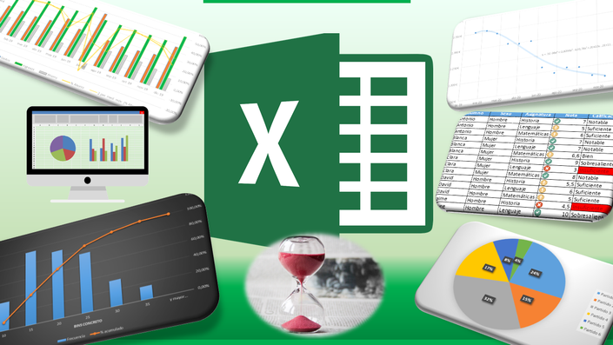
Technical Stacks
This Photo by Unknown Author is licensed under CC BY-NC-ND

Slide 7
Data Collection and understanding
Data Collection :
Primary source to gatherer data - Excel
Data dictionary :
List of columns :
invoice_id, branch, city, customer_type, gender, product_line, unit_price, quantity, VAT, total, date, time, payment_method, cogs, gross_margin_percentage, gross_income, rating
Data Dimension :
1000 rows x 17 columns

Slide 8
Data Preprocessing
Added required column:
Timeofday
dayname
monthname
Change the column name:
Invoice ID to invoice_id,
Customer type to customer_type,
Product line to product_line,
Unit price to unit_price.

Slide 9
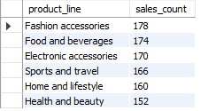
Product Analysis
Out of six product Line Fashion accessories was recorded as most selling product.
Health and beauty was lest selling product.

Slide 10
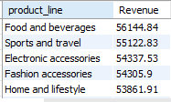



Sales Analysis
In January Month high Revenue was achieved
Food and beverages made Heigh revenue whereas Home and lifestyle product Line contributed less Revenue.
The Naypyitaw city made Heigh revenue respect of rest two cities.
In Afternoon, highest sales is recorded.

Slide 11




Customer Analysis
Customer having membership, contributing more in the revenue and purchasing more frequently.
Member customer was also paying more VAT than normal.
Female customers are the more predominant gender whose purchase count is higher than male.
In afternoon, Customer provides most ratings.

Slide 12
Recommendation
Optimize Product Offerings
Based on the insights from the product analysis, we should provide offers and discount on least performing items to improve the sales.
improve the quality of the product having low ratings.
Enhance Customer Experience
Customers having membership are having high purchased frequency and contributing more in revenue. We should aware the normal customer to be part of membership customer by giving discount on subscription.

Slide 13

Thanks

