Slide 1
TASkFLOW

Slide 2
TEAM 1 LOGIC LEGION
IBM Mentor
Mr. Vivek Singh
Training Officer
Edunet Mentor
Mr. Mohammad Kashif Siddiqui
Student Team
Shamshad Husain
Abhishek Tiwari
Harsh Shukla
Astha Sachan
Mr. Hemant Kumar Singh

Slide 3
Workload Division
Contribution of each team member in project
Shamshad Husain: Frontend Developer (Team Lead)
Abhishek Tiwari: Backend developer
Astha Sachan: Database Administrator & Management
Harsh Shukla: Data Structure Model. UI Designer

Slide 4
The Background
TaskFlow was designed to solve the common problems in traditional task management tools.
Older systems often struggle with real-time teamwork and lack automated features.
We aimed to create a platform that boosts efficiency and team collaboration.
Our focus is on making work smoother with an easy-to-use interface and modern design.
With TaskFlow, productivity is increased, and managing tasks becomes much simpler

Slide 5
Problem Statement “Challenges with Traditional Task Management Systems”
Dynamic Environments: Traditional systems struggle to manage complex and changing project landscapes effectively.
User Challenges: Common issues include disorganization, missed deadlines, and inefficient communication.
Lack of Updates: Many systems lack real-time updates and automation, resulting in manual errors.
Productivity Impact: These limitations contribute to reduced productivity and workflow inefficiencies.
Need for Improvement: A solution is required that enhances task tracking, fosters seamless collaboration, and adapts workflows for better project outcomes.

Slide 6
Proposed Solution
Objective: Enhance organizational productivity and team collaboration through a streamlined task management platform.
Solution: Address common task management challenges like progress tracking, priority setting, and team coordination.
Technology Integration: Leverage modern technologies to improve efficiency and user experience.
User-Centric Design: Focus on intuitive design to ensure ease of use for all team members.

Slide 7
Solution Design

Slide 8
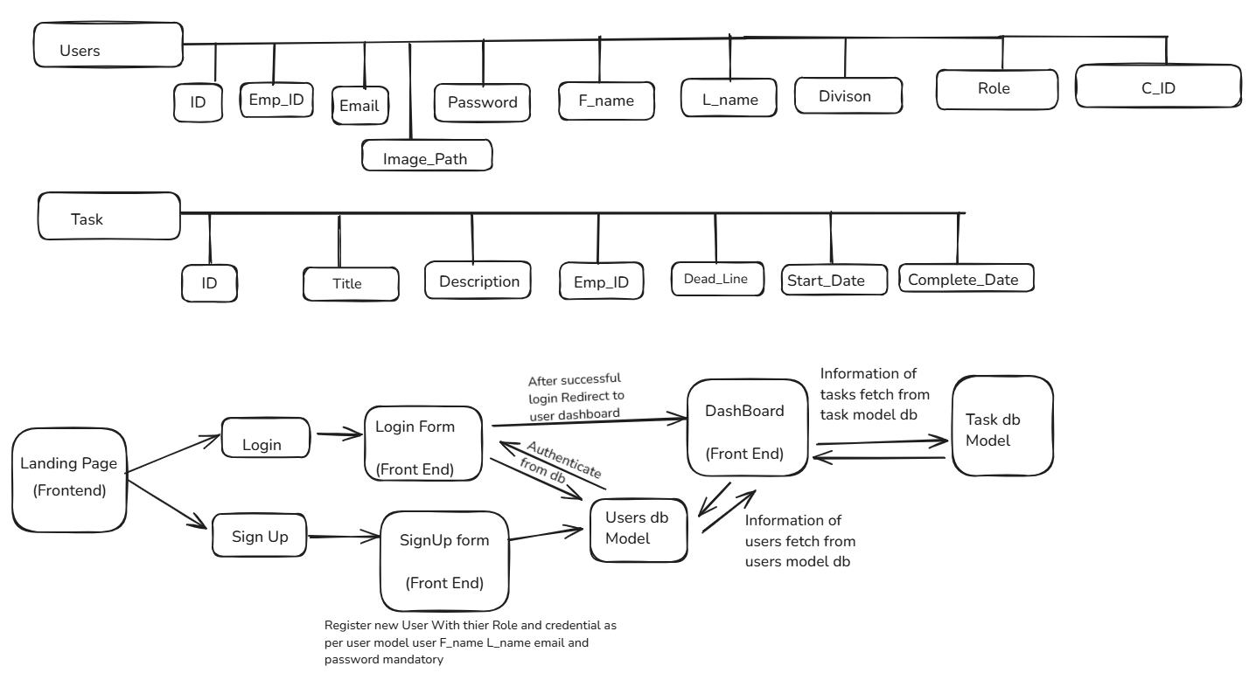
SolutionDesign

Slide 9
Technology Stack & Requirements
Frontend: HTML,CSS & Javascript.
Backend: Java
Framework: Springboot,Tailwind & Bootstrap
Software: VS Code Editor, MySQL Workbench, MySQL Server.

Slide 10

Innovative Idea
Real-Time Support: TaskFlow provides instant assistance for task management, helping users navigate their projects seamlessly.
Task Prioritization: The system analyzes user queries and project details to recommend prioritization strategies that optimize workflow.
Automated Updates: Routine updates are handled automatically, freeing users to focus on critical tasks without manual intervention.
Personalized Interactions: TaskFlow learns individual preferences and adapts to project dynamics, creating a tailored experience for each user.
Enhanced Productivity: By simplifying task management and responding to evolving project needs, TaskFlow boosts overall efficiency and effectiveness.

Slide 11
Results / Outcomes / Analysis
Let‘s Have a look on next Slide.

Slide 12
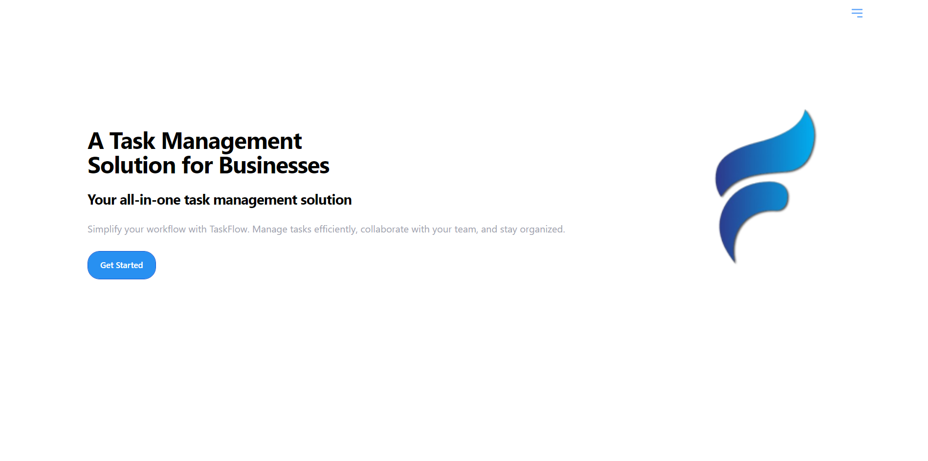
Landing Page
Landing
Page

Slide 13
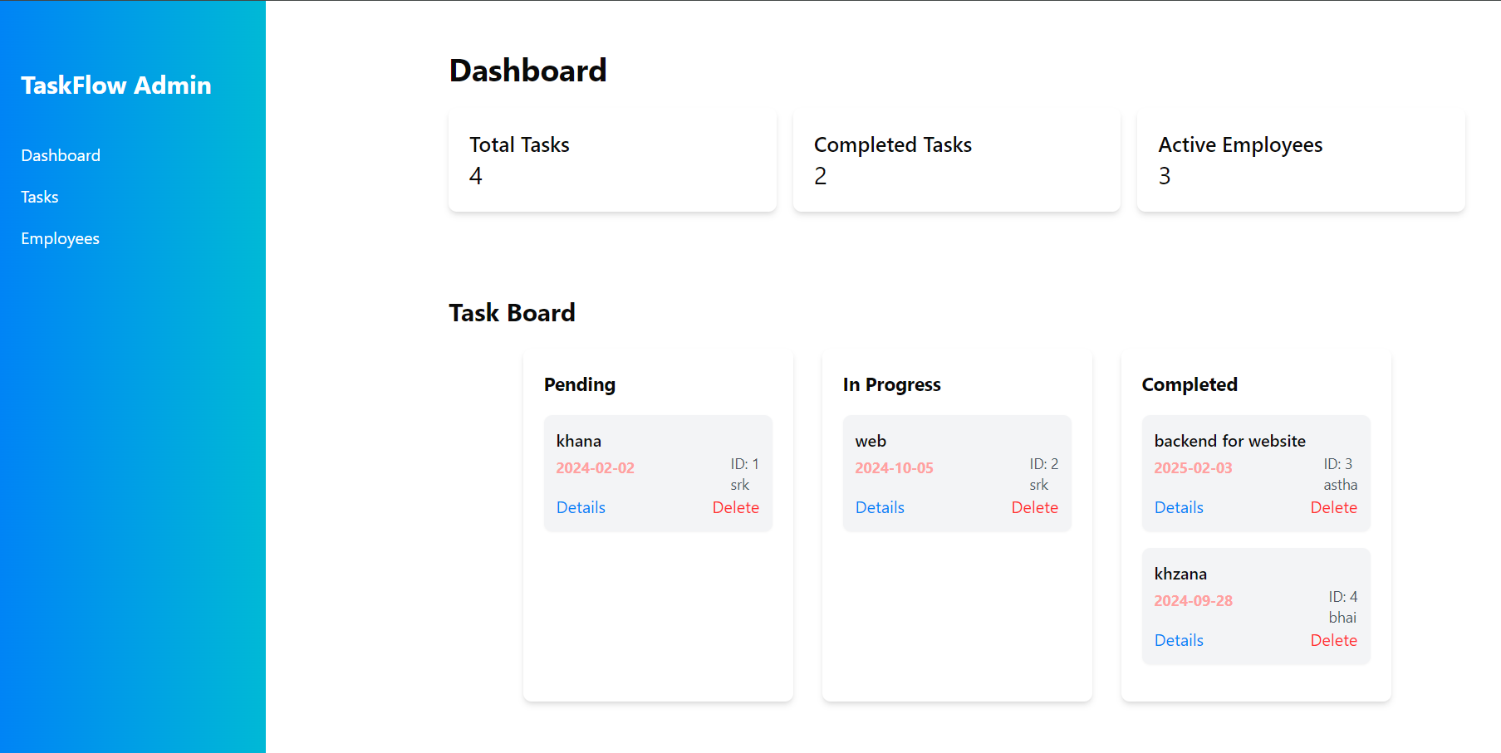
Admin DASHBOARD
Admin DASHBOARD

Slide 14
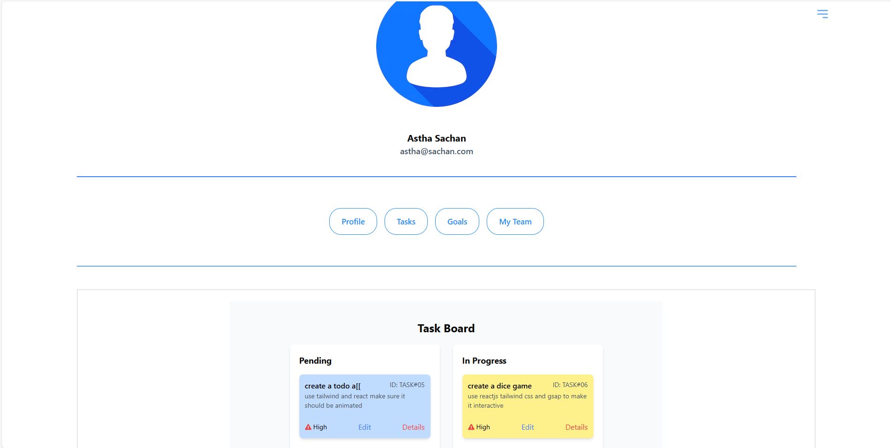
Profile
Profile

Slide 15

Limitations
Advanced features can make the system difficult to learn and use.
Performance may decline with increased project size and user load.
Difficulties in syncing with various third-party apps.
Potential security vulnerabilities with sensitive data.
High implementation and maintenance costs.

Slide 16

Future Enhancements/Scope
AI-Powered Task Prioritization
Enhanced Collaboration Tools
Customizable Dashboard
Mobile App Development
Advanced Analytics and Reporting
Time Tracking and Management
Feedback and Review System
Onboarding and Training Modules

Slide 17
The Demo showcasing the working solution/prototype

Slide 18
Thank You

