Slide 1
CAFFTAUR – Fuel The Force
Energy. Hydration. Spark.

Slide 2
Brand Introduction
CAFFTAUR is a performance-driven lifestyle beverage brand.
Built for strength, power, and premium identity.

Slide 3

Product Spotlight – Water
Advanced purification
Mineral balance
Safe consumption
Premium packaging

Slide 4
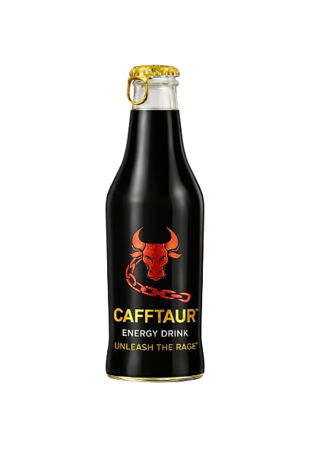
Product Spotlight – Energy Drink
Taurine + Caffeine synergy
Sustained energy release
Enhances endurance
Improves focus

Slide 5

Product Spotlight – Soda
Strong carbonation
Crystal clarity
Smooth finish
Perfect mixer compatibility

Slide 6
Performance Formula
Enhances endurance
Improves focus
Supports heart function
Reduces muscle stress

Slide 7
Brand Philosophy
We don’t sell drinks.
We fuel ambition.
We power endurance.

Slide 8
CAFFTAUR – Built Strong. Built Bold. Built to Dominate.

