Slide 1
Data Structures
with
C++
Lecture#10

Slide 2
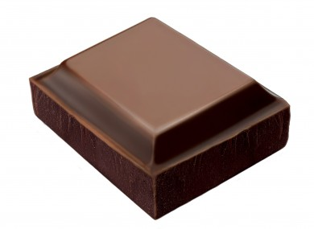
A stack is a collection with two operations
Push
Add an element on top of the stack
Pop
Remove an element from the top of the stack
top
top
top
top

Slide 3
Stack using array
template<class T> class Stack {
private:
T* stack;
int top, size;
public:
// Stack Constructor : creates an empty stack (top = -1)
Stack(int n = 0) : stack(new T[n]), top(-1), size(n) {}
// Stack Destructor : deletes the stack
~Stack() { delete [] stack; }
// check if the stack is empty
const bool empty() const { return top == -1; }
// push an element in the top of the stack
void push(const T& val);
// pop an element from the top of the stack
T pop();
};

Slide 4
Stack using array – push operation
template<class T> void Stack<T>::push(const T& val) {
if (top == size - 1)
throw StackException("overflow");
top = top + 1;
stack[top] = val;
}

Slide 5
Stack using array – pop operation
template<class T> T Stack<T>::pop() {
if (top == - 1)
throw StackException(“underflow");
T val = stack[top];
top = top - 1;
return val;
}

Slide 6
Stack using array – StackException class
class StackException {
private:
string msg;
public:
StackException(string str) : msg(str) {}
string getMessage() {
return msg;
}
};

Slide 7
Stack using array – testing our code
int main() {
Stack<int> stack(5);
try {
for (int i = 0; i < 5; i++)
stack.push(i);
while (!stack.empty())
cout << "extracting " << stack.pop() << " from stack" << endl;
}
catch (StackException& e) {
cout << e.getMessage() << endl;
}
return 0;
}

Slide 8


